Slide 1
IF THEN ELSE; CONTROL STRUCTURE IN MIPS

Slide 2
OBJECTIVES
Study how to implement translation of an “if then else” control structure in MIPS assembly language.

Slide 3

EXPLANATION
Translation of an “IF THEN ELSE” Control Structure The “If (condition) then do {this block of code} else do {that block of code}” control structure is probably the most widely used by programmers.
Let us suppose that a programmer initially developed an algorithm containing the following pseudo code.

Slide 4
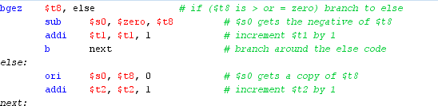
EXPLANATION
When the time comes to translate this pseudo code to MIPS assembly language the results could appear as shown below.
In MIPS assembly language, anything on a line following the number sign (#) is a
comment.
🢝 Notice how the comments in the code below help to make the connection back to the original pseudo code.

Slide 5

SHIFT LEFT LOGICAL
A shift left logical of one position moves each bit to the left by one. The low-order bit (the right-most bit) is replaced by a zero bit and the high-order bit (the left-most bit) is discarded.
Shifting by two positions is the same as performing a one-position shift two times. Shifting by zero positions leaves the pattern unchanged. Shifting an N-bit pattern left by N or more positions changes all of the bits to zero.

Slide 6
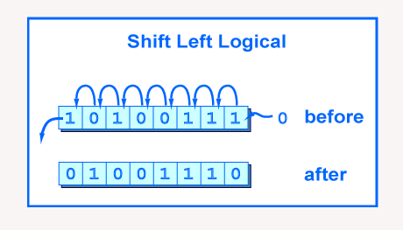

SHIFT LEFT LOGICAL
The picture shows the operation performed on eight bits. The original pattern is 10100111. and the resultant pattern is 0100110
Shifting a number one bit to the left is the same as multiplying that number by 2. More generally, shifting a number N bits to the left is the same as multiplying that number by 2^N.
It is widely used to compute the offset of an array, when each element of the array has a size that is a power of 2.

Slide 7
SHIFT RIGHT LOGICAL
Shifting right by n bits on an unsigned binary number has the effect of dividing it by 2^{n} (rounding towards 0)
MIPS also has a shift right logical instruction. It moves bits to the right by a number of
positions less than 32. The high-order bit gets zeros and the low-order bits are discarded.
If the bit pattern is regarded as an unsigned integer, or a positive two's comp. integer, then a right shift of one bit position performs an integer divide by two. A right shift by N positions performs an integer divide by 2^{N}.
The "trick" of dividing an integer by shifting should not be used in place of the MIPS arithmetic divide instruction (which will be covered in a few chapters). If you mean "divide" that is what you should write. But the trick is often used in hardware, and sometimes pops up in odd software uses, so you should know about it.

Slide 8
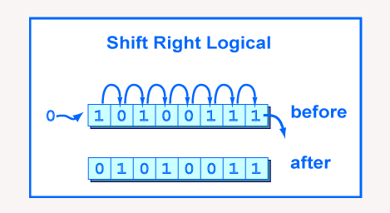
SHIFT RIGHT LOGICAL
As show in pic below

Slide 9
EXAMPLE PROGRAM STEP BY STEP
Step 1: declarations of messages.
.data
input: .asciiz "\n type any number"
rshift: .asciiz "\n number after right shift: " lshift: .asciiz "\n number after left shift: "

Slide 10


EXAMPLE PROGRAM STEP BY STEP
TRANSLATION OF AN IF THEN ELSE CONTROL STRUCTURE
Step 2: Initiating and printing declared input message
.text
la $a0,input
li $v0,4
syscall
# print input message

Slide 11


EXAMPLE PROGRAM STEP BY STEP TRANSLATION OF AN IF THEN ELSE CONTROL STRUCTURE
Step 3: Reading integer from user input
la $v0,5 # read integer
syscall

Slide 12
EXAMPLE PROGRAM STEP BY STEP TRANSLATION OF AN IF THEN ELSE CONTROL STRUCTURE
Step 4: Putting condition that if input value is greater or equal to zero if this condition is true then jump to the else section bgez = branch if greater or equal to zero
bgez $v0,else # if-else equivalent statement

Slide 13
EXAMPLE PROGRAM STEP BY STEP TRANSLATION OF AN IF THEN ELSE CONTROL STRUCTURE
Step 5:logical shifting of values using shift right logical, printing the value of rshift variable
srl $t2,$v0,2 # shift right logical by 2 bits la $a0,rshift # print value of rshift
li $v0,4 syscall

Slide 14
EXAMPLE PROGRAM STEP BY STEP
TRANSLATION OF AN IF THEN ELSE CONTROL STRUCTURE
Step 6: move the value of t2 to a0 and print the value after right shift. And jump to end for termination of program
move $a0,$t2 # print value after right shift
li $v0,1
syscall
b end # branch to statement at end unconditionally

Slide 15
EXAMPLE PROGRAM STEP BY STEP
TRANSLATION OF AN IF THEN ELSE CONTROL STRUCTURE
Step 7: the else statement code for shifting left logical as we previously did for the right shift logical
else:
sll $t2,$v0,2 # shift left logical
la $a0,lshift # print value of lshift
li $v0,4
syscall

Slide 16
EXAMPLE PROGRAM STEP BY STEP TRANSLATION OF AN IF THEN ELSE CONTROL STRUCTURE
Step 8: printing the left shifted value
move $a0,$t2 # print value after left shift
li $v0,1
syscall

Slide 17
EXAMPLE PROGRAM STEP BY STEP TRANSLATION OF AN IF THEN ELSE CONTROL STRUCTURE
Step 8: Program termination
end: li $v0,10 # terminate program
syscall

Slide 18
ANY QUESTIONS?

Slide 19
TASKS
Write a program in MIPS assembly language that takes input from user and print whether the input is greater or less than 10 and also shift input left and right 4 bits.

