Slide 1
Lecture10
Algorithms

Slide 2
ALGORITHM
In mathematics and computer science, an algorithm is a finite sequence of well-defined instructions, typically used to solve a class of specific problems or to perform a computations.

Slide 3
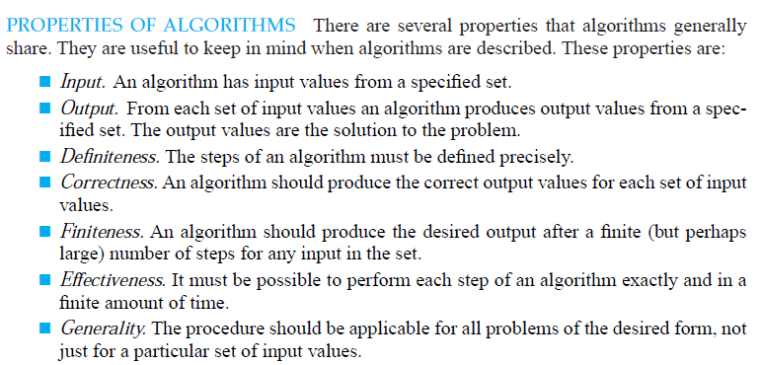
Properties of ALGORITHM

Slide 4



SEARCHING ALGORITHM
The problem of locating an element in an ordered list occurs in many contexts. For instance, a program that checks the spelling of words searches for them in a dictionary, which is just an ordered list of words. Problems of this kind are called searching problems

Slide 5
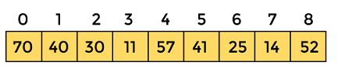
Working of Linear search
Now, let's see the working of the linear search Algorithm.
To understand the working of linear search algorithm, let's take an unsorted array. It will be easy to understand the working of linear search with an example.
Let the elements of array are -
Let the element to be searched is K = 41

Slide 6
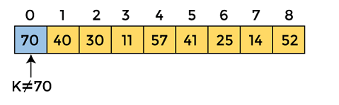
Working of Linear search
Now, start from the first element and compare K with each element of the array.
The value of K, i.e., 41, is not matched with the first element of the array. So, move to the next element. And follow the same process until the respective element is found.

Slide 7
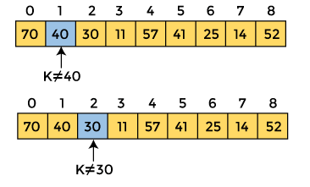
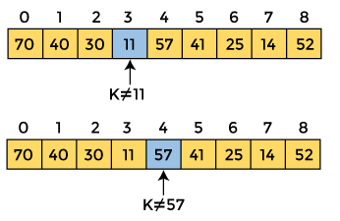
Working of Linear search

Slide 8
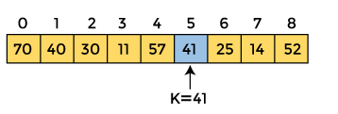
Working of Linear search
Now, the element to be searched is found. So algorithm will return the index of the element matched.

Slide 9
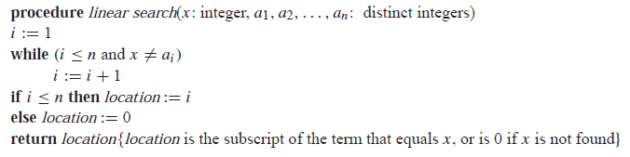
Linear Search Algorithm
Locate an element x in a list of distinct elements a1, a2, . . . , an, or determine that it is not in the list. The solution to this search problem is the location of the term in the list that equals x (that is, i is the solution if x = ai ) and is 0 if x is not in the list.

Slide 10
THE BINARY SEARCH
Binary Search algorithm can be used when the list has terms occurring in order of increasing size (for instance: if the terms are numbers, they are listed from smallest to largest; if they are words, they are listed in lexicographic, or alphabetic, order).
This second searching algorithm is called the binary search algorithm.

Slide 11
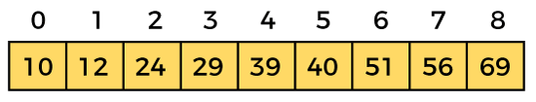
Binary Search
Now, let's see the working of the Binary Search Algorithm.
To understand the working of the Binary search algorithm, let's take a sorted array. It will be easy to understand the working of Binary search with an example.
Let the elements of array are -
Let the element to search is, K = 56

Slide 12
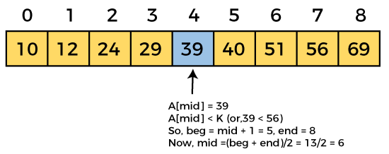
Working of Binary Search
We have to use the below formula to calculate the mid of the array -
So, in the given array -
beg = 0
end = 8
mid = (0 + 8)/2 = 4. So, 4 is the mid of the array.
mid = (beg + end)/2

Slide 13
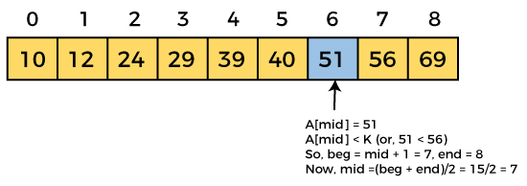
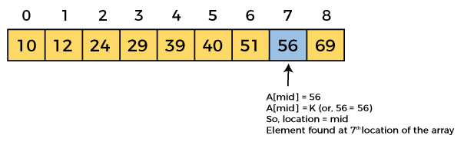
Working of Binary Search
Now, the element to search is found. So algorithm will return the index of the element matched.

Slide 14
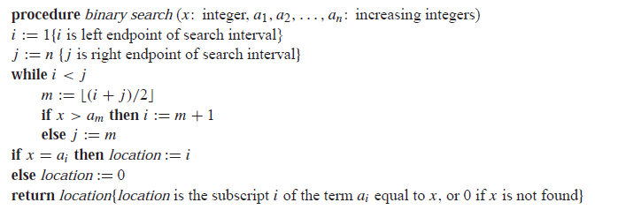
Binary Search Algorithm
Locate an element x in a list of distinct elements a1, a2, . . . , an, or determine that it is not in the list. The solution to this search problem is the location of the term in the list that equals x (that is, i is the solution if x = ai ) and is 0 if x is not in the list.

Slide 15
SORTING
Ordering the elements of a list is a problem that occurs in many contexts.
For example, to produce a telephone directory it is necessary to alphabetize the names of subscribers.
Similarly, producing a directory of songs available for downloading requires that their titles be put in alphabetic order.
Sorting is putting elements into a list in which the elements are in increasing order.
For instance, sorting the list 7, 2, 1, 4, 5, 9 produces the list 1, 2, 4, 5, 7, 9.
Sorting the list d, h, c, a, f (using alphabetical order) produces the list a, c, d, f, h.

Slide 16
THE BUBBLE SORT
The bubble sort is one of the simplest sorting algorithms, but not one of the most efficient.
It puts a list into increasing order by successively comparing adjacent elements, interchanging them if they are in the wrong order.
To carry out the bubble sort, we perform the basic operation, that is, interchanging a larger element with a smaller one following it, starting at the beginning of the list, for a full pass.
We iterate this procedure until the sort is complete.

Slide 17
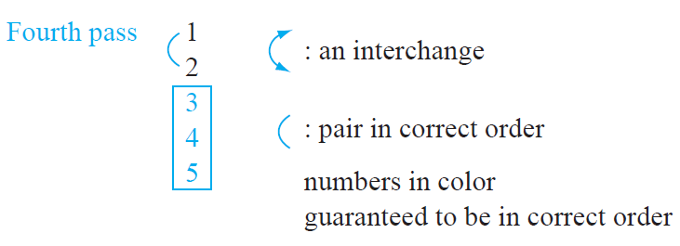
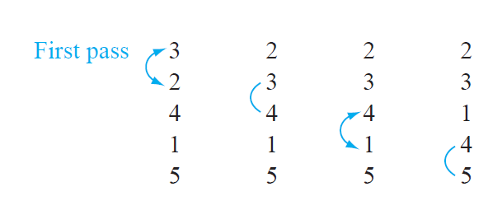
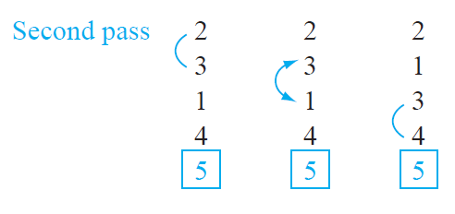
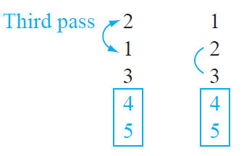
Working of BUBBLE SORT

Slide 18
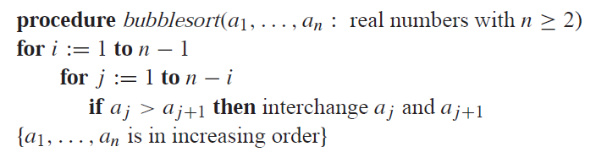
BUBBLE SORT ALGORITHM

