Slide 1
Lecture 12
Number Theory (Number Theory (Divisibility | Modular Arithmetic | Hashing |Pseudorandom # | Cryptography )

Slide 2
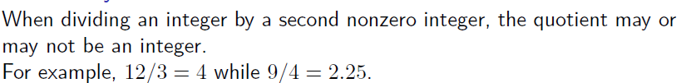
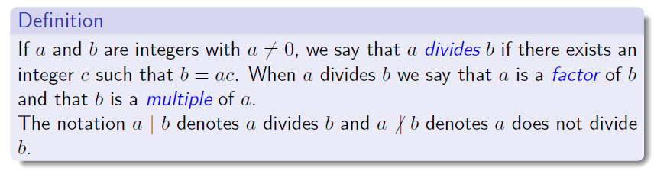
DIVISIBILITY

Slide 3

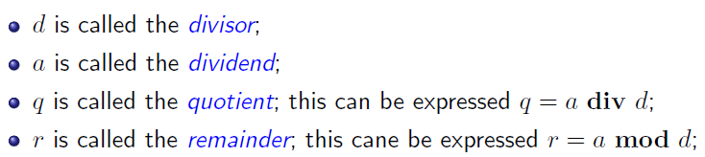
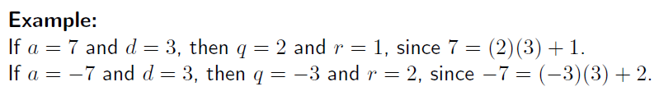

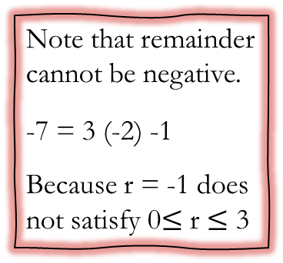
THE DIVISION ALGORITHM
Note that remainder cannot be negative.
-7 = 3 (-2) -1
Because r = -1 does not satisfy 0$≤$ r $≤$ 3

Slide 4
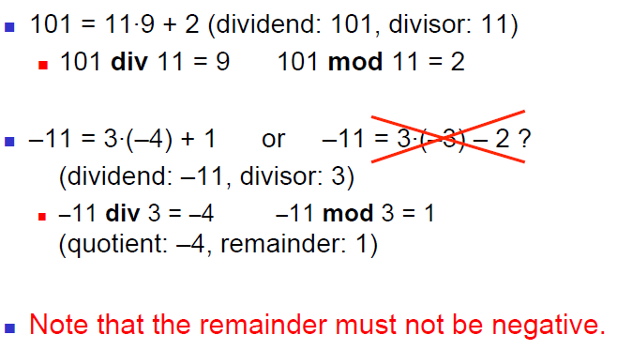
THE DIVISION ALGORITHM

Slide 5
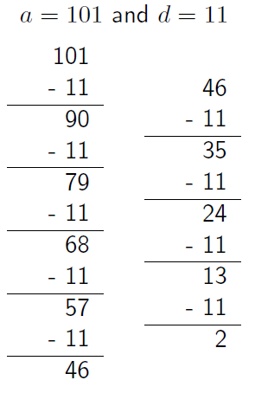
DIVISION
Using successive subtractions to find q and r:
q = 9 as we subtracted 11, 9 times
r = 2 since this was the last value before getting negative.

Slide 6
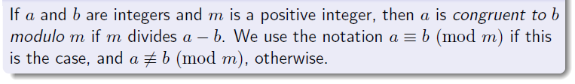
Modular Arithmetic

Slide 7

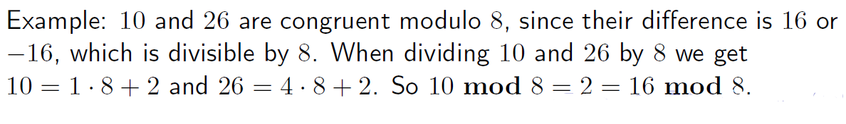
Modular Arithmetic

Slide 8

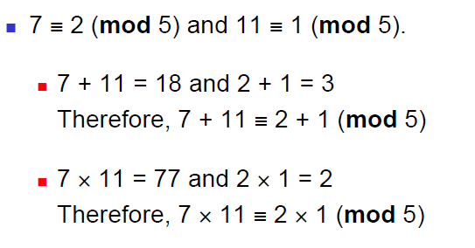
Modular Arithmetic

Slide 9
HASHING FUNTION

Slide 10

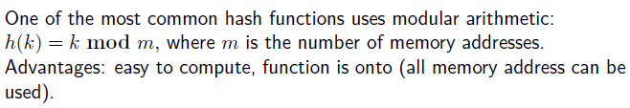
HASHING FUNCTION

Slide 11

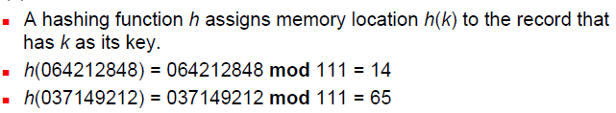
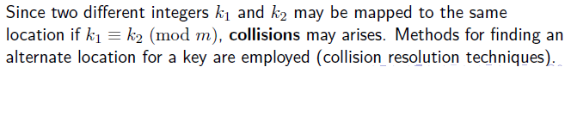
HASHING FUNCTION

Slide 12

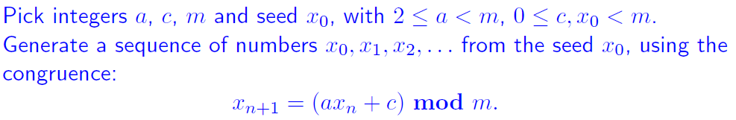
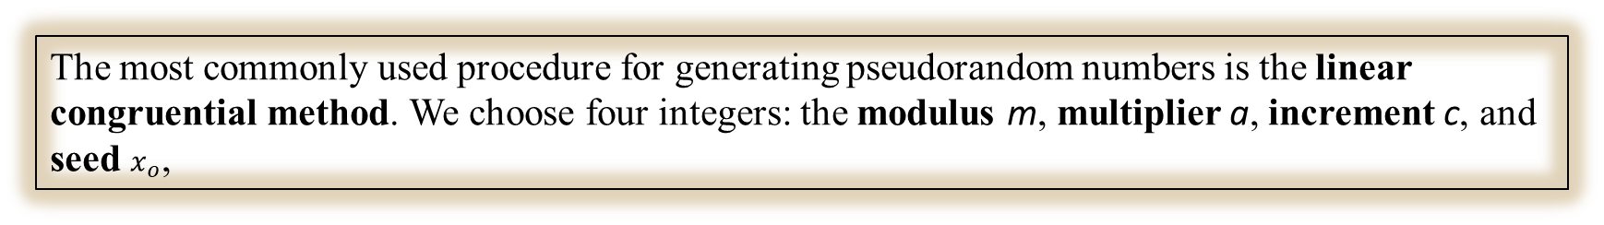
Pseudorandom Number Generators
The most commonly used procedure for generating pseudorandom numbers is the linear congruential method. We choose four integers: the modulus m, multiplier a, increment c, and seed $x_{o}$,

Slide 13

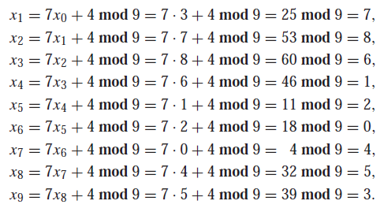
Pseudorandom Number Generators

Slide 14
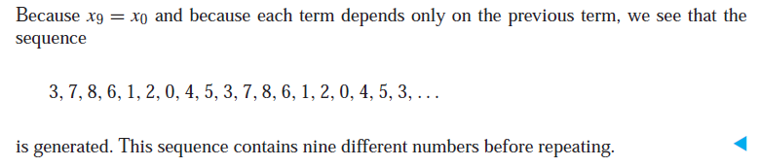
Pseudorandom Number Generators

Slide 15
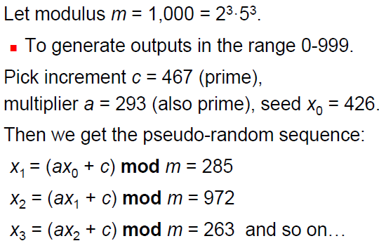
Pseudorandom Number Generators

Slide 16
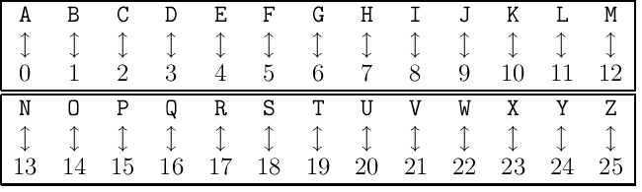
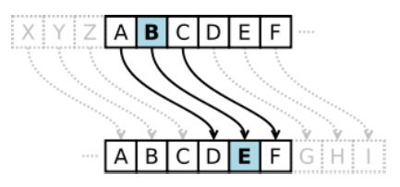
CRYPTOGRAPHY
CRYPTOGRAPHY is the study of secret messages
Encryption is the process of making a message secret.
Decryption is the process of determining the original message from the encrypted message.
Some simple early codes include Caesar’s cipher:
Assign an integer from 0 to 25 to each letter based on its position in the alphabet.
The Caesar cipher shifted each letter 3 letters forward in the alphabet
cyclically, sending xyz to abc respectively.

Slide 17
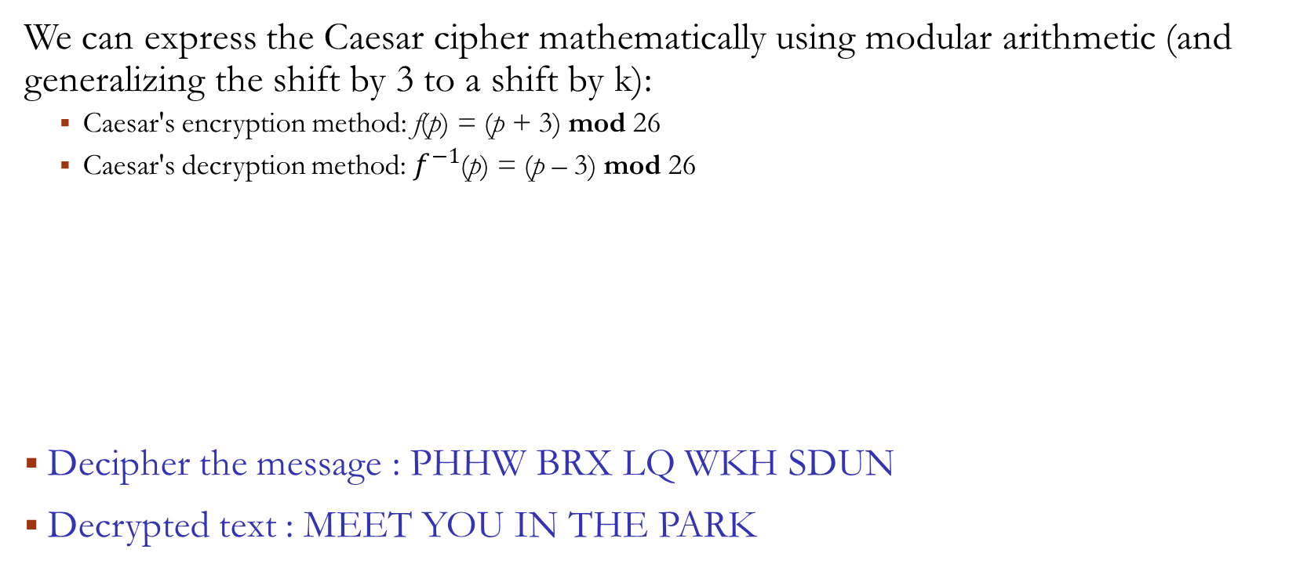
CRYPTOGRAPHY
We can express the Caesar cipher mathematically using modular arithmetic (and generalizing the shift by 3 to a shift by k):
Caesar's encryption method: f(p) = (p + 3) mod 26
Caesar's decryption method: $f^{−1}$(p) = (p – 3) mod 26
Decipher the message : PHHW BRX LQ WKH SDUN
Decrypted text : MEET YOU IN THE PARK

Slide 18
CRYPTOGRAPHY - EXAMPLE

Slide 19
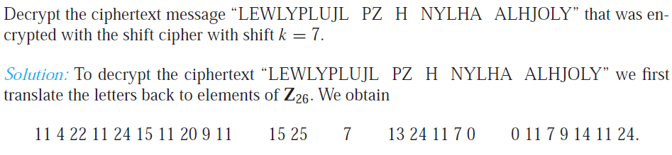
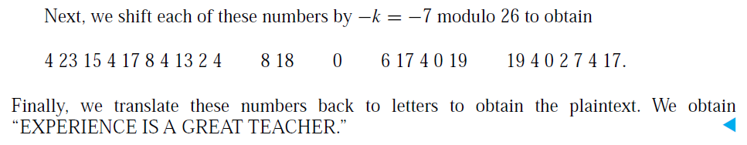
CRYPTOGRAPHY - EXAMPLE

Slide 20
CRYPTOGRAPHY Enhanced SECURITY
Caesar's encryption method does not provide a high level of security
A slightly better approach: f(p) = (ap + b) mod 26
Example
What letter replaces the letter K when the function f(p) = (7p + 3) mod 26 is used for encryption?
10 represents K
f(10) = (7×10 + 3) mod 26 = 73 mod 26 = 21
21 represents V
Therefore, K is replaced by V in the encrypted message

