Slide 1
Lecture 13
Number Theory (Prime |GCD | LCM | EUCLIDIAN ALGO)

Slide 2
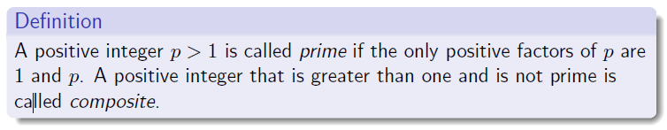
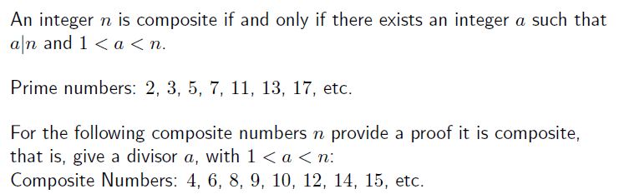
Primes

Slide 3
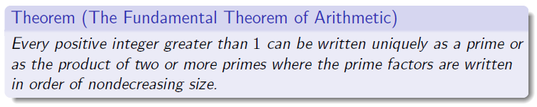

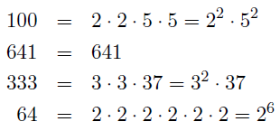
Primes

Slide 4
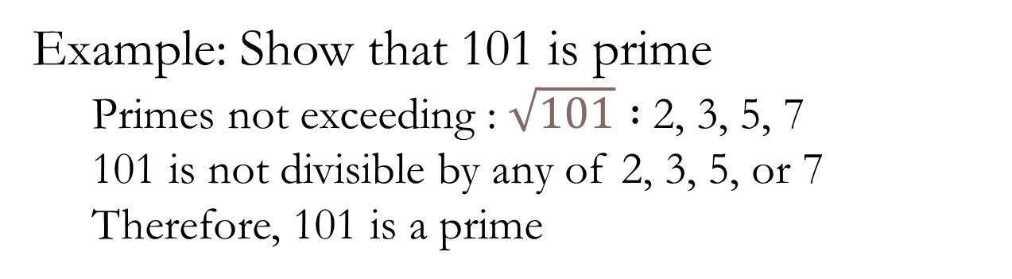
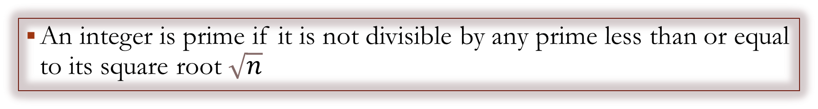
Prime
An integer is prime if it is not divisible by any prime less than or equal to its square root $\sqrt{n}$
Example: Show that 101 is prime
Primes not exceeding : $\sqrt{101} :$2, 3, 5, 7
101 is not divisible by any of 2, 3, 5, or 7
Therefore, 101 is a prime

Slide 5
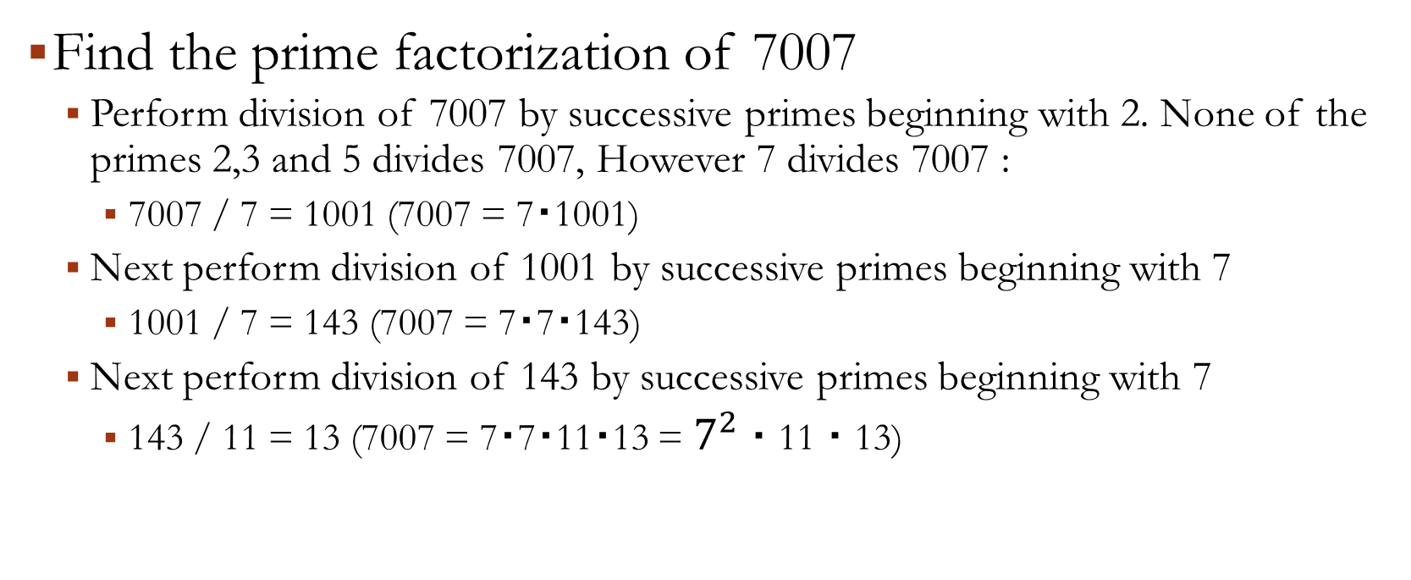
PRIME factorization
Find the prime factorization of 7007
Perform division of 7007 by successive primes beginning with 2. None of the primes 2,3 and 5 divides 7007, However 7 divides 7007 :
7007 / 7 = 1001 (7007 = 7・1001)
Next perform division of 1001 by successive primes beginning with 7
1001 / 7 = 143 (7007 = 7・7・143)
Next perform division of 143 by successive primes beginning with 7
143 / 11 = 13 (7007 = 7・7・11・13 = $7^{2}$・11・13)

Slide 6
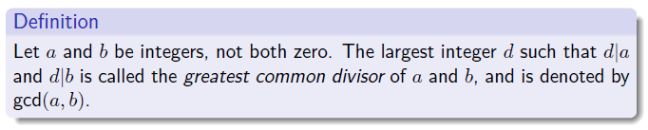

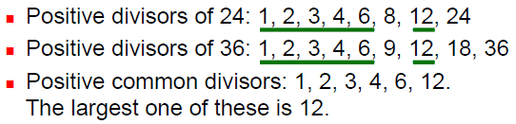
Greatest Common Divisors

Slide 7

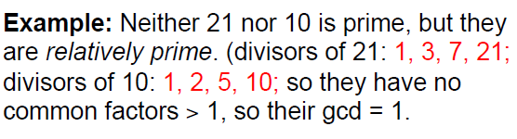
Greatest Common Divisors

Slide 8
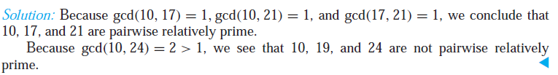
Greatest Common Divisors

Slide 9
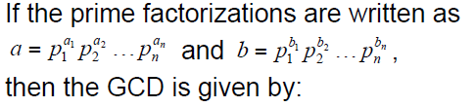

Greatest Common Divisors

Slide 10
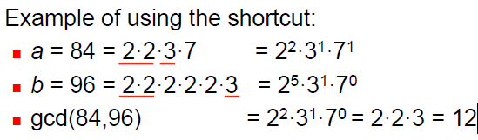
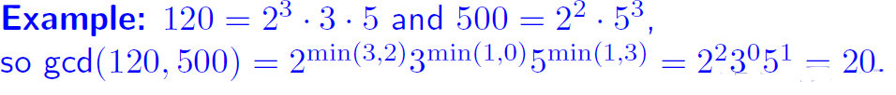
Greatest Common Divisors

Slide 11
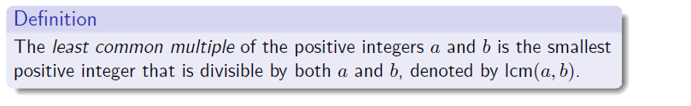
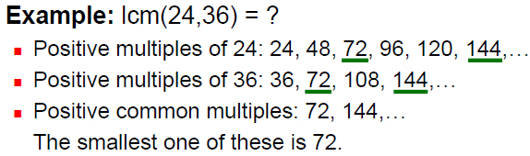
Least Common Multiple

Slide 12
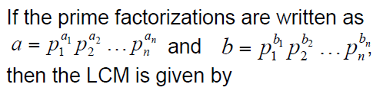
Least Common Multiple

Slide 13
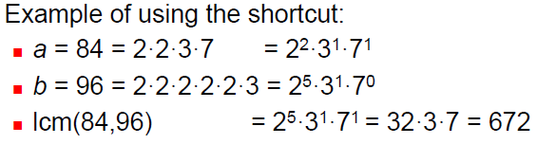

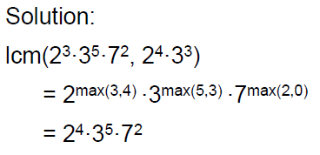
Least Common Multiple

Slide 14
The Euclidean Algorithm
Computing the greatest common divisor of two integers directly from the prime factorizations of these integers is inefficient.
The reason is that it is time-consuming to find prime factorizations.
We will give a more efficient method of finding the greatest common divisor, called the Euclidean algorithm.
Find gcd(91, 287).
First, divide 287, the larger of the two integers, by 91, the smaller, to obtain
287 = 91 ・ 3 + 14
Any divisor of 91 and 287 must also be a divisor of 287 − 91 ・ 3 = 14
Also, any divisor of 91 and 14 must also be a divisor of 287 = 91 ・ 3 + 14
Hence, the greatest common divisor of 91 and 287 is the same as the greatest common divisor of 91 and 14.

Slide 15
The Euclidean Algorithm
This means that the problem of finding gcd(91, 287) has been reduced to the problem of finding gcd(91, 14).
Next, divide 91 by 14 to obtain
91 = 14 ・ 6 + 7
Because any common divisor of 91 and 14 also divides 91 − 14 ・ 6 = 7 and any common divisor of 14 and 7 divides 91, it follows that gcd(91, 14) = gcd(14, 7).
Continue by dividing 14 by 7, to obtain
14 = 7 ・ 2
Because 7 divides 14, it follows that gcd(14, 7) = 7. Furthermore, because gcd(287, 91) = gcd(91, 14) = gcd(14, 7) = 7, the original problem has been solved.

Slide 16
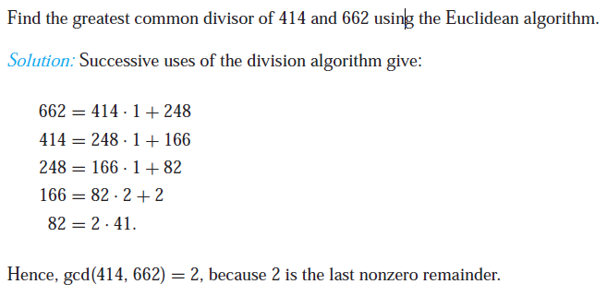
The Euclidean Algorithm

