Slide 1
Lecture 15
Pigeonhole Principle

Slide 2
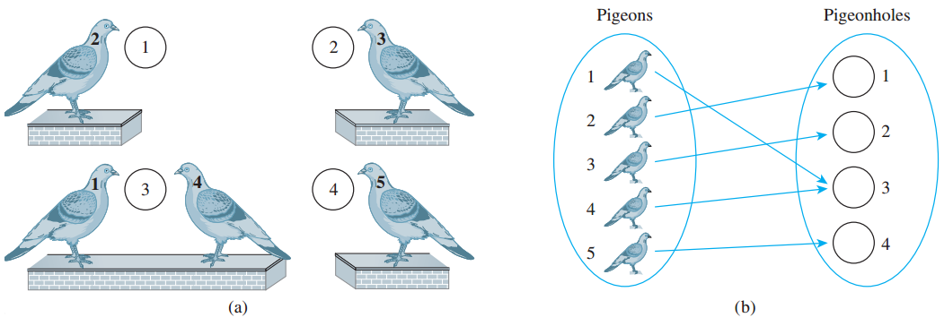
Introduction
The pigeonhole principle states that if n pigeons fly into m pigeonholes and n>m, then at least one hole must contain two or more pigeons.

Slide 3
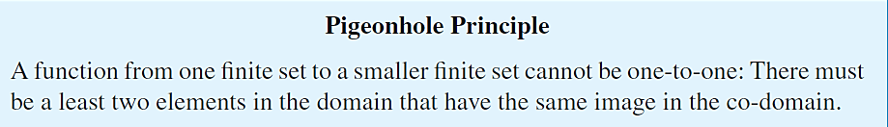
Pigeonhole Principle

Slide 4
Pigeonhole Principle EXAMPLES:
Among any group of 367 people, there must be at least two with the same birthday, because there are only 366 possible birthdays.
In any set of 27 English words, there must be at least two that begin with the same letter, since there are 26 letters in the English alphabet.

Slide 5
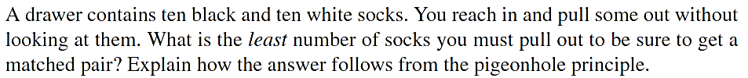
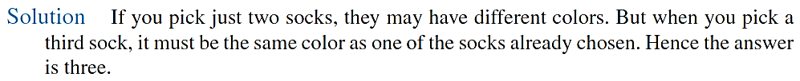
Pigeonhole Principle EXAMPLES:

Slide 6
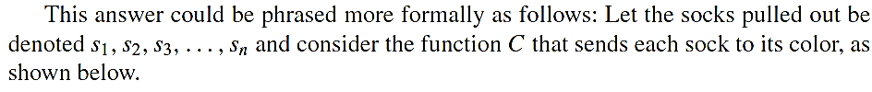
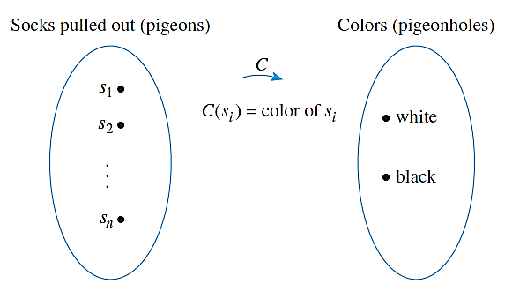
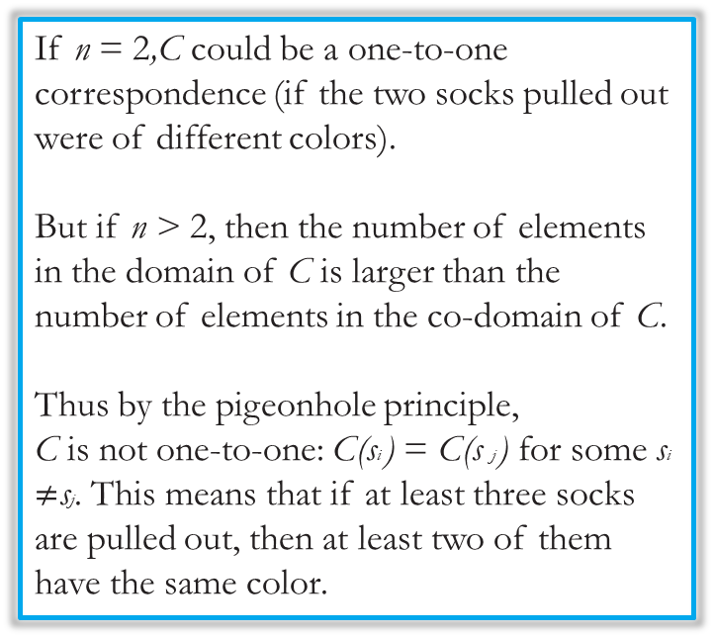
Pigeonhole Principle EXAMPLE:
If n = 2,C could be a one-to-one correspondence (if the two socks pulled out were of different colors).
But if n > 2, then the number of elements in the domain of C is larger than the number of elements in the co-domain of C.
Thus by the pigeonhole principle,
C is not one-to-one: C(si ) = C(s j ) for some si $≠$sj. This means that if at least three socks
are pulled out, then at least two of them have the same color.

Slide 7
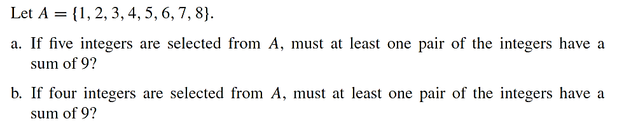
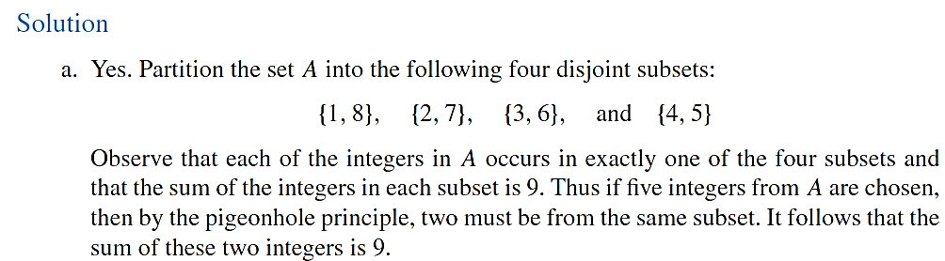
Pigeonhole Principle EXAMPLE:
Selecting a Pair of Integers with a Certain Sum

Slide 8
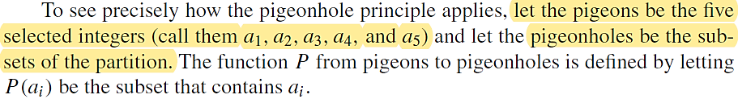
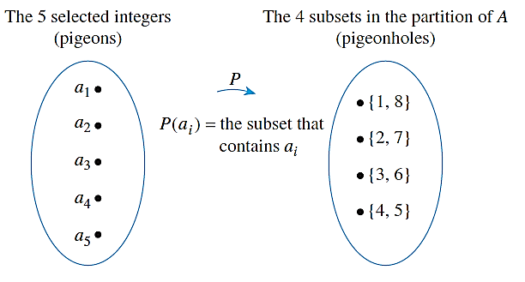
Pigeonhole Principle EXAMPLE:
Because there are more pigeons than pigeonholes, at least two pigeons must go to the same hole. Thus two distinct integers are sent to the same set. But that implies that those two integers are the two distinct elements of the set, so their sum is 9.

Slide 9
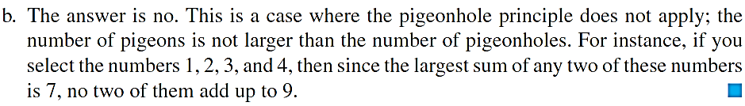
Pigeonhole Principle EXAMPLE:

Slide 10
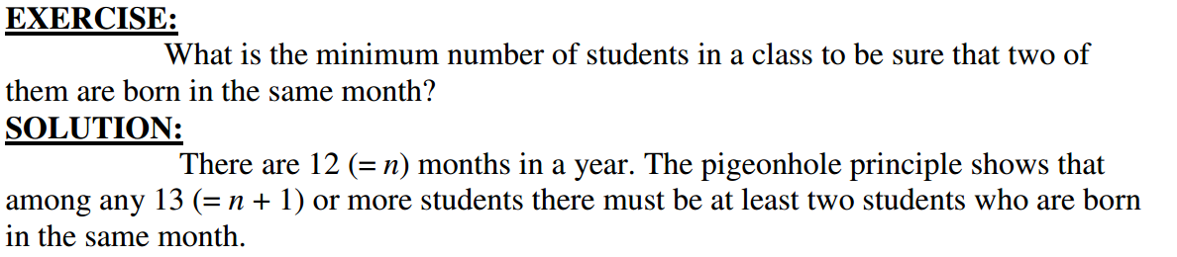
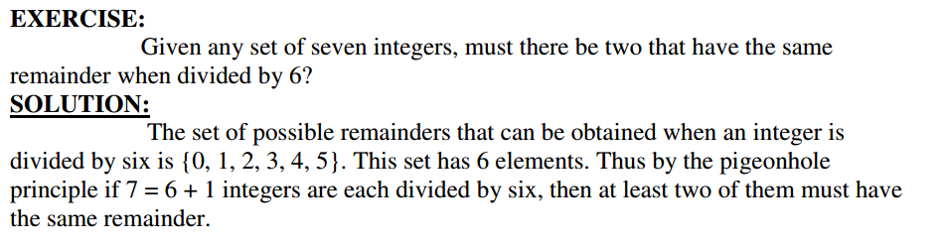
Pigeonhole Principle EXAMPLE:

Slide 11
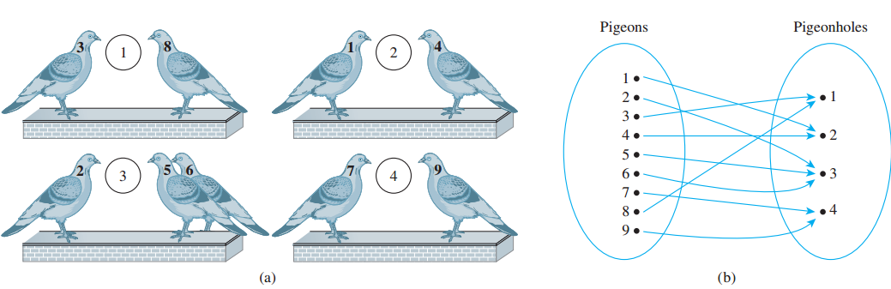

Generalized Pigeonhole Principle
Given m items and n containers, if m>n, there is at least one container with $\left\lceil m/n\right\rceil$ items

Slide 12
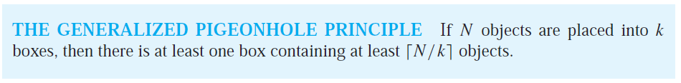
Generalized Pigeonhole Principle

Slide 13
Generalized Pigeonhole Principle
Suppose we have 10 containers, and we want to ensure that at least one of the container have more then 2 items in it. (before this we were talking about more then 1 item)
So, if we take 20 items and place them equally then 10 containers will be filled. However, if we have 21 items, only then 21st item will have to be placed within the container that already contains 2 items.
If you want to place more then 3 items in a container (and there are 10 containers in total) then there should be at least 31 items in total.

Slide 14

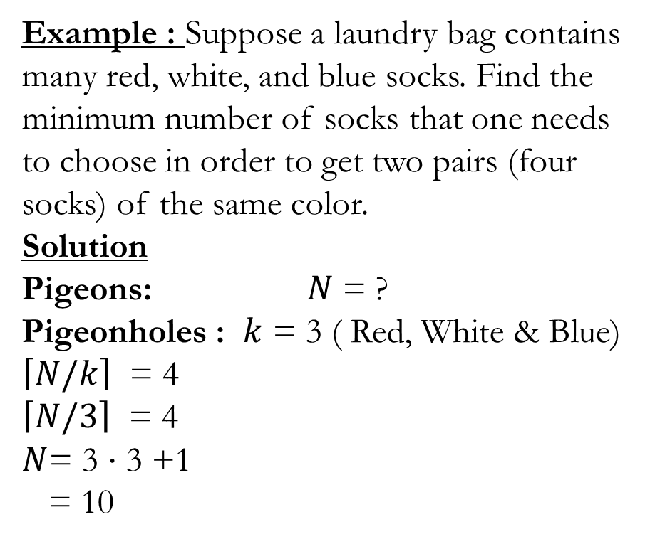
Generalized Pigeonhole Principle
Example : Suppose a laundry bag contains many red, white, and blue socks. Find the minimum number of socks that one needs to choose in order to get two pairs (four socks) of the same color.
Solution
Pigeons: $N$ = ?
Pigeonholes : $k$ = 3 ( Red, White & Blue)
$\left\lceil N/k\right\rceil$ = 4
$\left\lceil N/3\right\rceil$ = 4
$N$= 3 ⋅ 3 +1
= 10
Example: Among 100 people how many people are born in the same month ?
Solution:
Among 100 people there are at least
⎡100/12⎤= ⎡8 + 1/3⎤= 9
who were born in the same month.

Slide 15
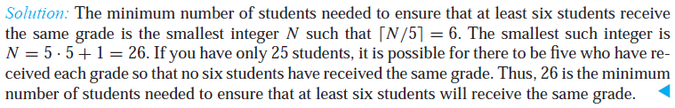
Generalized Pigeonhole Principle

Slide 16
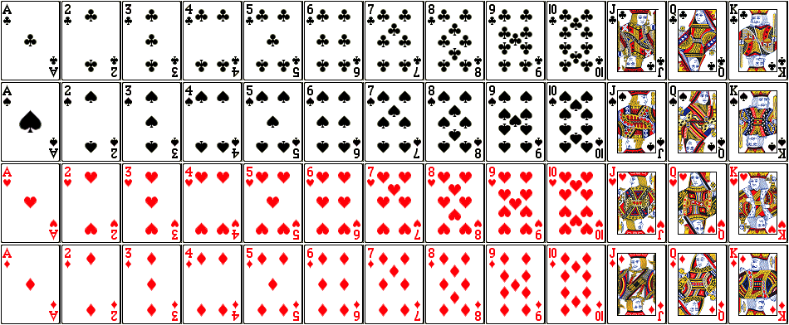
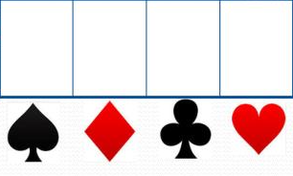
Generalized Pigeonhole Principle
How many cards must be selected from a standard deck of 52 cards to guarantee that at least three cards of the same suit are chosen?
A standard deck of 52
cards has 13 kinds of
cards, with four cards of
each of kind, one in each
of the four suits, hearts,
diamonds, spades, and
clubs.

Slide 17
Generalized Pigeonhole Principle
How many cards must be selected from a standard deck of 52 cards to guarantee that at least three cards of the same suit are chosen?
Assume there are four boxes, one for each suit,
Using the generalized pigeonhole principle, at least one box contains at least N/4 cards.
At least three cards of one suit are selected if N/4 ≥ 3.
The smallest integer N such that N/4 ≥ 3 is N = 4 · 2 + 1 = 9

