Slide 1
Lecture 19
TREES

Slide 2
Introduction to Trees
In this lecture we will focus on a particular type of graph called a tree, so named because such graphs resemble trees.
For example, family trees are graphs that represent genealogical charts.
A tree is an undirected graph T such that
T has no simple circuits
T is connected
A tree cannot contain multiple edges or loops. Therefore any tree must be a simple graph.
A tree with n vertices has n - 1 edges (where n ≥0).
Theorem: An undirected graph is a tree iff there is a unique simple path between any two of its vertices.
Tree

Slide 3
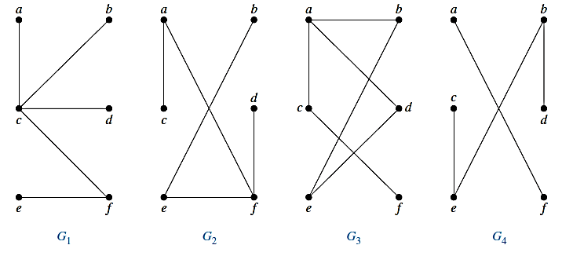
Example 1
Which of the graphs are trees?

Slide 4
Example 1
Which of the graphs are trees?
G1 and G2 are trees, because both are connected graphs with no simple circuits.
G3 is not a tree because e, b, a, d, e is a simple circuit in this graph.
G4 is not a tree because it is not connected.

Slide 5
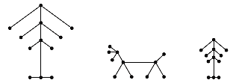
Forest
A forest is an undirected graph such that
It has no simple circuits
It is not necessarily connected
The connected components of a forest are trees
A Forest
One graph with 3 trees

Slide 6
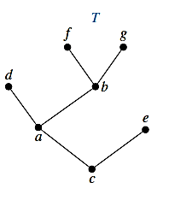
Rooted Tree
A rooted tree is a tree in which one vertex has been designated as the root and every edge is directed away from the root.
The terminology for trees has botanical and genealogical origins, like parent, child, siblings, descendants and ancestors.
With root a
With root c
a
c
a
b
c
d
b
e
e
f
d
f
g
g
Tree and Rooted Tree

Slide 7
Rooted Tree Terminologies
Suppose that T is a rooted tree. If v is a vertex in T other than the root, the parent of v is the unique vertex u such that there is a directed edge from u to v.
When u is the parent of v, v is called a child of u. Vertices with the same parent are called siblings.
The ancestors of a vertex other than the root are the vertices in the path from the root to this vertex, excluding the vertex itself and including the root.
The descendants of a vertex v are those vertices that have v as an ancestor.
A vertex of a rooted tree is called a leaf if it has no children.
Vertices that have children are called internal vertices.
The root is an internal vertex unless it is the only vertex in the graph, in which case it is a leaf.
If a is a vertex in a tree, the subtree with a as its root is the subgraph of the tree consisting of a and its descendants and all edges incident to these descendants.
The level of a vertex v in a rooted tree is the length of the unique path from the root to this vertex. The level of the root is defined to be zero.
The height of a rooted tree is the maximum of the levels of vertices. In other words, the height of a rooted tree is the length of the longest path from the root to any vertex.

Slide 8
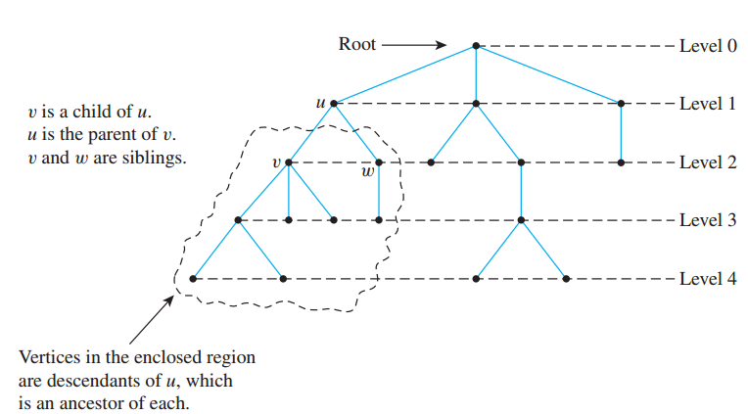
Rooted Tree
Leaf
Internal Vertex
The height of a rooted tree is the maximum level of any vertex of the tree.

Slide 9
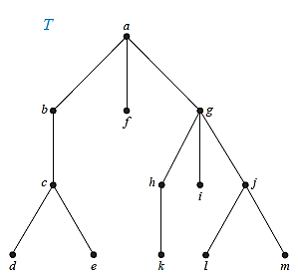
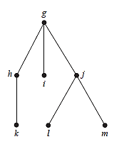
Subtree
The Subtree Rooted at g
A Rooted Tree T

Slide 10
Example 2
In the rooted tree T (with root a) shown in Figure, find the parent of c, the children of g, the siblings of h, all ancestors of e, all descendants of b, all internal vertices, and all leaves. What is the subtree rooted at g?

Slide 11
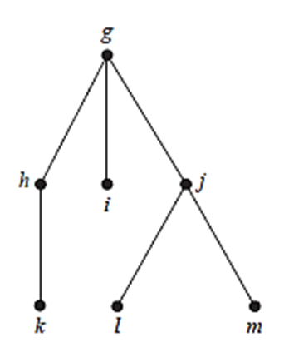
Example 2
In the rooted tree T (with root a) shown in Figure, find the parent of c, the children of g, the siblings of h, all ancestors of e, all descendants of b, all internal vertices, and all leaves. What is the subtree rooted at g?
SOLUTION:
Parent of c is b
The children of g are h, i, j
The siblings of h are i, j
All ancestors of e are c, b, a
All descendants of b are c, d, e
All internal vertices are a, b, g, c, h, j
All leaves are d, e, f, k, l, i, m
Subtree rooted at g is

Slide 12
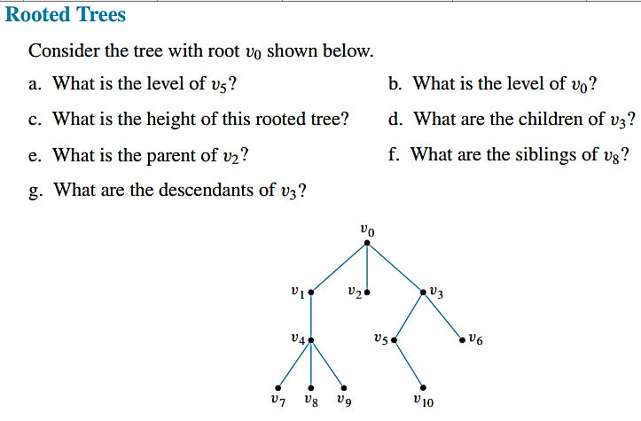
Example 3

Slide 13
Example 3

Slide 14
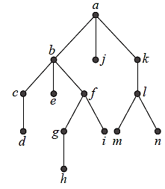
Example 4
Find the level of each vertex in the rooted tree shown in Figure. What is the height of this tree?

Slide 15
Example 4
Find the level of each vertex in the rooted tree shown in Figure. What is the height of this tree?
The root a is at level 0.
Vertices b, j , and k are at level 1.
Vertices c, e, f , and l are at level 2.
Vertices d, g, i, m, and n are at level 3. Finally, vertex h is at level 4.
Because the largest level of any vertex is 4, this tree has height 4.

Slide 16
Rooted Tree
A rooted tree is called an m-ary tree if every internal vertex has no more than m children.
The tree is called a full m-ary tree if every internal vertex has exactly m children.
An m-ary tree with m = 2 is called a binary tree.
In an ordered binary tree (usually called just a binary tree), if an internal vertex has two children, the first child is called the left child and the second child is called the right child.
The tree rooted at the left child of a vertex is called the left subtree of this vertex, and the tree rooted at the right child of a vertex is called the right subtree of the vertex.

Slide 17
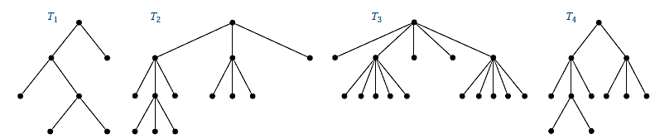
Example 5
Are the rooted trees in Figure full m-ary trees for some positive integer m?

Slide 18
Example 5
Are the rooted trees in Figure full m-ary trees for some positive integer m?
T₁ is a full binary tree because each of its internal vertices has two children.
T₂ is a full 3-ary tree because each of its internal vertices has three children.
In T₃ each internal vertex has five children, so T₃ is a full 5-ary tree.
T₄ is not a full m-ary tree for any m because some of its internal vertices have two children and others have three children so its just 3-ary tree.

Slide 19
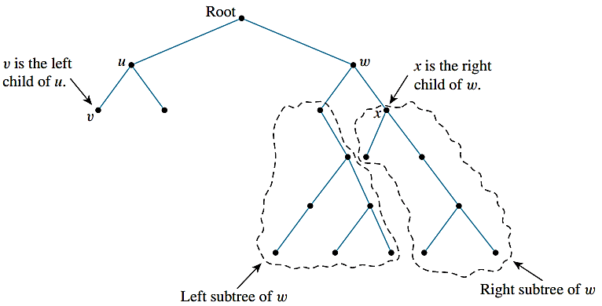
Binary Tree
A binary tree is a rooted tree in which every internal vertex has at most two children.
Every child in a binary tree is designated either a left child or a right child (but not both).
A full binary tree is a binary tree in which each internal vertex has exactly two children.

Slide 20
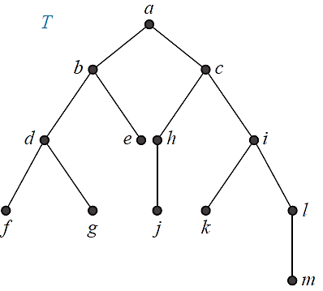
Example 6
What are the left and right children of d in the binary tree T shown in Figure (where the order is that implied by the drawing)? What are the left and right subtrees of c?

Slide 21
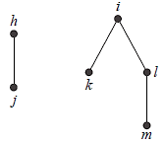
Example 6
What are the left and right children of d in the binary tree T shown in Figure (where the order is that implied by the drawing)? What are the left and right subtrees of c?
Solution:
The left child of d is f and the right child is g. We show the left and right subtrees
of c in Figures below respectively.
Left Subtree of c
Right Subtree of c

Slide 22
Balanced Tree
A rooted m-ary tree of height h is balanced if all leaves are at levels h or h−1.

Slide 23
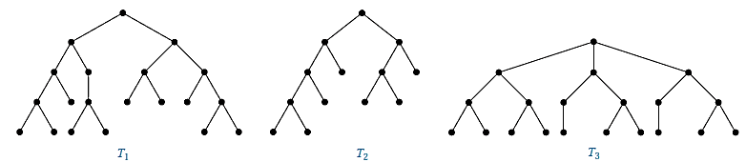
Example 7
Which of the rooted trees shown in Figure are balanced?

Slide 24
Example 7
Which of the rooted trees shown in Figure are balanced?
T1 is balanced, because all its leaves are at levels 3 and 4.
However, T2 is not balanced, because it has leaves at levels 2, 3, and 4.
Finally, T3 is balanced, because all its leaves are at level 3.

Slide 25
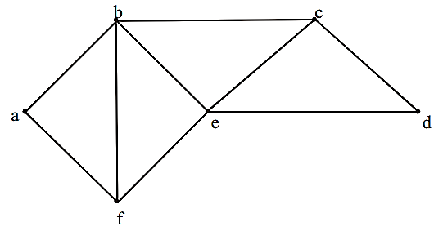
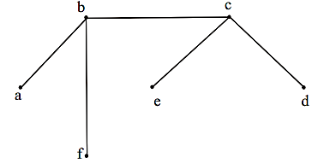
Spanning Tree
Suppose it is required to develop a system of roads between six major cities. A survey of the area revealed that only the roads shown in the graph could be constructed.
For economic reasons, it is desired to construct the least possible number of roads to connect the six cities. One such set of roads is
Note that the subgraph representing these roads is a tree, it is connected & circuit-free (six vertices and five edges)

Slide 26
Spanning Tree
Let G be a simple graph. A spanning tree of G is a subgraph of G that is a tree containing every vertex of G.
REMARKS:
Every connected graph has a spanning tree.
A graph may have more than one spanning trees.
Any two spanning trees for a graph have the same number of edges.

Slide 27
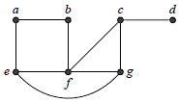
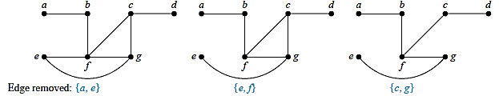
Example 8
Find a spanning tree of the simple graph G shown in Figure.
The graph G is connected, but it is not a tree because it contains simple circuits.
Remove the edge {a, e}. This eliminates one simple circuit, and the resulting subgraph is still connected and still contains every vertex of G.
Next remove the edge {e, f } to eliminate a second simple circuit.
Finally, remove edge {c, g} to produce a simple graph with no simple circuits.
This subgraph (the last figure on right) is one of the many spanning trees that can be formed, because it is a tree that contains every vertex of G.

Slide 28
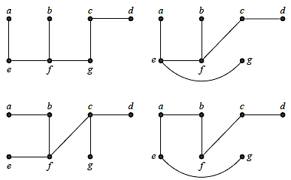
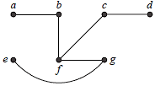
Example 8
Each of the trees shown below is a spanning tree of G.

Slide 29
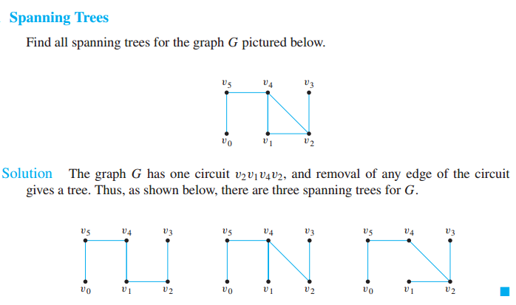
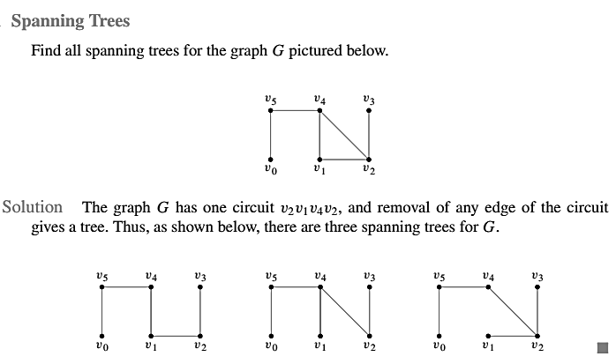
Example 9

Slide 30
Tree Traversal
Ordered rooted trees are often used to store information.
We need procedures for visiting each vertex of an ordered rooted tree to access data.
We will study some important algorithms for visiting all the vertices of an ordered rooted tree.
Ordered rooted trees can also be used to represent various types of expressions such as arithmetic expressions involving numbers, variables, and operations.

Slide 31
Universal Address Systems
Procedures for traversing all vertices of an ordered rooted tree rely on the orderings of children. In ordered rooted trees, the children of an internal vertex are shown from left to right in the drawings.
We will describe one way we can totally order the vertices of an ordered rooted tree. To produce this ordering, we must first label all the vertices. We do this recursively:
1. Label the root with the integer 0. Then label its k children (at level 1) from left to right
with 1, 2, 3, . . . , k.
2. For each vertex v at level n with label A, label its k_{v} children, as they are drawn from left to right, with A.1,A.2, . . . , A.k_{v}.

Slide 32
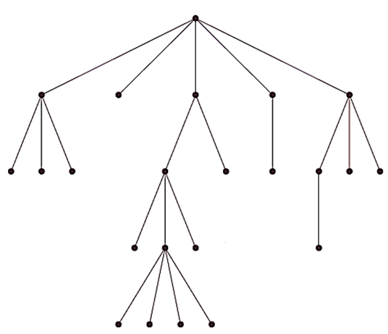
Example 10
Display the labeling of the universal address system next to the vertices in the ordered rooted tree shown in Figure.

Slide 33
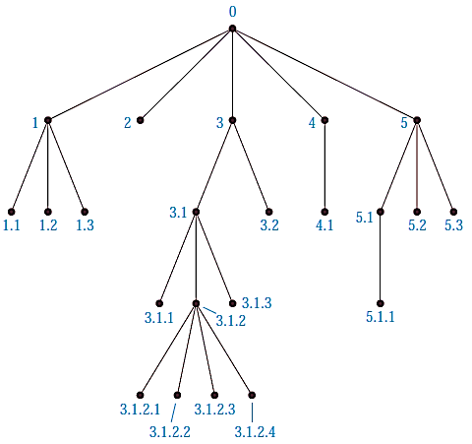
Example 10
Display the labeling of the universal address system next to the vertices in the ordered rooted tree shown in Figure.

Slide 34
Tree Traversal Algorithms
Procedures for systematically visiting every vertex of an ordered rooted tree are called traversal algorithms.
We will describe three of the most commonly used such algorithm:
Preorder traversal
Inorder traversal
Postorder traversal

Slide 35

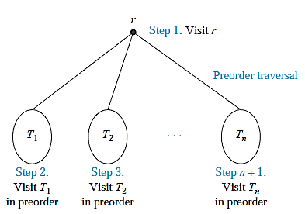
Preorder Traversal
In this traversal method, the root node is visited first, then the left subtree and finally the right subtree.

Slide 36
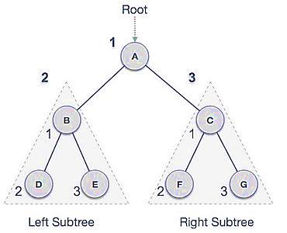
Preorder Traversal
We start from A, and following pre-order traversal, we first visit A itself and then move to its left subtree B. B is also traversed pre-order. The process goes on until all the nodes are visited. The output of pre-order traversal of this tree will be
A → B → D → E → C → F → G

Slide 37
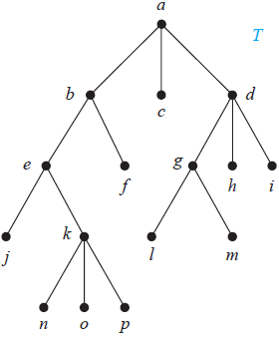
Example 11
In which order does a preorder traversal visit the vertices in the ordered rooted tree T shown in Figure?
Solution:
Preorder traversal: Visit root,
visit subtrees left to right.

Slide 38
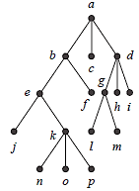
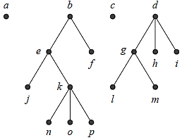
Example 11

Slide 39
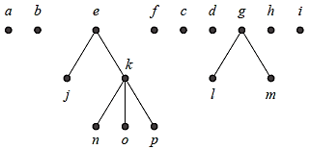
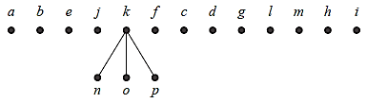

Example 11

Slide 40

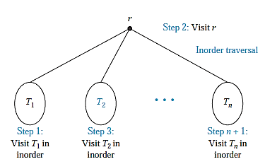
Inorder Traversal
If a binary tree is traversed in-order, the output will produce sorted key values in an ascending order.

Slide 41
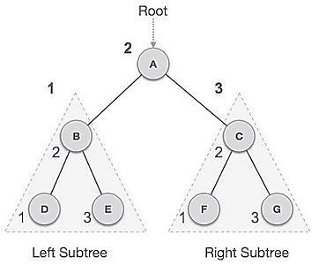
Inorder Traversal
We start from A, and following in-order traversal, we move to its left subtree B. B is also traversed in-order. The process goes on until all the nodes are visited. The output of inorder traversal of this tree will be
D → B → E → A → F → C → G

Slide 42
Example 12
In which order does a inorder traversal visit the vertices in the ordered rooted tree T shown in Figure?
Solution:
Inorder traversal: Visit leftmost subtree, visit root, visit other subtrees left to right

Slide 43
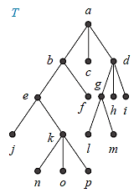
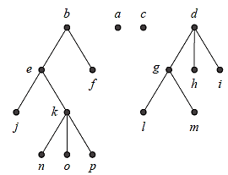
Example 12

Slide 44
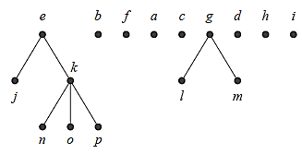
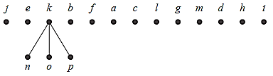

Example 12

Slide 45

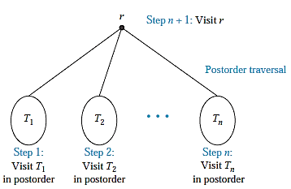
Postorder Traversal

Slide 46
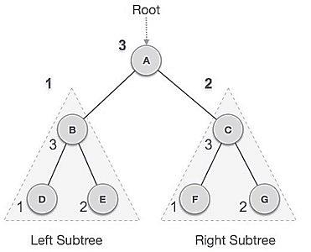
Postorder Traversal
We start from A, and following pre-order traversal, we first visit the left subtree B. B is also traversed post-order. The process goes on until all the nodes are visited. The output of post-order traversal of this tree will be
D → E → B → F → G → C → A

Slide 47
Example 13
In which order does a postorder traversal visit the vertices in the ordered rooted tree T shown in Figure?
Solution:
Postorder traversal: Visit subtrees left to right; visit root.

Slide 48
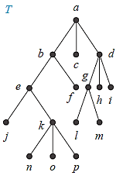
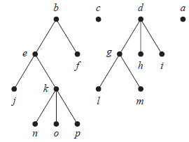
Example 13

Slide 49
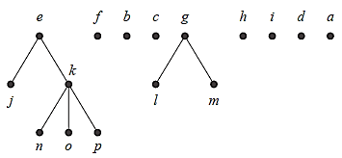
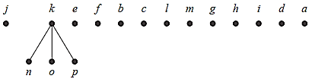

Example 13

Slide 50
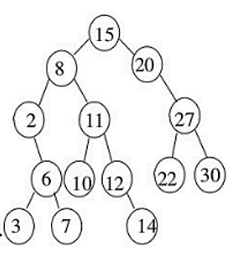
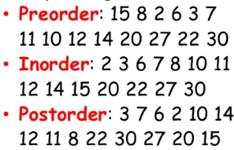
Example 14

Slide 51
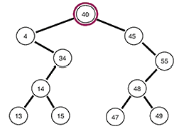
Example 15

Slide 52
Example 15
In-order: 4,13,14,15,34,40,45,47,48,49,55
Pre-order : 40,4,34,14,13,15,45,55,48,47,49
Post-order: 13, 15, 14, 34, 4, 47, 49, 48, 55, 45, 40

Slide 53
Prefix, Infix & Postfix
An inorder traversal of the binary tree representing an expression produces the original expression with the elements and operations in the same order as they originally occurred. The fully parenthesized expression obtained in this way is said to be in infix form.
We obtain the prefix form of an expression when we traverse its rooted tree in preorder. Expressions written in prefix form are said to be in Polish notation.
We obtain the postfix form of an expression by traversing its binary tree in postorder. Expressions written in postfix form are said to be in reverse Polish notation.

Slide 54
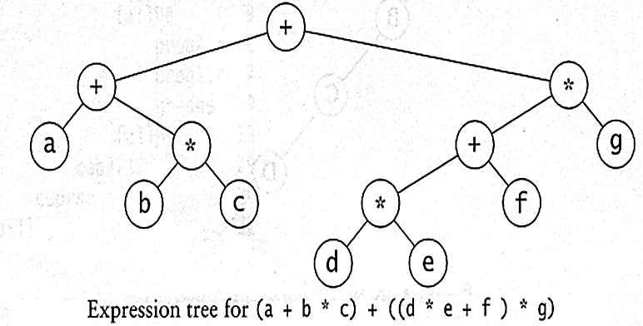
Example 16
Pre-order traversal
node, left, right
prefix expression
++a*bc*+*defg
In-order traversal
left, node, right.
infix expression
a+b*c+d*e+f*g
Post-order traversal
left, right, node.
postfix expression
abc*+de*f+g*+

Slide 55
REFERENCES
Kenneth Rosen Discrete Mathematics and Its Applications – Chapter # 11

