Slide 1
Lecture 2
Propositional Logic

Slide 2

INTRODUCTION
Logic is the study of the principles and methods that distinguishes between a valid and an invalid argument
Logic deals with general reasoning laws, which you can trust

Slide 3
Applications
Applied in proving program correctness and verification
Databases (Relational Algebra and Calculus)
Artificial Intelligence

Slide 4
Propositional Logic

Slide 5
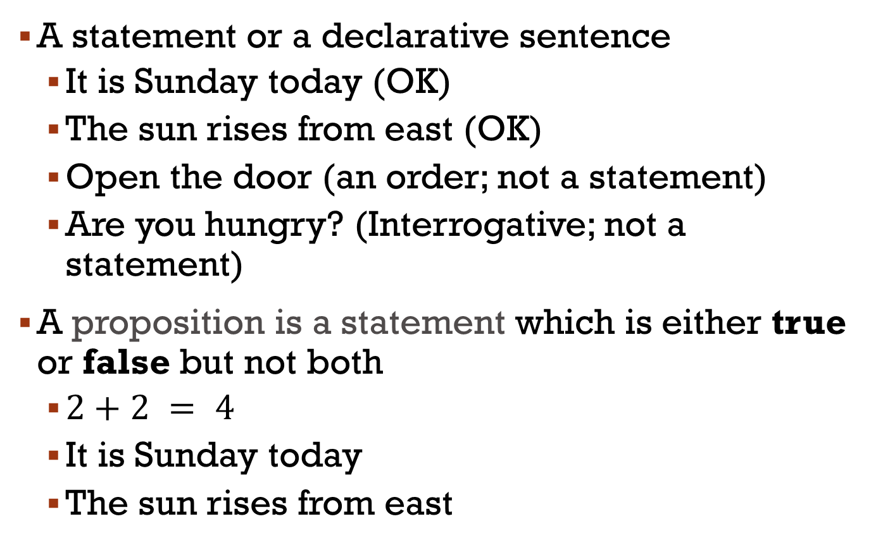
Proposition
A statement or a declarative sentence
It is Sunday today (OK)
The sun rises from east (OK)
Open the door (an order; not a statement)
Are you hungry? (Interrogative; not a statement)
A proposition is a statement which is either true or false but not both
$2+2 = 4$
It is Sunday today
The sun rises from east

Slide 6
Truth Values
If a proposition is true, we say that it has a truth value of “true”
If a proposition is false, its truth value is “false”
The truth values “true” and “false” are, respectively, denoted by the letters T and F

Slide 7
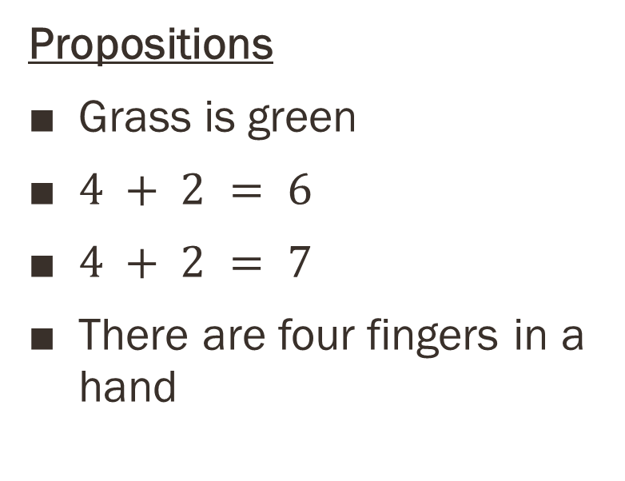
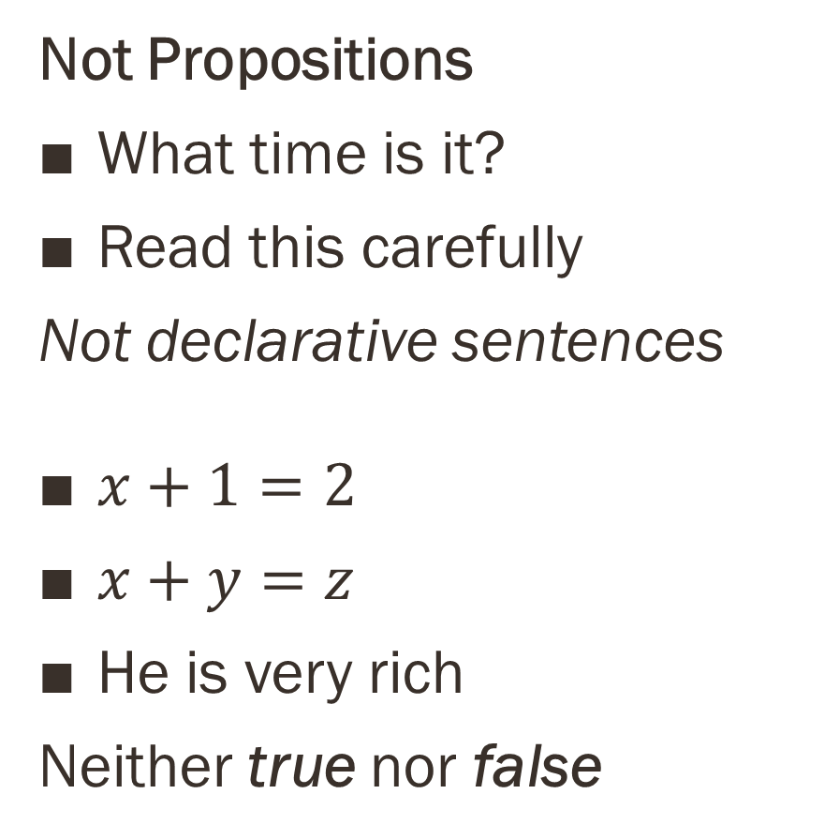
Examples
Not Propositions
What time is it?
Read this carefully
Not declarative sentences
$x+1=2$
$x+y=z$
He is very rich
Neither true nor false
Propositions
Grass is green
$4 + 2 = 6$
$4 + 2 = 7$
There are four fingers in a hand

Slide 8
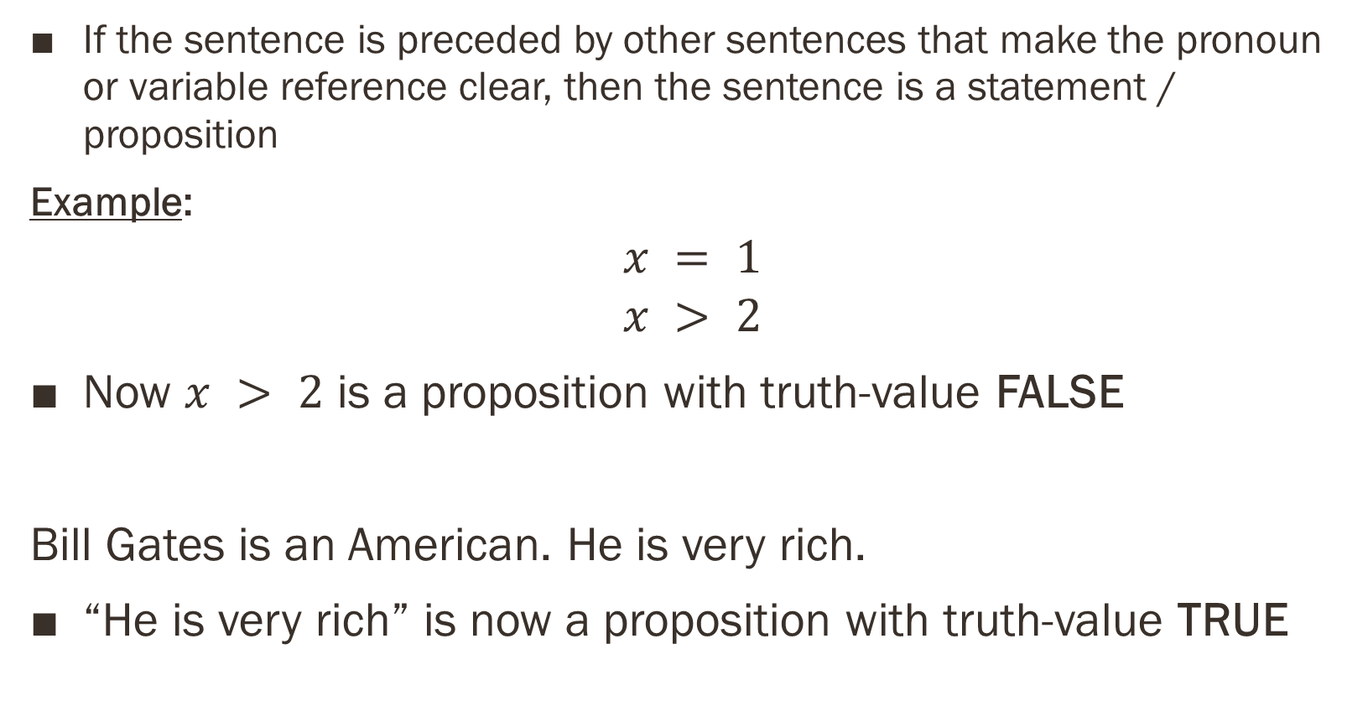
Context
If the sentence is preceded by other sentences that make the pronoun or variable reference clear, then the sentence is a statement / proposition
Example:
$$x = 1$$
$$x > 2$$
Now $x > 2$ is a proposition with truth-value FALSE
Bill Gates is an American. He is very rich.
“He is very rich” is now a proposition with truth-value TRUE
$$\text{or} x>2 \text{provided} \text{that} x=1$$

Slide 9
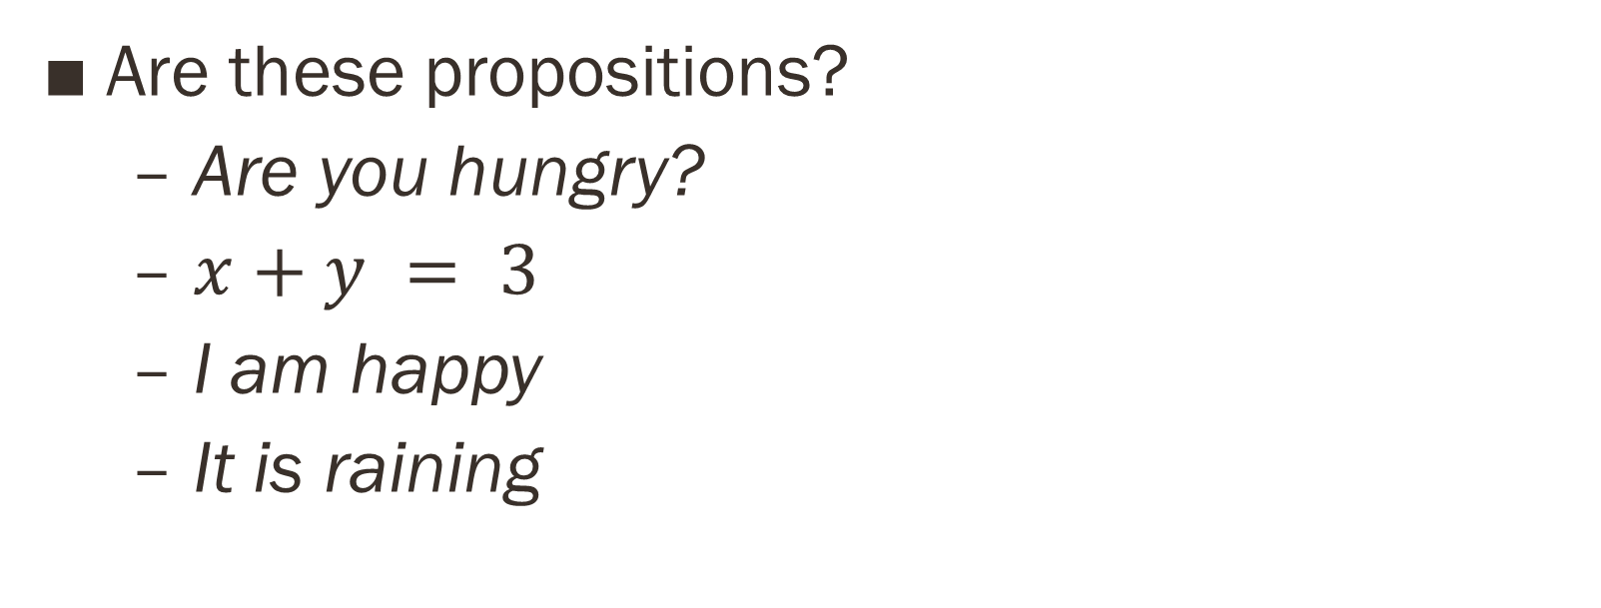
TEST
Are these propositions?
Are you hungry?
$x+y = 3$
I am happy
It is raining

Slide 10
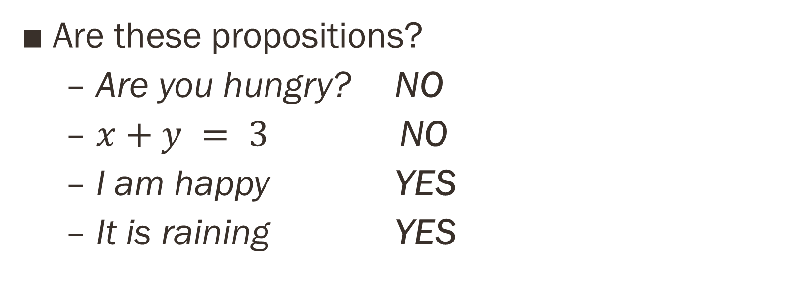
TEST
Are these propositions?
Are you hungry? NO
$x+y = 3 \text{NO}$
I am happy YES
It is raining YES

Slide 11
1.1 Propositional logic
The area of logic that deals with propositions is called the propositional logic
It was first developed systematically by the Greek philosopher Aristotle more than 2300 years ago

Slide 12
Compound Propositions
Compound propositions, are formed from existing propositions using logical operators (also called as connectives)
The methods to produce new propositions (from those that we already have) were discussed by the English mathematician George Boole in 1854 in his book The Laws of Thought

Slide 13
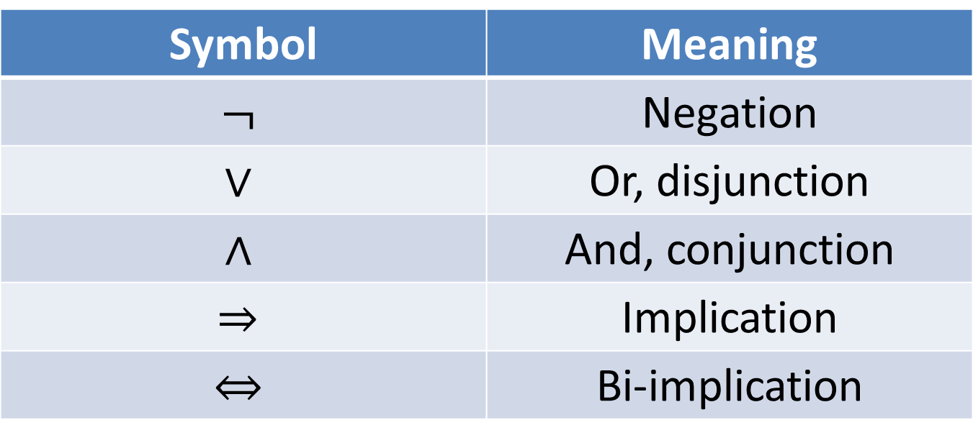
Symbols for Connectives
Symbol | Meaning
$$¬$$ | Negation
$$∨$$ | Or, disjunction
$$∧$$ | And, conjunction
$$⇒$$ | Implication
$$⇔$$ | Bi-implication

Slide 14
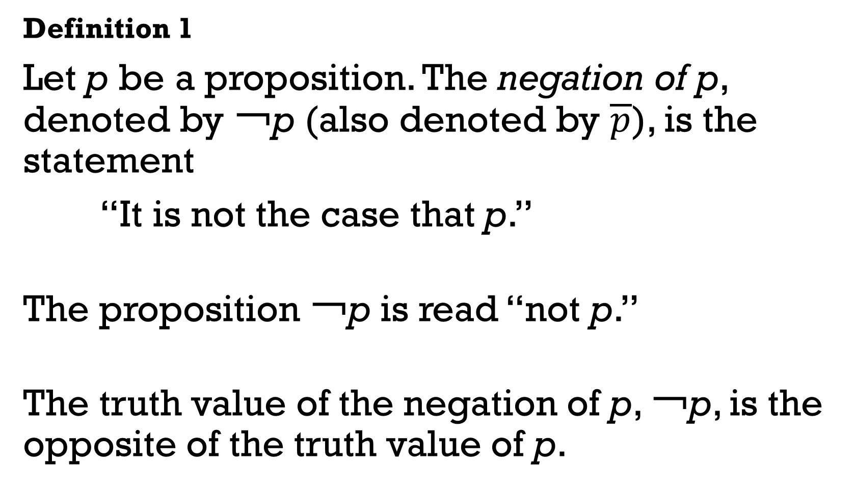
Negation
Definition 1
Let p be a proposition. The negation of p, denoted by ￢p (also denoted by $\overline{p}$), is the statement
“It is not the case that p.”
The proposition ￢p is read “not p.”
The truth value of the negation of p, ￢p, is the opposite of the truth value of p.

Slide 15
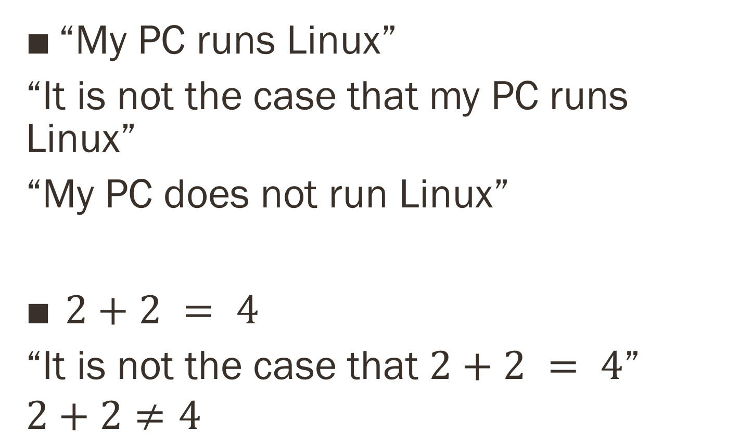
Examples
“My PC runs Linux”
“It is not the case that my PC runs Linux”
“My PC does not run Linux”
$2+2 = 4$
“It is not the case that $2+2 = 4$”
$$2+2≠4$$

Slide 16
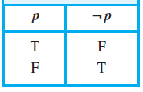

Truth Table for the Negation
Other Notation for negation: $\text{\sim }\text{p}$
What is the negation of “It is not the case that $2+2 = 4$”

Slide 17
The Conjunction
Definition 2
Let p and q be propositions. The conjunction of p and q, denoted by p ∧ q, is the proposition
“p and q.”
The conjunction p ∧ q is true when both p and q are true and is false otherwise.

Slide 18
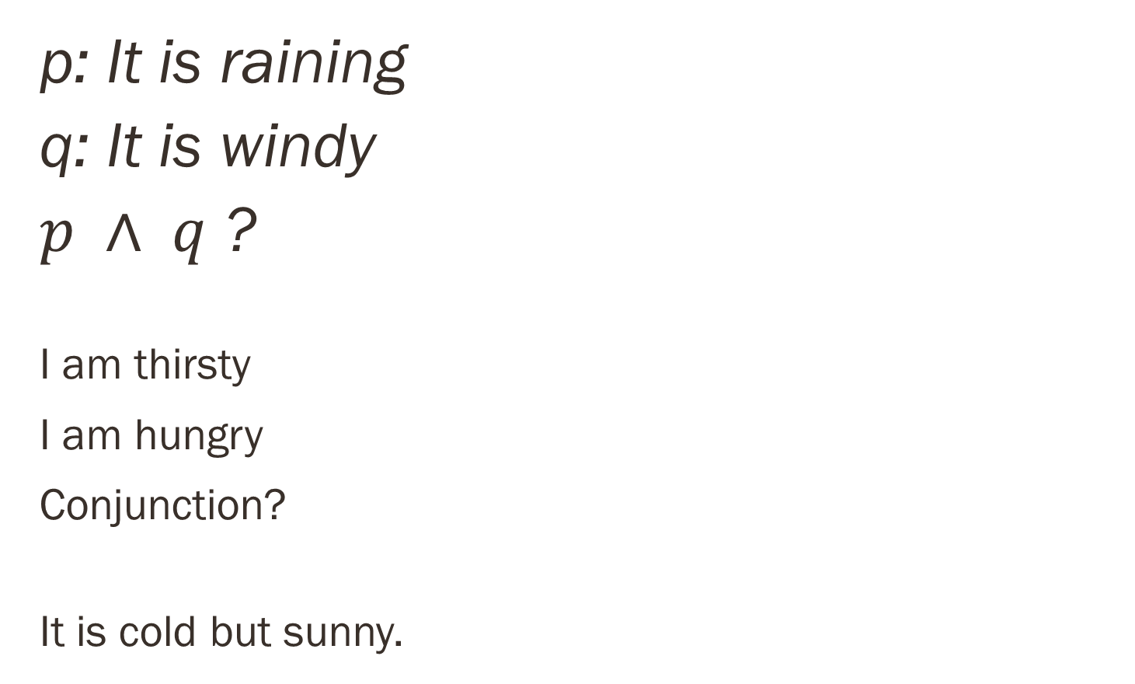
Examples
p: It is raining
q: It is windy
$p ∧ q$ ?
I am thirsty
I am hungry
Conjunction?
It is cold but sunny.

Slide 19
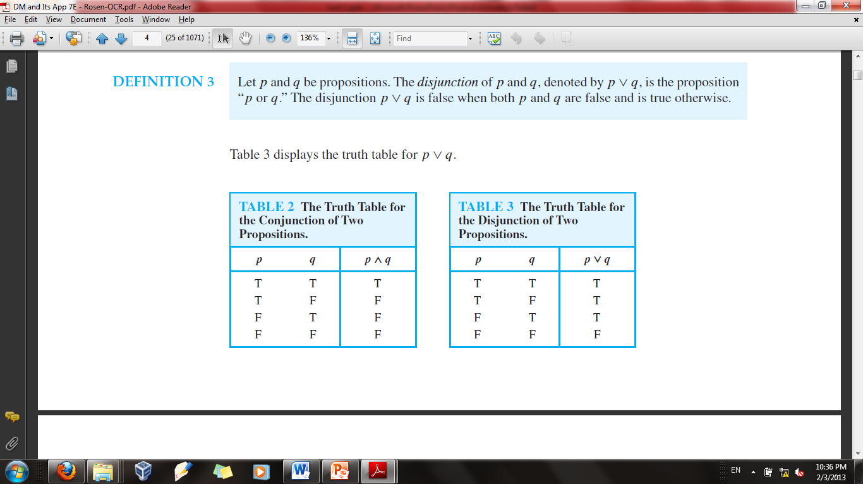
Truth Table
Can you do it for three propositions?
How many possible answers?

Slide 20
The Disjunction
Definition 3
Let p and q be propositions. The disjunction of p and q, denoted by p ∨ q, is the proposition
“p or q.”
The disjunction p ∨ q is false when both p and q are false and is true otherwise.

Slide 21
Truth Table

Slide 22
Inclusive vs. Exclusive
“Students who have taken calculus or computer science can take this class.”
(Inclusive or)
“Students who have taken calculus or computer science, but not both, can enroll in this class.”
Students who have taken either calculus or computer science, can enroll in this class.
(exclusive or)
Notes:
Here, we mean that students who have taken both calculus and computer science can take the
class, as well as the students who have taken only one of the two subjects. On the other hand,
we are using the exclusive or when we say
“Students who have taken calculus or computer science, but not both, can enroll in this
class.”
Here, we mean that students who have taken both calculus and a computer science course cannot
take the class. Only those who have taken exactly one of the two courses can take the class.
Similarly, when a menu at a restaurant states, “Soup or salad comes with an entrée,” the
restaurant almost always means that customers can have either soup or salad, but not both.
Hence, this is an exclusive, rather than an inclusive, or

Slide 23
Exclusive Disjunction
Definition 4:
Let p and q be propositions. The exclusive or of p and q, denoted by p ⊕ q, is the proposition that is true when exactly one of p and q is true and is false otherwise.
Either p or q.
p or q but not both.

Slide 24
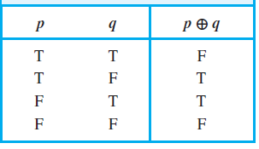
Truth Table
Either p or q.
p or q but not both.

Slide 25
Conditional Statements
Definition 5:
Let p and q be propositions. The conditional statement p → q is the proposition “if p, then q.” The conditional statement p → q is false when p is true and q is false, and true otherwise.
In the conditional statement p → q, p is called the hypothesis (or antecedent or premise) and q is called the conclusion (or consequence).
The statement p → q is called a conditional statement because p → q asserts that q is true on the condition that p holds.
A conditional statement is also called an implication.

Slide 26
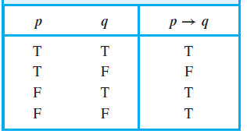
Conditional Statements/ Implication
p: Premise, Hypothesis, antecedent
q: Conclusion, Consequence
The statement p → q is true when
both p and q are true
p is false (no matter what truth value q has)

Slide 27
Example
A useful way to understand the truth value of a conditional statement is to think of an obligation or a contract. For example, the pledge many politicians make when running for office is
“If I am elected, then I will lower taxes.”
If the politician is elected, voters would expect this politician to lower taxes.
Furthermore, if the politician is not elected, then voters will not have any expectation that this person will lower taxes, although the person may have sufficient influence to cause those in power to lower taxes.
It is only when the politician is elected but does not lower taxes that voters can say that the politician has broken the campaign pledge. This last scenario corresponds to the case when p is true but q is false in p → q.

Slide 28
Example
Similarly, consider a statement that a professor might make:
“If you get 100% on the final, then you will get an A.”
If you manage to get a 100% on the final, then you would expect to receive an A. (First condition)
If you do not get 100% you may or may not receive an A depending on other factors. (Third and Fourth condition)
However, if you do get 100%, but the professor does not give you an A, you will feel cheated. (Second condition)

Slide 29
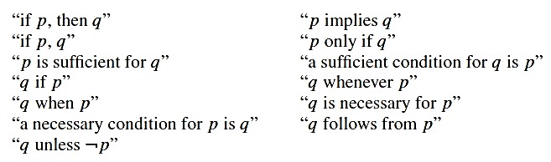
Other forms
Conditional statements play an essential role in mathematical reasoning
Many ways to express an implication (p -> q) :

Slide 30
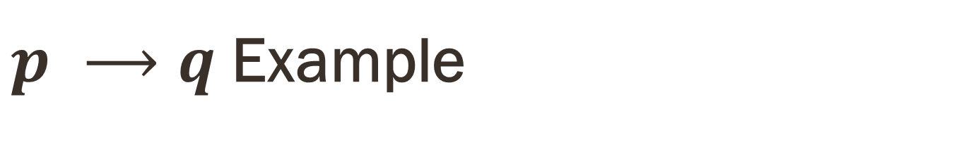
$p ⟶q$Example
Similarly, consider a statement that a professor might make:
“If you get 100% on the final, then you will get an A.”
Let p:= you get 100% on the final
q:= you will get an A
Express the statement p → q as a statement in English.
p implies that q.
you get 100% on the final implies that you will get an A.
If p, then q.
If you get 100% on the final, then that you will get an A.

Slide 31

$p ⟶q$Example Cont.
If p, q.
If you get 100% on the final, that you will get an A.
p is sufficient for q.
Get 100% on the final is sufficient for getting an A.
q only if p.
you will get an A only if you get 100% on the final.
q unless ￢ p.
you will get an A unless you don’t get 100% on final.

Slide 32
Exercise
Translate the propositions into respective formulae
It is raining and windy.
It is sunny but freezing.
Give me tea or coffee.

Slide 33
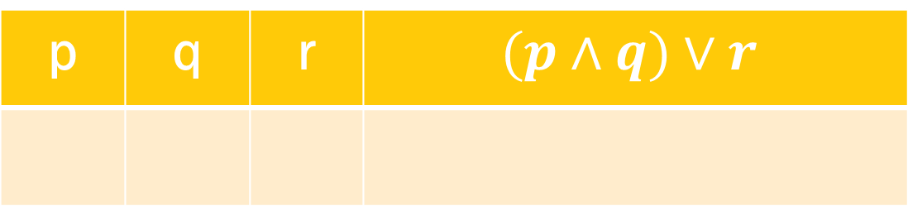
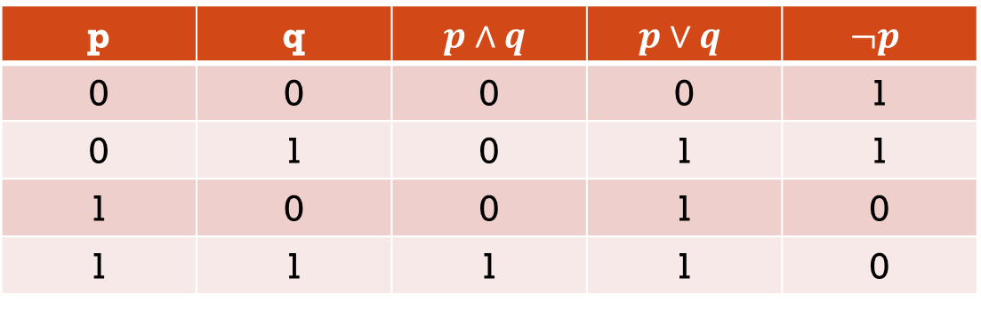
Truth tables
p | q | $$p∧q$$ | $$p∨q$$ | $$¬p$$
0 | 0 | 0 | 0 | 1
0 | 1 | 0 | 1 | 1
1 | 0 | 0 | 1 | 0
1 | 1 | 1 | 1 | 0
Exercise
p | q | r | $$(p∧q)∨r$$

Slide 34
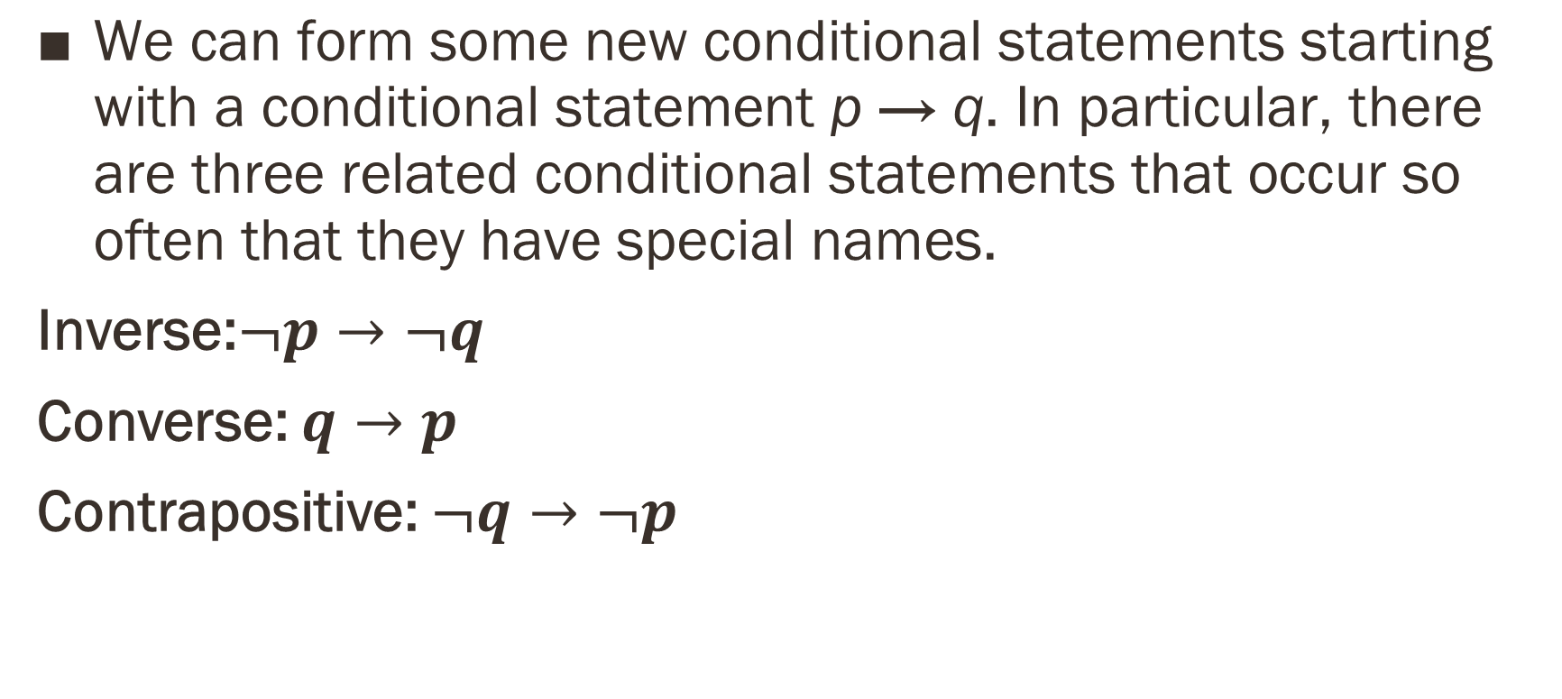
CONVERSE, CONTRAPOSITIVE & INVERSE
$\text{We} \text{can} \text{form} \text{some} \text{new} \text{conditional} \text{statements} \text{starting} \text{with} \text{a} \text{conditional} \text{statement} \text{p} \text{→ }\text{q}\text{. }\text{In} \text{particular}\text{, }\text{there} \text{are} \text{three} \text{related} \text{conditional} \text{statements} \text{that} \text{occur} \text{so} \text{often} \text{that} \text{they} \text{have} \text{special} \text{names}\text{.}$
Inverse:$¬p→¬q$
Converse: $q→p$
Contrapositive: $¬q→¬p$

Slide 35
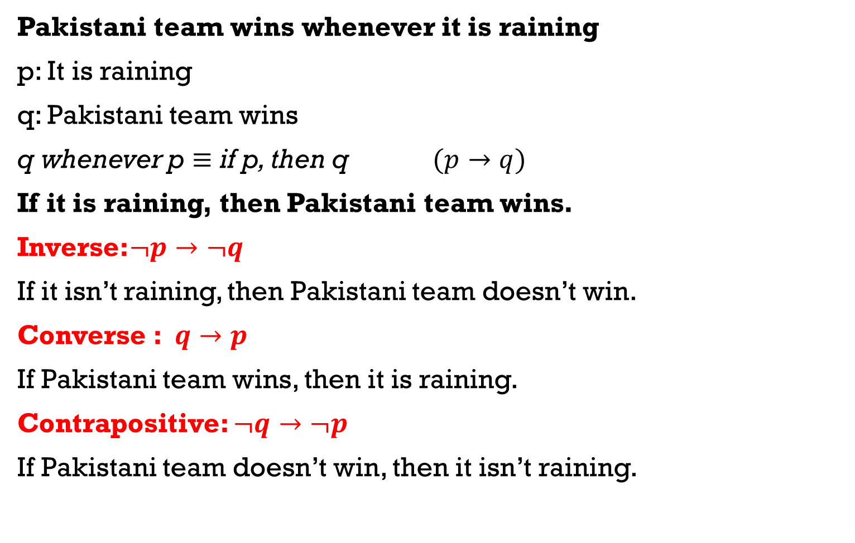
Example
Pakistani team wins whenever it is raining
p: It is raining
q: Pakistani team wins
q whenever p $≡$ if p, then q $(p→q)$
If it is raining, then Pakistani team wins.
Inverse:$¬p→¬q$
If it isn’t raining, then Pakistani team doesn’t win.
Converse : $q→p$
If Pakistani team wins, then it is raining.
Contrapositive: $¬q→¬p$
If Pakistani team doesn’t win, then it isn’t raining.

Slide 36
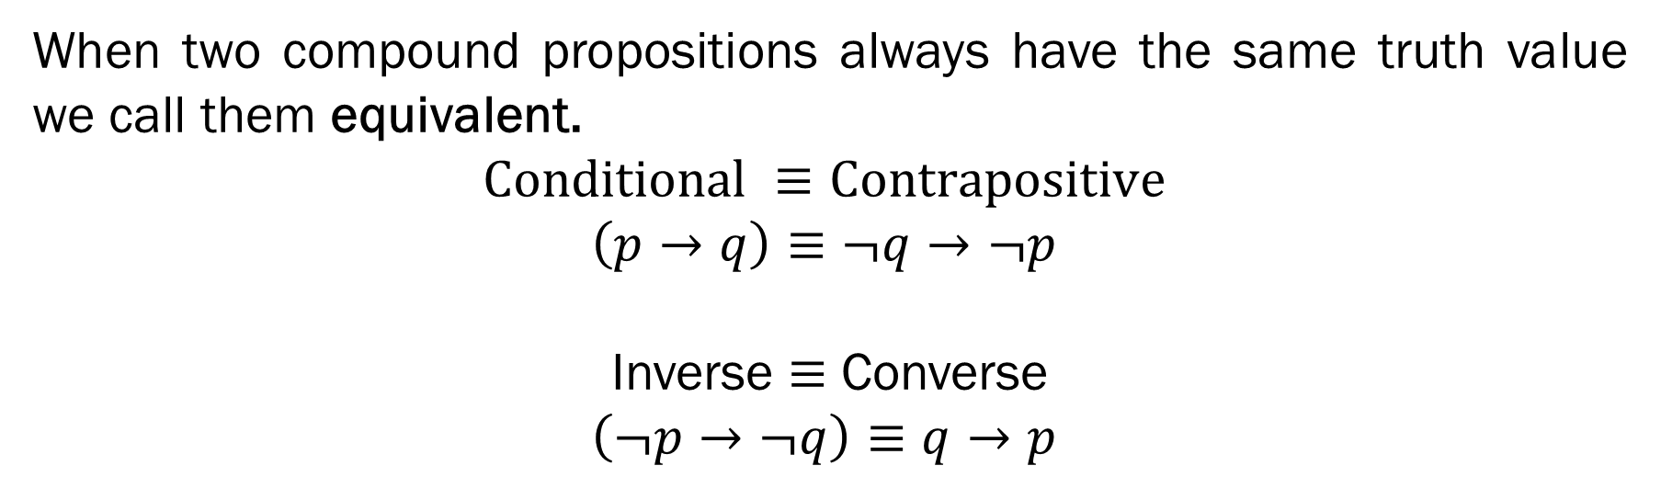
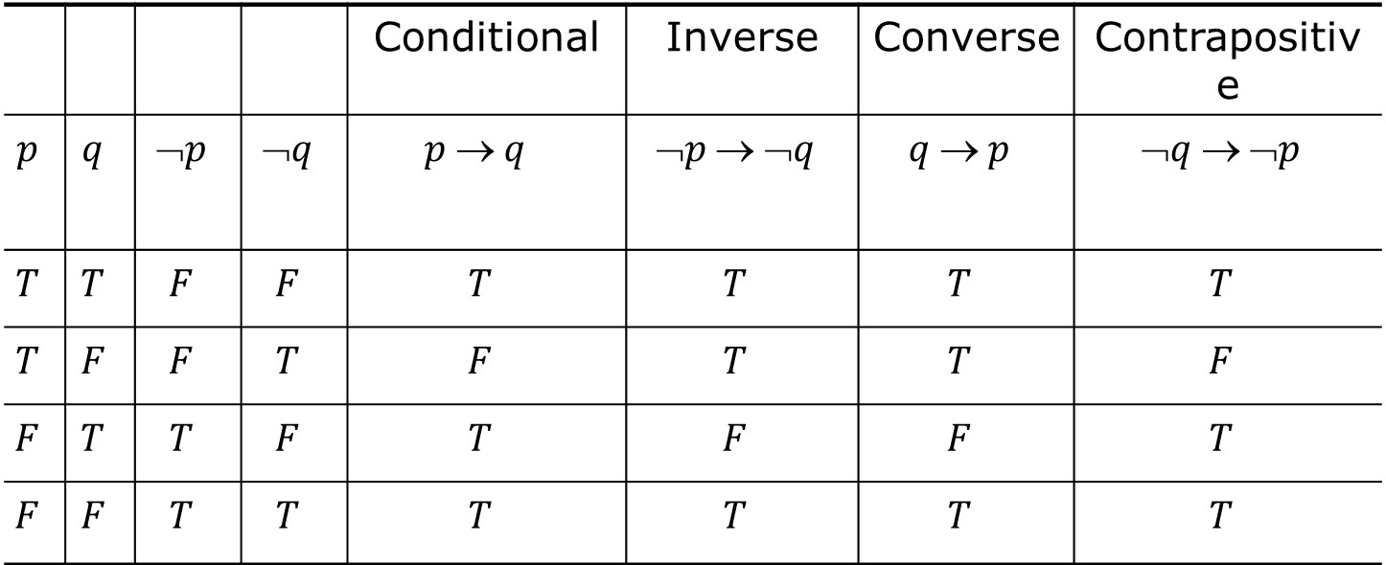
 |  |  |  | Conditional | Inverse | Converse | Contrapositive
$$p$$ | $$q$$ | $$➢p$$ | $$➢q$$ | $$p  q$$ | $$➢p  ➢q$$ | $$q  p$$ | $$➢q  ➢p$$
$$T$$ | $$T$$ | $$F$$ | $$F$$ | $$T$$ | $$T$$ | $$T$$ | $$T$$
$$T$$ | $$F$$ | $$F$$ | $$T$$ | $$F$$ | $$T$$ | $$T$$ | $$F$$
$$F$$ | $$T$$ | $$T$$ | $$F$$ | $$T$$ | $$F$$ | $$F$$ | $$T$$
$$F$$ | $$F$$ | $$T$$ | $$T$$ | $$T$$ | $$T$$ | $$T$$ | $$T$$
When two compound propositions always have the same truth value we call them equivalent.
$$\text{Conditional} ≡\text{Contrapositive}$$
$$\left(p→q\right)≡¬q→¬p$$
Inverse $≡$ Converse
$$\left(¬p→¬q\right)≡q→p$$

Slide 37
Biconditionals
Definition 6
Let p and q be propositions. The biconditional statement p ↔ q is the proposition “p if and only if q.”
The biconditional statement p ↔ q is true when p and q have the same truth values, and is false otherwise.
Biconditional statements are also called bi-implications.

Slide 38
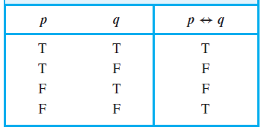
Truth Table
p ↔ q has exactly the same truth value as
(p → q) ∧ (q → p)

Slide 39
Common ways to express p ↔ q
“p is necessary and sufficient for q”
“if p then q, and conversely”
“p iff q”

Slide 40
Example
Let p be the statement “You can take the flight,” and let q be the statement “You buy a ticket.” Then p ↔ q is the statement
“You can take the flight if and only if you buy a ticket.”
p: “You can take the flight”
q: “You buy a ticket”
You can take the flight if and only if you buy a ticket
You can take the flight iff you buy a ticket
The fact that you can take the flight is necessary and sufficient for buying a ticket

Slide 41
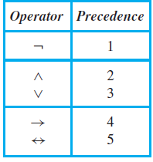
Precedence of Logical Operators

Slide 42
Construct the truth table of the compound proposition
(p ∨ ¬q) → ( p ∧ q )

Slide 43
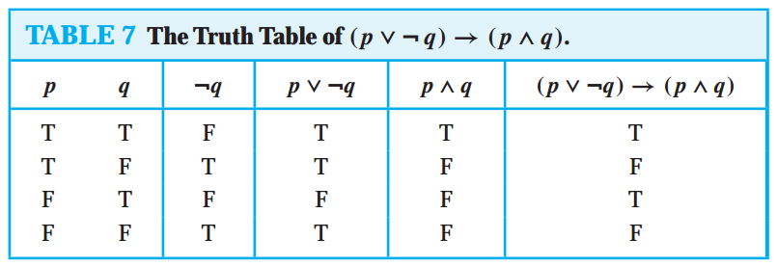
Construct the truth table of the compound proposition
(p ∨ ¬q) → ( p ∧ q )

Slide 44
References
Kenneth Rosen Discrete Mathematics and Its Applications – Chapter # 01

