Slide 1
Lecture 20
Boolean Algebra

Slide 2
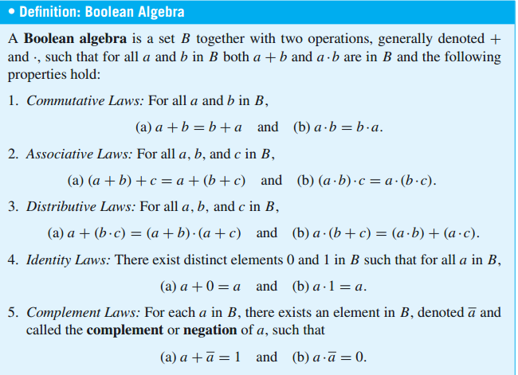
Boolean Algebra
1. Commutative Laws
2. Associative Laws
3. Distributive Laws
4. Identity Laws
5. Complement Laws

Slide 3
Boolean Algebra

Slide 4
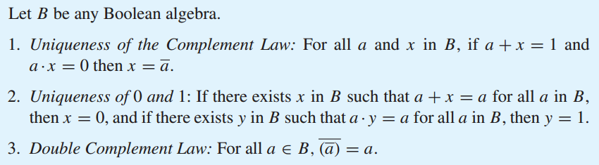
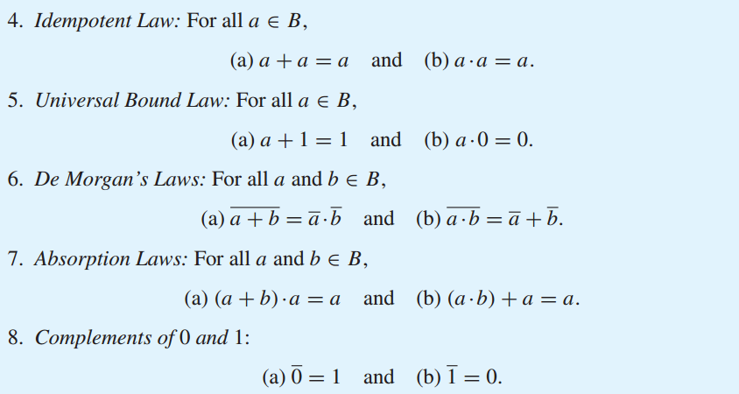
Properties of a Boolean Algebra

Slide 5
Properties of a Boolean Algebra

Slide 6
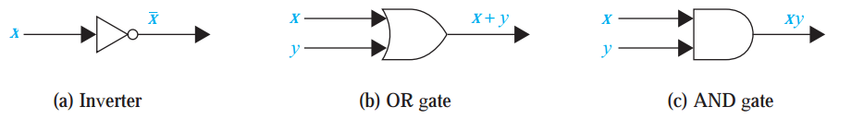
Application of Boolean Algebra
Boolean algebra is used to model the circuitry of electronic devices. Each input and each output of such a device can be thought of as a member of the set {0,1}.
A computer, or other electronic device, is made up of a number of circuits. Each circuit can be designed using the rules of Boolean algebra.

Slide 7
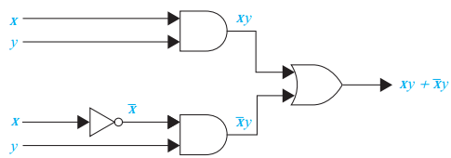
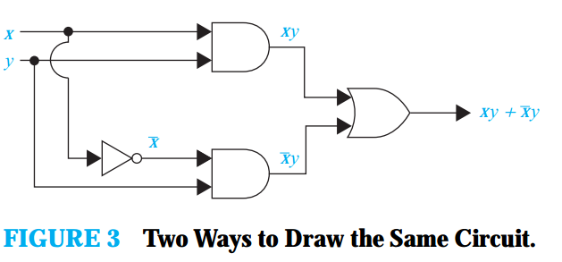
Combinations of Gates
Combinational circuits can be constructed using a combination of inverters, OR gates, and AND gates. When combinations of circuits are formed, some gates may share inputs.
Note also that output from a gate may be used as input by one or more other elements, as shown below. Both drawings depict the circuit that produces the output

Slide 8

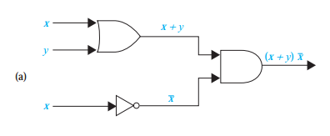

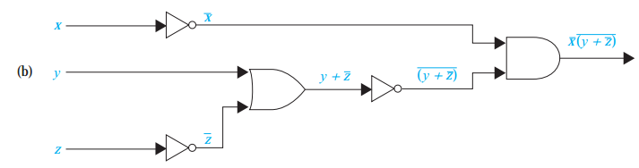
Combinations of Gates

Slide 9
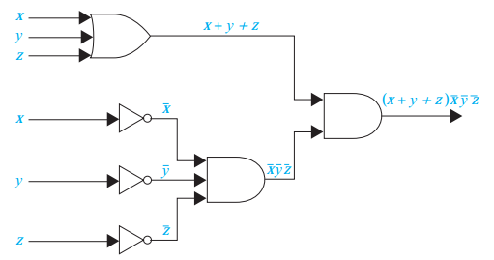
Combinations of Gates

Slide 10
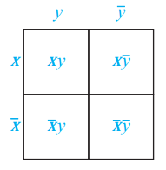
Karnaugh Maps
To reduce the number of terms in a Boolean expression representing a circuit, it is necessary to find terms to combine.
There is a graphical method, called a Karnaugh map or K-map, for finding terms to combine for Boolean functions involving a relatively small number of variables.
There are four possible min terms in the sum-of-products expansion of a Boolean function in the two variables x and y.
A K-map for a Boolean function in these two variables consists of four cells, where a 1 is placed in the cell representing a minterm if this minterm is present in the expansion.
K-maps in Two Variables.

Slide 11
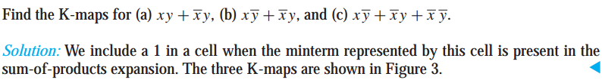
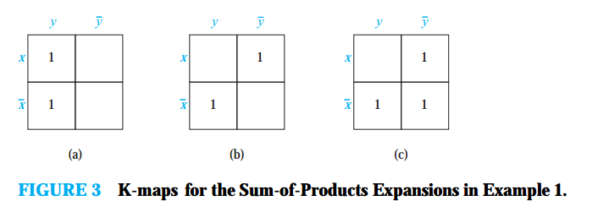
We can identify minterms that can be combined from the K-map. Whenever there are 1s
in two adjacent cells in the K-map, the minterms represented by these cells can be combined
into a product involving just one of the variables. For instance, xyandxyare represented by
adjacent cells and can be combined intoy, becausexy+xy=(x+x)y=y. Moreover, if 1s are in all four cells, the four minterms can be combined into one term, namely, the Boolean
expression 1 that involves none of the variables. We circle blocks of cells in the K-map that
represent minterms that can be combined and then find the corresponding sum of products. The
goal is to identify the largest possible blocks, and to cover all the 1s with the fewest blocks using
the largest blocks first and always using the largest possible blocks.

Slide 12
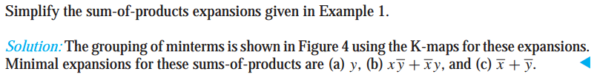
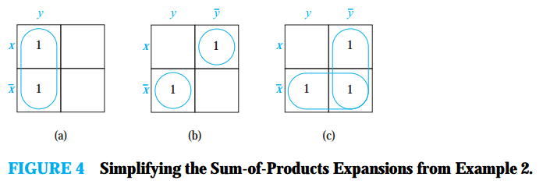

Slide 13
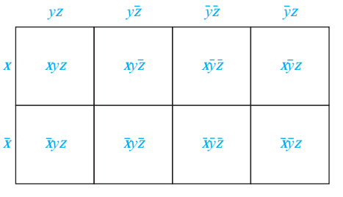
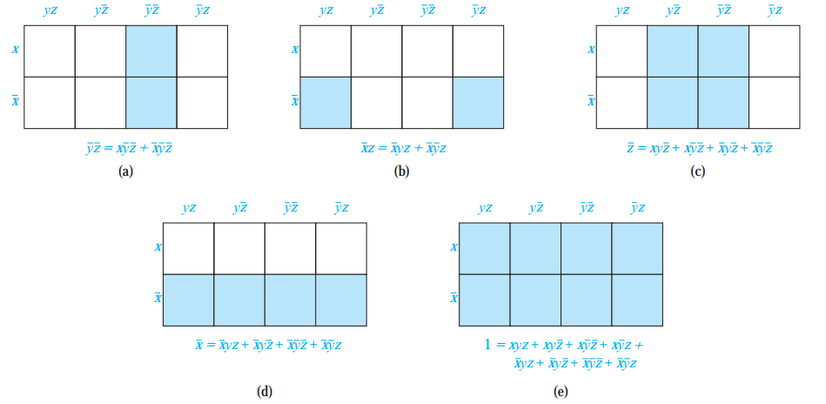
K-map in three variables
A K-map in three variables is a rectangle divided into eight cells.
The goal is to identify the largest possible blocks in the map and cover all the 1s in the map with the least number of blocks, using the largest blocks first. The largest possible blocks are always chosen, but we must always choose a block if it is the only block of 1s covering a 1 in the K-map.

Slide 14
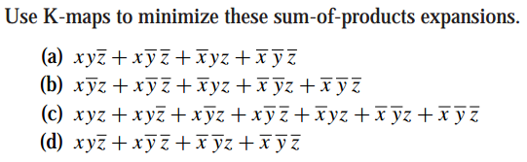
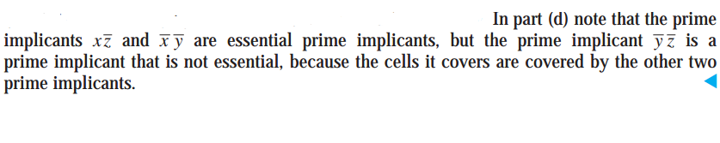
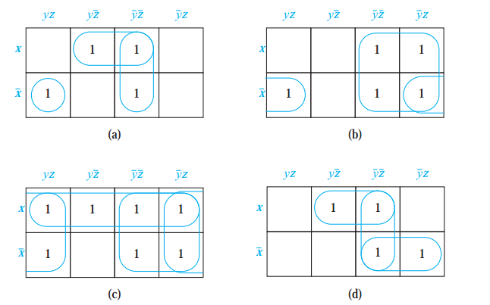
The grouping of blocks shows that minimal expansions into Boolean sums of Boolean products are
RULES
No zeros allowed.
No diagonals.
Only power of 2 number of cells in each group.
Groups should be as large as possible.
Every 1 must be in at least one group.
Overlapping allowed.
Wrap around allowed.
Fewest number of groups possible.

Slide 15
REFERENCES
Kenneth Rosen Discrete Mathematics and Its Applications – Chapter # 13
Discrete Mathematics with Applications by Susanna (4e)– Chapter # 12

