Slide 1
Lecture 3
Application of Propositional Logic

Slide 2
Applications of Propositional Logic
Statements in mathematics and the sciences and in natural language often are imprecise or ambiguous. To make such statements precise, they can be translated into the language of logic.
For example, logic is used in the specification of software and hardware, because these specifications need to be precise.
Furthermore, propositional logic and its rules can be used to design computer circuits, to construct computer programs, to verify the correctness of programs, and to build expert systems.
Logic can be used to analyze and solve many familiar puzzles.

Slide 3
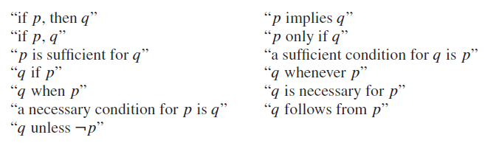

Translating English Sentences
You can access the Internet from campus only if you are a computer science major or you are not a freshman.
$a:$ You can access the Internet from campus
$c:$ You are a computer science major
$f:$ you are a freshman

Slide 4

Translating English Sentences
You can access the Internet from campus only if you are a computer science major or you are not a freshman.
$a:$ You can access the Internet from campus
$c:$ You are a computer science major
$f:$ you are a freshman
$$a→ (c∨¬f)$$

Slide 5
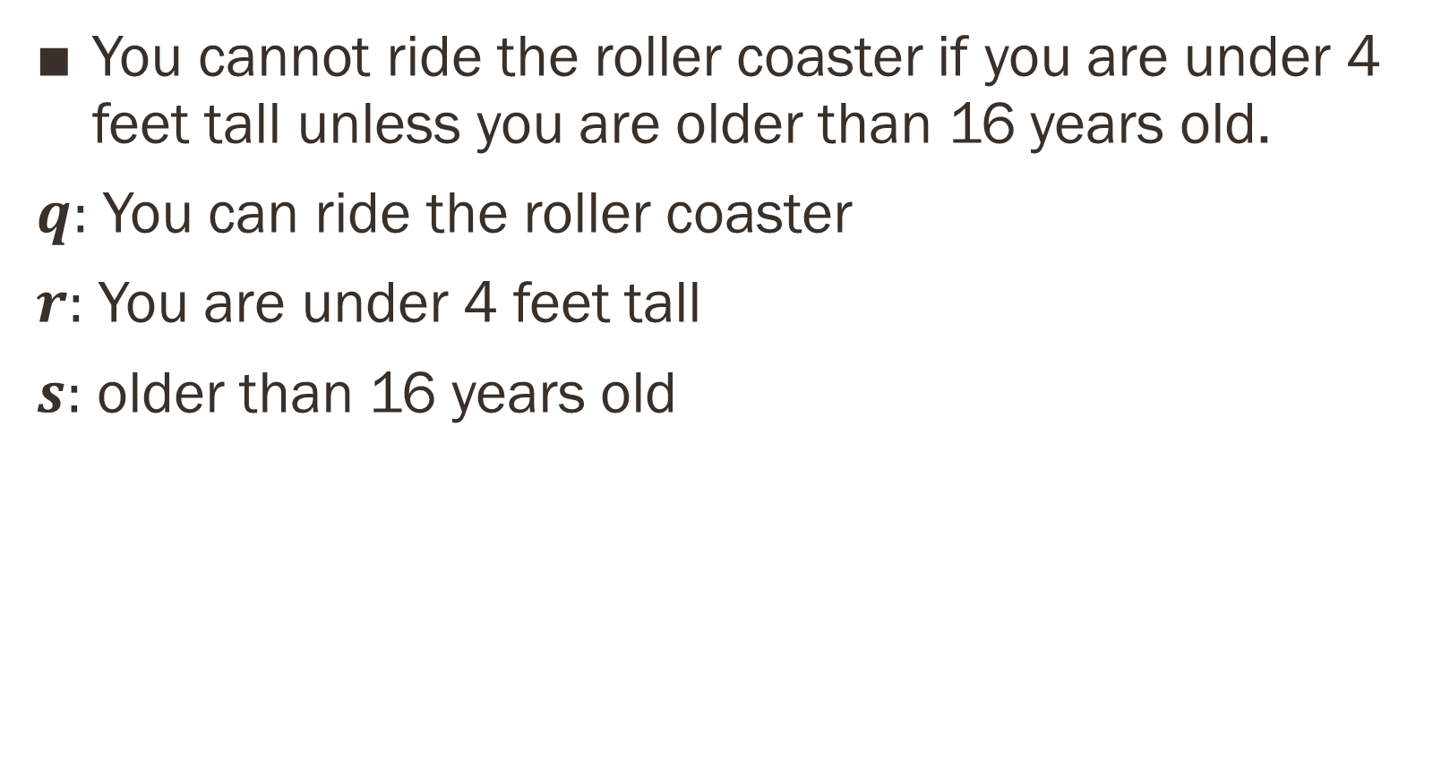
You cannot ride the roller coaster if you are under 4 feet tall unless you are older than 16 years old.
$q:$ You can ride the roller coaster
$r:$ You are under 4 feet tall
$s:$ older than 16 years old

Slide 6
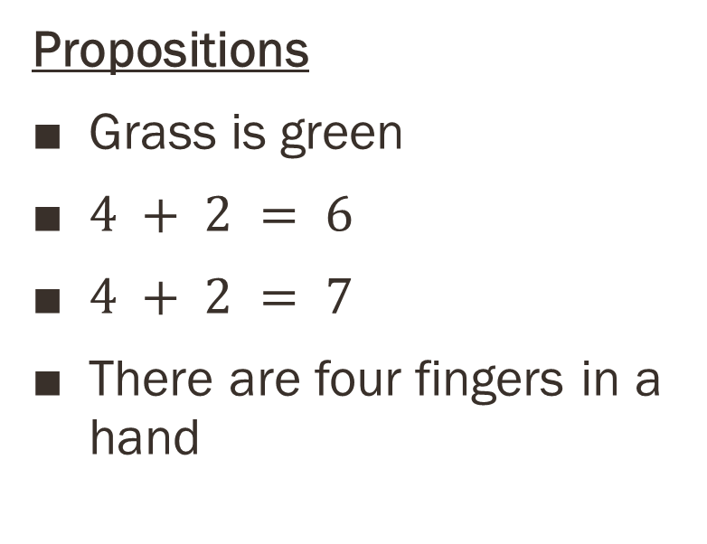
You cannot ride the roller coaster if you are under 4 feet tall unless you are older than 16 years old.
$q:$ You can ride the roller coaster
$r:$ You are under 4 feet tall
$s:$ older than 16 years old
$$(r∧¬s)→¬q$$

Slide 7
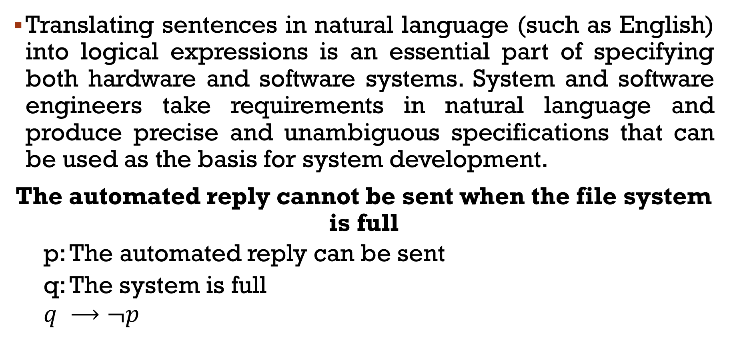
System Specifications
Translating sentences in natural language (such as English) into logical expressions is an essential part of specifying both hardware and software systems. System and software engineers take requirements in natural language and produce precise and unambiguous specifications that can be used as the basis for system development.
The automated reply cannot be sent when the file system is full
p: The automated reply can be sent
q: The system is full
$$q ⟶¬p$$

Slide 8
Consistency
System specifications should be consistent,
They should not contain conflicting requirements that could be used to derive a contradiction.
When specifications are not consistent, there would be no way to develop a system that satisfies all specifications.

Slide 9
Determine whether these system specifications are consistent:
The diagnostic message is stored in the buffer or it is retransmitted.
The diagnostic message is not stored in the buffer.
If the diagnostic message is stored in the buffer, then it is retransmitted.

Slide 10
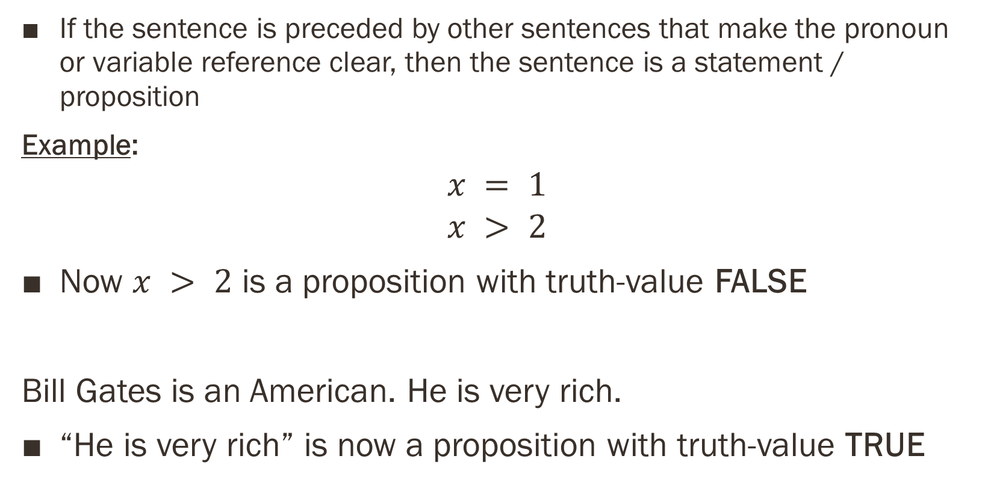
Determine whether these system specifications are consistent:
The diagnostic message is stored in the buffer or it is retransmitted.
The diagnostic message is not stored in the buffer.
If the diagnostic message is stored in the buffer, then it is retransmitted.
p: The diagnostic message is stored in the buffer
q: The diagnostic message is retransmitted
1. $p∨q$ 2. $¬p$ 3. $p→q$

Slide 11
1. $p∨q$ 2. $¬p$ 3. $p→q$
Reasoning
An assignment of truth values that makes all three specifications true must have p false to make $￢p$ true.
Because we want $p ∨ q$ to be true but $p$ must be false, q must be true.
Because $p → q$ is true when $p$ is false and $q$ is true
we conclude that these specifications are consistent
Let us do it with truth table now???

Slide 12
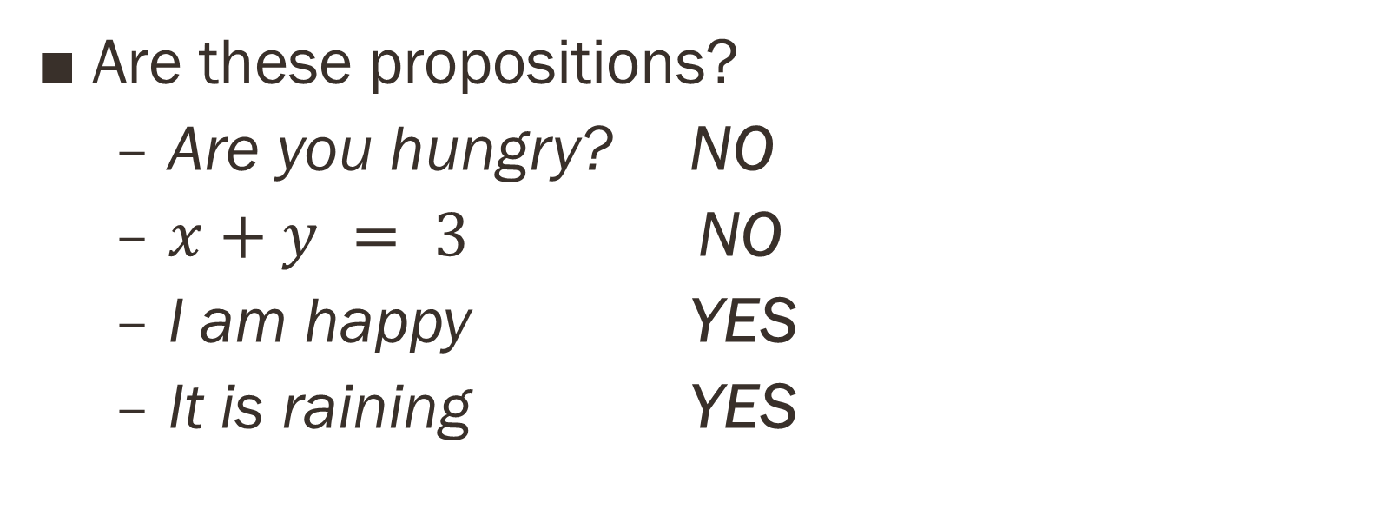
Does it remain consistent if the specification
“The diagnostic message is not retransmitted” is added?
The diagnostic message is stored in the buffer or it is retransmitted.
The diagnostic message is not stored in the buffer.
If the diagnostic message is stored in the buffer, then it is retransmitted.
p: The diagnostic message is stored in the buffer
q: The diagnostic message is retransmitted
1. $p∨q$ 2. $¬p$ 3. $p→q$ 4. $¬q$

Slide 13
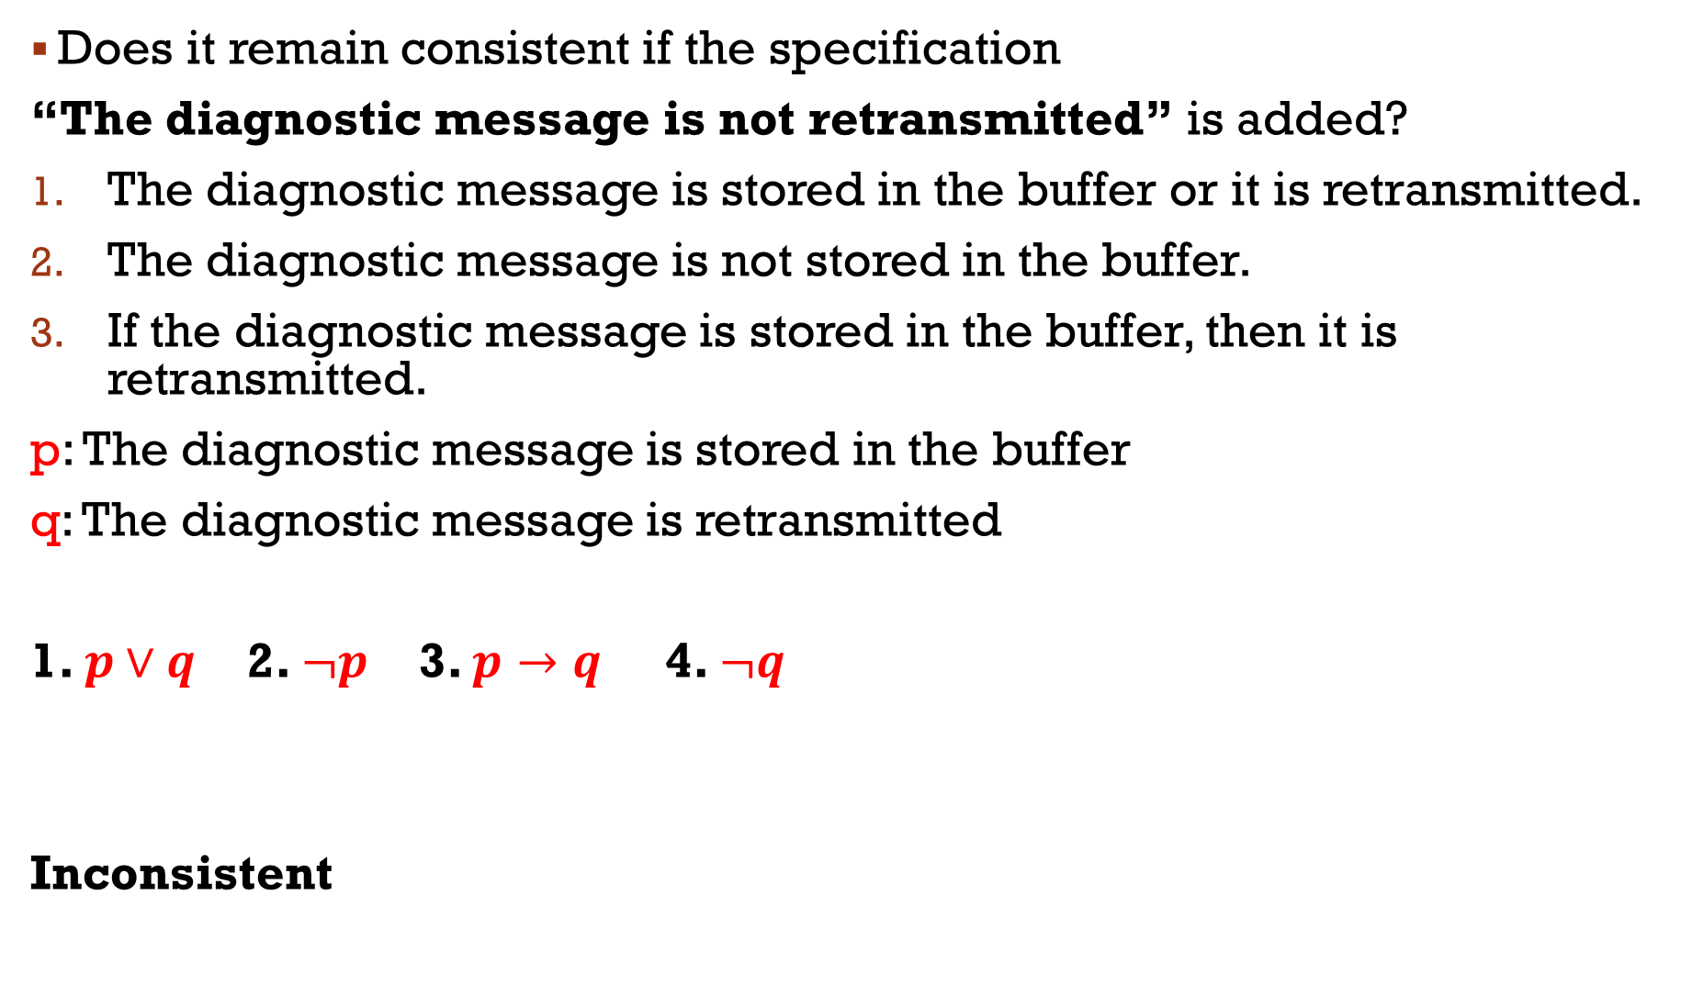
Does it remain consistent if the specification
“The diagnostic message is not retransmitted” is added?
The diagnostic message is stored in the buffer or it is retransmitted.
The diagnostic message is not stored in the buffer.
If the diagnostic message is stored in the buffer, then it is retransmitted.
p: The diagnostic message is stored in the buffer
q: The diagnostic message is retransmitted
1. $p∨q$ 2. $¬p$ 3. $p→q$ 4. $¬q$
Inconsistent

Slide 14
Logic Puzzles (Do it yourself)
An island has two kinds of inhabitants,
Knights, who always tell the truth
Knaves, who always lie.
You encounter two people A and B.
What are A and B if
A says “B is a knight”
B says “The two of us are opposite types?

Slide 15

A says “B is a knight”
B says “The two of us are opposite types?
p: A is a knight $¬p$: A is a knave
q: B is a knight $¬q$: B is a knave

Slide 16
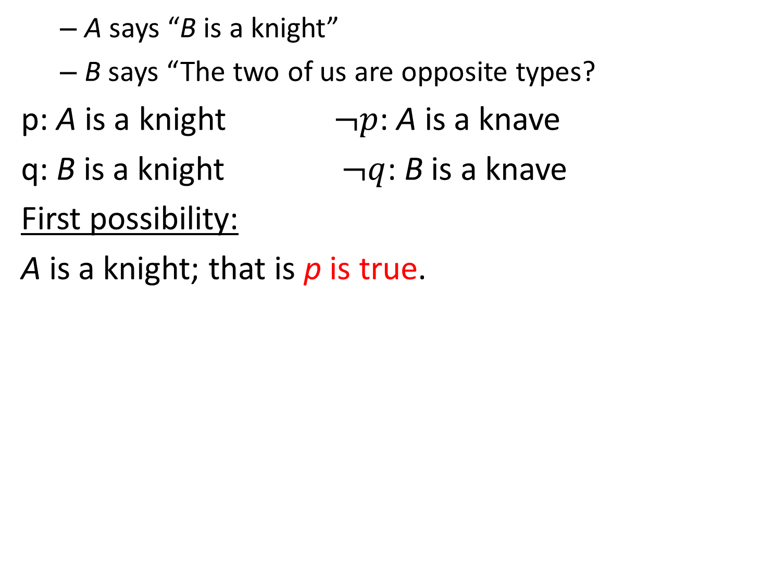
A says “B is a knight”
B says “The two of us are opposite types?
p: A is a knight $¬p$: A is a knave
q: B is a knight $¬q$: B is a knave
First possibility:
A is a knight; that is p is true.

Slide 17
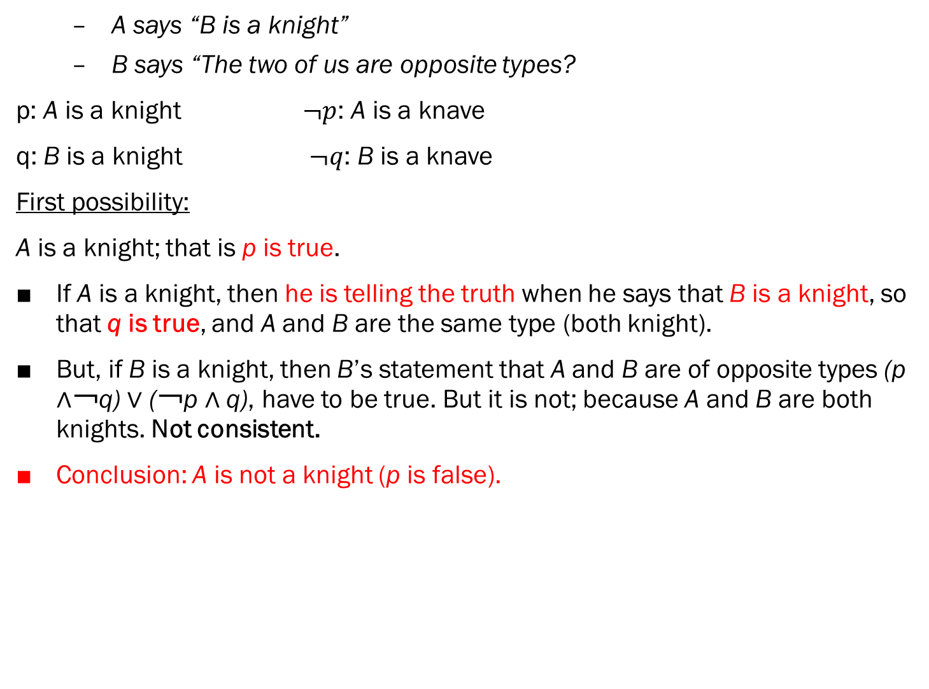
A says “B is a knight”
B says “The two of us are opposite types?
p: A is a knight $¬p$: A is a knave
q: B is a knight $¬q$: B is a knave
First possibility:
A is a knight; that is p is true.
If A is a knight, then he is telling the truth when he says that B is a knight, so that q is true, and A and B are the same type (both knight).
But, if B is a knight, then B’s statement that A and B are of opposite types (p ∧￢q) ∨ (￢p ∧ q), have to be true. But it is not; because A and B are both knights. Not consistent.
Conclusion: A is not a knight (p is false).

Slide 18
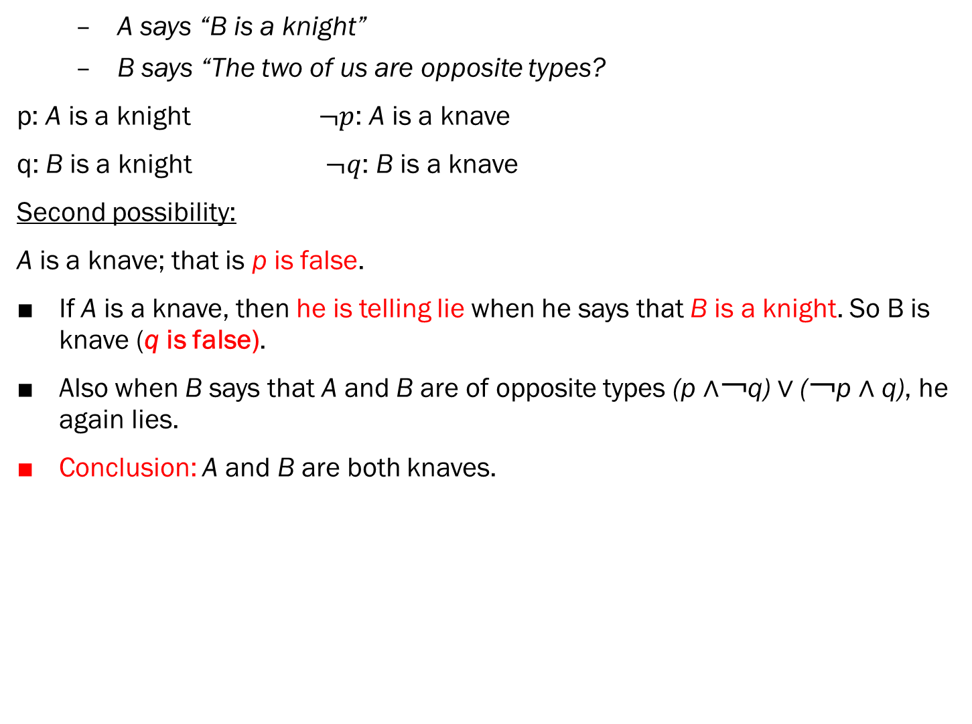
A says “B is a knight”
B says “The two of us are opposite types?
p: A is a knight $¬p$: A is a knave
q: B is a knight $¬q$: B is a knave
Second possibility:
A is a knave; that is p is false.
If A is a knave, then he is telling lie when he says that B is a knight. So B is knave (q is false).
Also when B says that A and B are of opposite types (p ∧￢q) ∨ (￢p ∧ q), he again lies.
Conclusion: A and B are both knaves.

Slide 19
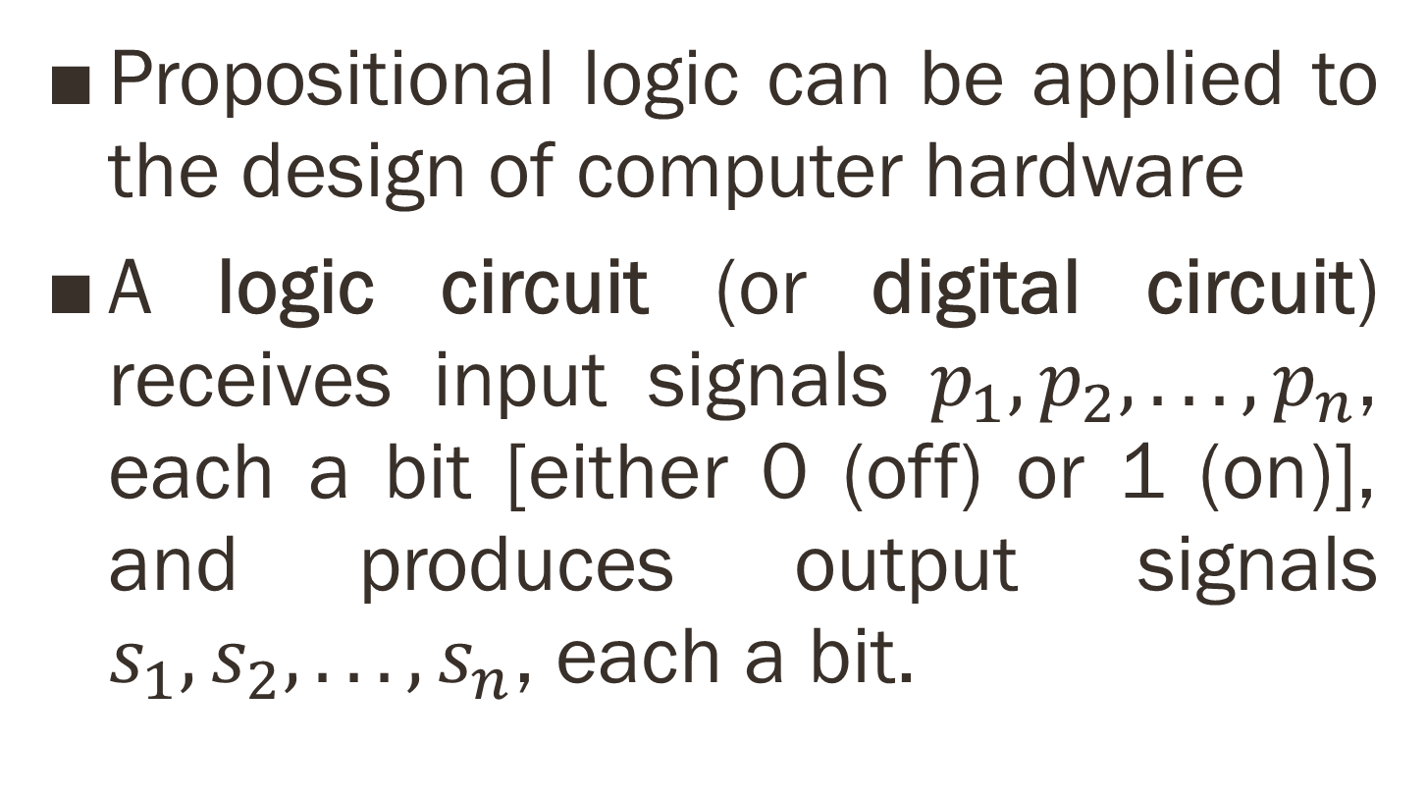
Logic Circuits
Propositional logic can be applied to the design of computer hardware
A logic circuit (or digital circuit) receives input signals $p_{1}, p_{2}, . . . , p_{n}$, each a bit [either 0 (off) or 1 (on)], and produces output signals $s_{1}, s_{2}, . . . , s_{n}$, each a bit.

Slide 20
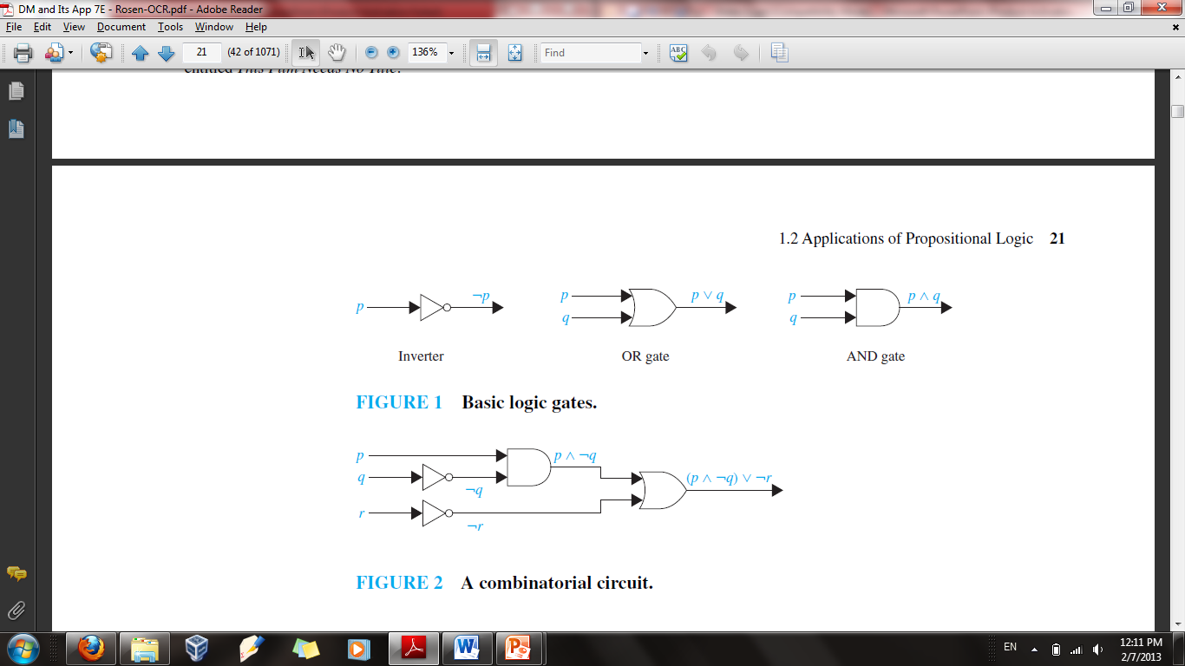
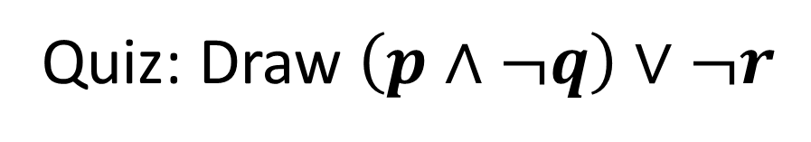
Quiz: Draw $\left(p∧¬q\right)∨¬r$

Slide 21
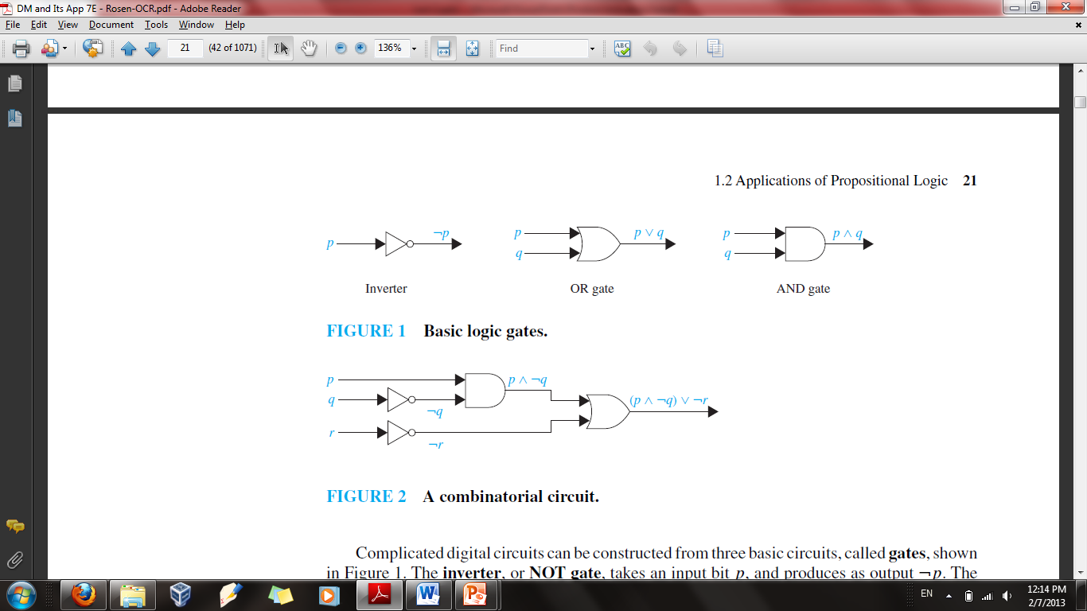
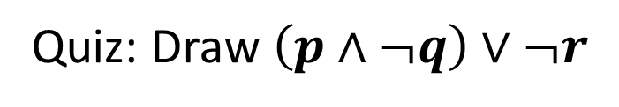
Quiz: Draw $\left(p∧¬q\right)∨¬r$

Slide 22
1.3 Propositional Equivalence
An important type of step used in a mathematical argument is the replacement of a statement with another statement with the same truth value
Propositional Equivalence is extensively used in the construction of mathematical arguments.

Slide 23
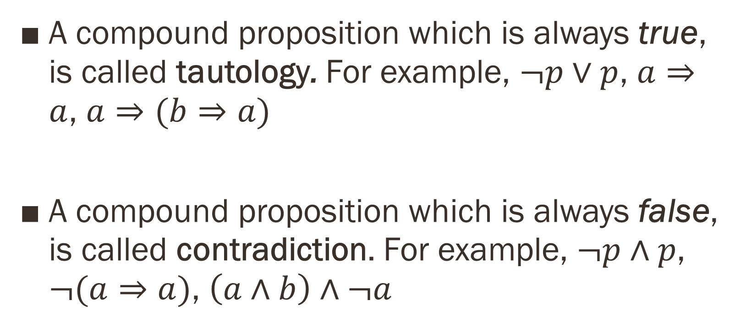
Tautology and Contradiction
A compound proposition which is always true, is called tautology. For example, $¬p∨p$, $a⇒a$, $a⇒(b⇒a)$
A compound proposition which is always false, is called contradiction. For example, $¬p∧p$, $¬(a⇒a)$, $\left(a∧b\right)∧¬a$

Slide 24
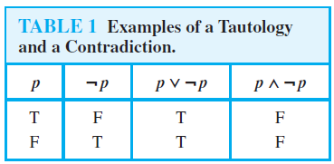
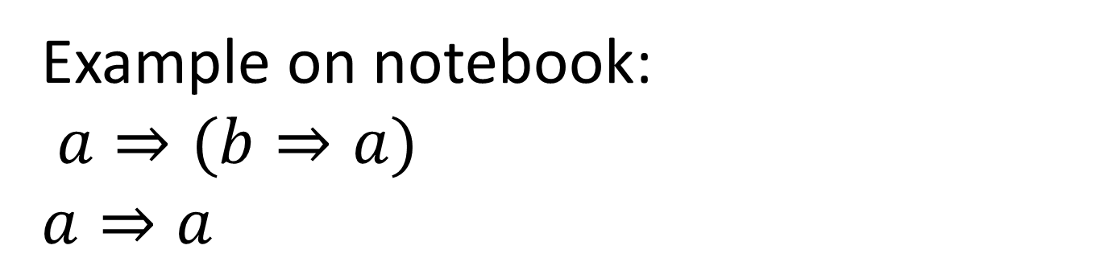
Example on notebook:
$a⇒(b⇒a)$
$$a⇒a$$

Slide 25
Logical Equivalences
Compound propositions that have the same truth values in all possible cases are called logically equivalent.
The compound propositions p and q are called logically equivalent if p ↔ q is a tautology.
The notation p ≡ q denotes that p and q are logically equivalent.

Slide 26
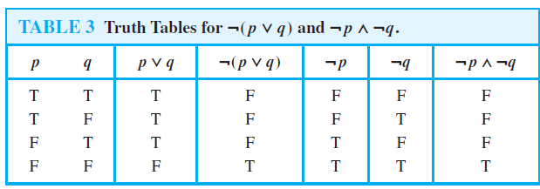

Show that $¬\left(p∨q\right)≡¬p∧¬q$

Slide 27

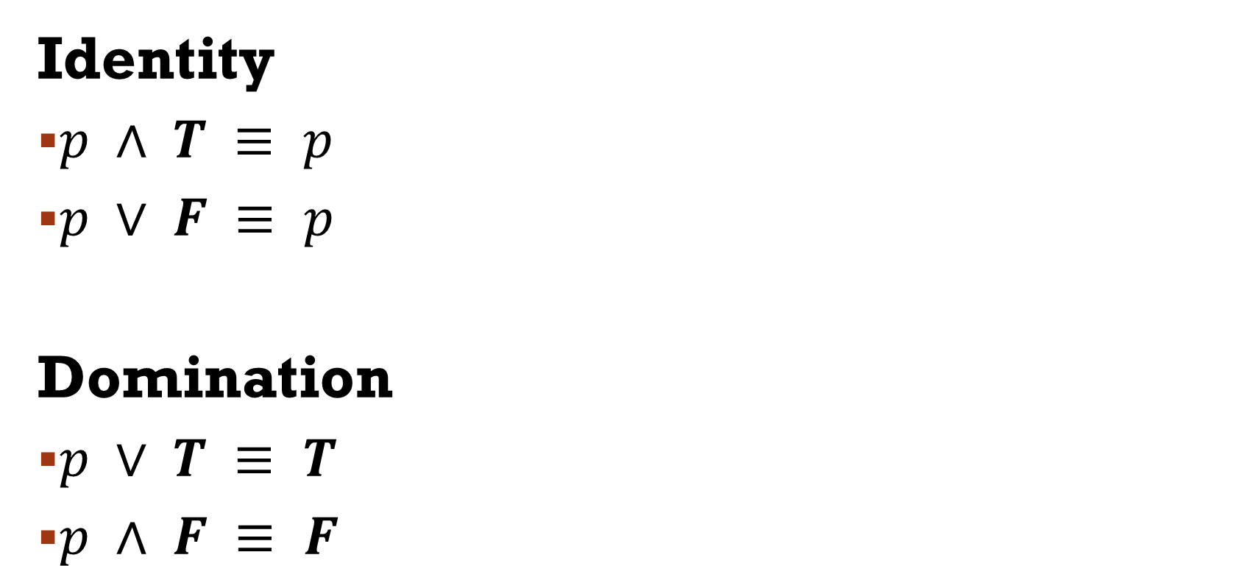
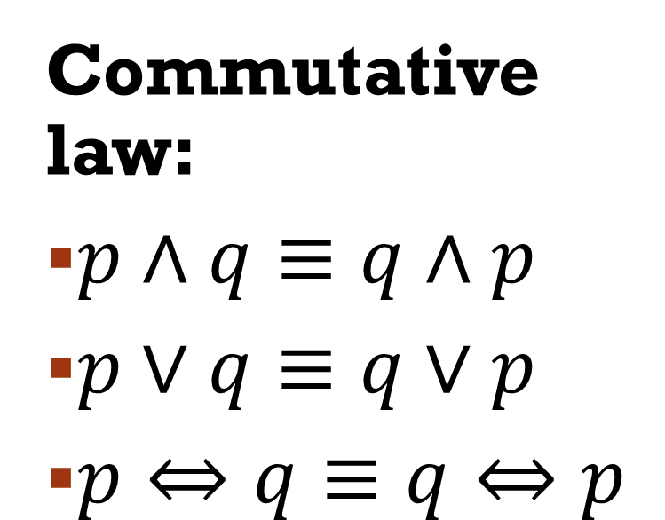
Standard equivalences
Idempotence
$p∧p≡p$
$p∨p≡p$
Double Negation
$¬¬p≡p$
Commutative law:
$p∧q≡q∧p$
$p∨q≡q∨p$
$p⇔q≡q⇔p$
Identity
$p ∧ T ≡ p$
$p ∨ F ≡ p$
Domination
$p ∨ T ≡ T$
$p ∧ F ≡ F$

Slide 28

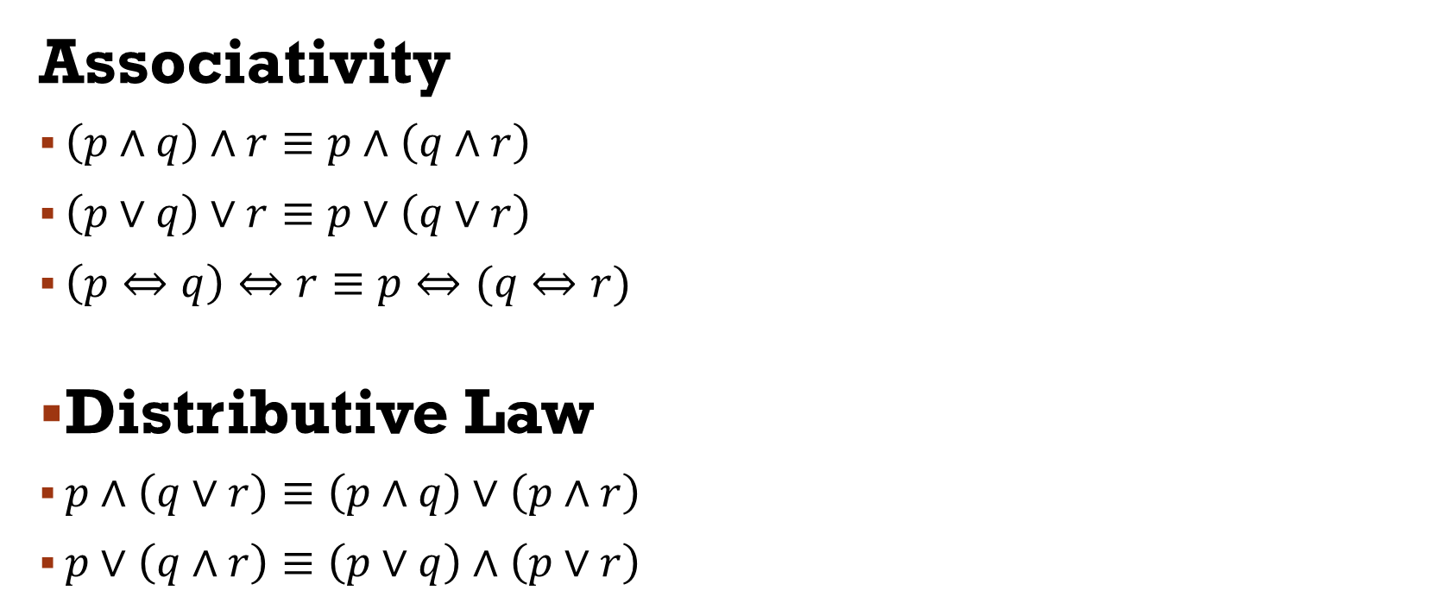
Standard equivalences
Inversion $¬T≡F$ $¬F≡T$
Negation $¬p ≡ (p⇒F)$
Contradiction $p∧¬p ≡ F$
Associativity
$\left(p∧q\right)∧r≡p∧\left(q∧r\right)$
$\left(p∨q\right)∨r≡p∨\left(q∨r\right)$
$\left(p⇔q\right)⇔r≡p⇔(q⇔r)$
Distributive Law
$p∧\left(q∨r\right)≡\left(p∧q\right)∨\left(p∧r\right)$
$p∨\left(q∧r\right)≡\left(p∨q\right)∧\left(p∨r\right)$

Slide 29
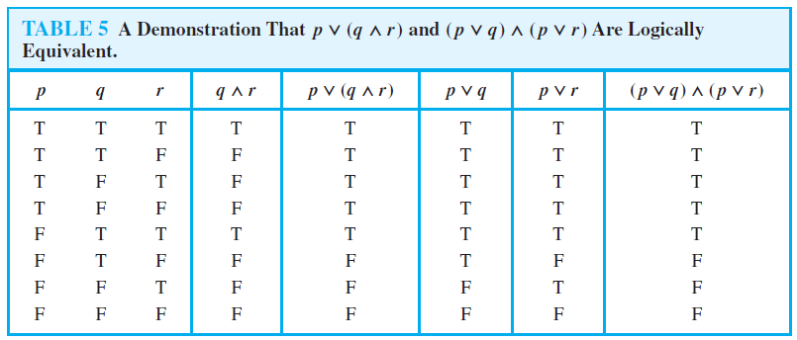
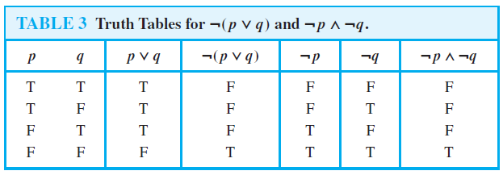

Slide 30
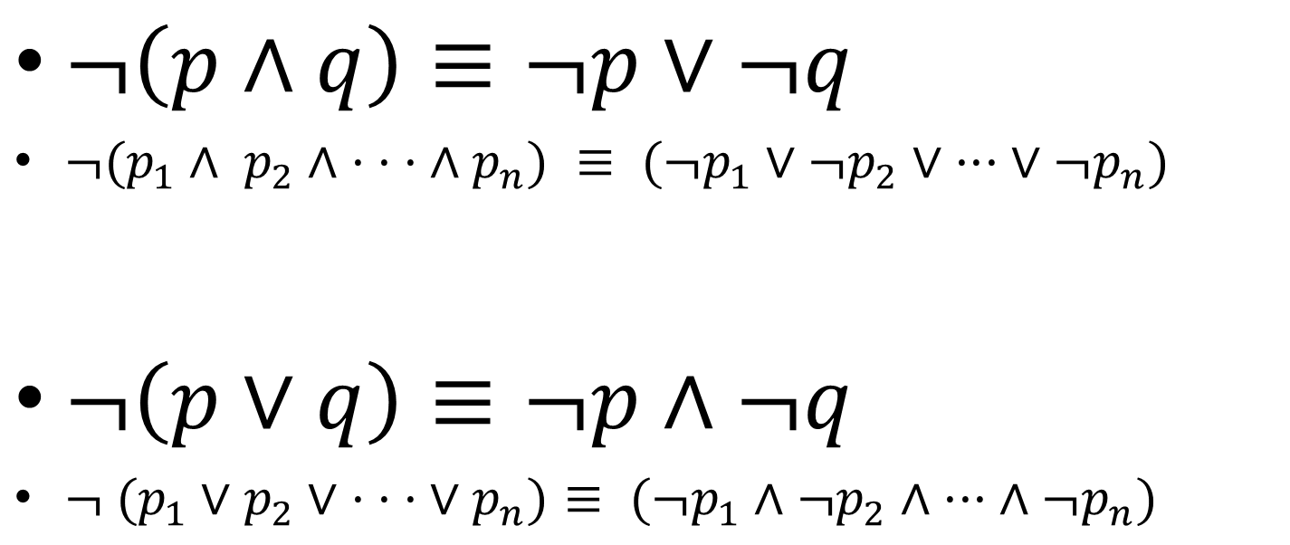
De Morgan’s Law
$¬\left(p∧q\right)≡¬p∨¬q$
$¬(p_{1}∧ p_{2}∧ · · · ∧p_{n}) ≡ (¬p_{1}∨¬p_{2}∨ ··· ∨¬p_{n})$
$¬\left(p∨q\right)≡¬p∧¬q$
$¬ (p_{1}∨p_{2}∨ · · · ∨p_{n})≡ (¬p_{1}∧¬p_{2}∧ ··· ∧{¬p}_{n})$

Slide 31


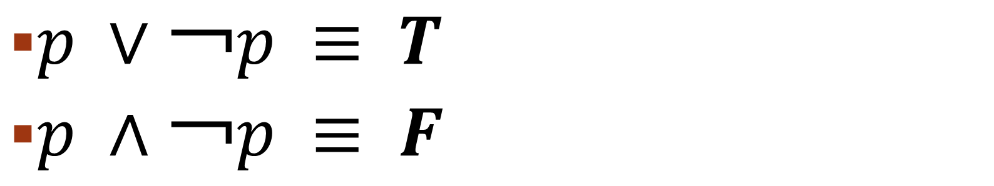
Absorption laws
$p ∨ (p ∧ q) ≡ p$
$p ∧ \left(p ∨ q\right)≡ p$
Negation laws
$p ∨￢p ≡ T$
$p ∧￢p ≡ F$

Slide 32
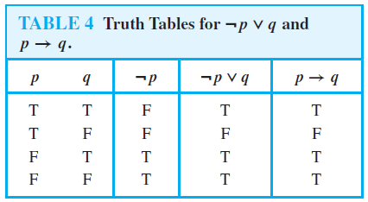

Implication
$p⇒q≡¬p∨q$
$p∨q≡¬p⇒q$

Slide 33
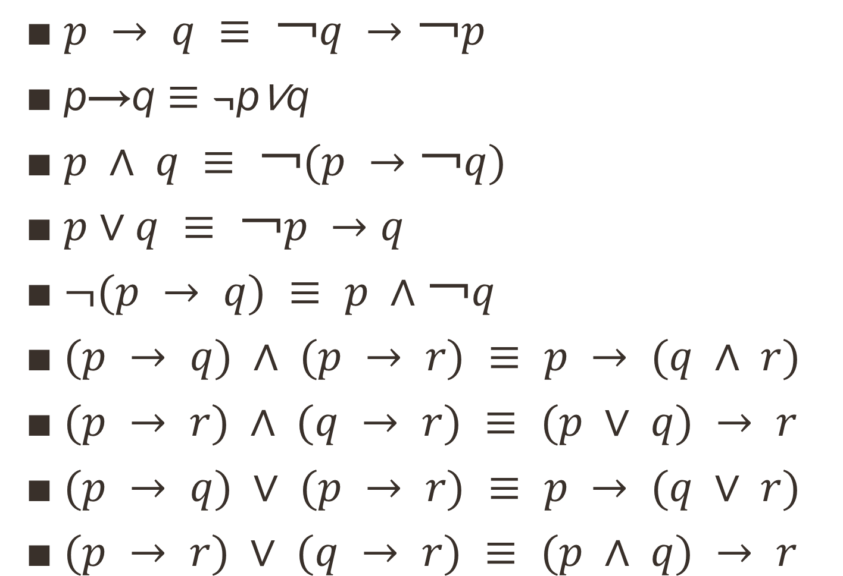
More Implication Laws
$p → q ≡ ￢q →￢p$
p→q $≡$¬p∨q
$p ∧ q ≡ ￢(p →￢q)$
$p∨q ≡ ￢p →q$
$¬(p → q) ≡ p ∧￢q$
$(p → q) ∧ (p → r) ≡ p → (q ∧ r)$
$(p → r) ∧ (q → r) ≡ (p ∨ q) → r$
$(p → q) ∨ (p → r) ≡ p → (q ∨ r)$
$(p → r) ∨ (q → r) ≡ (p ∧ q) → r$

Slide 34
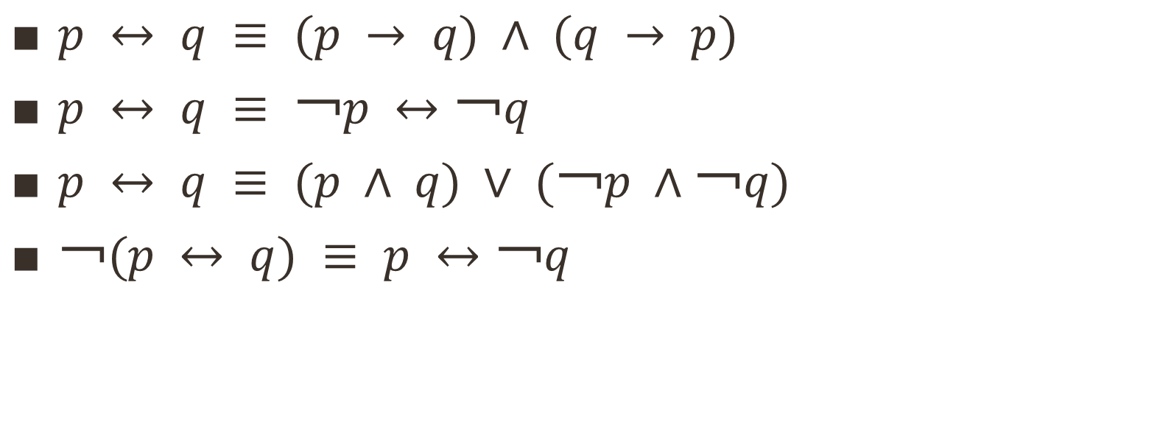
Bi-implications
$p ↔ q ≡ (p → q) ∧ (q → p)$
$p ↔ q ≡ ￢p ↔￢q$
$p ↔ q ≡ (p ∧ q) ∨ (￢p ∧￢q)$
$￢(p ↔ q) ≡ p ↔￢q$

Slide 35
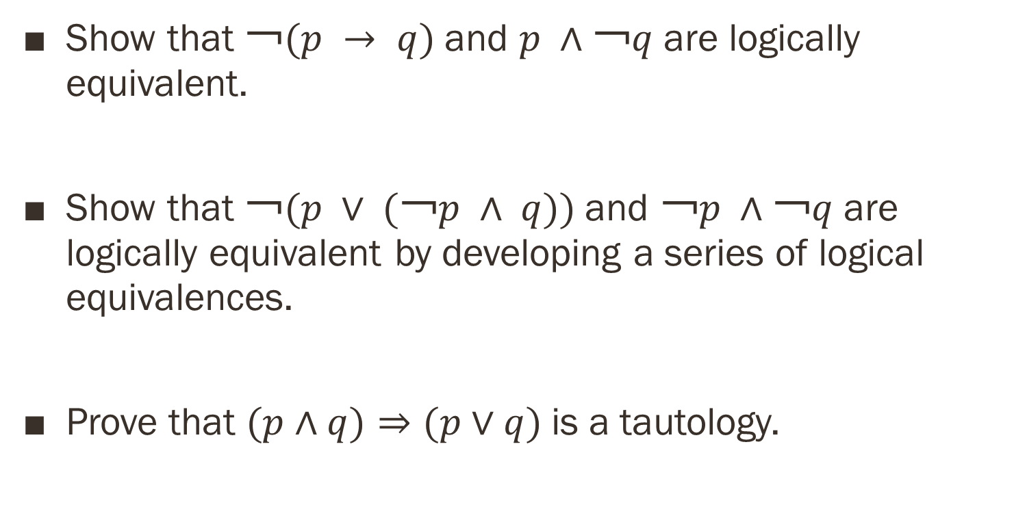
Using Logical Equivalence
Show that $￢(p → q)$and $p ∧￢q$are logically equivalent.
Show that $￢(p ∨ (￢p ∧ q))$and $￢p ∧￢q$are logically equivalent by developing a series of logical equivalences.
Prove that $(p∧q)⇒(p∨q)$is a tautology.

Slide 36
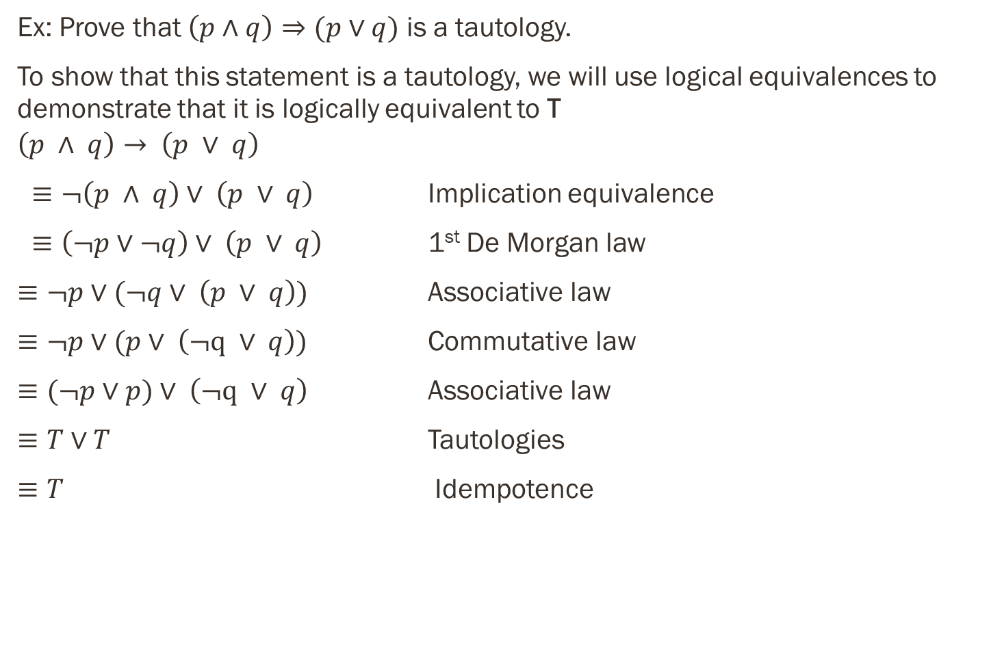
Using Logical Equivalence
Ex: Prove that $\left(p∧q\right)⇒(p∨q)$ is a tautology.
To show that this statement is a tautology, we will use logical equivalences to demonstrate that it is logically equivalent to T
$$\left(p ∧ q\right)→ \left(p ∨ q\right)$$
$≡¬\left(p ∧ q\right)∨ \left(p ∨ q\right)$ Implication equivalence
$≡\left(¬p∨¬q\right)∨ \left(p ∨ q\right)$ 1st De Morgan law
$≡¬p∨(¬q∨ \left(p ∨ q\right))$ $\text{Associative} \text{law}$
$≡¬p∨(p∨ \left(¬q ∨ q\right))$ $\text{Commutative} \text{law}$
$≡(¬p∨p)∨ \left(¬q ∨ q\right)$ $\text{Associative} \text{law}$
$≡T∨T$ Tautologies
$≡T$ Idempotence

Slide 37
References
Kenneth Rosen Discrete Mathematics and Its Applications – Chapter # 01

