Slide 1
Lecture 4
Predicates and Quantifiers

Slide 2
Why Predicate Logic?
Propositional Logic is not expressive enough
It cannot adequately express the meaning of statements in mathematics and in natural language
Example 1:
“Every computer connected to the university network is functioning properly.”
No rules of propositional logic allow us to conclude the truth of the statement that:
“The computer MATH3 is functioning properly.”

Slide 3
Why Predicate Logic?
Example 2:
“There is a computer on the university network that is under attack by an intruder.”
"CS2 is under attack by an intruder"
Predicate Logic is more expressive and powerful

Slide 4
Predicate Logic
Proposition, YES or NO?
3 + 2 = 5
X + 2 = 5
Computer X is under attack by an intruder
X + 2 = 5 for any choice of X in {1, 2, 3}
X + 2 = 5 for some X in {1, 2, 3}
Computer X is under attack by an intruder for some X in {CS001, MATH034}

Slide 5
Predicate Logic
Proposition, YES or NO?
3 + 2 = 5 YES
X + 2 = 5 NO
Computer X is under attack by an intruder NO
X + 2 = 5 for any choice of X in {1, 2, 3} YES
X + 2 = 5 for some X in {1, 2, 3} YES
Computer X is under attack by an intruder for some X in {CS001, MATH034} YES

Slide 6
Propositional Functions
Consider $P(x) = x < 5$
$P(x)$ has no truth values ($x$ is not given a value)
$P(1)$ is true: The proposition $1<5$ is true
$P(10)$is false: The proposition $10<5$ is false
$P(x)$ will create a proposition when given a value
Exercise:
1) Let $P(x) =$“x is a multiple of 5”
For what values of $x, P(x)$is true?
2)Let $P(x) = x + 3<10$
For what values of $x, P(x)$is true?

Slide 7
Propositional Functions
Functions with multiple variables:
$P(x,y) := x + y = 0$
$P(1, 2)$ is false, $P(1,−1)$ is true
$P(x,y, z) := x + y = z$
$P(3, 4, 5)$ is false, $P(1, 2, 3)$ is true
$P\left(x_{1},x_{2},x_{3}… x_{n}\right):=…$
Anatomy of a propositional function
$P(x) := x + 5 > x$
predicate
function
variable

Slide 8
Predicates
A predicate is a declarative statement with at least one variable (i.e., unknown value).
A predicate, or propositional function, is a function that takes some variable(s) as arguments and returns True or False.
Fiaz eats pizza at least once a week.
Define:
P(x) = “x eats pizza at least once a week.”
Note that P(x) is not a proposition, P(Fiaz) is.

Slide 9
Predicates
Suppose $Q(x,y) := “x > y”$
Proposition, YES or NO?
$Q(x,y)$
$Q(3,4)$
$Q(x,9)$
Predicate, YES or NO?
$Q(x,y)$
$Q(3,4)$
$Q(x,9)$

Slide 10
Predicates
Suppose $Q(x,y) := “x > y”$
Proposition, YES or NO?
$Q(x,y)$ NO
$Q(3,4)$ YES
$Q(x,9)$ NO
Predicate, YES or NO?
$Q(x,y)$ YES
$Q(3,4)$ NO
$Q(x,9)$ YES

Slide 11
References
Kenneth Rosen Discrete Mathematics and Its Applications – Chapter # 01
Discrete Structures Dr. Humaiyon – (Essentials)

Slide 12
Quantification
Quantification expresses the extent to which a predicate is true over a range of elements.
In English, the words all, some, many, none, and few are used in quantifications.

Slide 13
Quantifiers
Quantifiers are words that refer to quantities such as “some” or “all” and tell for how many elements a given predicate is true.
Two types:
Universal
Existential

Slide 14
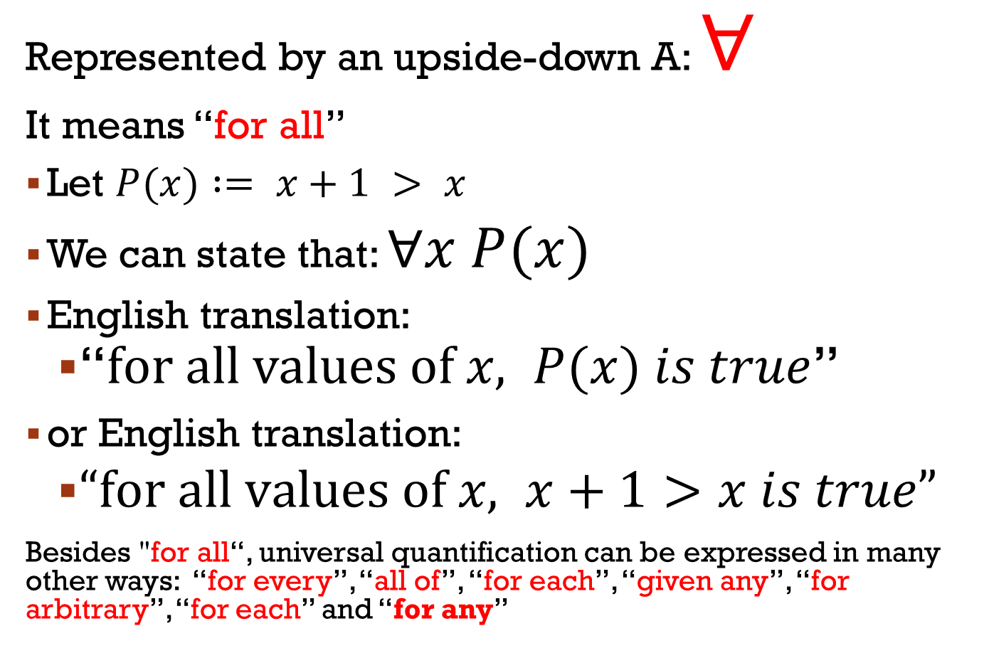
Universal quantifier
Represented by an upside-down A: $∀$
It means “for all”
Let $P(x) := x+1 > x$
We can state that: $∀x P(x)$
English translation:
“$\text{for} \text{all} \text{values} \text{of} x, P(x) is true$”
or English translation:
$“\text{for} \text{all} \text{values} \text{of} x, x+1>x is true”$
Besides "for all“, universal quantification can be expressed in many other ways: “for every”, “all of”, “for each”, “given any”, “for arbitrary”, “for each” and “for any”

Slide 15
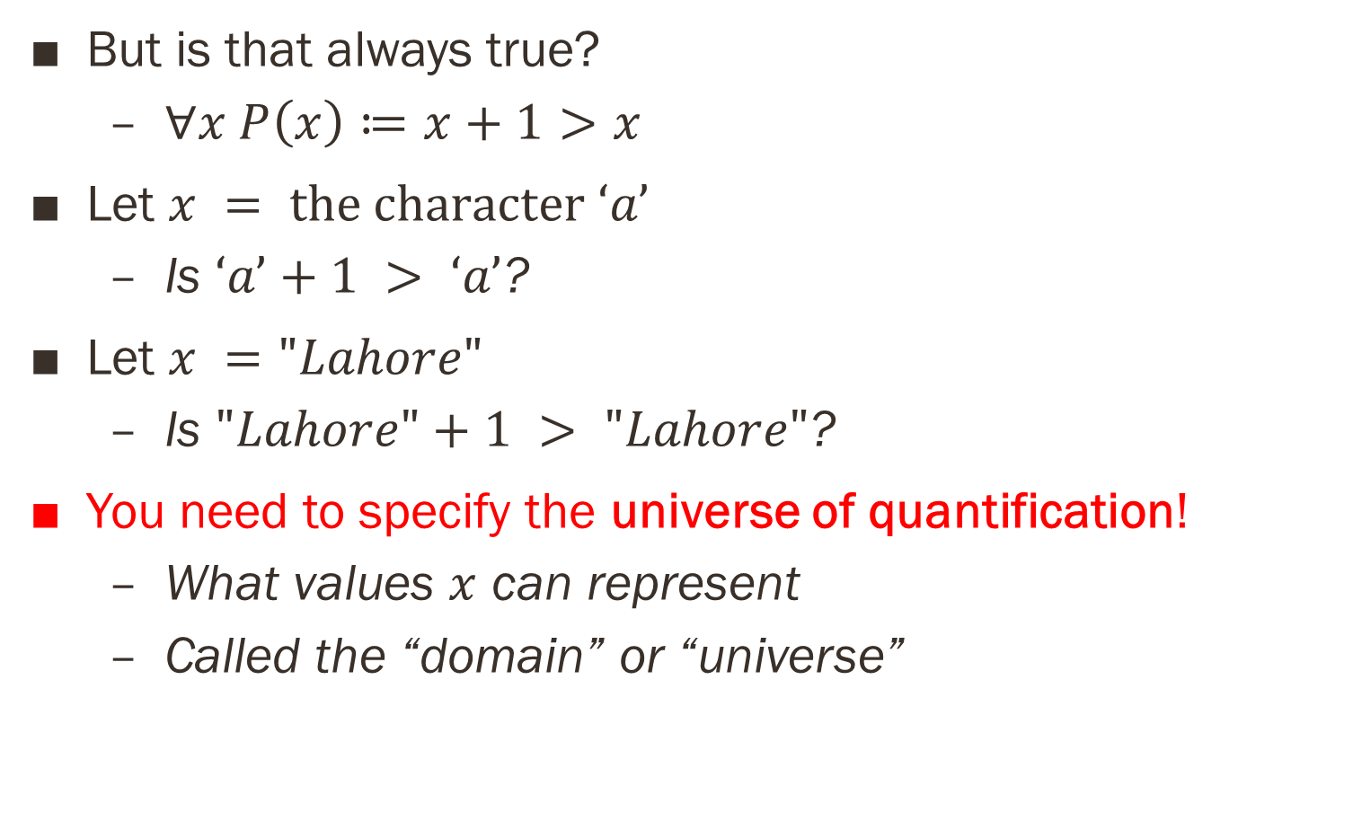
Universal quantifier
But is that always true?
$∀x P\left(x\right)≔x+1>x$
Let $x = \text{the} \text{character} ‘a’$
Is $‘a’+1 > ‘a’$?
Let $x ="Lahore"$
Is $"Lahore"+1 > "Lahore"$?
You need to specify the universe of quantification!
What values $x$ can represent
Called the “domain” or “universe”

Slide 16
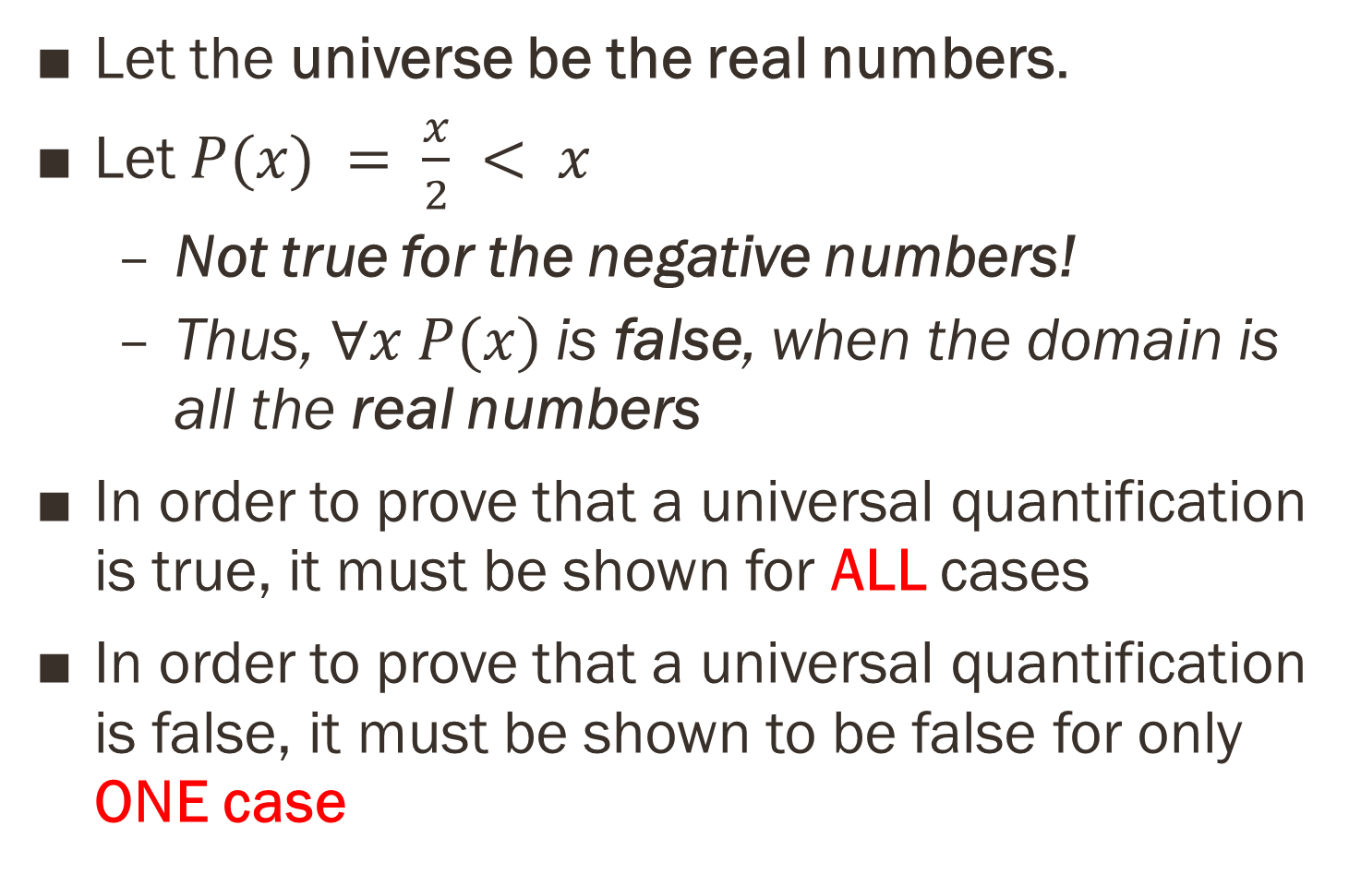
Universal quantifier
Let the universe be the real numbers.
Let $P(x) = \frac{x}{2} < x$
Not true for the negative numbers!
Thus, $∀x P(x)$is false, when the domain is all the real numbers
In order to prove that a universal quantification is true, it must be shown for ALL cases
In order to prove that a universal quantification is false, it must be shown to be false for only ONE case

Slide 17
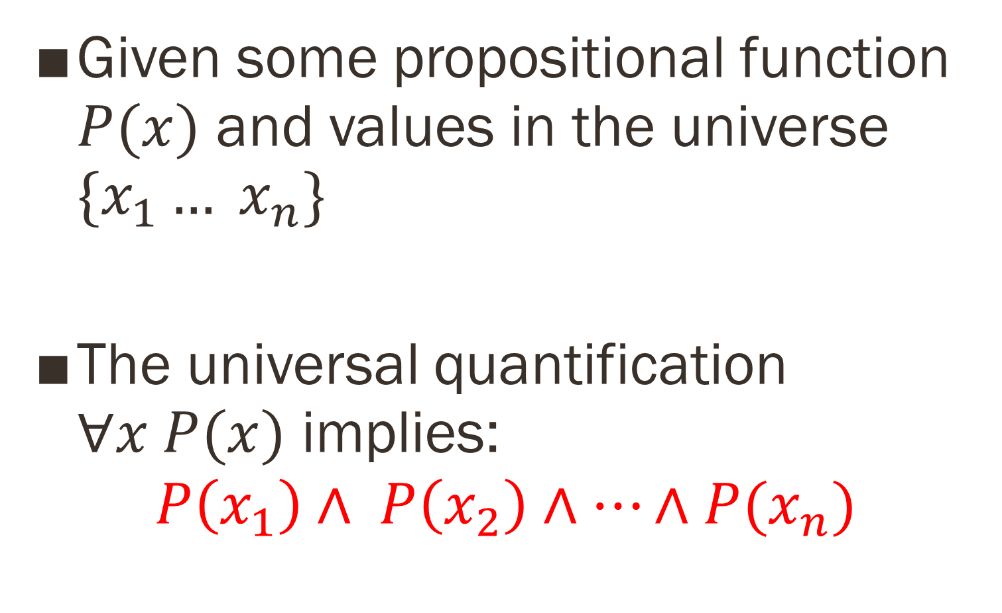
Universal quantifier
Given some propositional function $P(x)$ and values in the universe $\{x_{1}… x_{n}\}$
The universal quantification $∀x P(x)$ implies:
$$P\left(x_{1}\right)∧ P\left(x_{2}\right)∧…∧P(x_{n})$$

Slide 18

Quiz
What is the truth value of $∀x P (x)$, where $P(x)$ is the statement $x^{2}<10$and the domain consists of the positive integers not exceeding 4?

Slide 19
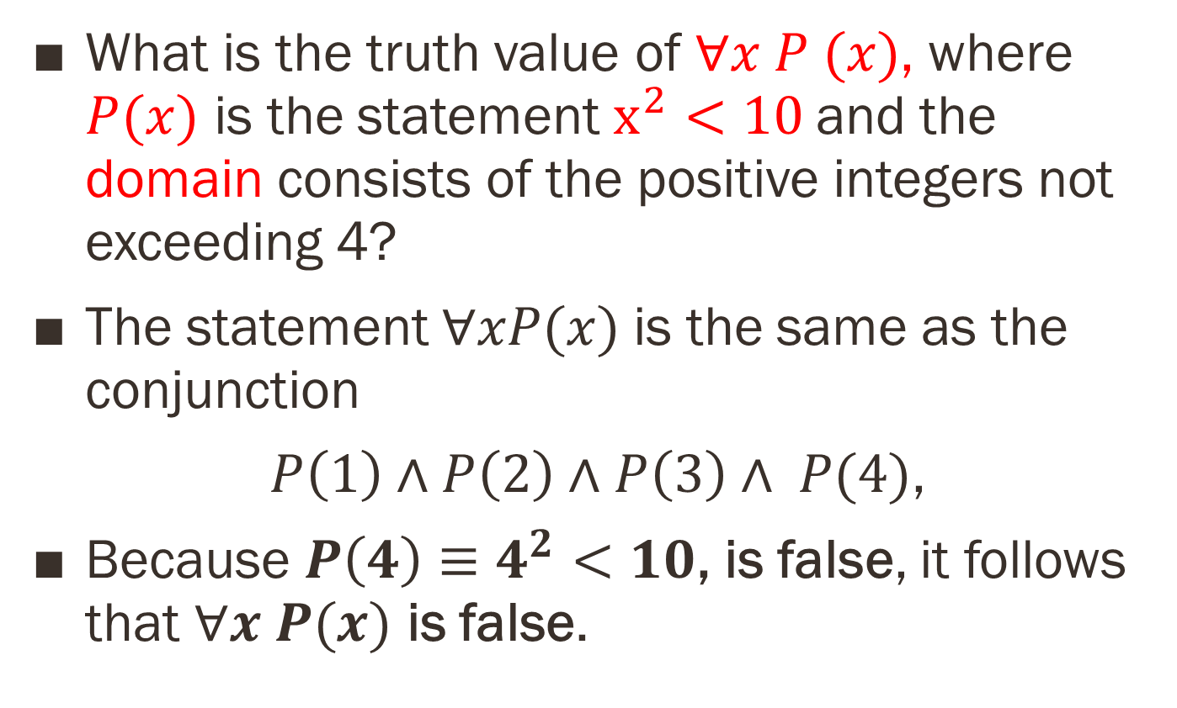
Quiz
What is the truth value of $∀x P (x)$, where $P(x)$ is the statement $x^{2}<10$and the domain consists of the positive integers not exceeding 4?
The statement $∀xP(x)$is the same as the conjunction
$P\left(1\right)∧P\left(2\right)∧P\left(3\right)∧ P(4)$,
Because $P\left(4\right)≡4^{2}<10$, is false, it follows that $∀x P(x)$ is false.

Slide 20
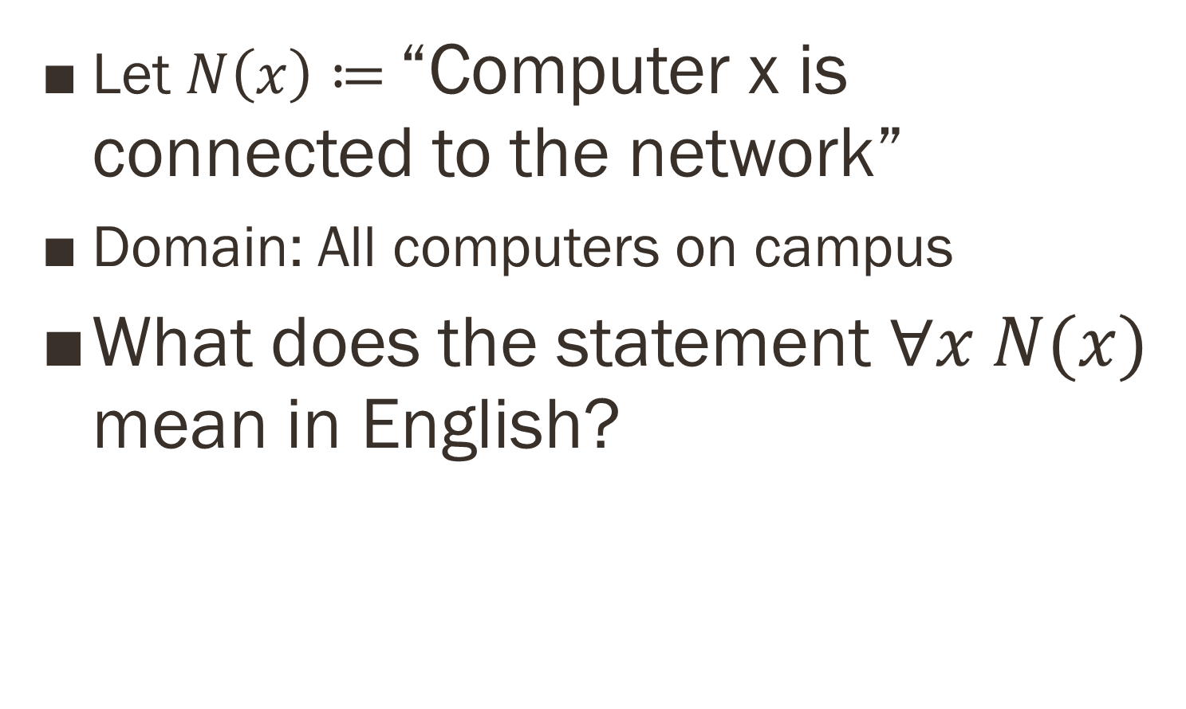
Quiz: Meaning in English
Let $N\left(x\right)≔$“Computer x is connected to the network”
Domain: All computers on campus
What does the statement $∀x N(x)$ mean in English?

Slide 21
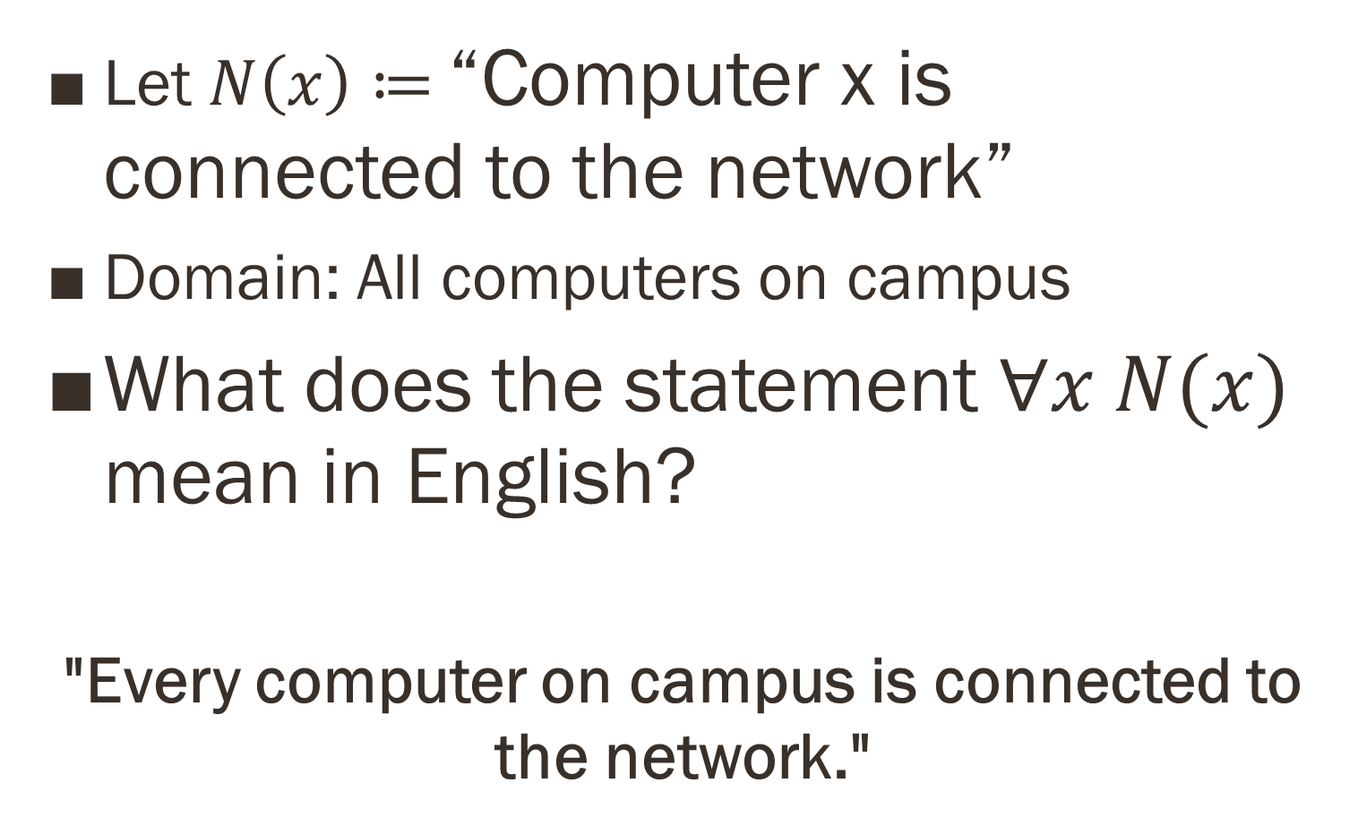
Quiz: Meaning in English
Let $N\left(x\right)≔$“Computer x is connected to the network”
Domain: All computers on campus
What does the statement $∀x N(x)$ mean in English?
"Every computer on campus is connected to the network."

Slide 22
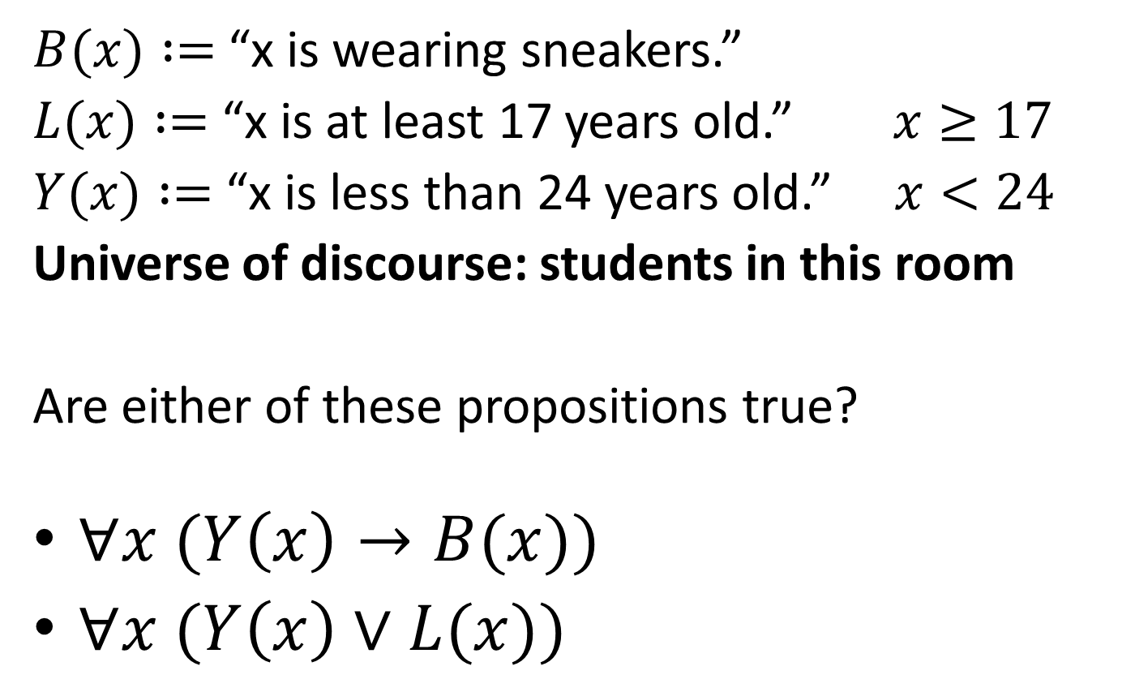
Example
$B(x) :=$“x is wearing sneakers.”
$L(x) :=$ “x is at least 17 years old.” $x≥17$
$Y(x) :=$“x is less than 24 years old.” $x<24$
Universe of discourse: students in this room
Are either of these propositions true?
$∀x (Y\left(x\right)→B(x))$
$∀x (Y\left(x\right)∨L(x))$

Slide 23
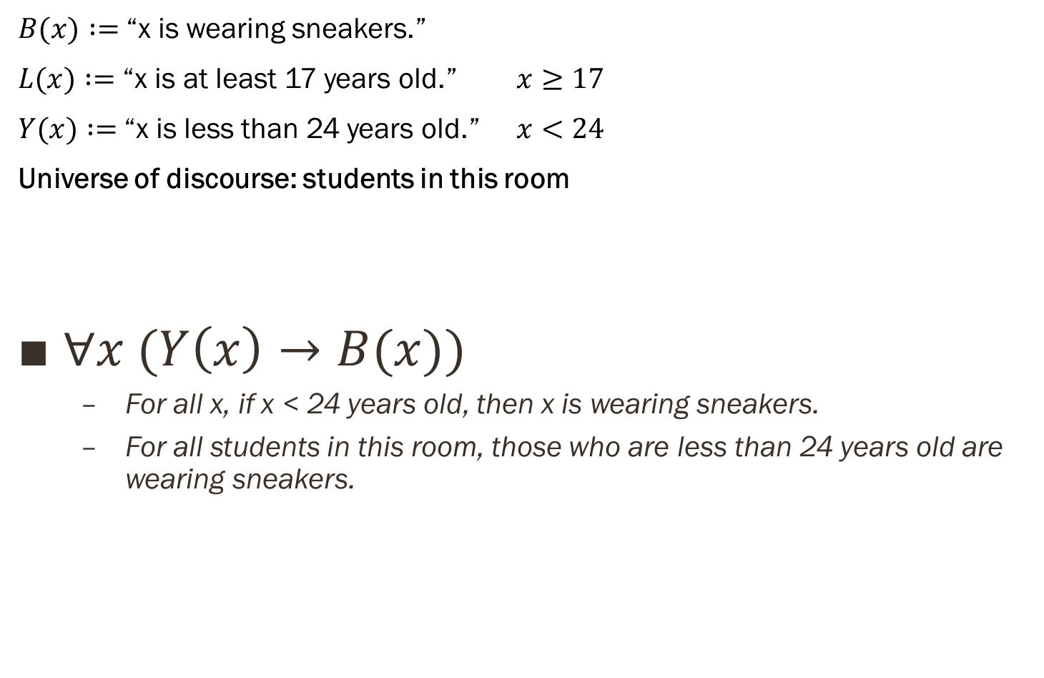
Example
$B(x) :=$“x is wearing sneakers.”
$L(x) :=$ “x is at least 17 years old.” $x≥17$
$Y(x) :=$“x is less than 24 years old.” $x<24$
Universe of discourse: students in this room
$∀x (Y\left(x\right)→B(x))$
For all x, if x < 24 years old, then x is wearing sneakers.
For all students in this room, those who are less than 24 years old are wearing sneakers.

Slide 24
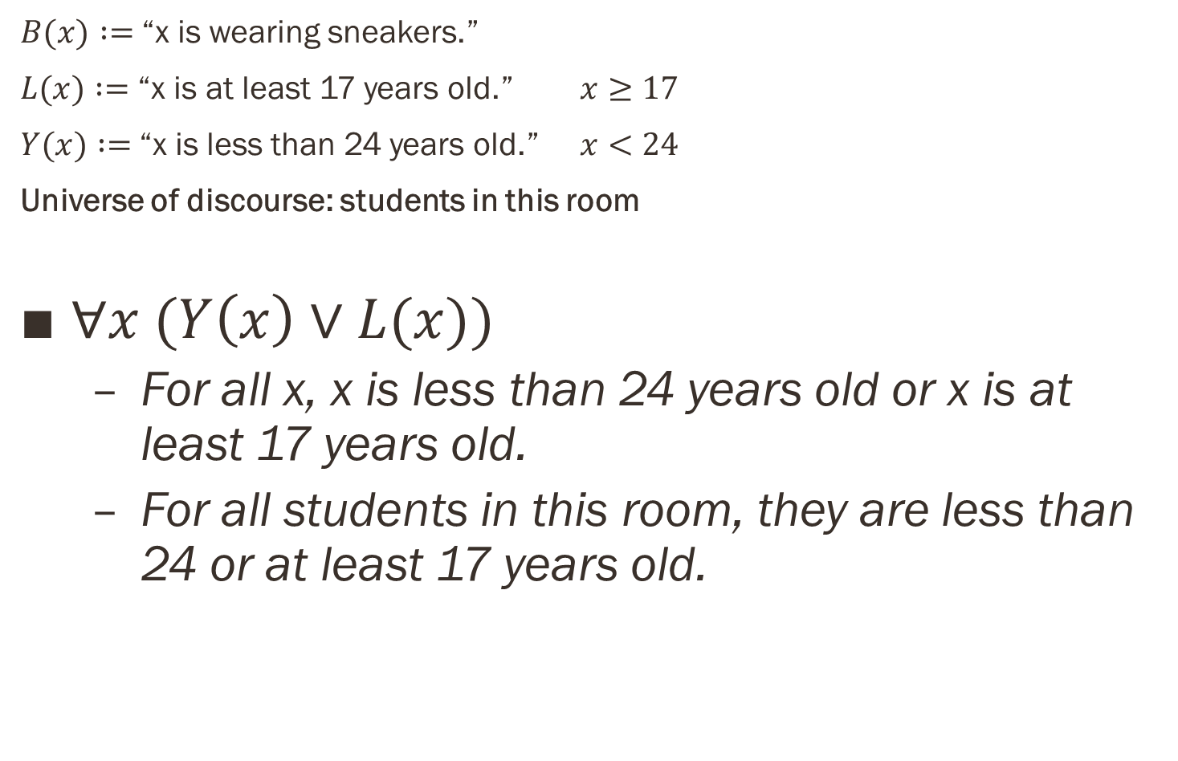
Example
$B(x) :=$“x is wearing sneakers.”
$L(x) :=$ “x is at least 17 years old.” $x≥17$
$Y(x) :=$“x is less than 24 years old.” $x<24$
Universe of discourse: students in this room
$∀x (Y\left(x\right)∨L(x))$
For all x, x is less than 24 years old or x is at least 17 years old.
For all students in this room, they are less than 24 or at least 17 years old.

Slide 25
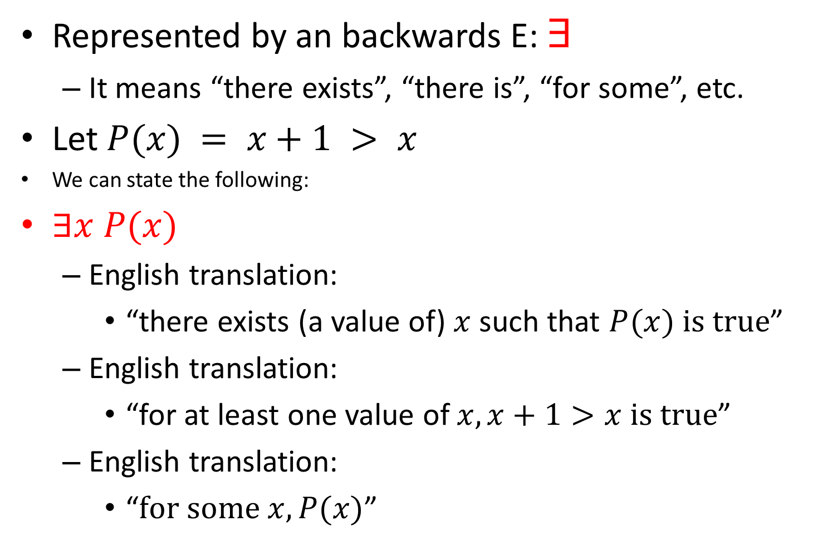
Existential quantification
Represented by an backwards E: $∃$
It means “there exists”, “there is”, “for some”, etc.
Let $P(x) = x+1 > x$
We can state the following:
$∃x P(x)$
English translation:
“there exists (a value of) $x$ such that $P(x) \text{is} \text{true}$”
English translation:
“for at least one value of $x, x+1>x \text{is} \text{true}$”
English translation:
“$\text{for} \text{some} x, P(x)$”

Slide 26
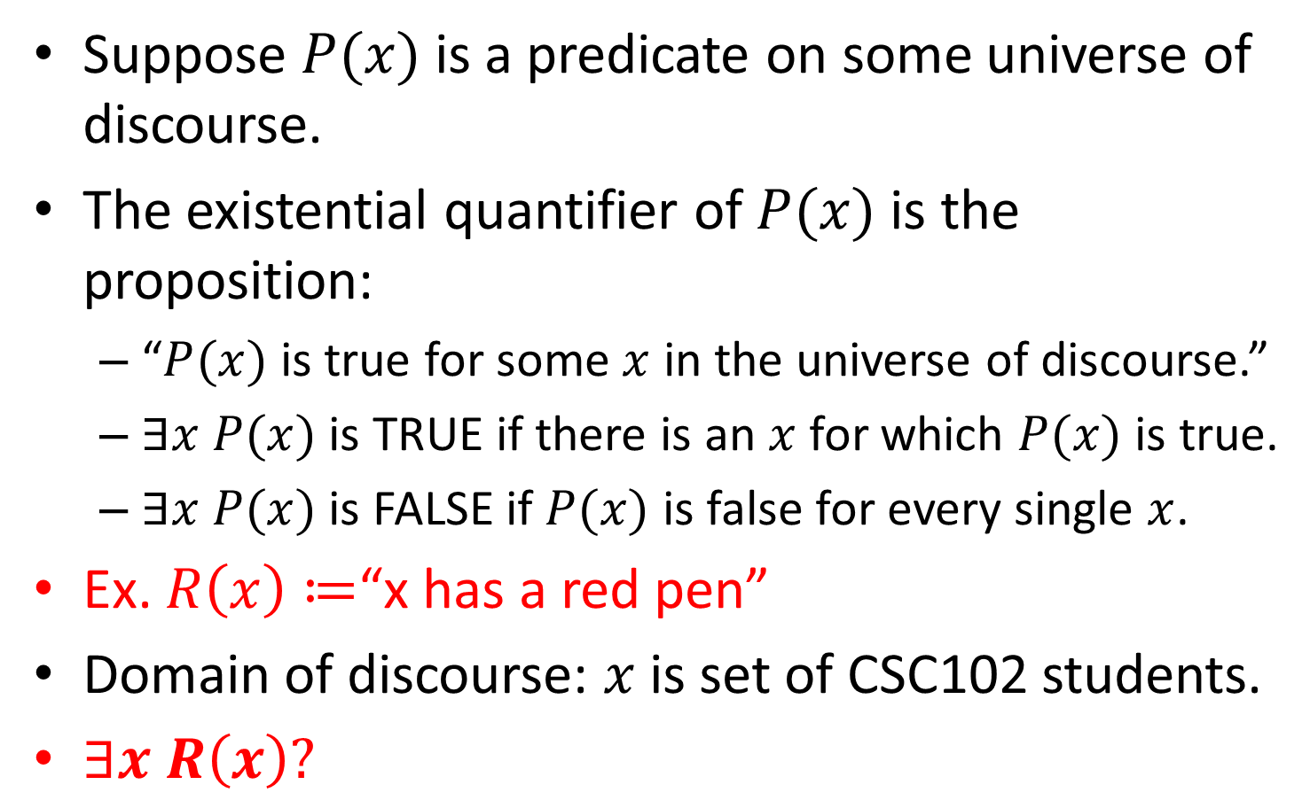
Existential quantification
Suppose $P(x)$ is a predicate on some universe of discourse.
The existential quantifier of $P(x)$ is the proposition:
“$P(x)$ is true for some $x$ in the universe of discourse.”
$∃x P(x)$ is TRUE if there is an $x$for which $P(x)$ is true.
$∃x P(x)$ is FALSE if $P(x)$ is false for every single $x$.
Ex. $R\left(x\right)≔$“x has a red pen”
Domain of discourse: $x$ is set of CSC102 students.
$∃x R\left(x\right)?$

Slide 27
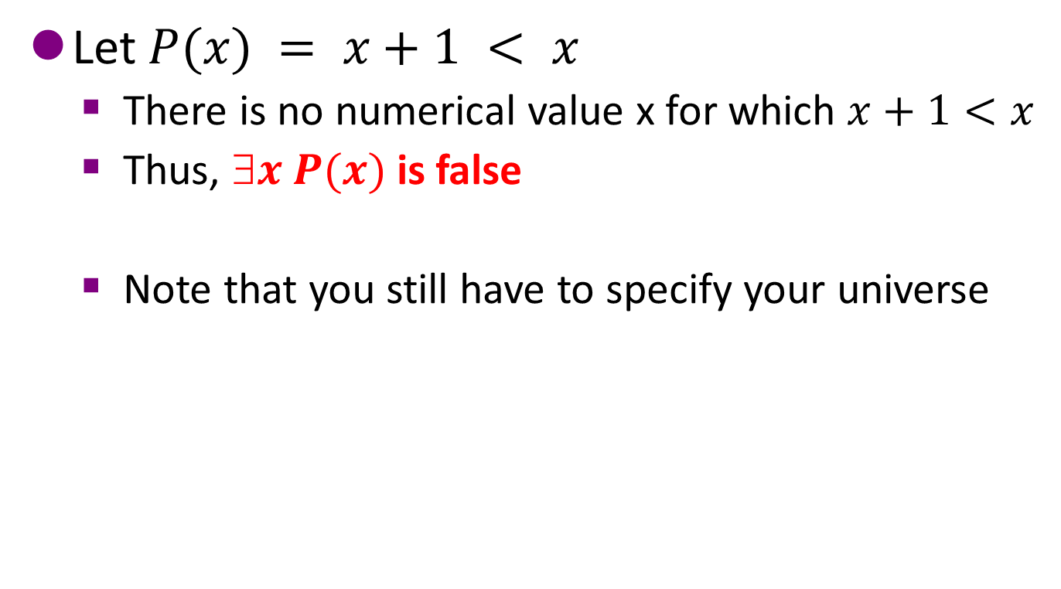
Existential quantification
Let $P(x) = x+1 < x$
There is no numerical value x for which $x+1<x$
Thus, $x P(x)$is false
Note that you still have to specify your universe

Slide 28
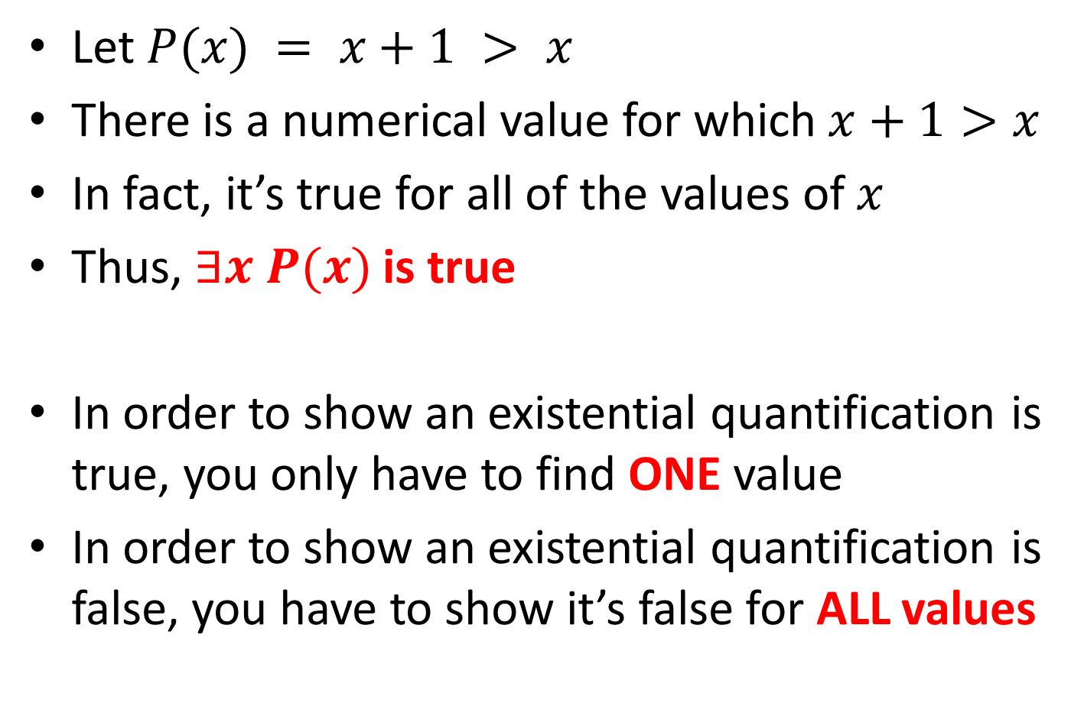
Existential quantification
Let $P(x) = x+1 > x$
There is a numerical value for which $x+1>x$
In fact, it’s true for all of the values of $x$
Thus, $∃x P(x)$is true
In order to show an existential quantification is true, you only have to find ONE value
In order to show an existential quantification is false, you have to show it’s false for ALL values

Slide 29
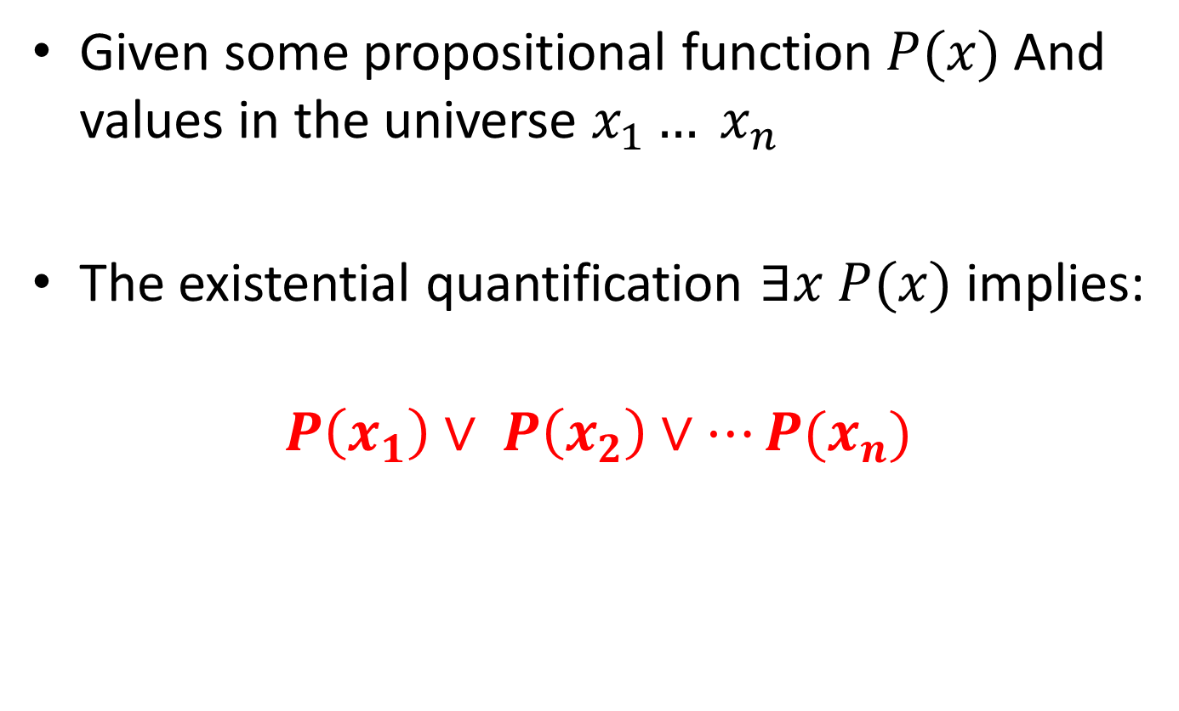
Existential quantification
Given some propositional function$P(x)$And values in the universe $x_{1}… x_{n}$
The existential quantification $∃x P(x)$ implies:
$$P\left(x_{1}\right)∨ P\left(x_{2}\right)∨…P(x_{n})$$

Slide 30
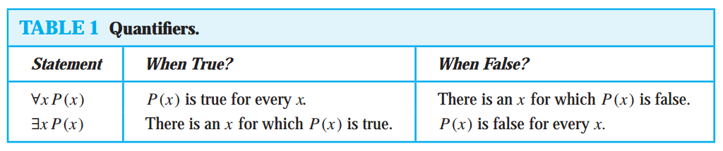
Universal vs Existential Quantifiers

Slide 31
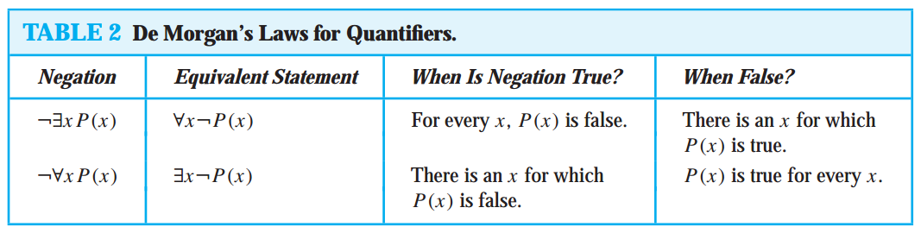
Negating Quantified Expression

Slide 32
EXAMPLE # 01
Consider these statements. The first two are called premises and the third is called the conclusion. The entire set is called an argument.
“All lions are fierce.”
“Some lions do not drink coffee.”
“Some fierce creatures do not drink coffee.

Slide 33
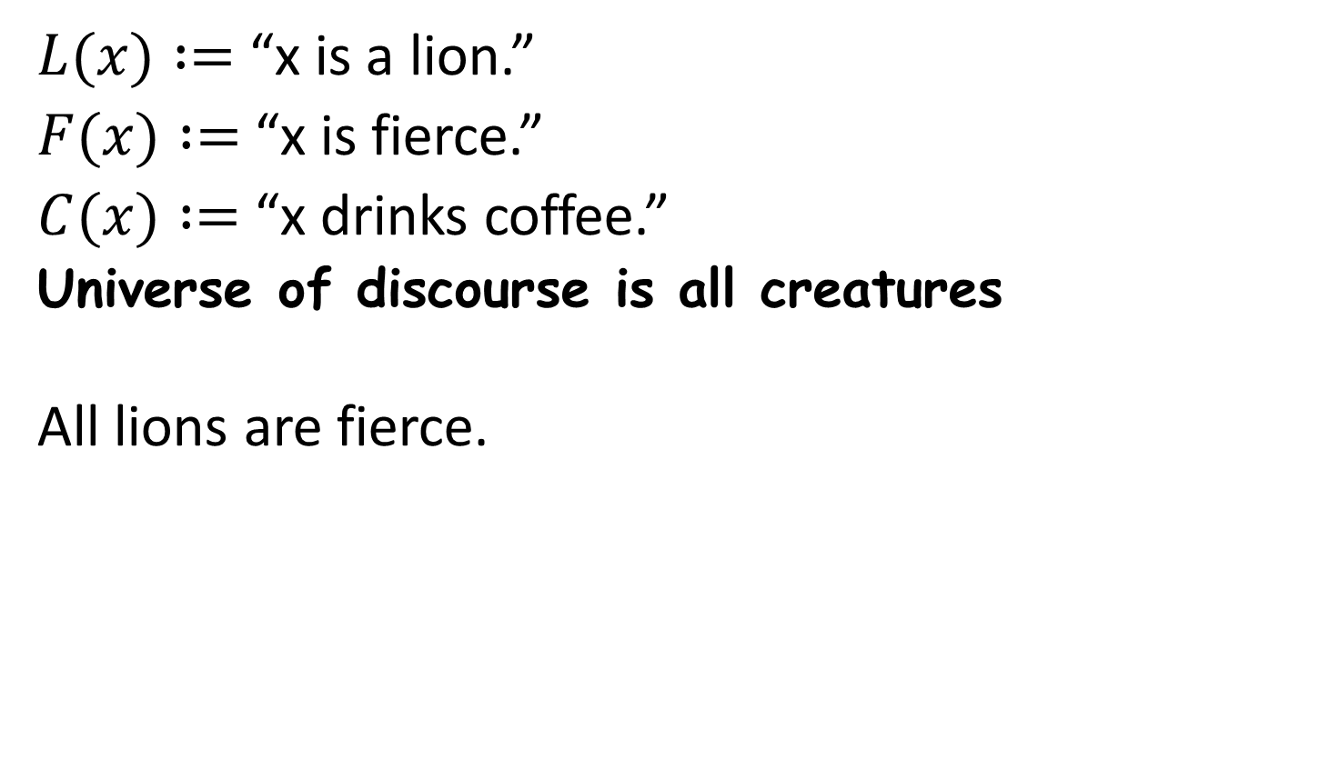
Example # 01
$L(x) :=$ “x is a lion.”
$F(x) :=$ “x is fierce.”
$C(x) :=$ “x drinks coffee.”
Universe of discourse is all creatures
All lions are fierce.

Slide 34
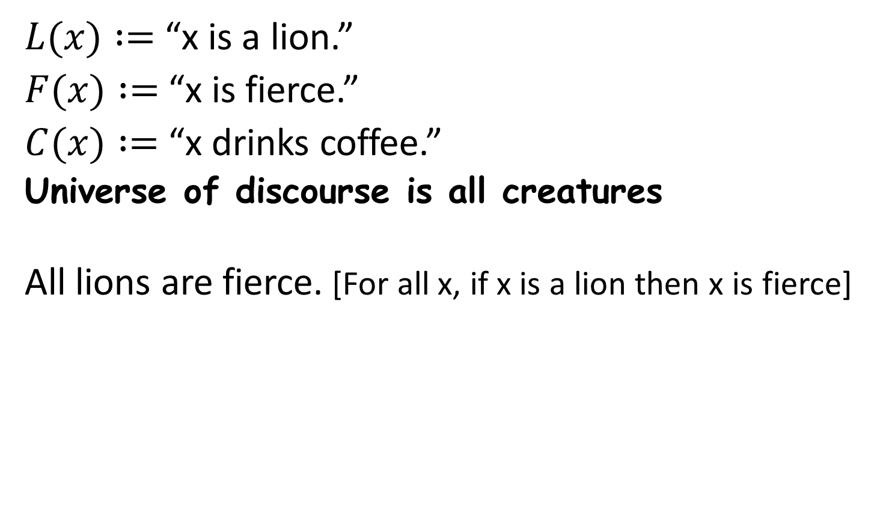
Example # 01
$L(x) :=$ “x is a lion.”
$F(x) :=$ “x is fierce.”
$C(x) :=$ “x drinks coffee.”
Universe of discourse is all creatures
All lions are fierce. [For all x, if x is a lion then x is fierce]

Slide 35
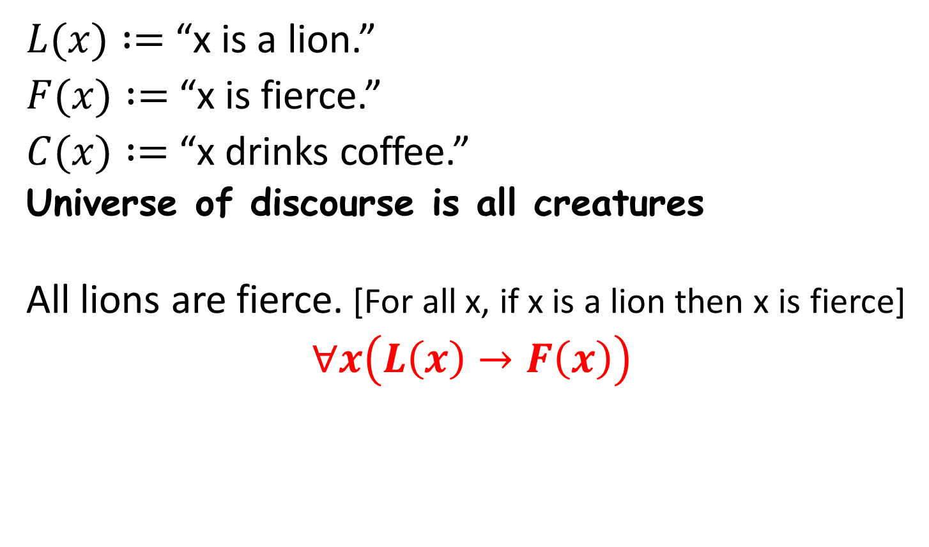
Example # 01
$L(x) :=$ “x is a lion.”
$F(x) :=$ “x is fierce.”
$C(x) :=$ “x drinks coffee.”
Universe of discourse is all creatures
All lions are fierce. [For all x, if x is a lion then x is fierce]
$$∀x\left(L\left(x\right)→F\left(x\right)\right)$$

Slide 36
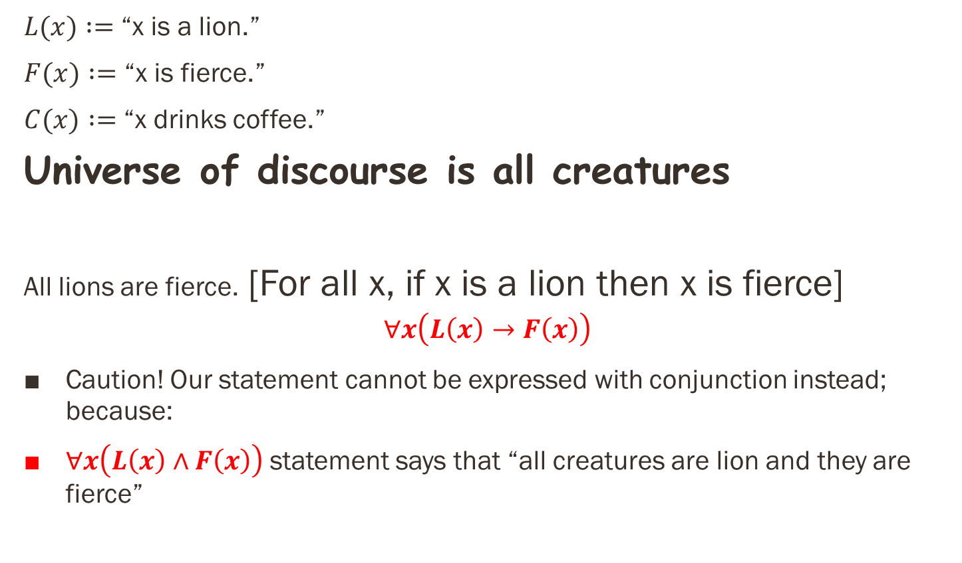
Example # 01
$L(x) :=$ “x is a lion.”
$F(x) :=$ “x is fierce.”
$C(x) :=$ “x drinks coffee.”
Universe of discourse is all creatures
All lions are fierce. [For all x, if x is a lion then x is fierce]
$$∀x\left(L\left(x\right)→F\left(x\right)\right)$$
Caution! Our statement cannot be expressed with conjunction instead; because:
$∀x\left(L\left(x\right)∧F\left(x\right)\right)$statement says that “all creatures are lion and they are fierce”

Slide 37
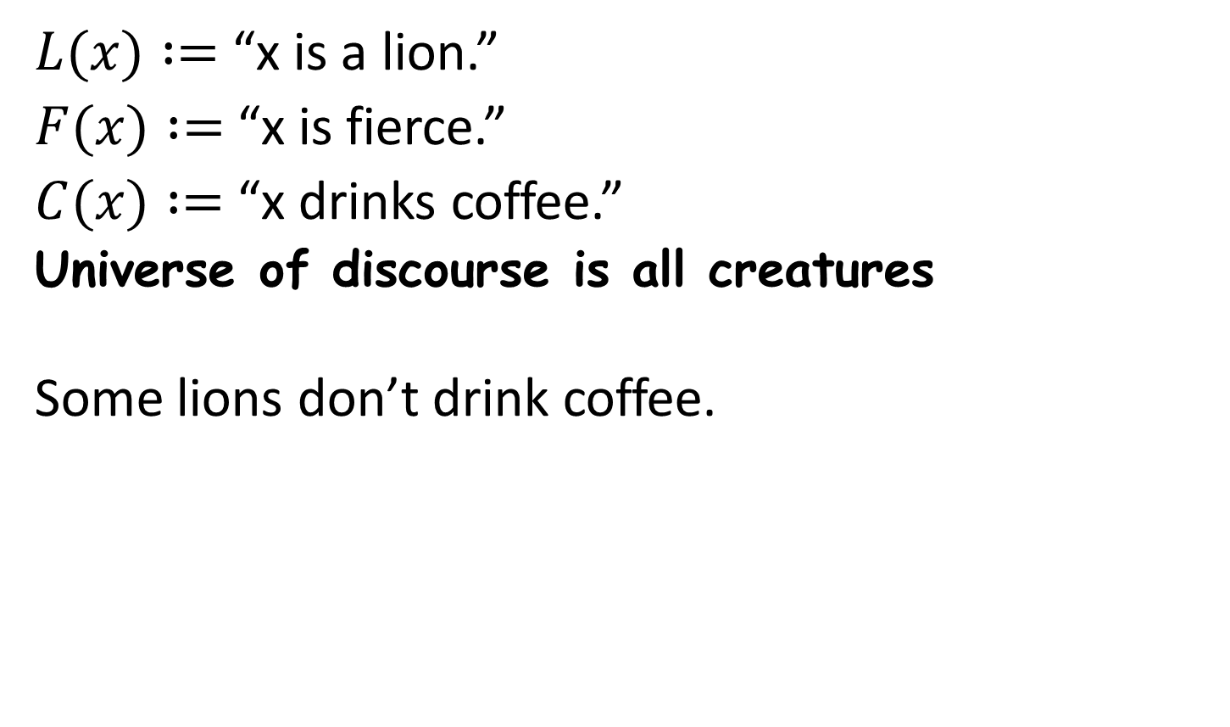
Example # 01
$L(x) :=$ “x is a lion.”
$F(x) :=$ “x is fierce.”
$C(x) :=$ “x drinks coffee.”
Universe of discourse is all creatures
Some lions don’t drink coffee.

Slide 38
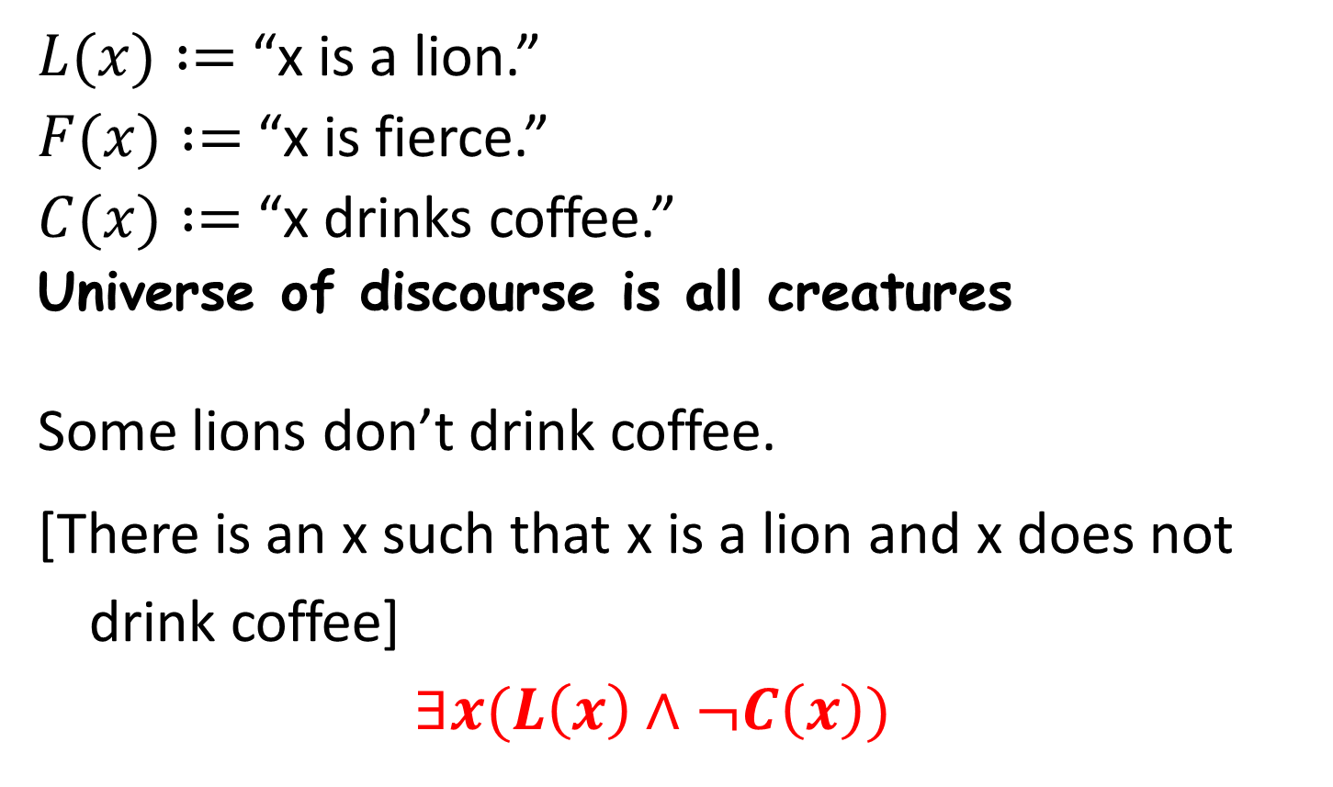
Example # 01
$L(x) :=$ “x is a lion.”
$F(x) :=$ “x is fierce.”
$C(x) :=$ “x drinks coffee.”
Universe of discourse is all creatures
Some lions don’t drink coffee.
[There is an x such that x is a lion and x does not drink coffee]
$$∃x(L\left(x\right)∧¬C\left(x\right))$$

Slide 39
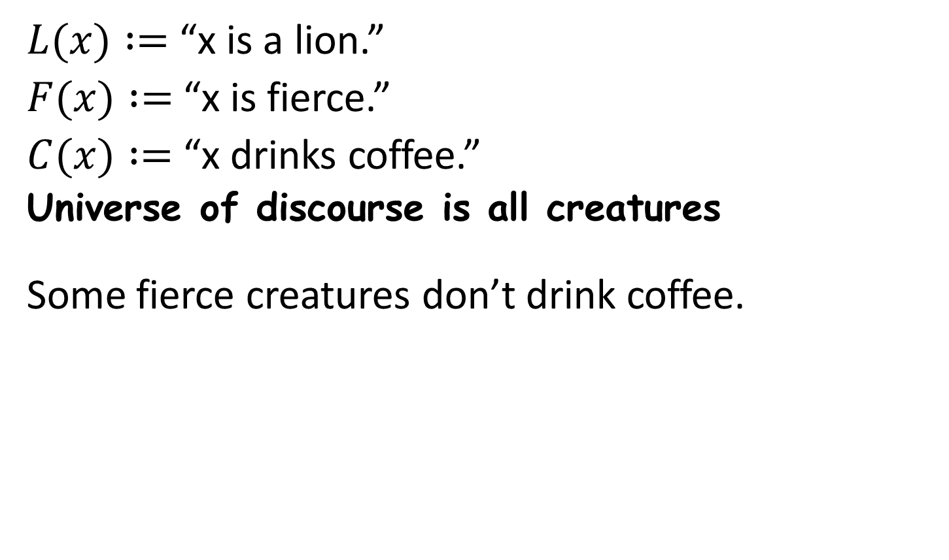
Example # 01
$L(x) :=$ “x is a lion.”
$F(x) :=$ “x is fierce.”
$C(x) :=$ “x drinks coffee.”
Universe of discourse is all creatures
Some fierce creatures don’t drink coffee.

Slide 40
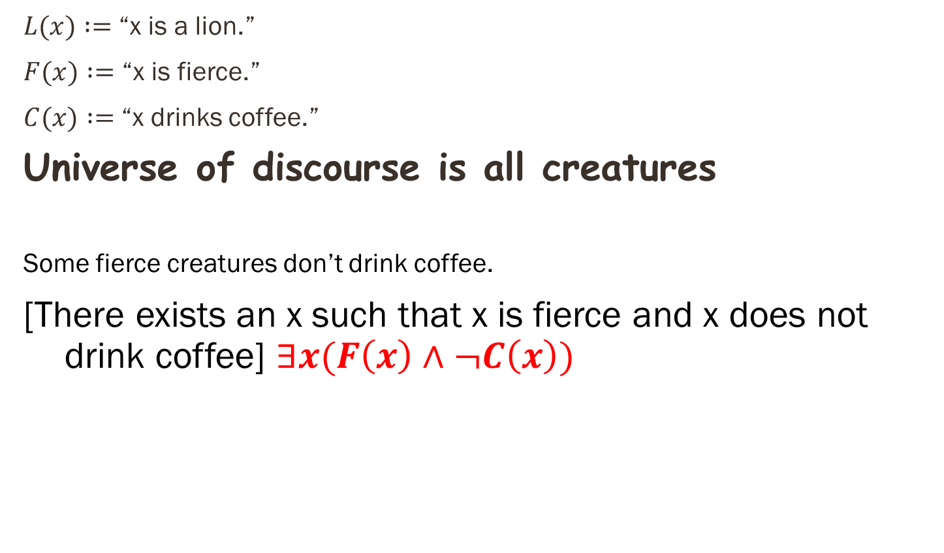
Example # 01
$L(x) :=$ “x is a lion.”
$F(x) :=$ “x is fierce.”
$C(x) :=$ “x drinks coffee.”
Universe of discourse is all creatures
Some fierce creatures don’t drink coffee.
[There exists an x such that x is fierce and x does not drink coffee] $∃x(F\left(x\right)∧¬C\left(x\right))$

Slide 41
EXAMPLE # 02
Consider these statements, of which the first three are premises and the fourth is a valid conclusion.
“All hummingbirds are richly colored.”
“No large birds live on honey.”
“Birds that do not live on honey are dull in color.”
“Hummingbirds are small.”

Slide 42
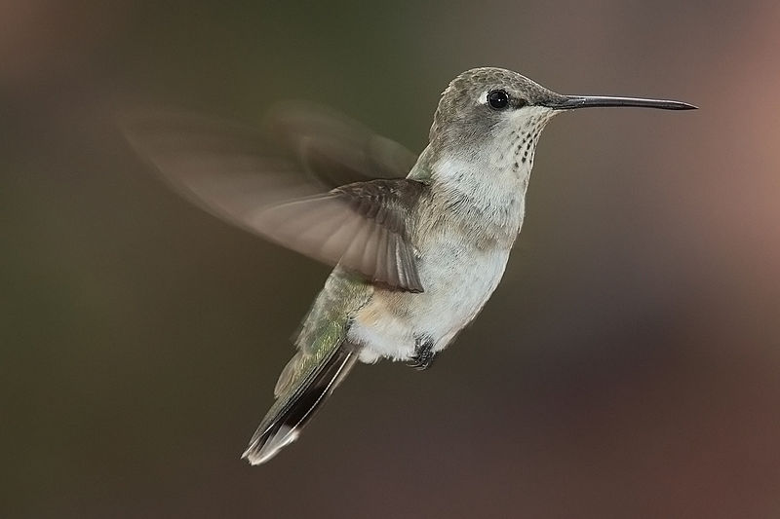
Example # 02
B(x) = “x is a hummingbird.”
L(x) = “x is a large bird.”
H(x) = “x lives on honey.”
R(x) = “x is richly colored.”
Universe of discourse is all birds.
All hummingbirds are richly colored.

Slide 43
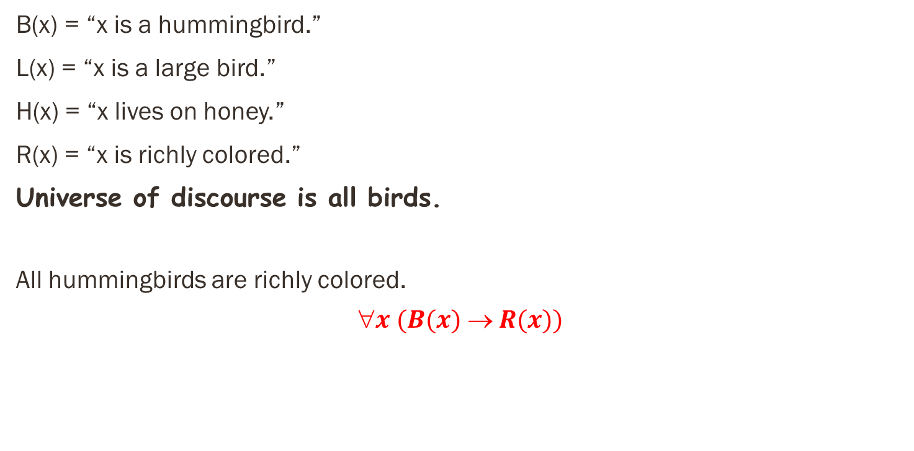
Example # 02
B(x) = “x is a hummingbird.”
L(x) = “x is a large bird.”
H(x) = “x lives on honey.”
R(x) = “x is richly colored.”
Universe of discourse is all birds.
All hummingbirds are richly colored.
$$x (B(x)  R(x))$$

Slide 44
Example # 02
B(x) = “x is a hummingbird.”
L(x) = “x is a large bird.”
H(x) = “x lives on honey.”
R(x) = “x is richly colored.”
Universe of discourse is all birds.
No large birds live on honey.

Slide 45
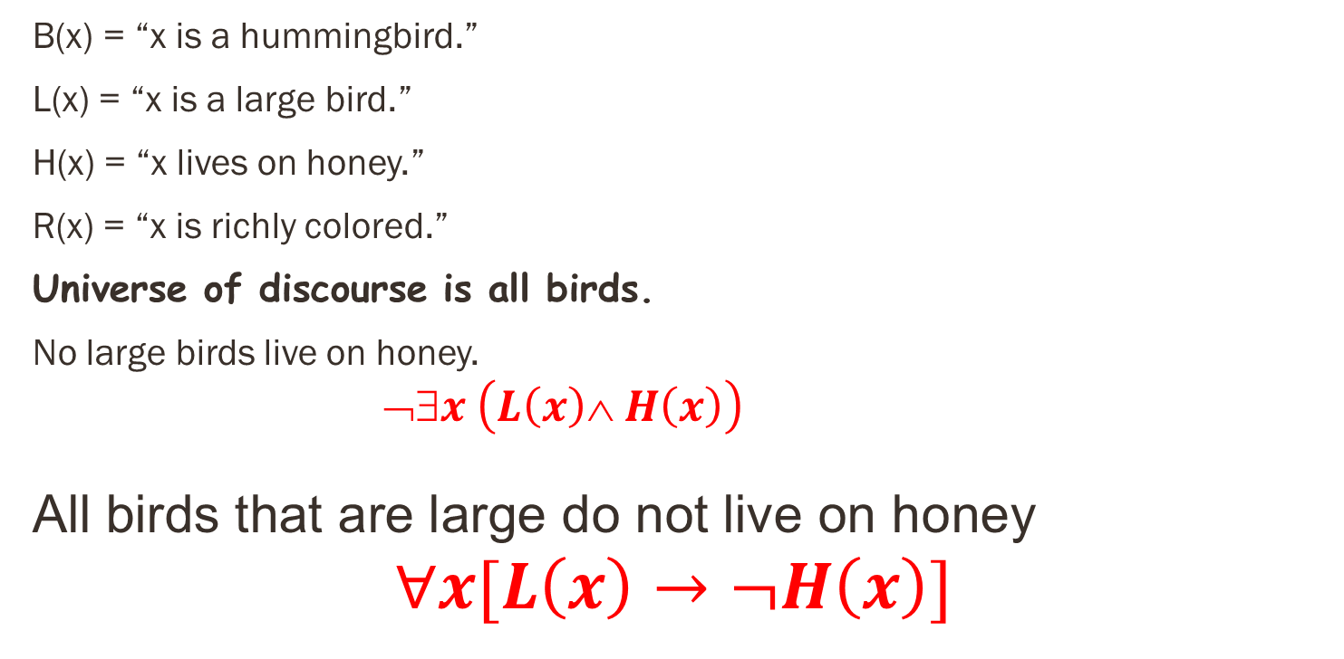
Example # 02
B(x) = “x is a hummingbird.”
L(x) = “x is a large bird.”
H(x) = “x lives on honey.”
R(x) = “x is richly colored.”
Universe of discourse is all birds.
No large birds live on honey.
$$➢∃x \left(L\left(x\right)∧ H\left(x\right)\right)$$
All birds that are large do not live on honey
$$∀x[L\left(x\right)→¬H\left(x\right)]$$

Slide 46
Example # 02
B(x) = “x is a hummingbird.”
L(x) = “x is a large bird.”
H(x) = “x lives on honey.”
R(x) = “x is richly colored.”
Universe of discourse is all birds.
Birds that do not live on honey are dully colored.

Slide 47

Example # 02
B(x) = “x is a hummingbird.”
L(x) = “x is a large bird.”
H(x) = “x lives on honey.”
R(x) = “x is richly colored.”
Universe of discourse is all birds.
Birds that do not live on honey are dully colored.
$$x \left(¬H\left(x\right)→ ¬R\left(x\right)\right)$$

Slide 48
Do Exercises

Slide 49
References
Kenneth Rosen Discrete Mathematics and Its Applications – Chapter # 01
Discrete Structures Dr. Humaiyon – (Essentials)

