Slide 1
Lecture 5
Rule of Inference

Slide 2
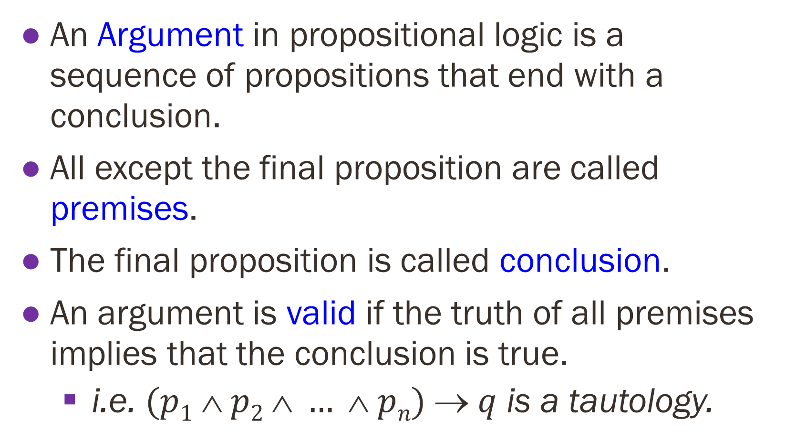
Definitions
An Argument in propositional logic is a sequence of propositions that end with a conclusion.
All except the final proposition are called premises.
The final proposition is called conclusion.
An argument is valid if the truth of all premises implies that the conclusion is true.
i.e. $(p1  p2  …  pn)  q$ is a tautology.

Slide 3
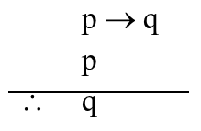
Rules of Inference Valid Arguments in Propositional Logic
Assume you are given the following two statements:
“if you are in this class, then you will get A grade”
“you are in this class”
Therefore,
“You will get A grade”

Slide 4
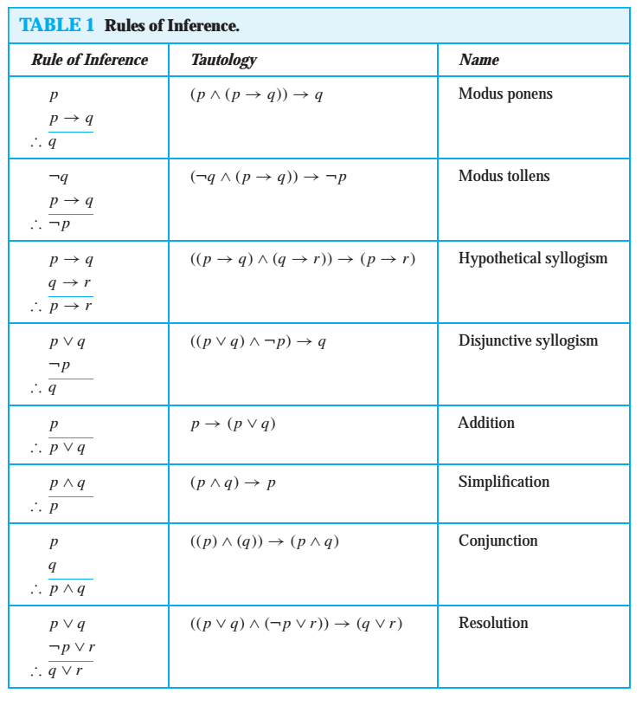
RULE OF INFERENCE

Slide 5
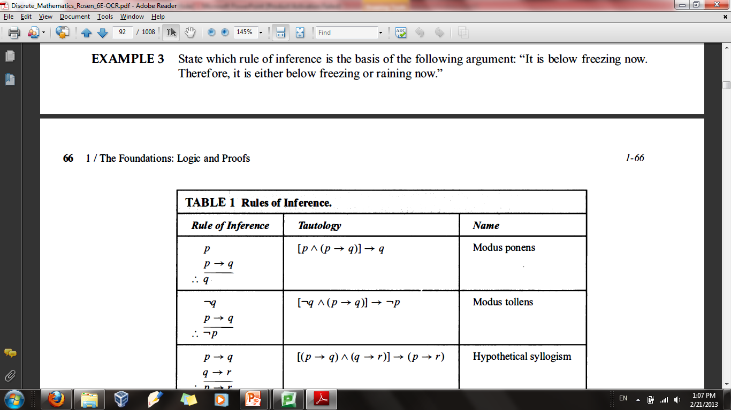
Modus Ponens (Law of Detachment) (Latin for “the way that affirms by affirming”
If it snows today, then we will go skiing
Hypothesis: It is snowing today
By modus ponens, the conclusion is:
We will go skiing

Slide 6
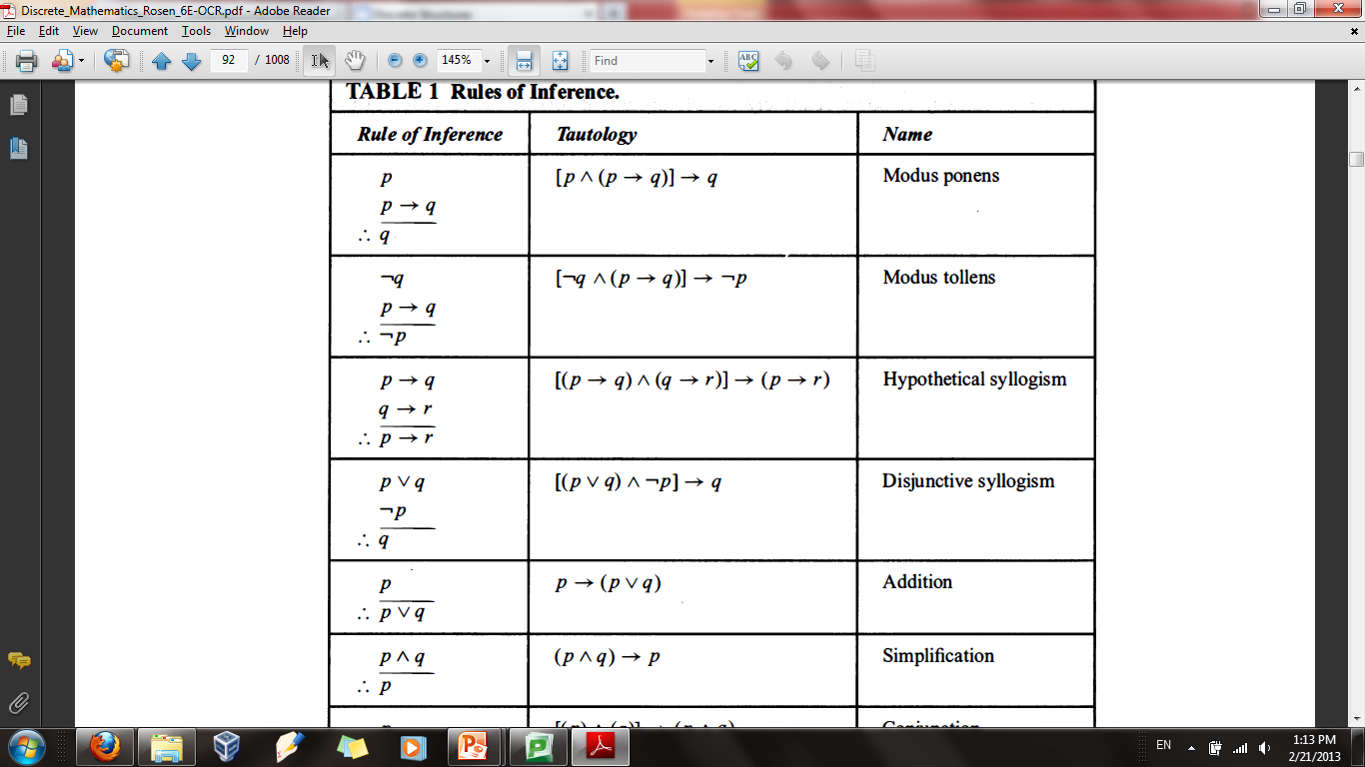
Modus Tollens (Law of Contrapositive Inference) (Latin for "the way that denies by denying")
Assume you are given the following two statements:
“you will not get A grade”
“if you are in this class, you will get A grade”
Let p = “you are in this class”
Let q = “you will get A grade”
By Modus Tollens, you can conclude that you are not in this class

Slide 7
Modus Tollens (Law of Contrapositive Inference)
The law of contrapositive states that, in a condition if the conclusion is false, then the hypothesis must be false also.
The general form is the following:
P → Q.
~Q
Therefore we can conclude ~P.
The following are examples:
If it is raining, then there are clouds in the sky. P → Q
There are no clouds in the sky. ~Q
Thus, it is not raining. ~P

Slide 8
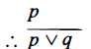
Addition
If you know that p is true, then p ∨ q will ALWAYS be true i.e. p → p ∨ q

Slide 9
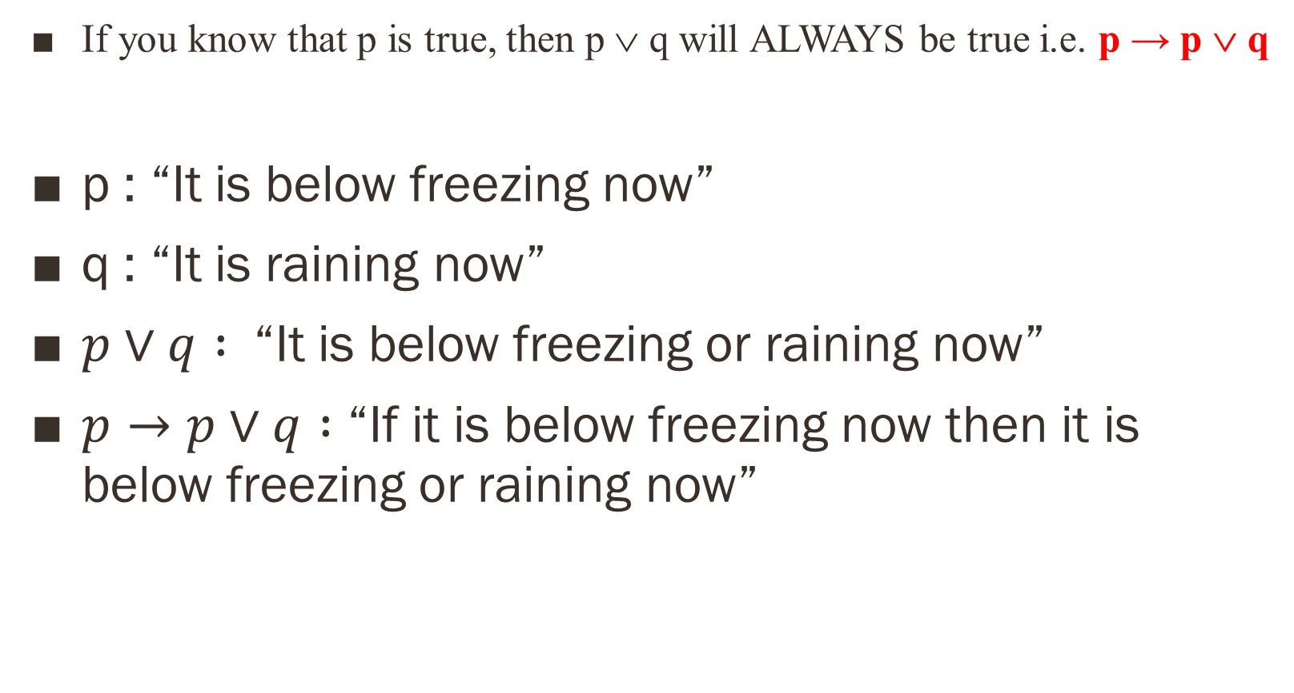
Addition
If you know that p is true, then p ∨ q will ALWAYS be true i.e. p → p ∨ q
p : “It is below freezing now”
q : “It is raining now”
$p∨q :$ “It is below freezing or raining now”
$p→p∨q :$ “If it is below freezing now then it is below freezing or raining now”

Slide 10
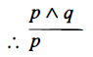
Simplification
If p ∧ q is true, then p will ALWAYS be true i.e. p ∧ q → p

Slide 11
Simplification
If p ∧ q is true, then p will ALWAYS be true i.e. p ∧ q → p
p: “It is below freezing”
q: “It is raining now”
p ∧ q : It is below freezing and raining now.
p ∧ q → p: It is below freezing and raining now implies that it is below freezing

Slide 12
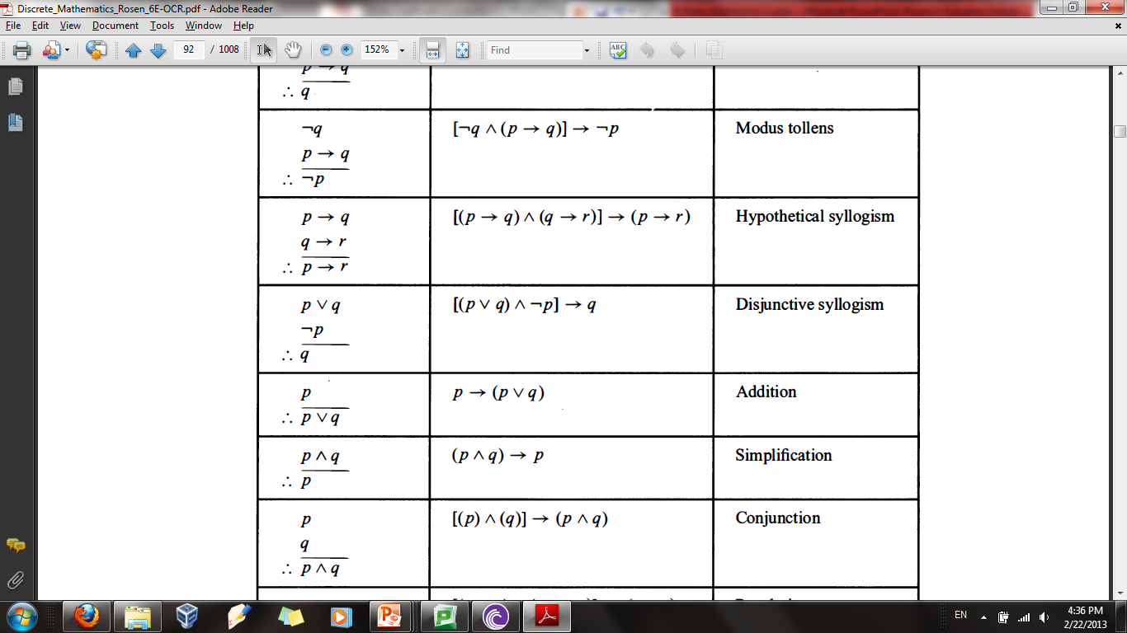
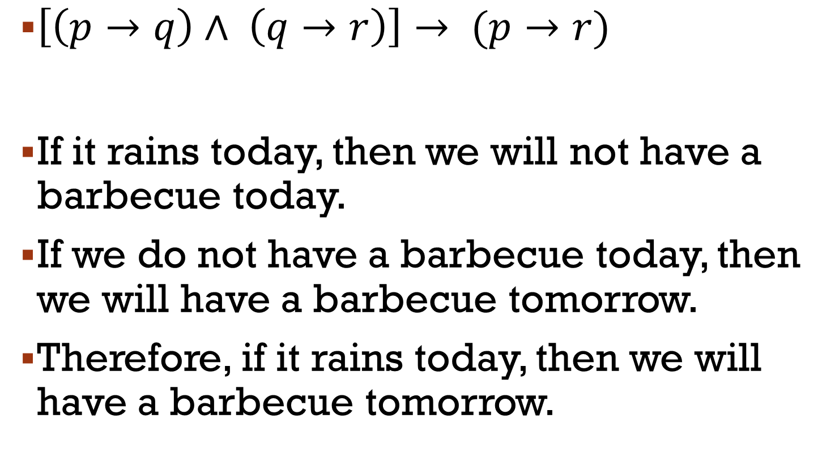
Hypothetical syllogism (Chain Rule)
$\left[\left(p→q\right)∧ \left(q→r\right)\right]→ (p→r)$
If it rains today, then we will not have a barbecue today.
If we do not have a barbecue today, then we will have a barbecue tomorrow.
Therefore, if it rains today, then we will have a barbecue tomorrow.

Slide 13
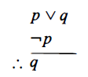
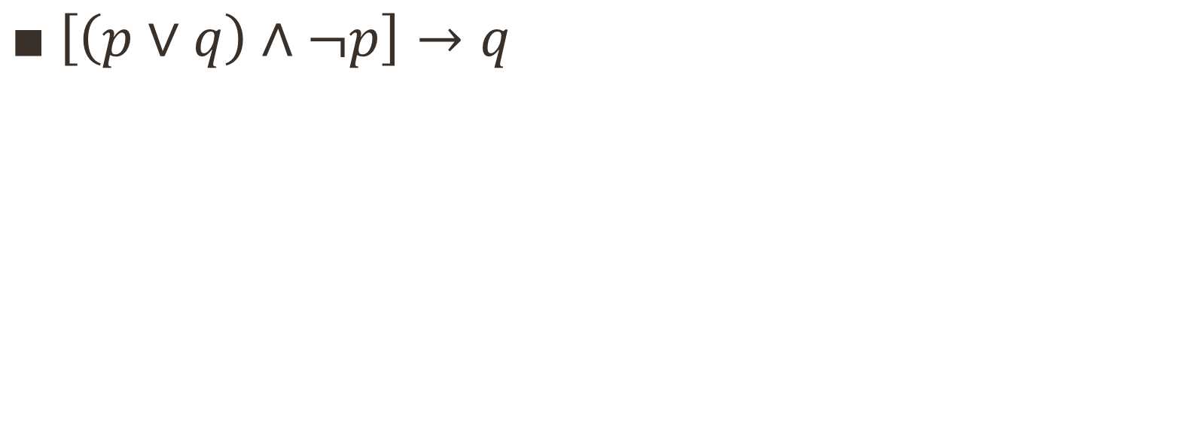
Disjunctive syllogism (Law of Disjunctive Inference)
$\left[\left(p∨q\right)∧¬p\right]→q$

Slide 14
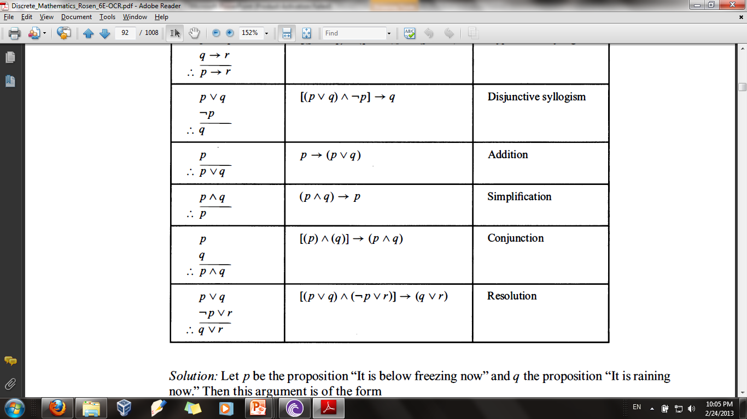
Resolution
Computer programs have been developed to automate the task of reasoning and proving theorems.
Many of these programs make use resolution

Slide 15
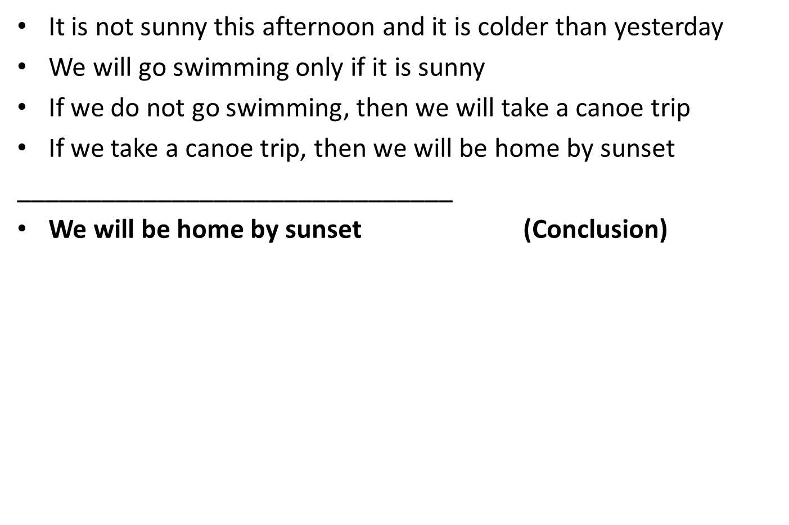
Rules of Inference to Build Arguments
It is not sunny this afternoon and it is colder than yesterday
We will go swimming only if it is sunny
If we do not go swimming, then we will take a canoe trip
If we take a canoe trip, then we will be home by sunset
_______________________________
We will be home by sunset (Conclusion)

Slide 16
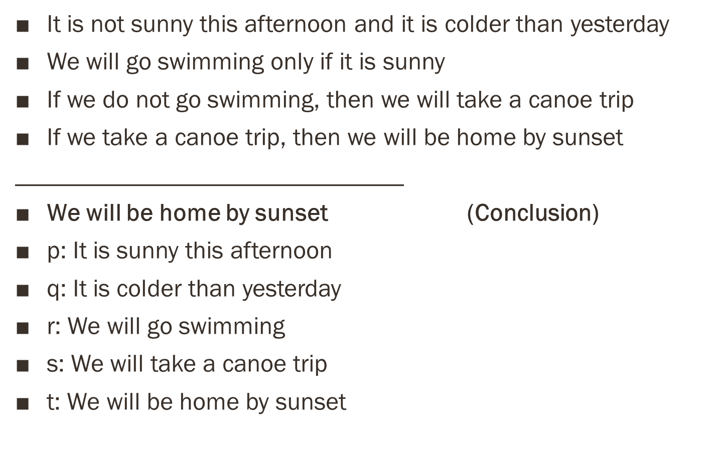
Rules of Inference to Build Arguments
It is not sunny this afternoon and it is colder than yesterday
We will go swimming only if it is sunny
If we do not go swimming, then we will take a canoe trip
If we take a canoe trip, then we will be home by sunset
_______________________________
We will be home by sunset (Conclusion)
p: It is sunny this afternoon
q: It is colder than yesterday
r: We will go swimming
s: We will take a canoe trip
t: We will be home by sunset

Slide 17
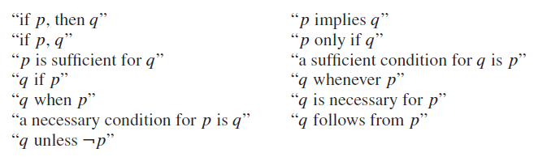
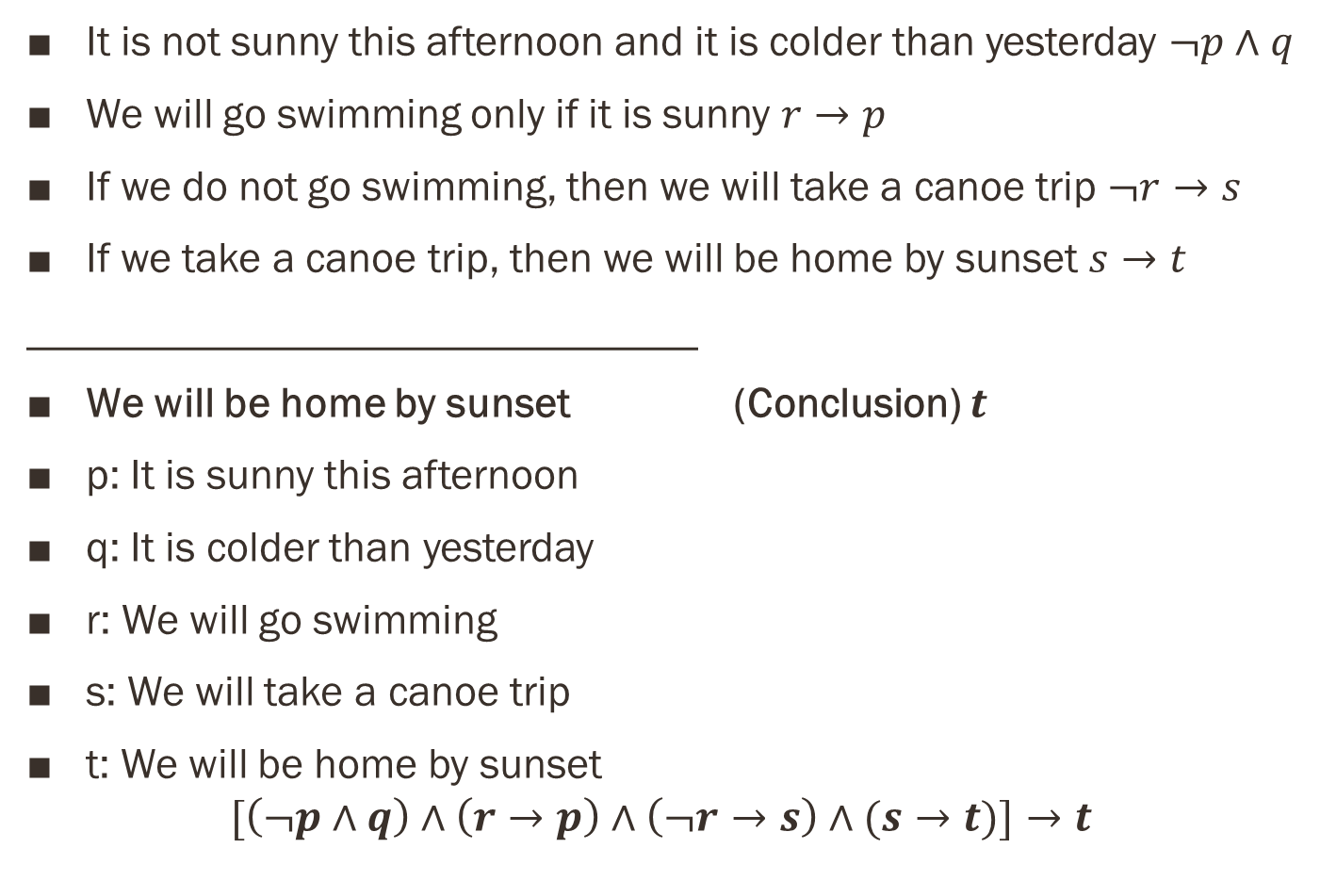
Rules of Inference to Build Arguments
It is not sunny this afternoon and it is colder than yesterday $¬p∧q$
We will go swimming only if it is sunny $r→p$
If we do not go swimming, then we will take a canoe trip $¬r→s$
If we take a canoe trip, then we will be home by sunset $s→t$
_______________________________
We will be home by sunset (Conclusion) $t$
p: It is sunny this afternoon
q: It is colder than yesterday
r: We will go swimming
s: We will take a canoe trip
t: We will be home by sunset
$$[\left(¬p∧q\right)∧\left(r→p\right)∧\left(¬r→s\right)∧(s→t)]→t$$

Slide 18
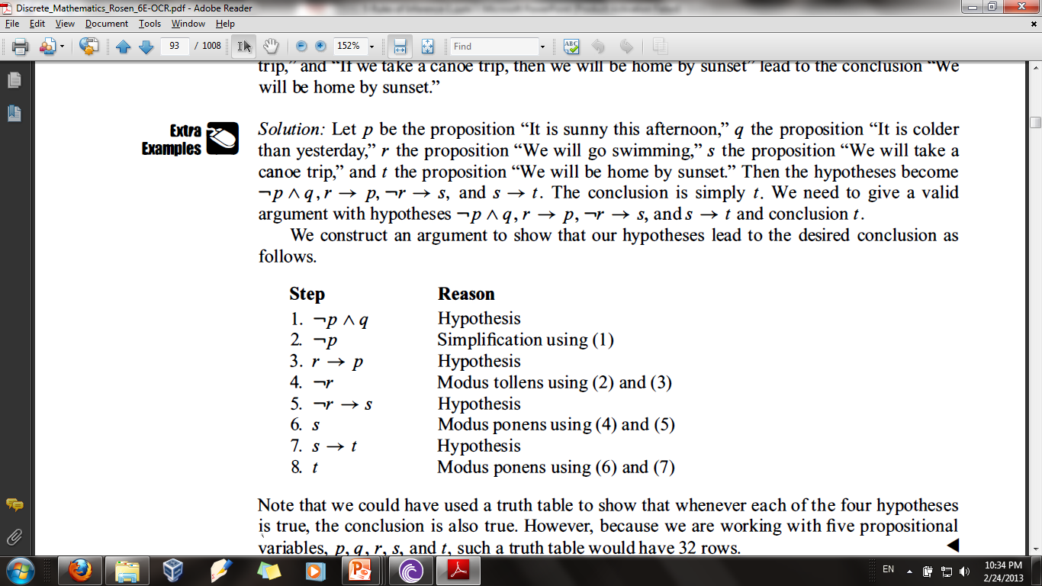

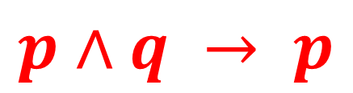
Rules of Inference to Build Arguments
$[\left(¬p∧q\right)∧\left(r→p\right)∧\left(¬r→s\right)∧(s→t)]→t$
$$p∧q → p$$

Slide 19

Rules of Inference to Build Arguments
$[\left(¬p∧q\right)∧\left(r→p\right)∧\left(¬r→s\right)∧(s→t)]→t$

Slide 20
Rules of Inference to Build Arguments
$[\left(¬p∧q\right)∧\left(r→p\right)∧\left(¬r→s\right)∧(s→t)]→t$

Slide 21
Rules of Inference to Build Arguments
$[\left(¬p∧q\right)∧\left(r→p\right)∧\left(¬r→s\right)∧(s→t)]→t$

Slide 22
If you send me an e-mail message, then I will finish writing the program
If you do not send me an e-mail message, then I will go to sleep early
If I go to sleep early, then I will wake up feeling refreshed
____________________________________
If I do not finish writing the program, then I will wake up feeling refreshed

Slide 23
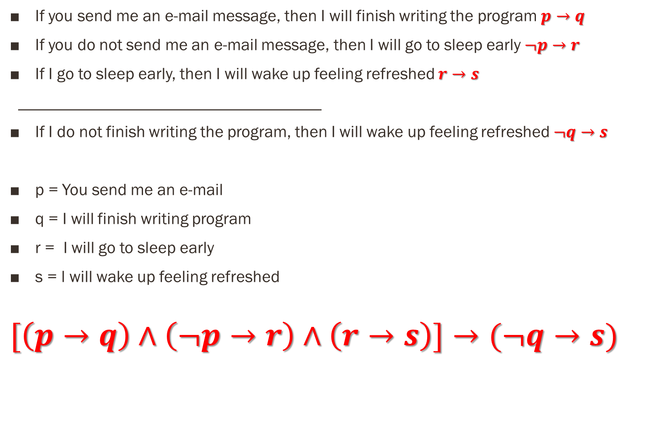
If you send me an e-mail message, then I will finish writing the program $p→q$
If you do not send me an e-mail message, then I will go to sleep early $¬p→r$
If I go to sleep early, then I will wake up feeling refreshed $r→s$
____________________________________
If I do not finish writing the program, then I will wake up feeling refreshed $¬q→s$
p = You send me an e-mail
q = I will finish writing program
r = I will go to sleep early
s = l will wake up feeling refreshed
$$[\left(p→q\right)∧\left(¬p→r\right)∧\left(r→s\right)]→(¬q→s)$$

Slide 24
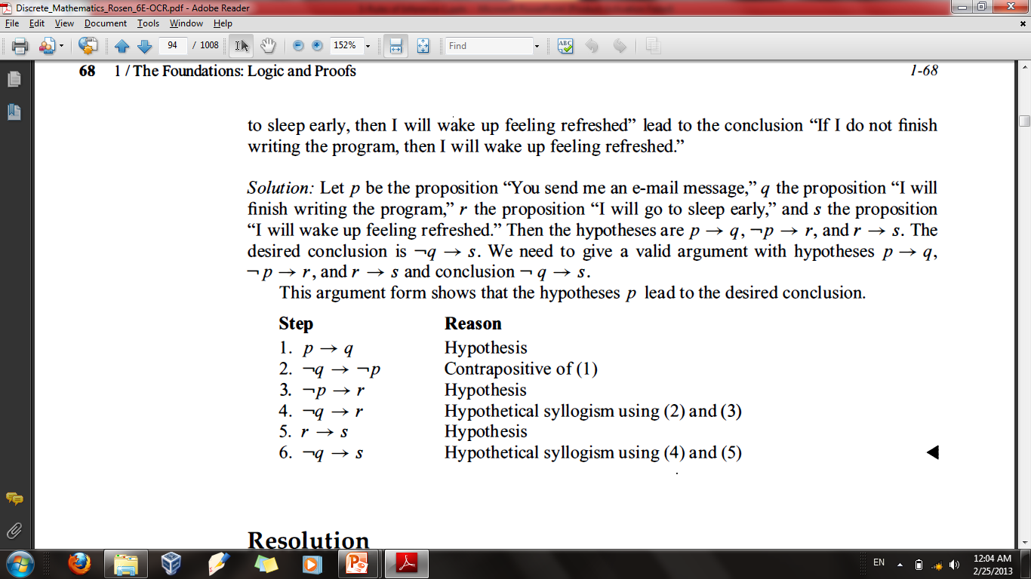

$[(p→q)∧(¬p→r)∧(r→s)]→(¬q→s)$

Slide 25
$[(p→q)∧(¬p→r)∧(r→s)]→(¬q→s)$

Slide 26
$[(p→q)∧(¬p→r)∧(r→s)]→(¬q→s)$

Slide 27
$[(p→q)∧(¬p→r)∧(r→s)]→(¬q→s)$

Slide 28
$[(p→q)∧(¬p→r)∧(r→s)]→(¬q→s)$

Slide 29
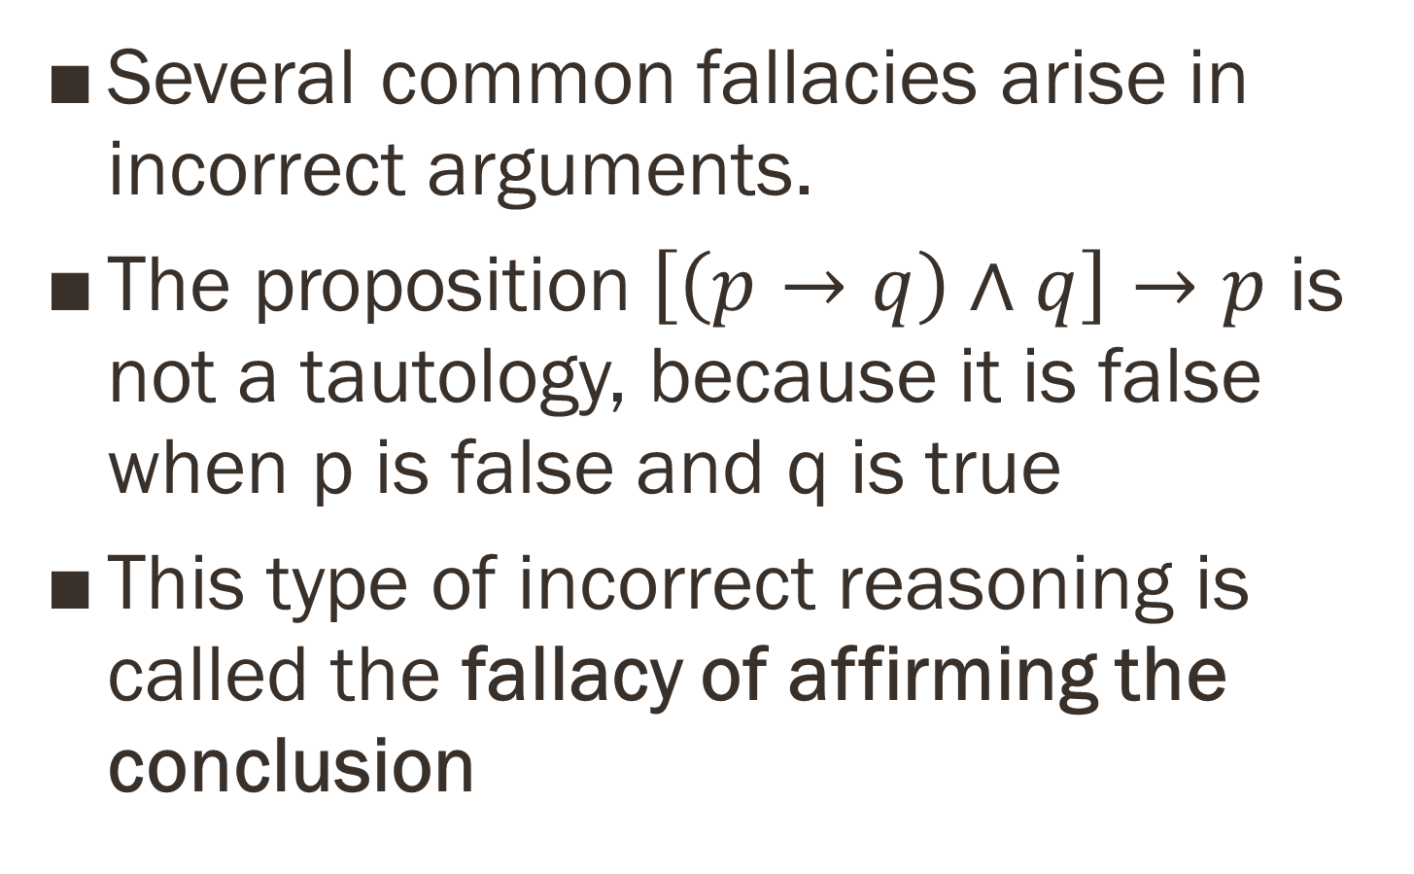
Fallacies
Several common fallacies arise in incorrect arguments.
The proposition$\left[\left(p→q\right)∧q\right]→p$ is not a tautology, because it is false when p is false and q is true
This type of incorrect reasoning is called the fallacy of affirming the conclusion

Slide 30
Example
If you do every problem in this book, then you will learn discrete mathematics.
You learned discrete mathematics.
Therefore, you did every problem in this book.
p: You did every problem in this book
q: You learned discrete mathematics

Slide 31
If you do every problem in this book, then you will learn discrete mathematics.
You learned discrete mathematics.
______________________________________
Therefore, you did every problem in this book.
p: You did every problem in this book
q: You learned discrete mathematics

Slide 32
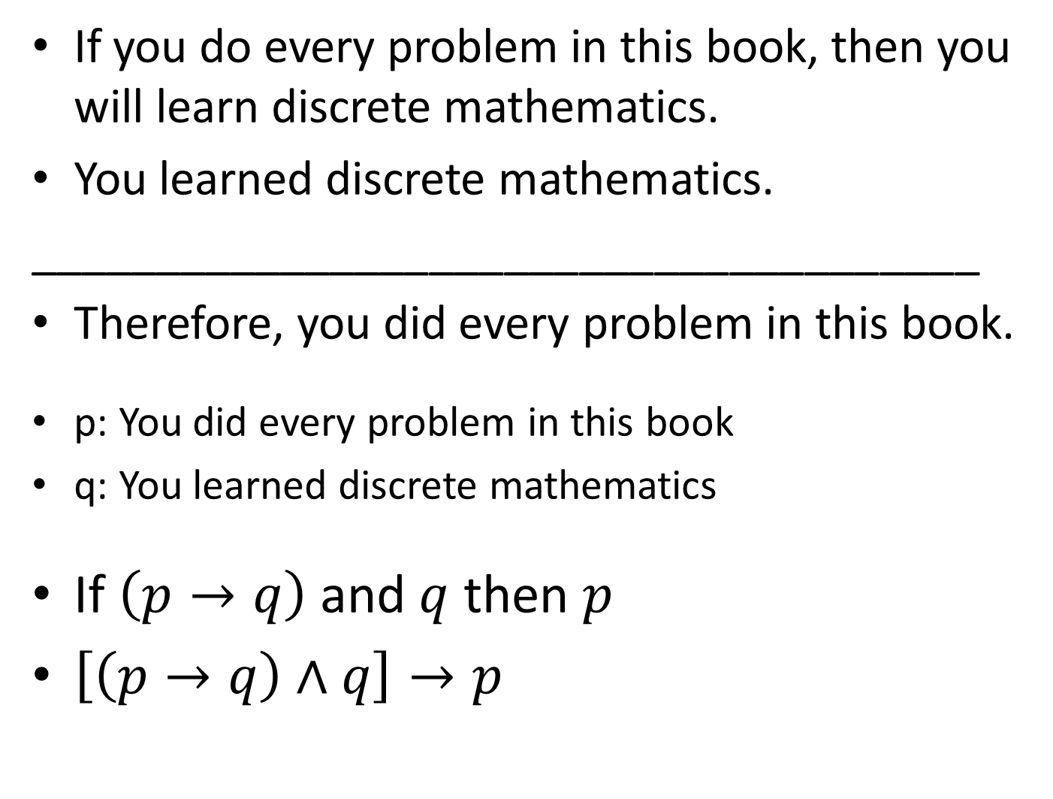
If you do every problem in this book, then you will learn discrete mathematics.
You learned discrete mathematics.
______________________________________
Therefore, you did every problem in this book.
p: You did every problem in this book
q: You learned discrete mathematics
If $\left(p→q\right)$ and $q$ then $p$
$\left[\left(p→q\right)∧q\right]→p$

Slide 33
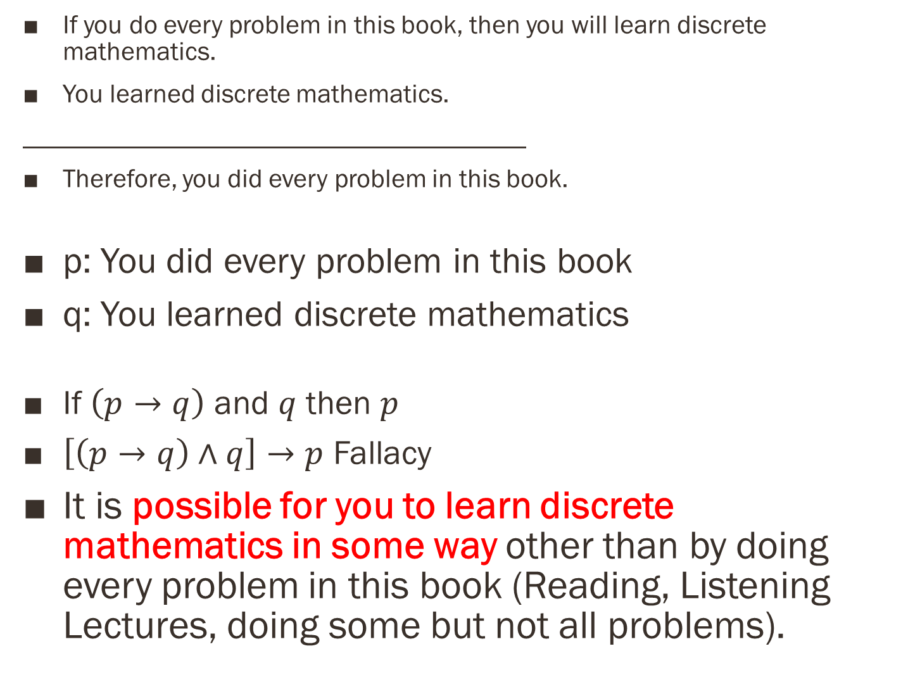
If you do every problem in this book, then you will learn discrete mathematics.
You learned discrete mathematics.
______________________________________
Therefore, you did every problem in this book.
p: You did every problem in this book
q: You learned discrete mathematics
If $\left(p→q\right)$ and $q$ then $p$
$\left[\left(p→q\right)∧q\right]→p$ Fallacy
It is possible for you to learn discrete mathematics in some way other than by doing every problem in this book (Reading, Listening Lectures, doing some but not all problems).

Slide 34
Do Exercises

Slide 35
References
Kenneth Rosen Discrete Mathematics and Its Applications – Chapter # 01
http://slideplayer.com/slide/5784816/
Discrete Structures Dr. Humaiyon – (Essentials)

