Slide 1
Lecture 6
Sets & Set Operations

Slide 2
What is a set?
A set is an unordered collection of “objects”
Cities in the Pakistan: {Lahore, Karachi, Islamabad, … }
Sets can contain non-related elements: {3, a, red, Gilgit }
We will most often use sets of numbers
All positive numbers less than or equal to 5: {1, 2, 3, 4, 5}
Properties
Order does not matter
{1, 2, 3, 4, 5} is equivalent to {3, 5, 2, 4, 1}
Sets do not have duplicate elements
Consider the list of students in this class
It does not make sense to list somebody twice

Slide 3
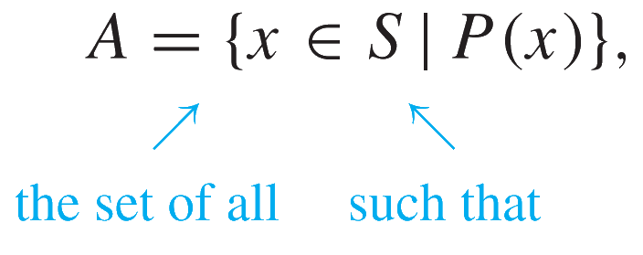
Specifying a Set
Capital letters (A, B, S…) for sets
Italic lower-case letter for elements (a, x, y…)
Easiest way: list all the elements
A = {1, 2, 3, 4, 5}, Not always feasible!
May use ellipsis (…): B = {0, 1, 2, 3, …}
May cause confusion. C = {3, 5, 7, …}. What’s next?
If the set is all odd integers greater than 2, it is 9
If the set is all prime numbers greater than 2, it is 11
Can use set-builder notation
D = {x | x is prime and x > 2}
E = {x | x is odd and x > 2}
The vertical bar means “such that”

Slide 4
Specifying a set
A set “contains” the various “members” or “elements” that make up the set
If an element a is a member of (or an element of) a set S, we use the notation a ∈ S
4 ∈ {1, 2, 3, 4}
If not, we use the notation a ∉ S
7 ∉ {1, 2, 3, 4}

Slide 5
Often used sets
N = {0,1, 2, 3, …} is the set of natural numbers
Z = {…, -2, -1, 0, 1, 2, …} is the set of integers
Z+ = {1, 2, 3, …} is the set of positive integers
Q = {p/q | p ∈ Z, q ∈ Z, q ≠ 0} is the set of rational numbers
Any number that can be expressed as a fraction of two integers (where the denominator is not zero)
R is the set of real numbers

Slide 6
The universal set 1
U is the universal set – the set of all of elements (or the “universe”) from which given any set is drawn
For the set {-2, 0.4, 2}, U would be the real numbers
For the set {0, 1, 2}, U could be the N, Z, Q, R depending on the context
For the set of the vowels of the alphabet, U would be all the letters of the alphabet

Slide 7
Venn diagrams
Represents sets graphically
The box represents the universal set
Circles represent the set(S)
Consider set S, which is the set of all vowels in the alphabet
b
c
d
f
U
g
h
j
e
k
l
m
i
n
p
q
a
S
r
s
t
u
v
w
x
o
y
z

Slide 8
Sets of sets
Sets can contain other sets
S = { {1}, {2}, {3} }
T = { {1}, {{2}}, {{{3}}} }
V = { {{1}, {{2}}}, {{{3}}}, { {1}, {{2}}, {{{3}}} } }
V has only 3 elements!
Note that 1 ≠ {1} ≠ {{1}} ≠ {{{1}}}
They are all different

Slide 9
The Empty Set
If a set has zero elements, it is called the empty (or null) set
Written using the symbol ∅
Thus, ∅ = { } ← VERY IMPORTANT
It can be a element of other sets
{ ∅, 1, 2, 3, x } is a valid set
∅ ≠ { ∅ }
The first is a set of zero elements
The second is a set of 1 element
Replace ∅ by { }, and you get: { } ≠ {{ }}
It’s easier to see that they are not equal that way

Slide 10
Set Equality, Subsets
Two sets are equal if they have the same elements
{1, 2, 3, 4, 5} = {5, 4, 3, 2, 1}
{1, 2, 3, 2, 4, 3, 2, 1} = {4, 3, 2, 1}
Two sets are not equal if they do not have the same elements
{1, 2, 3, 4, 5} ≠ {1, 2, 3, 4}
Two sets A and B are equal iff ∀ x (x ∈ A ↔ x ∈ B)
If all the elements of a set S are also elements of a set T, then S is a subset of T
If S = {2, 4, 6}, T = {1, 2, 3, 4, 5, 6, 7}, S is a subset of T
This is specified by S ⊆ T meaning that ∀ x (x ∈ S → x ∈ T)
For any set S, S ⊆ S i.e. ∀S (S ⊆ S)
For any set S, ∅ ⊆ S i.e. ∀S (∅ ⊆ S)

Slide 11
Subsets
A ⊆ B means “A is a subset of B.”
A ⊇ B means “A is a superset of B.”
A = B if and only if A and B have exactly the same elements.
iff, A ⊆ B and B ⊆ A
iff, ∀x ((x ∈ A) ↔ (x ∈ B)).
So to show equality of sets A and B, show:
A ⊆ B
B ⊆ A

Slide 12
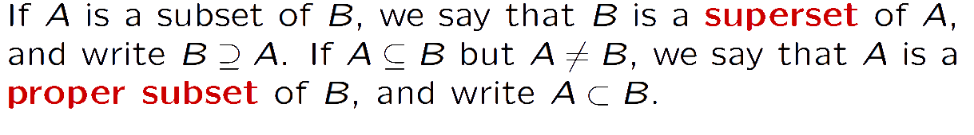
Subset, Superset & Proper Set

Slide 13
Proper Subsets
If S is a subset of T, and S is not equal to T, then S is a proper subset of T
Can be written as: R ⊆ T and R ≠ T
Let T = {0, 1, 2, 3, 4, 5}
If S = {1, 2, 3}, S is not equal to T, and S is a subset of T
A proper subset is written as S ⊂ T
∀ x (x ∈ S → x ∈ T) ∧ ∃ x (x ∈ T ∧ x ∉ S)
Let Q = {4, 5, 6}. Q is neither a subset of T nor a proper subset of T
The difference between “subset” and “proper subset” is like the difference between “less than or equal to” and “less than” for numbers

Slide 14
Is ∅ ⊆ {1,2,3}? Yes!
Is ∅ ∈ {1,2,3}? No!
Is ∅ ⊆ {∅,1,2,3}? Yes!
Is ∅ ∈ {∅,1,2,3}? Yes!
Quiz time:
Is {x} ⊆ {x}?
Is {x} ∈ {x,{x}}?
Is {x} ⊆ {x,{x}}?
Is {x} ∈ {x}?
Yes
Yes
Yes
No

Slide 15
Set cardinality
The cardinality of a set is the number of elements in a set, written as |A|
Examples
Let R = {-2, -3, 0, 1, 2}. Then |R| = 5
|∅| = 0
Let S = {∅, {a}, {b}, {a, b}}. Then |S| = 4

Slide 16
Power Sets
Given S = {0, 1}. All the possible subsets of S?
∅ (as it is a subset of all sets), {0}, {1}, and {0, 1}
The power set of S (written as P(S)) is the set of all the subsets of S
P(S) = { ∅, {0}, {1}, {0,1} }
Note that |S| = 2 and |P(S)| = 4
Let T = {0, 1, 2}. The P(T) = { ∅, {0}, {1}, {2}, {0,1}, {0,2}, {1,2}, {0,1,2} }
Note that |T| = 3 and |P(T)| = 8
P(∅) = { ∅ }
Note that |∅| = 0 and |P(∅)| = 1
If a set has n elements, then the power set will have 2^{n} elements

Slide 17
Cartesian Products
The order of elements in a collection is often important.
Because sets are unordered, a different structure is needed to represent ordered collections. This is provided by ordered n-tuples.

Slide 18
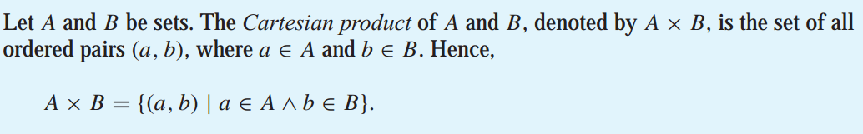
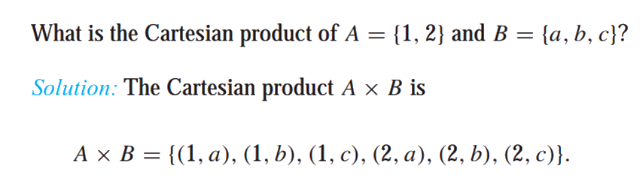
Cartesian Products
Note that the Cartesian products A×B and B×A are not equal, unless A=∅ or B=∅ (so that A×B = ∅) or A=B

Slide 19
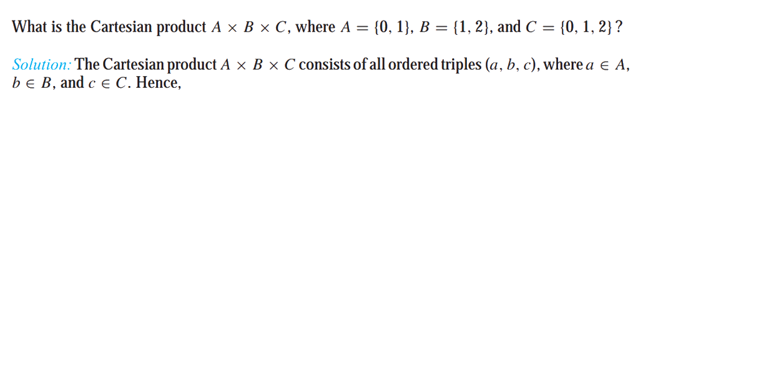
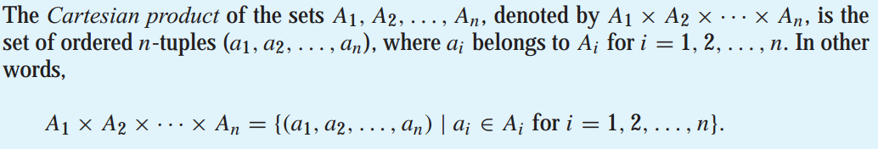
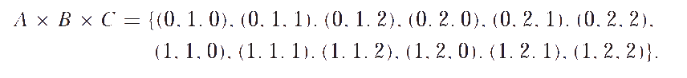
Cartesian Products

Slide 20
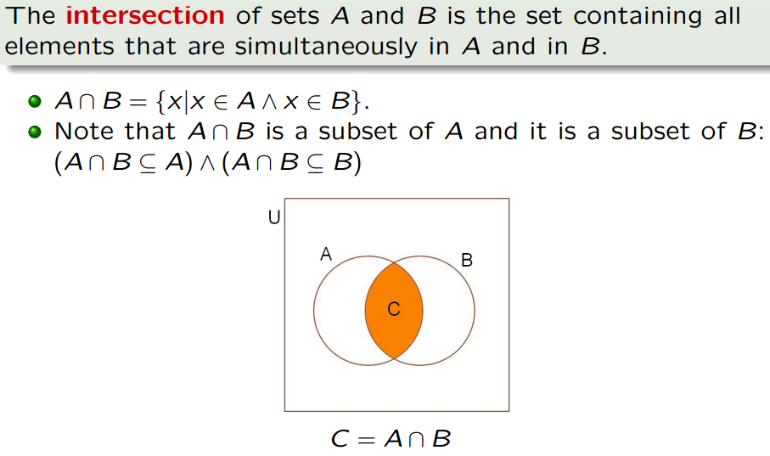
Set operations: Intersection

Slide 21
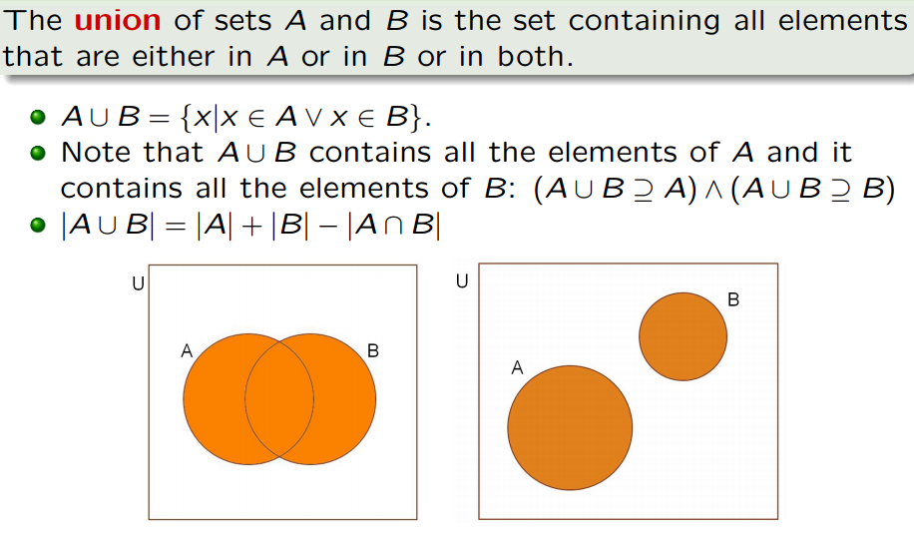
Set operations: Union

Slide 22
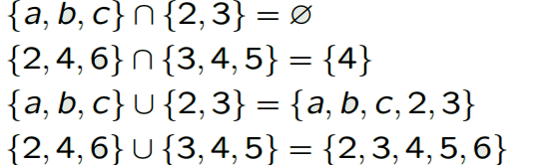
Union Vs Intersection
{1, 2} ∪ ∅ = {1, 2}
{1, 2} ∩ ∅ = ∅

Slide 23
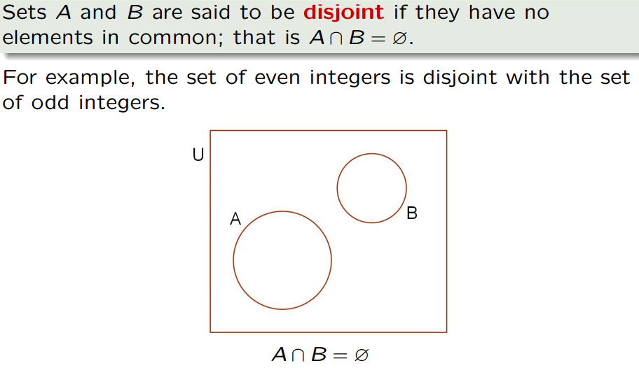
Set operations: Disjoint

Slide 24
Set operations: Disjoint
Formal definition for disjoint sets:
Two sets are disjoint if their intersection is the empty set
Further examples
{1, 2, 3} and {3, 4, 5} are not disjoint
{a, b} and {3, 4} are disjoint
{1, 2} and ∅ are disjoint
Their intersection is the empty set
∅ and ∅ are disjoint!
Because their intersection is the empty set

Slide 25
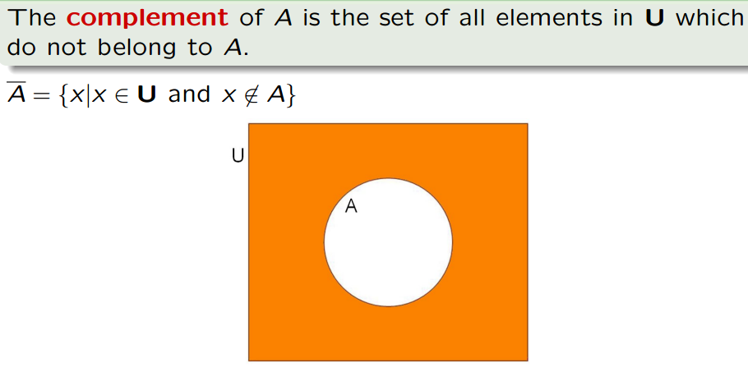
Set operations: Complement

Slide 26
Set operations: Complement
Formal definition for the complement of a set:
A = { x | x ∉ A } = A^{c}
Or U – A, where U is the universal set
Further examples (assuming U = Z)
{1, 2, 3}^{c} = { …, -2, -1, 0, 4, 5, 6, … }
{a, b}^{c} = Z
Properties of complement sets
(A^{c})^{c} = A Complementation law
A ∪ A^{c} = U Complement law
A ∩ A^{c} = ∅ Complement law

Slide 27
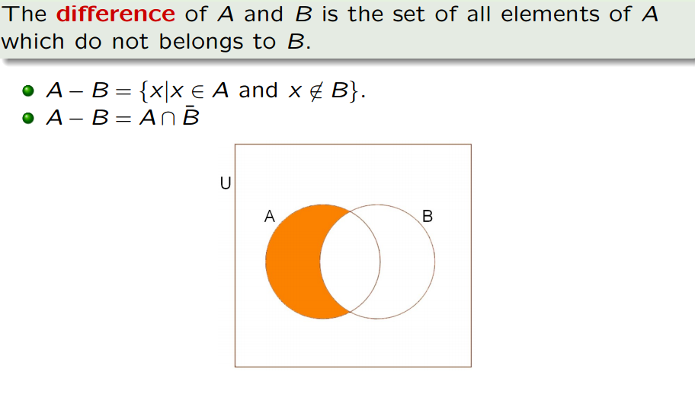
Set operations: Difference

Slide 28
Set operations: Difference
Formal definition for the difference of two sets:
A - B = { x | x ∈ A and x ∉ B }
Sometimes denoted by A\B.
Further examples
{1, 2, 3} - {3, 4, 5} = {1, 2}
{a, b} - {3, 4} = {a, b}
{1, 2} - ∅ = {1, 2}
The difference of any set S with the empty set will be the set S

Slide 29
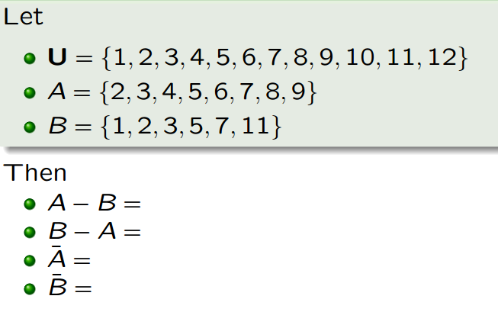
Set operations: Difference

Slide 30
Exercise
What is the cardinality of AUB where A and B are two finite sets?
|A ∪ B| = |A| + |B| ???
Incorrect
|A ∪ B| = |A| + |B| − |A ∩ B|???
Correct

Slide 31
Exercise
What is the cardinality of A∩B where A and B are two finite sets?
|A∩B | = |B| - |B - A|???
Correct
|A∩B | = |A| - |A - B|???
Correct
|A∩B | = |A| + |B| - (|A - B| + |B - A|)???
Incorrect

Slide 32
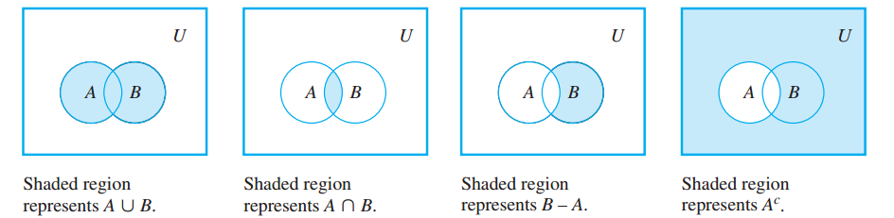

Slide 33
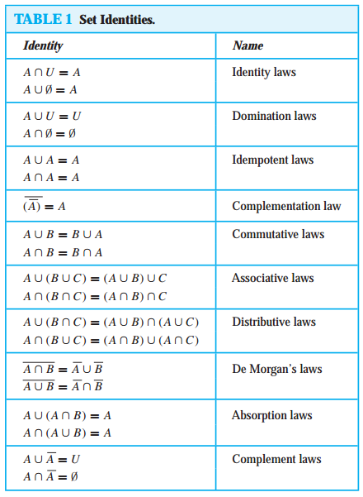
SET IDENTITES

Slide 34
Showing each is a subset of the others Second Example Proof
(A ∩ B)^{c} = A^{c} ∪ B^{c}
Proof: Want to prove that
(A ∩ B)^{c} ⊆ A^{c} ∪ B^{c} and A^{c} ∪ B^{c} ⊆ (A ∩ B)^{c}
(i) x ∈ (A ∩ B)^{c}
⇒ x ∉ (A ∩ B)
⇒ ¬ (x ∈ A ∩ B)
⇒ ¬ (x ∈ A ∧ x ∈ B)
⇒ ¬ (x ∈ A) ∨ ¬ (x ∈ B)
⇒ x ∉ A ∨ x ∉ B
⇒ x ∈ A^{c} ∨ x ∈ B^{c}
⇒ x ∈ A^{c} ∪ B^{c}
(ii) Similarly we show that A^{c} ∪ B^{c} ⊆ (A ∩ B)^{c}

Slide 35
Same proof with Set builder Notation (A ∩ B)^{c} = A^{c} ∪ B^{c}
A ∩ B = {x | x ∉ A ∩ B} Definition of complement
= {x |￢(x ∈ (A ∩ B))}
= {x |￢(x ∈ A ∧ x ∈ B)} Definition of intersection
= {x | ￢(x ∈ A)∨￢(x ∈ B)} De Morgan’s law
= {x | x ∉ A ∨x ∉ B}
= {x | x ∈ A ∨ x ∈ B} Definition of complement
= {x | x ∈ A ∪ B} Definition of union
= A ∪ B meaning of set builder notation

Slide 36
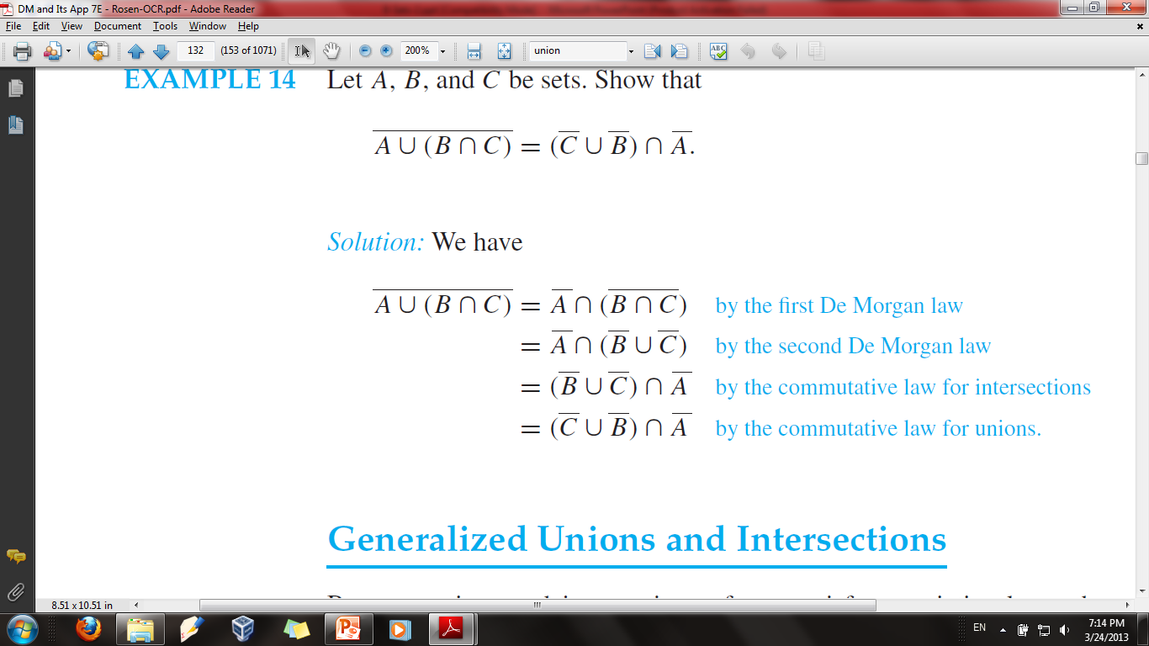

Slide 37
References
Kenneth Rosen Discrete Mathematics and Its Applications – Chapter # 02
Discrete Mathematics, Theeradech Mookum– (Essentials)

