Slide 1
Lecture 7
Functions

Slide 2
Recall the Cartesian Product
Let S = { Ali, Babar, Chishti } and G = { A, B, C }
S×G = { (Ali, A), (Ali, B), (Ali, C), (Babar, A), (Babar, B), (Babar, C), (Chishti , A), (Chishti , B), (Chishti , C) }
A relation
The final grades will be a subset of this:
{ (Ali, C), (babar, B), (Chishti, A) }

Slide 3
Grade Assignment
Ali |  | A
Babar |  | B
Chishti |  | C
Ali |  | A
Babar |  | B
Chishti |  | C

Slide 4
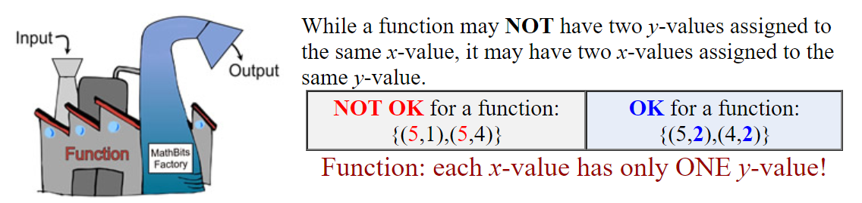
Function
This assignment is an example of a function
A function is a set of ordered pairs in which each x-element has only ONE y-element associated with it

Slide 5
Definition 1
Let A and B be nonempty sets. A function f from A to B is an assignment of exactly one element of B to each element of A.
We write f (a) = b if b is the unique element of B assigned by the function f to the element a of A.
If f is a function from A to B, we write f : A → B.

Slide 6
Domain, Codomain and Range
There are special names for what can go into, and what can come out of a function:
What can go into a function is called the Domain
What may possibly come out of a function is called the Codomain
What actually comes out of a function is called the Range

Slide 7
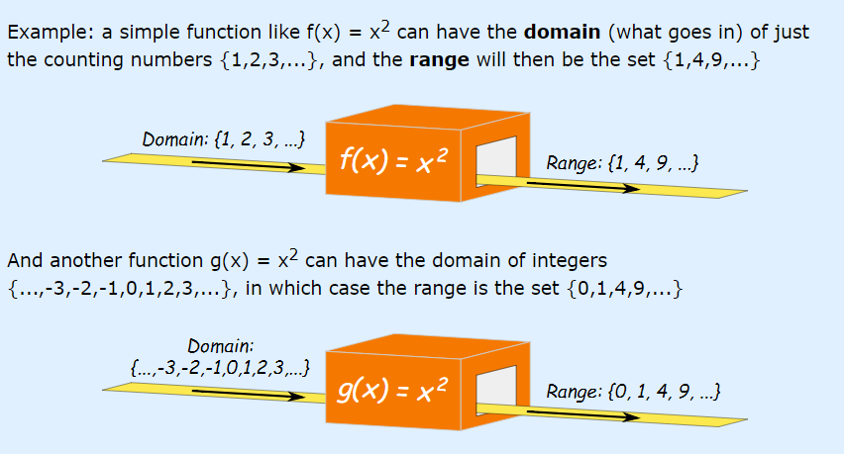

Slide 8
Domain, Codomain and Range Cont.
If f is a function from A to B, we say that A is the domain of f and B is the codomain of f.
Domain
A
B
Co-domain
f
f(4.3)
4.3
4

Slide 9
Domain, Codomain and Range Cont.
If f (a) = b, we say that b is the image of a and a is a preimage of b.
Domain
R
Z
Co-domain
f
f(4.3)
4.3
4
Pre-image of 4
Image of 4.3

Slide 10
Domain, Codomain and Range Cont.
If f is a function from A to B, we say that f maps A to B.
f maps R to Z
f : A → B
Domain
R
Z
Co-domain
f
f(4.3)
4.3
4
Pre-image of 4
Image of 4.3

Slide 11
Domain, Codomain and Range Cont.
A pre-image
of 1
The image
of “a”
Domain
Co-domain
Ali
Babar
Chishti
Dawood
Shariq
A
B
C
D
F
“a”
“bb“
“cccc”
“dd”
“e”
1
2
3
4
5
A class grade function
A string length function
g(Ali) = A
g(Babar) = C
g(Chishti) = A
…
f(x) = length x
f(“a”) = 1
f(“bb”) = 2
…

Slide 12
Domain, Codomain and Range Cont.
The range of f is the set of all images of elements of A.
Range
a
e
i
o
u
1
2
3
4
5
Some function…

Slide 13
Not a valid function!
“a”
“bb“
“cccc”
“dd”
“e”
1
2
3
4
5

Slide 14
Exercise
Let f : Z → Z
assign the square of an integer to this integer
What is f (x) =?
f(x) = x²
What is domain of f ?
Set of all integers
What is codomain of f ?
Set of all integers
What is the range of f ?
{0, 1, 4, 9, . . . }. All integers that are perfect squares

Slide 15
Function arithmetic
Just as we are able to add (+), subtract (-), multiply (×), and divide (÷) two or more numbers, we are able to + , - , × , and ÷ two or more functions
Let f and g be functions from A to R. Then f + g, f – g, f × g and f/g are also functions from A to R defined for all x ∈ A by:
(f + g)(x) = f(x) + g(x)
(f - g)(x) = f(x) - g(x)
(f g)(x) = f (x)g(x) (f g)(x) Ξ (f × g)(x)
(f/g)(x) = f(x)/g(x) given that g(x)≠0

Slide 16
Example
Let f₁ and g be functions from R to R such that:
f(x) = x² //square function
g (x) = x − x² //some other function
What are the functions f + g and f g?
f + g = (f + g)(x) = f (x) + g(x) = x² + (x − x²) = x
(f g) = (f g)(x) = f(x)g(x) = x²(x − x²) = x³ − x⁴
What is f(x)+g(x) and f+g(x) if x=2?
f(2)=4, g(2)=-2; f(2)+g(2) = 4-2=2
f+g(2) = 2

Slide 17
Another Example
Let f and g be functions from R to R such that:
f (x) = 3x+2
g (x) = -2x + 1
What is the function f g?
f g = (f g) (x) = f (x)g(x) = (3x+2)(-2x+1) = -6x²- x +2
Let x = -1, what is f(-1).g(-1) and (f g)(-1)?
f (-1) = 3(-1) + 2 = -1
g(-1) = -2(-1) + 1= 3
f(-1) g(-1) = -1×3 = -3
(f g) (-1) = -6(-1)² – (-1) + 2
= -6+1+2
= -3

Slide 18
One-to-one functions
A function for which every element of the range of the function corresponds to exactly one element of the domain.
Formal definition: A function f is one-to-one if
f(x) = f(y) implies x = y.
a
e
i
o
1
2
3
4
5
a
e
i
o
1
2
3
4
5
A one-to-one function
A function that is
not one-to-one

Slide 19
More on one-to-one
Injective is synonymous with one-to-one
“A function is injective”
A function is an injection if it is one-to-one
Note that there can be un-used elements in a co-domain
a
e
i
o
1
2
3
4
5
A one-to-one function

Slide 20
Exercise
Determine that the function f(x) = x² of type Z × Z is one-to-one.
-2 ->4
-1 ->1
0 -> 0
1 -> 1
2 -> 4
3 -> 9
10 -> 100
The function f(x)=x² is not one-to-one because, for instance,
f(1) = 1
f(−1)=1,
but 1≠−1
Note that the function f(x)=x² with its domain restricted to Z⁺ is one-to-one.

Slide 21
Onto functions
A function is onto if each element in the co-domain is an image of some pre-image
Formal definition: A function f is onto if for all
y ∈ C, there exists x ∈ D such that f(x) = y.
a
e
i
o
u
1
2
3
4
a
e
i
o
1
2
3
4
5
An onto function
A function that is not onto

Slide 22
More on onto
Surjective is synonymous with onto
“A function is surjective”
A function is a surjection if it is onto
Note that there can be multiple used elements in the co-domain
a
e
i
o
u
1
2
3
4
An onto function

Slide 23
Exercise
Determine that the function f(x) = x² of type Z × Z is onto?
The function f is not onto
because there is no integer x with
x²=−1 or x²=5 , for instance.
0
1
2
3
⁞
0
1
2
3
4
5
6
7
8
9
⁞

Slide 24
Onto vs. one-to-one
Are the following functions onto, one-to-one, both, or neither?
a
b
c
1
2
3
4
a
b
c
d
1
2
3
4
a
b
c
1
2
3
4
1-to-1, not onto
Both 1-to-1 and onto
Not a valid function
a
b
c
d
1
2
3
a
b
c
d
1
2
3
4
Onto, not 1-to-1
Neither 1-to-1 nor onto

Slide 25
Bijections
Consider a function that is both one-to-one and onto:
Such a function is a one-to-one correspondence, or a bijection
a
b
c
d
1
2
3
4

Slide 26
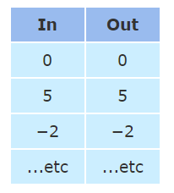
Identity functions
A function such that the image and the pre-image are ALWAYS equal
f(x) = 1*x
f(x) = x + 0
The domain and the co-domain must be the same set

Slide 27
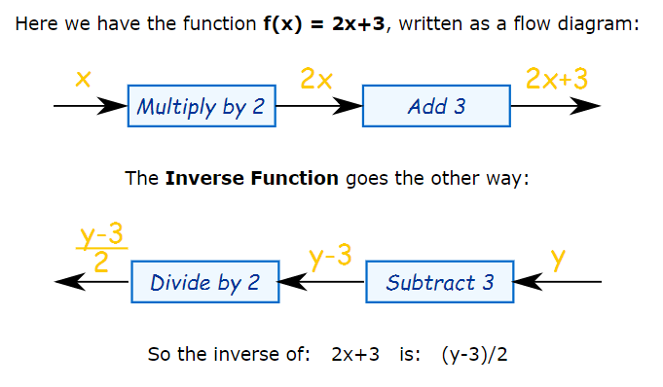
Inverse functions
An inverse function goes the other way!

Slide 28
Inverse functions
The inverse of f(x) is f ⁻¹(y)
Or we can find an inverse by using Algebra:
Put "y" for "f(x)", and
Solve for x (i.e. x in terms of y)

Slide 29
Inverse functions
If f(a) = b, then f⁻¹(b) = a
Let f(x) = 2*x
R
f
R
f⁻¹
f(4.3)
4.3
8.6
f⁻¹(8.6)
Then f⁻¹(x) = x/2

Slide 30
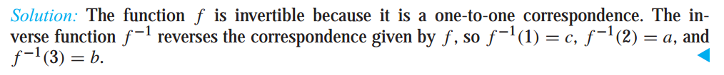
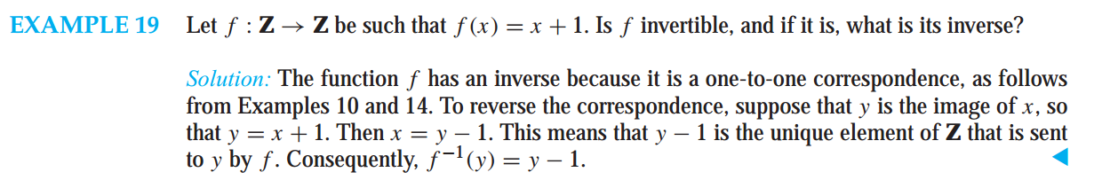
Inverse functions
Question # 01 : Find the inverse of the function: f(x)= 2x+3
Question # 02 : Convert Fahrenheit to Celsius
f (F) = (F - 32) × (5/9)

Slide 31
More on inverse functions
Can we define the inverse of the following functions?
An inverse function can ONLY be defined on a bijection
a
b
c
1
2
3
4
a
b
c
d
1
2
3
What is f⁻¹(2)?
Not onto!
What is f⁻¹(2)?
Not 1-to-1!

Slide 32
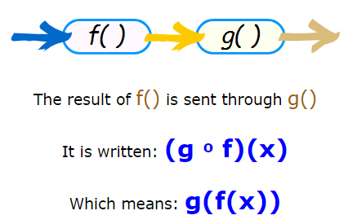
Composition of Functions
"Function Composition" is applying one function to the results of another:

Slide 33
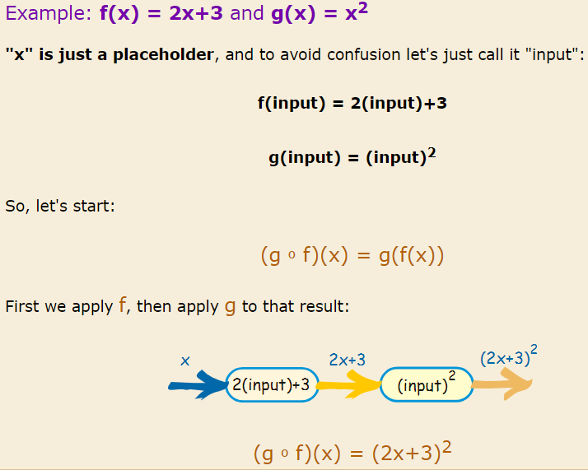
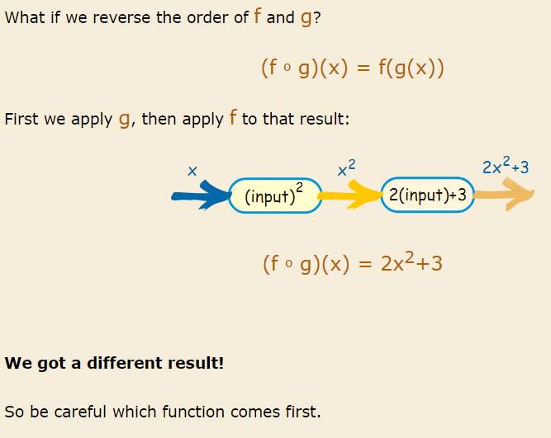
Composition of Functions

Slide 34
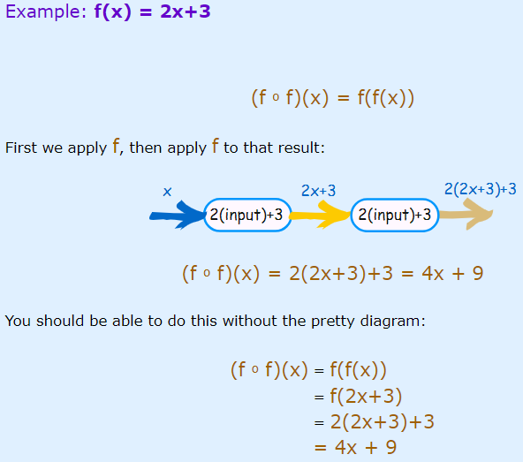
Composition of Functions

Slide 35
Compositions of functions
Let f(x) = 2x+3 Let g(x) = 3x+2
f ○ g
R
R
R
g
f
g(1)
f(5)
f(g(1))=13
1
g(1)=5
(f ○ g)(1)
f(g(x)) = 2(3x+2)+3 = 6x+7

Slide 36
Compositions of functions
Does f(g(x)) = g(f(x))?
Let f(x) = 2x+3
Let g(x) = 3x+2
f(g(x)) = 2(3x+2)+3 = 6x+7
g(f(x)) = 3(2x+3)+2 = 6x+11
Function composition is not commutative!
Not equal!

Slide 37
REFERENCES
http://www.mathsisfun.com/sets/function-inverse.html
Kenneth Rosen Discrete Mathematics and Its Applications – Chapter # 02
Discrete Structures Dr. Humaiyon – (Essentials)

