Slide 1
Lecture 8
Sequence & Summation

Slide 2
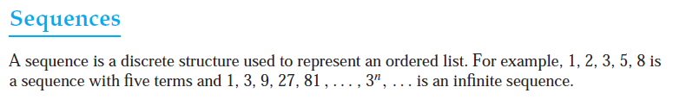
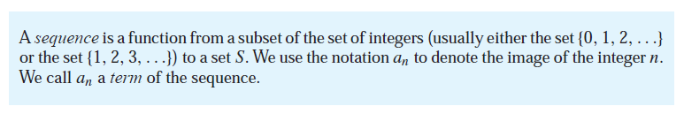
Sequence
We use the notation {an} to describe the sequence. (Note that an represents an individual
term of the sequence {an}.

Slide 3
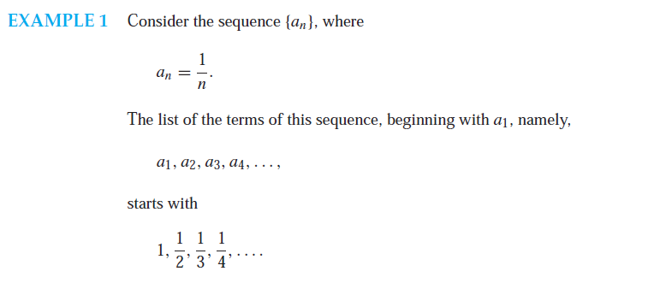
Sequence

Slide 4
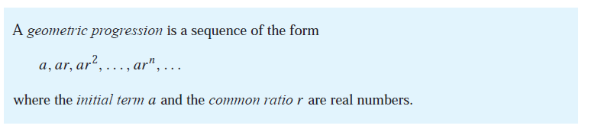
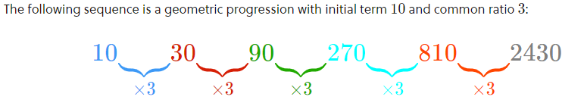
Geometric Progression
Remark: A geometric function f (x) = ${ar}^{x}$
A geometric progression (GP), also called a geometric sequence, is a sequence of non-zero numbers where each term after the first is found by multiplying the previous one by a fixed, non-zero number called the common ratio.

Slide 5
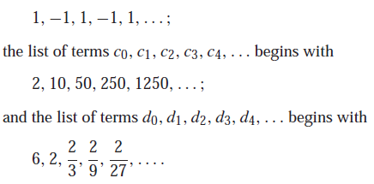
Geometric Progression

Slide 6
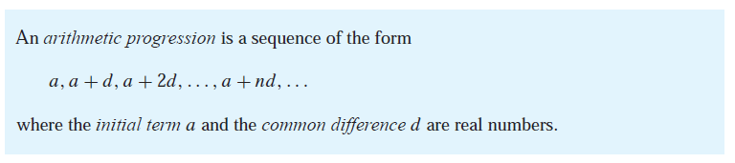
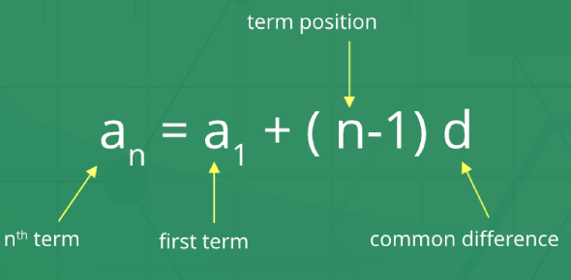
arithmetic progression
Remark: An arithmetic progression f (x) = dx + a.
Arithmetic Progression is a sequence of numbers in order, in which the difference between any two consecutive numbers is a constant value. It is also called Arithmetic Sequence.

Slide 7
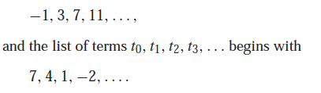
arithmetic progression

Slide 8
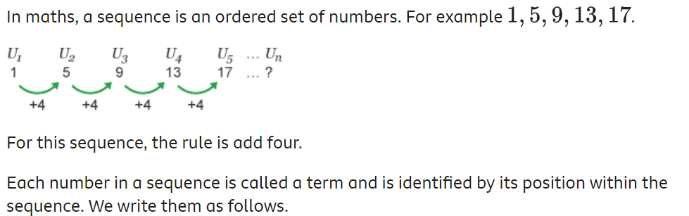
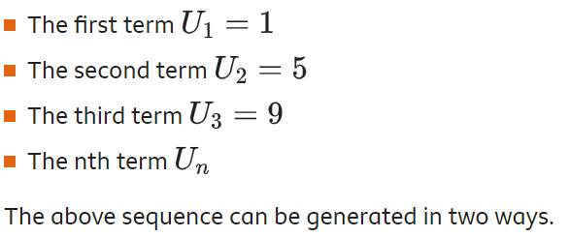
Example

Slide 9
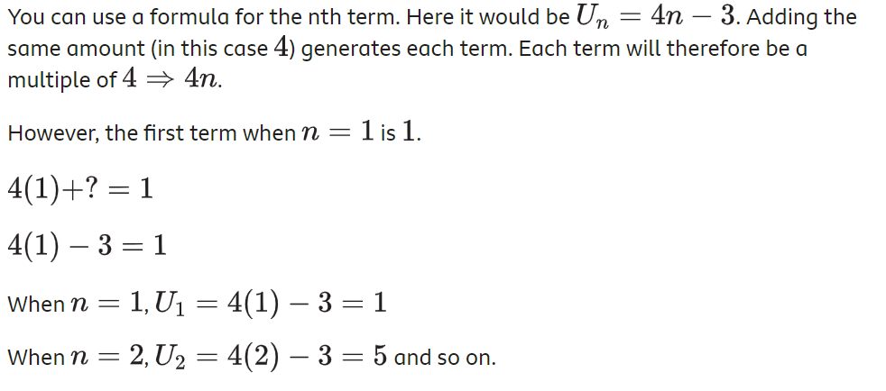
Method # 01: Arithmetic Sequence

Slide 10
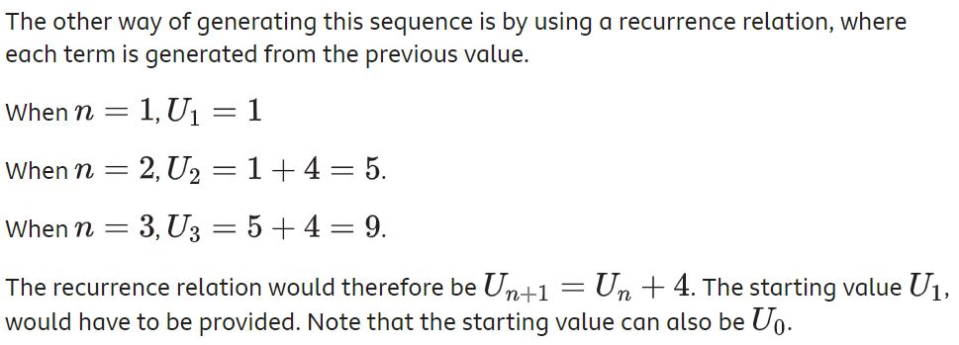
Method # 02: Reoccurrence Relation

Slide 11
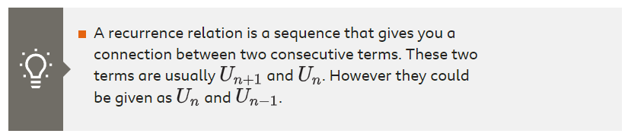
Reoccurrence Relation
A recurrence relation is an equation which represents a sequence based on some rule. It helps in finding the subsequent term (next term) dependent upon the preceding term (previous term). If we know the previous term in a given series, then we can easily determine the next term.

Slide 12
Reoccurrence Relation

Slide 13
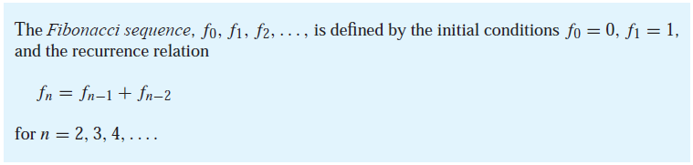
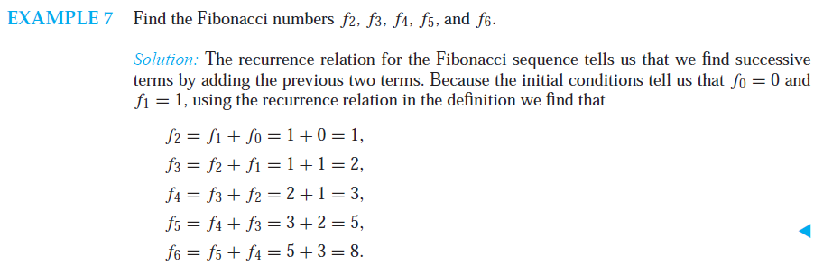
Reoccurrence Relation

Slide 14
Reoccurrence Relation
How can we produce the terms of a sequence if the first 10 terms are
1, 3, 4, 7, 11, 18, 29, 47,76, 123?
Solution: Observe that each successive term of this sequence, starting with the third term,
is the sum of the two previous terms.
4 = 3 + 1,
7 = 4 + 3,
11 = 7 + 4, and so on.
Consequently, if Ln is the nth term of this sequence, we guess that the sequence is determined
by the recurrence relation Ln = Ln−1 + Ln−2 with initial conditions L1 = 1 and L2 = 3 (the same recurrence relation as the Fibonacci sequence, but with different initial conditions). This
sequence is known as the Lucas sequence,

Slide 15
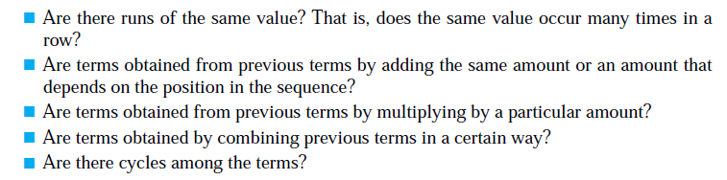
Determining the sequence formula
A common problem in discrete mathematics is finding a closed formula, a recurrence relation, or some other type of general rule for constructing the terms of a sequence. There are many questions you could ask, but some of the more useful are:

Slide 16
Determining the Sequence formula
1, 0, 1, 1, 0, 0, 1, 1, 1, 0, 0, 0, 1, 1, 1, 1, …
The sequence alternates 1’s and 0’s, increasing the number of 1 and 0 each time.
1, 2, 2, 3, 4, 4, 5, 6, 6, 7, 8, 8, …
The sequence increases by one but repeats all even numbers twice.
1, 0, 2, 0, 4, 0, 8, 0, 16, 0, …
The non-zero numbers are geometric sequences (2^{n}), such that every non-zero number is succeeded by a zero.

Slide 17
Determining the Sequence formula
3, 6, 12, 24, 48, 96, 192, …
Each term is twice the previous
a₁ = 3, a_{n} = 2*a_{n-1} (recurrence relation)
Is the above a Geometric Sequence? (a_{n} = ar^{n-1})?
a_{n} = 3 * 2^{n-1} (sequence formula)
15, 8, 1, -6, -13, -20, -27, ….
Each term is 7 less than previous term
a₁ = 15, a_{n} = a_{n-1} - 7
a_{n} = 22 – 7*n

Slide 18
Determining the Sequence formula
3, 5, 8, 12, 17, 23, 30, 38, 47, ….
Initial condition: a₁ = 3 a₂ = 5, a₃ = 8, a₄ = 12
a₂ = a₁ + 2
a₃ = a₂ + 3
a₄ = a₃ + 4
….
a_{n} = a_{n-1} + n
The difference between successive terms increased by 1

Slide 19
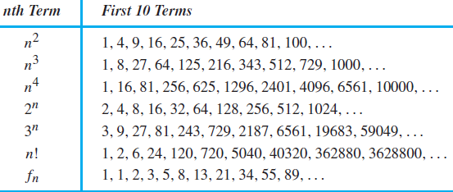
Some Useful Sequences
n(n+1)/2 : 1, 3, 6, 10, 15, …

Slide 20
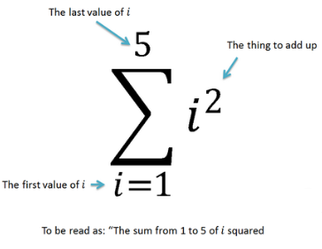
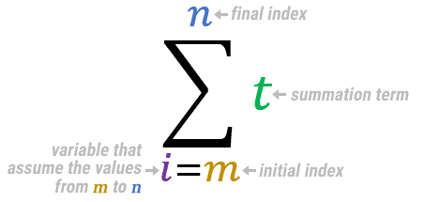
Summation
A simple method for indicating the sum of a finite (ending) number of terms in a sequence is the summation notation. This involves the Greek letter sigma, Σ.

Slide 21
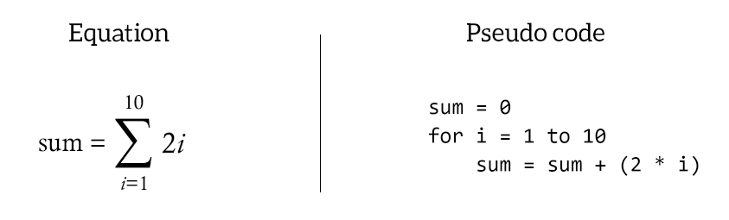
Summation
Summation is like a for loop.

Slide 22
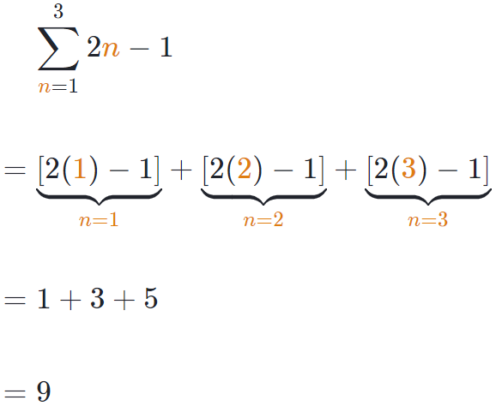
Summation
This is a summation of the expression 2n-1 for integer values of n from 1 to 3:

Slide 23
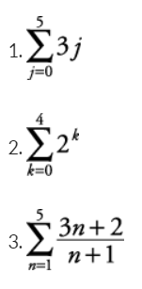

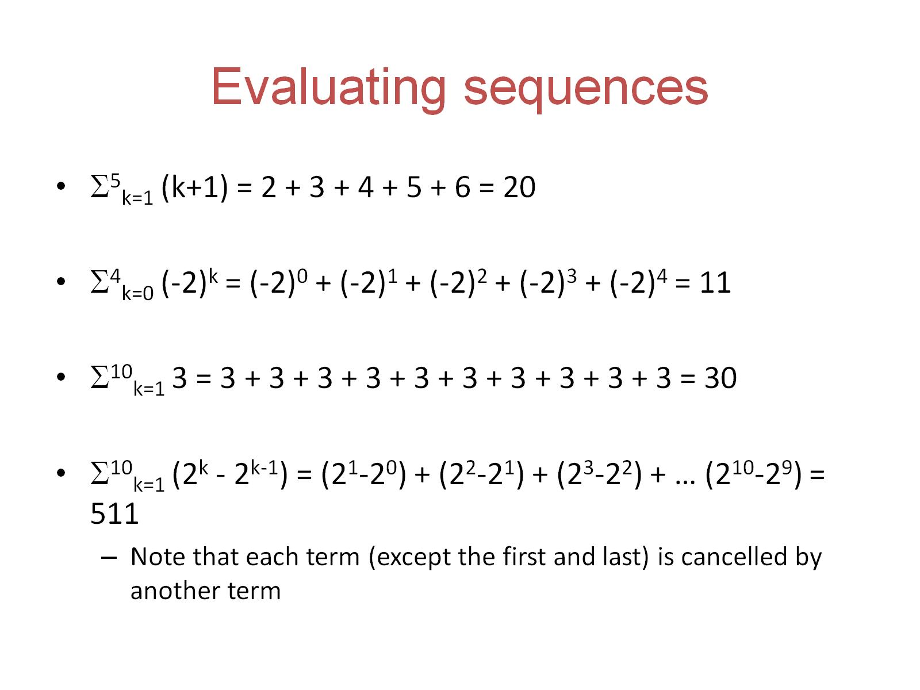

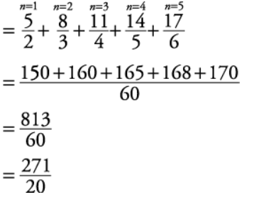
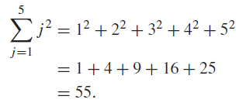
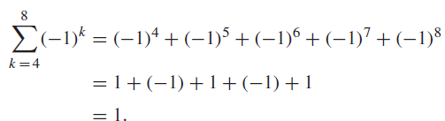
Summation

Slide 24



Summation
Use sigma notation to express series 8 + 11 + 14 + 17 + 20
This is an arithmetic series with five terms whose first term is 8 and whose common difference is 3. Therefore, a ₁ = 8 and d = 3. The nth term of the corresponding sequence is
Since there are five terms, the given series can be written as

Slide 25
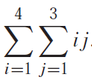
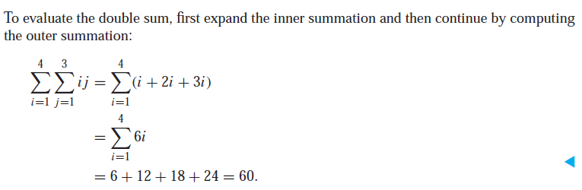
Summation
Double summations arise in many contexts (as in the analysis of nested loops in computer programs). An example of a double summation is

Slide 26
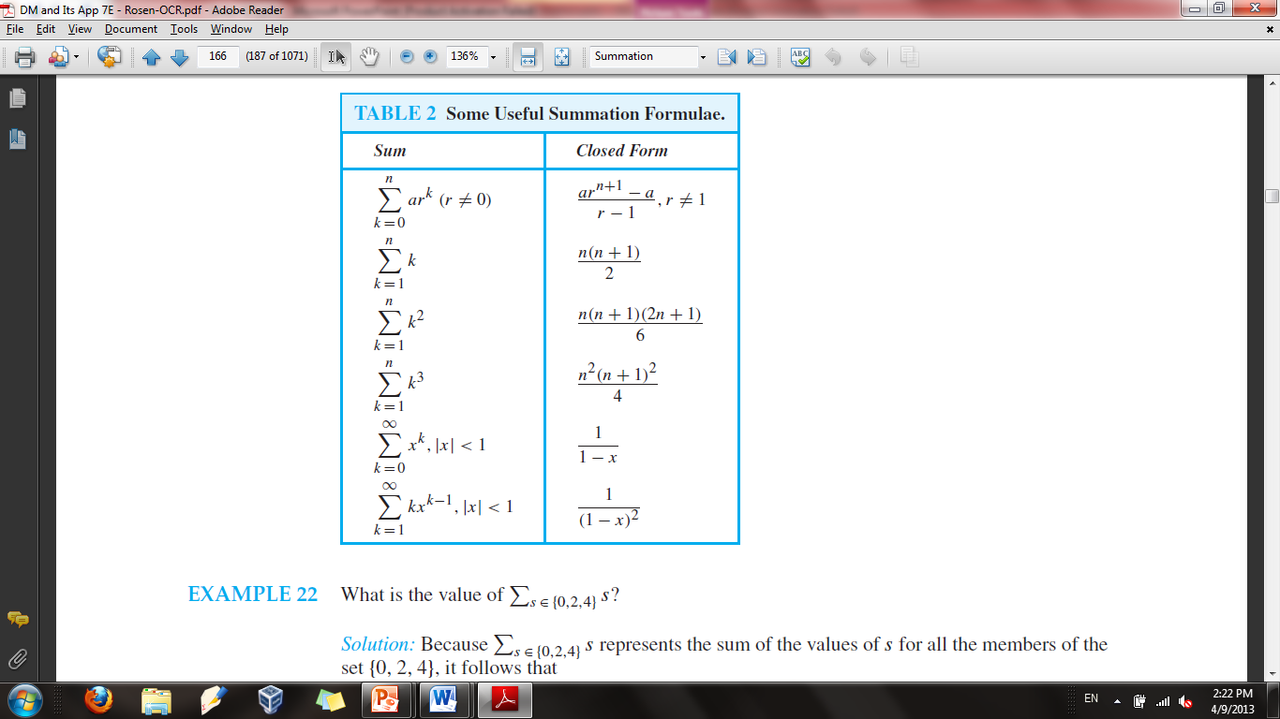

Slide 27
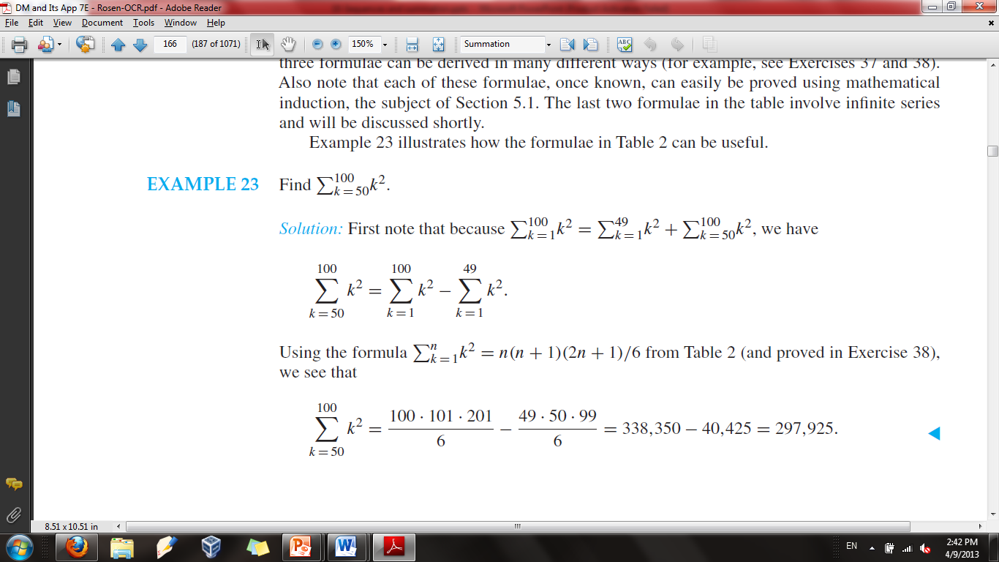
Example

Slide 28
REFERENCES
http://www.mathsisfun.com/sets/function-inverse.html
Kenneth Rosen Discrete Mathematics and Its Applications – Chapter # 02
Discrete Structures Dr. Humaiyon – (Essentials)

