Slide 1
Lecture 9
Mathematical Induction

Slide 2
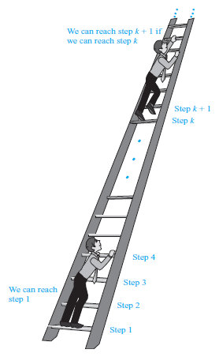
Example
Suppose that we have an infinite ladder
We can reach the first rung of the ladder.
If we can reach a particular rung of the ladder, then we can reach the next rung.
Then, we can conclude that we are able to reach every rung of this infinite ladder.

Slide 3
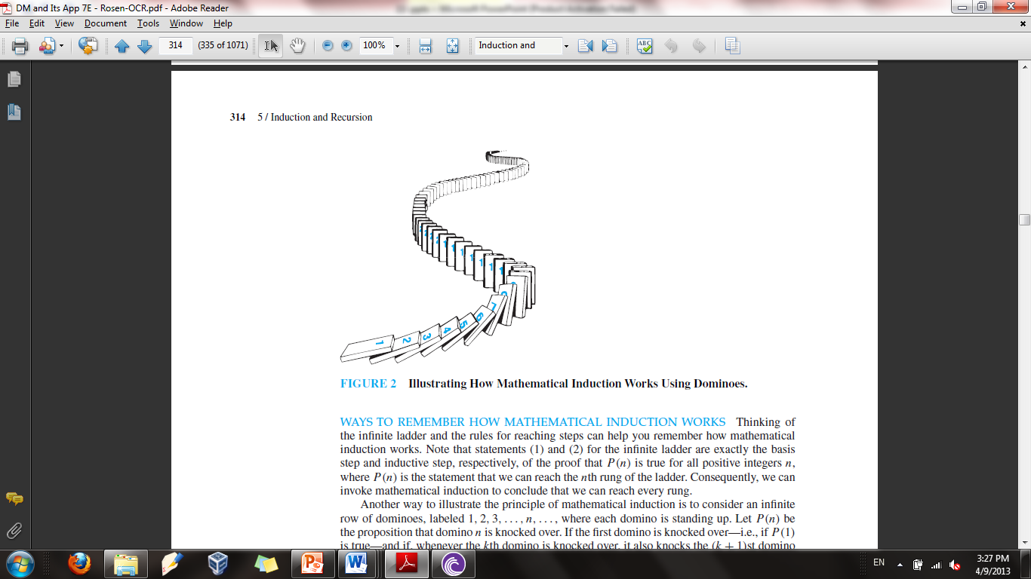
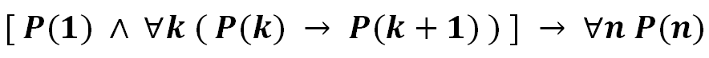
Example using Dominoes
An infinite row of dominoes, labeled 1, 2, 3, ..., n
P(n): Domino n is knocked over
P(1): The first domino is knocked over
P(k): The k^{th} domino is knocked over
The fact that
The first domino is knocked over
And whenever the k^{th} domino is knocked over, it also knocks the (k+1)st domino over
Implies that all the dominoes are knocked over

Slide 4
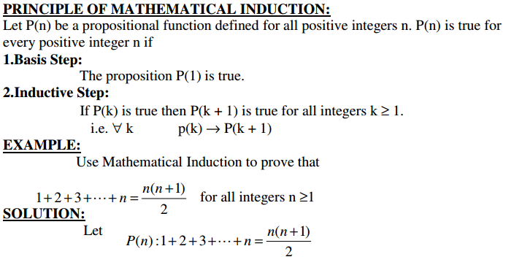

Slide 5
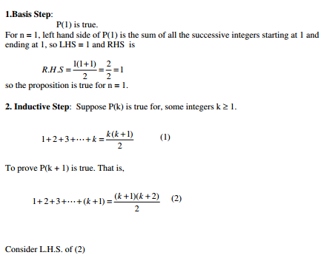

Slide 6
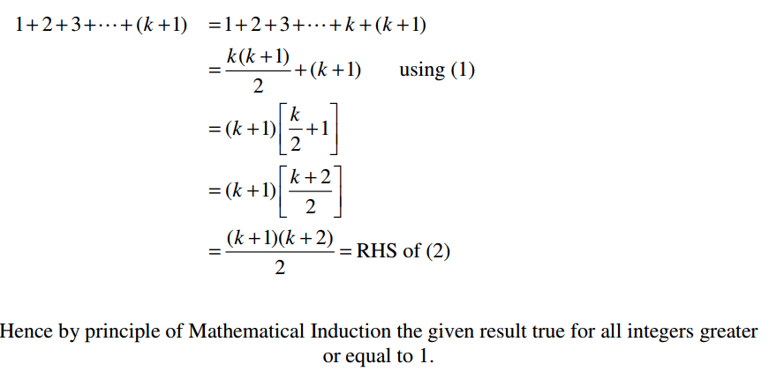

Slide 7
REFERENCES
Kenneth Rosen Discrete Mathematics and Its Applications – Chapter # 05
Discrete Mathematics with Applications by Susanna (4e)– Chapter # 05

