Slide 1

DATA STRUCTURES & ALGORITHMS
Introduction
Instructor: Engr. Laraib Siddiqui

Slide 2
Course Learning Outcomes
Describe basic data structures and relevant standard algorithms
Demonstrate working of different algorithms and processes of data structures
Design different algorithms for data structures operations
Analyze and compare algorithms for efficiency

Slide 3
Reference Books
Data Structures and algorithm analysis in C, Fourth Edition, by Mark Allen Weiss.
C++ Plus Data Structures, Fifth Edition, Nell Dale.
Foundations of Algorithms Using C++ Pseudocode, Third Edition, by Richard Neapolitan & Kumarss Naimipour.

Slide 4
Why Learn this course?
To address these issues:
Data Search
Processor speed
Multiple requests

Slide 5


Introduction
Why we need data???
Data can be referred as:
Collection of facts
Value or Set of Values
Raw information
Structure refers to:
Way of organizing data
Set of rules to hold data

Slide 6
Data Structure
Organizing & storing data
Mathematical & logical model of organization of data
Set of procedures to define, store, access & manipulate data
OR
Data Structure is group of data elements which provides an efficient way of storing and organizing data in the memory.

Slide 7
How we define the efficient way of storing & organizing data?
Efficiency denotes to solve the problem within its resource constraints.
Space
Time
Total resources that the solution consumes effects the solution’s cost.
DESIGN ISSUE???

Slide 8
Types of Data Structures
Linear Elements form sequence Single level
Non-Primitive
Derived from basic data types
E.g. Array, Linked list, Stacks
Non- Linear Elements form hierarchy Multilevel
Data Structures
Primitive
Basic data types which cannot be further divide
E.g. Integer, Real, Character, Boolean

Slide 9
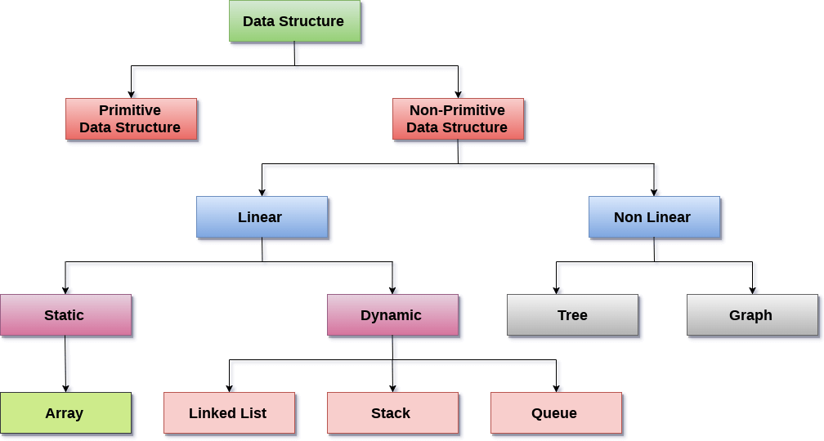
Types of Data Structures

Slide 10
Linear Data Structures
Data Structure | Description
Array | Collection of items of same data type which stores in contiguous block of memory
Linked List | Sequence of links which contains items. Each link contains a connection to another link.
Stack | Linear list in which insertion and deletions are allowed only at one end, called top.
Queue | Opened at both end. It follows First-In-First-Out (FIFO) methodology for storing the data items.

Slide 11
Non – Linear Data Structures
Data Structure | Description
Tree | Multilevel data structures with a hierarchical relationship among its elements known as nodes.
Graph | Pictorial representation of the set of elements (represented by vertices) connected by the links known as edges.

Slide 12
Selecting a Data Structure
Analyze the problem to determine the resource constraints a solution must meet.
Determine the basic operations that must be supported. Quantify the resource constraints for each operation.
Select the data structure that best meets these requirements.

Slide 13
Operations
Traversing
Accessing each data element exactly once so that certain items in the data may be processed
Searching
Finding the location of the data element (key) in the structure
Inserting
Adding a new data element to the structure
Deleting
Removing a data element from the structure
Sorting
Arrange the data elements in a logical order
Merging
Combining data elements from two or more data structures into one

Slide 14

Abstract Data Types
Abstract data type refers to a set of data values and associated operations that are specifically accurately, independent of any particular implementation.
It is called “abstract” because it gives an implementation-independent view. The process of providing only the essentials and hiding the details is known as abstraction.
Think of ADT as a black box which hides the inner structure and design of the data type.

Slide 15
