Slide 1


Sorting – Quick Sort
Instructor: Engr. Laraib Siddiqui

Slide 2
Algorithm
Choose the lowest index value as pivot
Take two variables to point left and right of the list excluding pivot
left points to the low index
right points to the high
while value at left is less than pivot move right
while value at right is greater than pivot move left
if both step 5 and step 6 does not match swap left and right Step 8 − if left ≥ right, the point where they met is new pivot
2

Slide 3

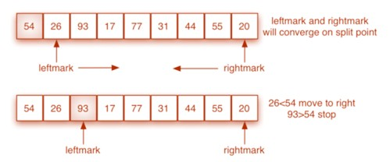
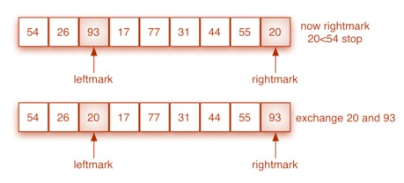
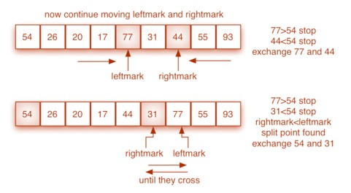
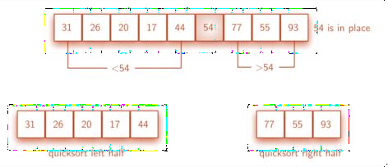
1
2
4
3
5
6
8
7
3

Slide 4





















Worst Case Partitioning
Worst-case partitioning
One region has one element and the other has n – 1 elements
Maximally unbalanced
n
n n
n - 1
n - 2
1
n - 1
n - 2
n - 3
1
Recurrence: q=1
T(n) = T(1) + T(n – 1) + n,
1
n
1
T(1) = Θ(1)
2
3
1 2
1
T(n) = T(n – 1) + n
⎛ ⎞
n
Θ(n²)
n +
∑
2
2
⎜
k −1 = Θ(n) + Θ(n )
= Θ(n )
⎟
⎝ k =1 ⎠
4

Slide 5
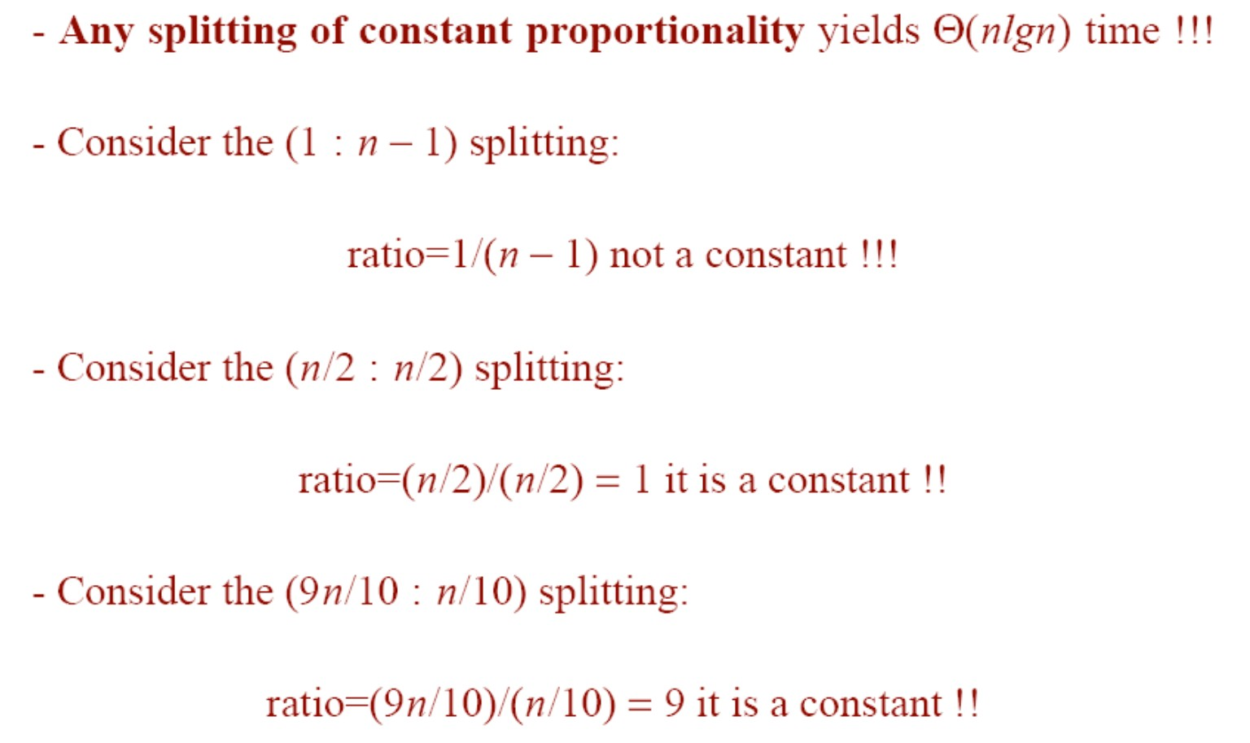
How does partition affect performance?
5

Slide 6
Choice of Pivot
Choosing the first element as pivot can cause worst case behavior on already sorted
arrays.
For improvement in selecting pivot, pick the median value of three elements (first, mid and last) from data array as a pivot.

Slide 7
Practice
Given the following list of numbers [14, 17, 13, 15, 19, 10, 3, 16, 9, 12] which answer shows the contents of the list after the second partitioning according to the quicksort algorithm?
a) [9, 3, 10, 13, 12]
b) [9, 3, 10, 13, 12, 14]
c) [9, 3, 10, 13, 12, 14, 17, 16, 15, 19]
d) [9, 3, 10, 13, 12, 14, 19, 16, 15, 17]

Slide 8
Practice
Which of the following methods is the most effective for picking the pivot element?
first element
last element
median-of-three partitioning
random element

Slide 9
Practice
Find the pivot element from the given input using median-of-three partitioning method.
8, 1, 4, 9, 6, 3, 5, 2, 7, 0.
8
7
9
6

