Slide 1
Queue
Instructor: Engr. Laraib Siddiqui

Slide 2
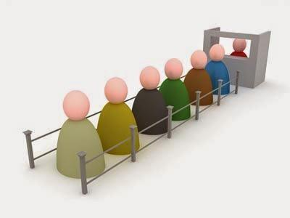


Queues

Slide 3






Queue
▪
Linear data structure.
▪
Follows First in First Out (FIFO Strategy).
▪
Primary operations
▪Enqueue –Add data
▪Dequeue – Remove Data
Data
Data
Data
Data
Data
Data

Slide 4
















Example
Queue
1.
Enqueue(18)
1.
Enqueue(18)
2
20
6
2
20
6
18
2.
Dequeue( )
3.
Dequeue( )
4.
Enqueue(10)
3
2. Dequeue( ) 20
6
18
.
Dequeue(
)
6
18
5.
Enqueue(
-
5 )
5.
Enqueue(
-
4. Enqueue(10)
6
18
10
5)
6
18
10
-5

Slide 5
Operation-Enqueue
This procedure inserts an item into a queue.
procedure enqueue(data)
if queue is full
return overflow
end if
rear ← rear + 1
queue[rear] ← data
return true
end procedure

Slide 6
Operation-Dequeue
This procedure removes an item from a queue.
procedure dequeue
if queue is empty
return underflow
end if
front ← front + 1
return true
end procedure

Slide 7
Applications
▪Efficiently keep tracking of the most recently added elements.
▪Web server request management where you want to first come first serve.
▪Breadth first search (BFS) graph traversal.
▪CPU scheduling, Disk scheduling.
▪Handling of interrupts in real time systems
▪Call Center phone systems use Queues to hold people calling them in order.

Slide 8
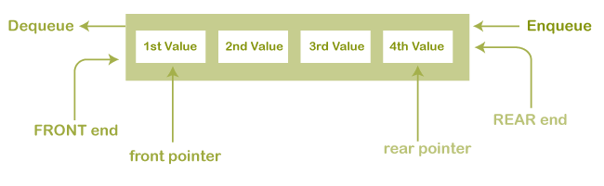
Types of
Queue
Linear Queue
insertion takes place from one end while the deletion occurs from another
end.

Slide 9
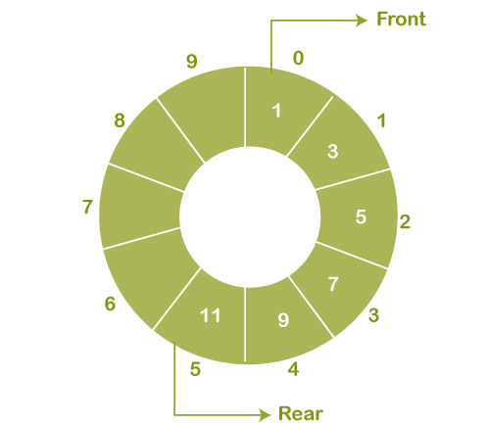
Types of
Queue
Circular
queue
▪Arrangement of elements in a circular fashion.
▪Last node connected with first node which solves the problem of wastage of memory
when removing items.
▪Also known as ring buffer.

Slide 10
Types of
Queue
Deque (Double ended Queue)
▪Elements can be added or removed at either end but not in the middle.
▪Also called double ended queue.
Types
1.
Input
restricted
deque
Insertion can be done only at one of the end, while deletion can be done from both ends.
2.
Output
restricted
deque
Deletion can be done only at one of the ends, while insertions can be done on both ends.

Slide 11
Types of Queues
Priority
queue
▪Collection of elements such that each element has been assigned a priority.
▪Element of higher priority is processed before any element of lower priority.
▪Elements with same priority are processed according to first come first serve basis.

Slide 12
Complexity
Queue
Access
O(n)
Search
O(n)
Deletion
O(1)
Insertion
O(1)

