Slide 1

Trees
Instructor: Engr. Laraib Siddiqui

Slide 2
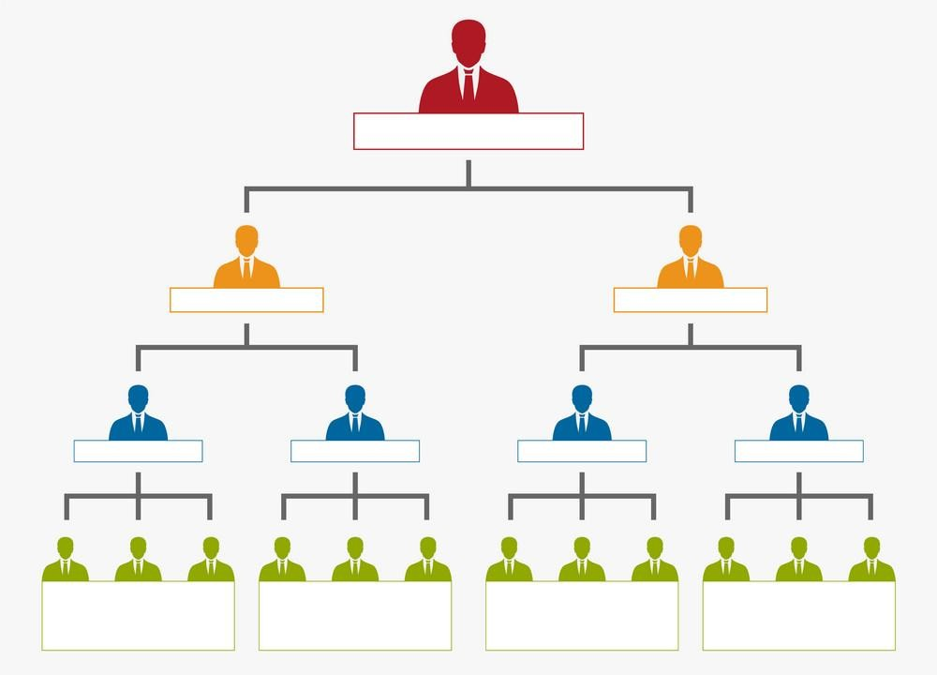
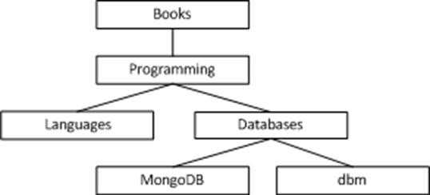
Trees

Slide 3
Key Terms
Root – Node at the top of the tree
Path - sequence of nodes along the edges of a tree
Predecessor – node that is above certain node.
Successor – node that is below certain node.
Ancestor – all nodes that is before certain node and in the same path.
Descendant – All nodes that is after certain node and in the same path.
Parent – predecessor that is one level above certain node.
Child – node below a given node .
Sibling – nodes that have same parent.
Leaf – node which have no child.

Slide 4
Key Terms
Degree of a node – number of child of that node.
Degree of a tree – maximum degree of nodes in a given tree.
Height of a node – maximum path length from that node to a leaf node.
Height of a tree – distance of the root to leaf.
Levels – represents the generation of a node. If root node is at level 0, then its next child node is at level 1
Depth of a tree – maximum level of any leaf in the tree.

Slide 5
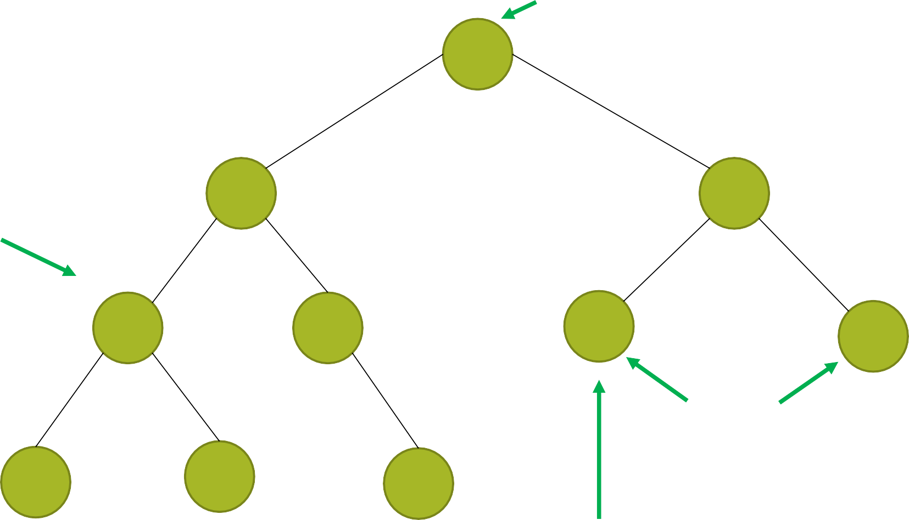
Root
Level 1
Level 2
Parent Node
Level 3
Child Node
Sibling
Level 4
Leaf Node
Sub Tree

Slide 6


ancestors of a
descendants of a
a
a

Slide 7
Characteristics of trees
Non-linear data structure
Combines advantages of an ordered array
Searching as fast as in ordered array
Insertion and deletion as fast as in linked list

Slide 8
Applications
Directory structure of a file store.
Structure of an arithmetic expressions.
Used in almost every high bandwidth router for storing router tables.
Used in almost every 3 D video game to determine what objects need to be rendered.
Used in compression algorithms, such as those used by the .jpeg and .mp3 file formats.

Slide 9
Binary trees
A binary tree is a tree such that
every node has at most 2 children
each node is labeled as being either a left child or a right child

Slide 10
Properties of Binary Tree
Maximum degree of one node is 2.
Maximum number of node each level is 2^{(𝑁 −1)}
Maximum node until level N is 2^{𝑁} - 1.

Slide 11
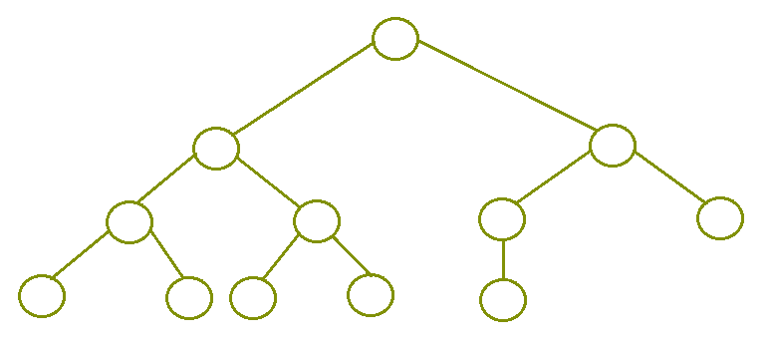
Types of Binary Tree
Complete binary tree
It is a binary tree in which every level, except possibly the last, is completely filled, and all nodes are as far left as possible.

Slide 12
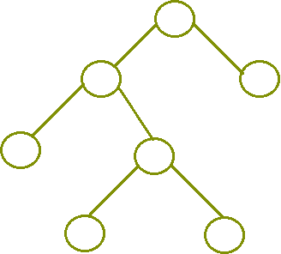
Types of Binary Tree
Full/ Strict binary tree
It is a tree in which every node in the tree has either 0 or 2 children.

Slide 13
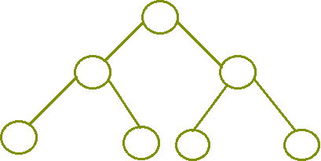
Types of Binary Tree
Perfect binary tree
It is a binary tree in which all interior nodes have two children and all leaves have the same depth or same level.

Slide 14

Types of Binary Tree
Degenerate Binary Tree
A binary tree is said to be a degenerate binary tree or pathological binary tree if every internal node has only a single child.

Slide 15
Tree Traversal
Process to visit all the nodes of a tree and may print their values too.
Depth First
In order traversal
Left – Root - Right
Pre order traversal
Root – Left - Right
Post order traversal
Left - Right - Root
Breath First/Level order

Slide 16
Pre Order
A
B
C
D
E
F
G
A → B → D → E → C → F → G

Slide 17
In Order
A
B
C
D
E
F
G
D → B → E → A → F → C → G

Slide 18
Post Order
A
B
C
D
E
F
G
D → E → B → F → G → C → A

Slide 19
Breath First/ Level Order
A
B
C
D
E
F
G
A → B → C → D → E → F → G

Slide 20
Example: Construct Binary tree using preorder and inorder traversals
Preorder: 1, 2 , 4, 8, 9, 10, 11, 5, 3, 6, 7 Root – Left - Right
Inorder: 8, 4, 10, 9, 11, 2, 5, 1, 6, 3, 7 Left – Root - Right
8,4 , 10 , 9, 11, 2, 5
8,4 , 10 , 9, 11 2 5
1
6, 3, 7
6
3
7
8
4
10 , 9, 11
5
6
7
8
10 9
11
10
11

Slide 21
Example: Construct Binary tree using postorder and inorder traversals
Postorder: | 9, | 1, | 2, 12, 7, 5, | 3, | 11, 4, 8 | Left - Right - Root
Inorder: | 9, | 5, | 1, 7, 2, 12, | 8, | 4, 3, 11 | Left – Root - Right
 |  |  | 9, 5, 1, 7, 2, 12 | 8 | 4, 3, 11
5
4
9
1, 7, 2, 12
3, 11
9
1
7
2, 12
11
3
1
2
12
3
2

Slide 22
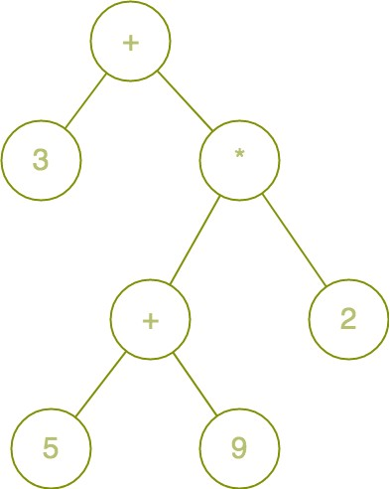
Expression Trees
Expression Tree is a special kind of binary tree which is used to represent expressions with the following properties:
Each leaf is an operand.
The root and internal nodes are operators.
Subtrees are subexpressions with the root being an operator.

Slide 23
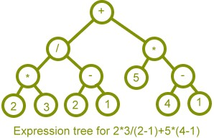
Expression Trees

