Slide 1
Trees : BST
Instructor: Engr. Laraib Siddiqui

Slide 2
Binary Search Tree
Binary search tree is a data structure that quickly allows us to maintain a sorted list
of numbers.
▪The left sub-tree of a node has a key less than or equal to its parent node's key.
▪The right sub-tree of a node has a key greater than to its parent node's key.
30
15
36
12
18
32
40
2

Slide 3
Searching and insertion in BST
Suppose an ITEM with the root node N of the tree. The following algorithm finds the
location of ITEM in the binary search tree, or inserts ITEM as a new node in its
a)
Compare
ITEM
with the root node
N
of the tree.
▪ITEM > N, proceed to the right child of N
b)
Repeat step (a) until one of the following occurs:
▪We meet an empty subtree, which indicates that the search is unsuccessful, and we
insert ITEM in place of the empty subtree.
3

Slide 4
Example: Insertion in BST
10,12,5,4,20,8,7,15,13
Insert 10
Insert 12, 12 > 10, will be
Insert 5, 5 < 10, will be
added to left
Insert 4, 4 < 10 & 4 < 5,
will be added to left
added to right
10
10
10
10
5
12
5
12
12
4
4

Slide 5
Example: Insertion in BST
10,12,5,4,20,8,7,15,13
10
10
10
5
12
5
12
5
12
4
8
20
4
20
4
8
20
7
Insert 20, 20 > 10 & 20 > 12
, will be added to right
Insert 8, 8 < 10 & 8 > 5 , will
be added to right
Insert 7, 7 < 10 & 7 < 8, will be
added to left
5

Slide 6
Example: Insertion in BST
10,12,5,4,20,8,7,15,13
10
10
5
12
5
12
4
8
20
4
8
20
Insert 13, 13 > 10 & 13 > 12 &
13 < 20 & 13 < 15, will be
7
15
7
15
Insert 15, 15 > 10 & 15 > 12 &
15 < 20, will be added to left
13
6

Slide 7
Deleting in a BST
a)
Find the desired element.
▪It does not exist
▪It exists in the left subtree
▪It exists in the right subtree
b)
Replace the desired element with its successor (if any)
▪Node is a leaf node – Remove the node
▪Node has left/right subtree –Successor of the node replace the node.
▪Node has both left and right subtrees –Successor which can replace the node, can either be the
largest value in the left subtree or the smallest value in the right subtree.
7

Slide 8
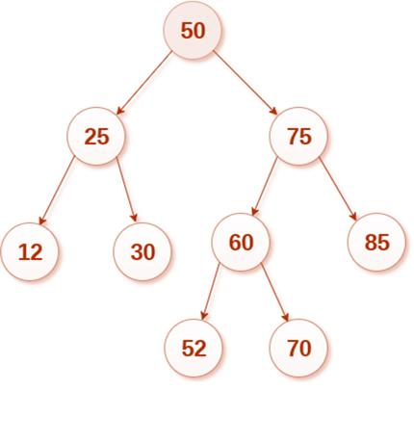


Deleting in a BST
Delete 85
Node is a leaf node – Remove the node
8

Slide 9
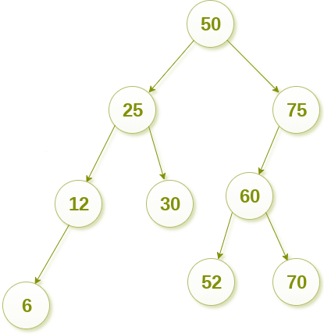
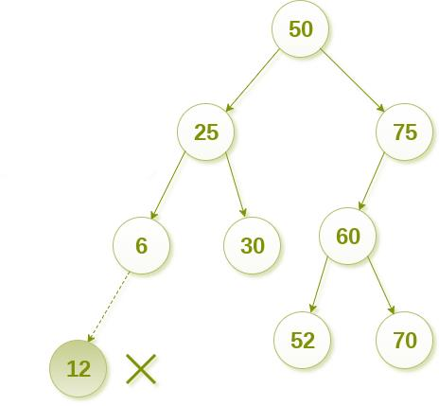
Deleting in a BST
Delete 12
Node has left/right subtree –Successor of the node replace the node.
9

Slide 10
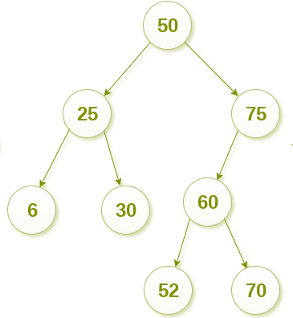
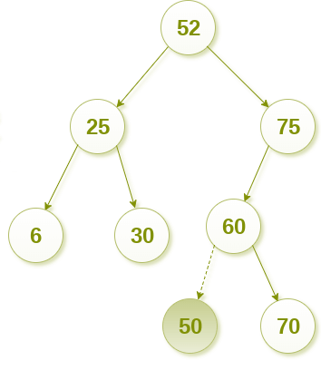
Deleting in a BST
Delete 50
Node has both left and right subtrees –Successor which can replace the node, can either be the
largest value in the left subtree or the smallest value in the right subtree.
10

Slide 11
Complexity
Binary search tree
Access
O(n)
Search
O(n)
Deletion
O(n)
Insertion
O(n)
11

Slide 12
Binary Search Tree
What happens when you Insert elements in ascending order?????
Example
1
Issue: Lack of Balance
2
Solution: Balanced binary search trees (BBST)
4
6
8
12

