Slide 1

Trees : AVL
Instructor: Engr. Laraib Siddiqui

Slide 2
Balanced Binary Tree
Self balancing binary search tree.
Adjust itself in order to maintain a low logarithmic height allowing for faster
operations: insertion & deletions.
Tree is balanced ????
check balance factor
Balance Factor = height(leftSubTree) − height(rightSubTree)

Slide 3
AVL Search Tree
They are height-balanced binary search trees
The invariant in the AVL which forces it to remain balanced is the requirement that the balance factor is always either -1 , 0 or +1.
Balance factor can be determine by:
height(left subtree) - height(right subtree)
Note: If a node’s BF is not -1 , 0 or +1 then it can be adjusted through rotations.

Slide 4
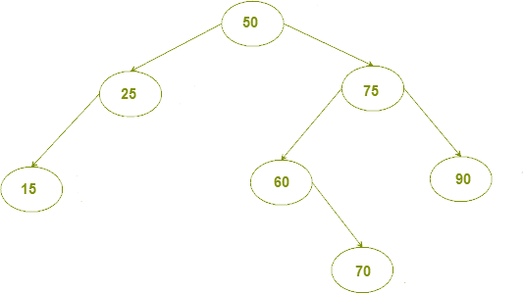
Is this tree is balanced?

Slide 5
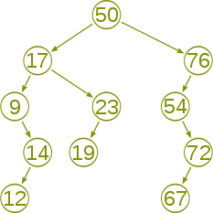
Is this tree is balanced?

Slide 6
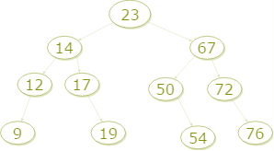
Is this tree is balanced?

Slide 7
Tree Rotations
We can shuffle/ transform / rotate the value and nodes in the tree as long as BST invariant satisfied!
4
5 5
3
5
4
4
D
D
3
3
C
C
A
B
C
D
A
B
A
B

Slide 8
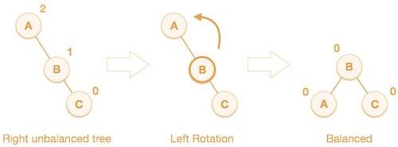
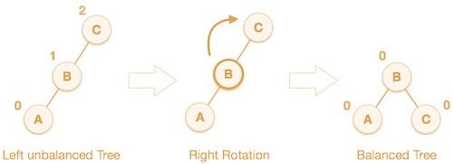
AVL Rotations
Left Rotation
If a tree becomes unbalanced, when a node is inserted into the right subtree of the right subtree, then we perform a single left rotation
Right Rotation
If a tree becomes unbalanced, when a node is inserted in the left subtree of the left subtree. The tree then needs a right rotation.

Slide 9

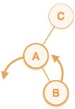
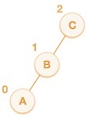
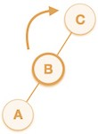
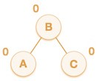

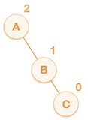
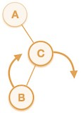
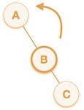
AVL Rotations
Left-Right Rotation
If a node has been inserted into the right subtree of the left subtree. This makes an unbalanced node. This scenario cause to perform left-right rotation.
Right-Left Rotation
If a node has been inserted into the left subtree of the right subtree. This makes an unbalanced node.

Slide 10

AVL
Insert H, I, J, B, A, E, C, F, D
0
-1
-2
I
H
H
H
0
I
I
-1
H
J
0
J
BST is right-skewed, perform RR Rotation on node H.

Slide 11

AVL
Insert H, I, J, B, A, E, C, F, D
I
I
I
2
H
J
H
J
B
J
B
1
B
A
H
0
A
BST from H is left-skewed, perform LL Rotation on node H.

Slide 12

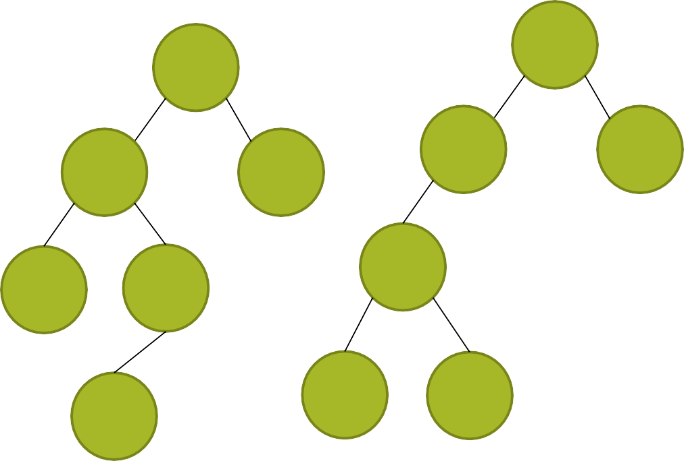

AVL
Insert H, I, J, B, A, E, C, F, D
2
I
H
I
H
J
B
-1
J
B
I
1
B
A
H
A
E
J
A
E
E

Slide 13
AVL
Insert H, I, J, B, A, E, C, F, D
H
H
B
I
B
I
A
E
J
A
E
J
C
C
F

Slide 14
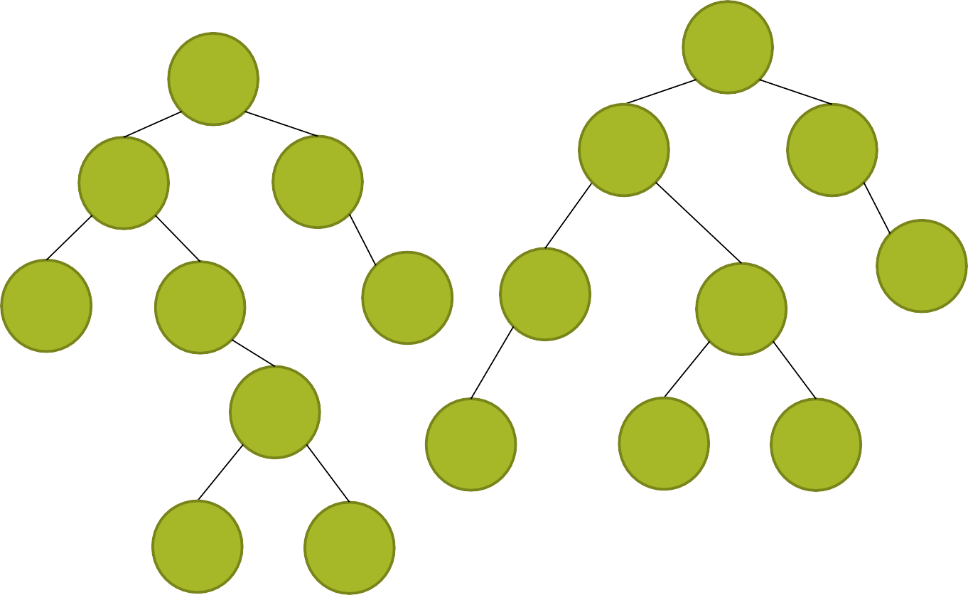


AVL
Insert H, I, J, B, A, E, C, F, D
2
H
H
H
-2
C
I
B
I
B
I
J
A
E
J
A
C
J
B
E
C
F
E
A
D
F
D
D
F

Slide 15
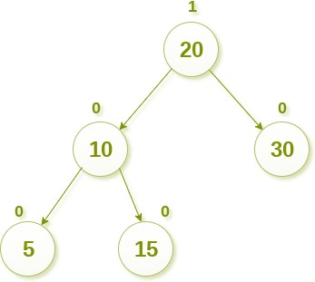
Deletion

Slide 16
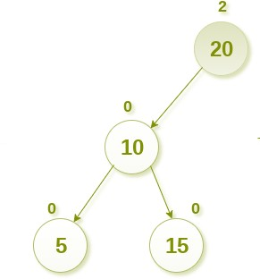
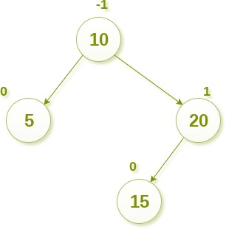
Deletion

Slide 17
Complexity
 | AVL Tree
Access | O(logn)
Search | O(logn)
Deletion | O(logn)
Insertion | O(logn)

