Slide 1

Trees : M ways
Instructor: Engr. Laraib Siddiqui

Slide 2
M-Way Search Tree
It can have more than two children. M is called the degree of the tree.
Requirement????
Favors retrieval and manipulation of data stored in external memory.
Goal???
Minimizes the accesses while retrieving a key from a file.

Slide 3

M-Way Search Tree
It can have m pointers and m-1 keys in one node. Properties:
Each node has 0 .. m subtrees
A node with k < m subtrees, contains k-1 keys.
The key values of the first subtree are all less than the key value.
The data entries are ordered.
Representation:
Where,
P are pointers to the subtree.
K are key values in the node

Slide 4
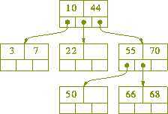
3-way search tree

Slide 5
3-way search tree
Insert 10, 60, 100, 200,40,120
10
60
40
100
200
120

Slide 6

4-way search tree
Insert 10, 60, 100, 200,40,120

Slide 7
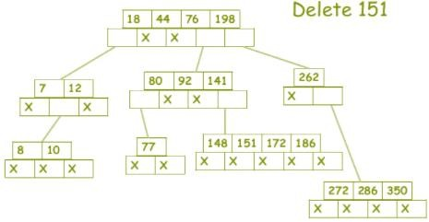
5 Way - Deletion

Slide 8
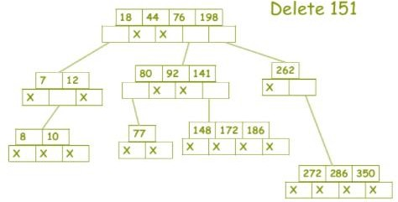
5 Way - Deletion

Slide 9
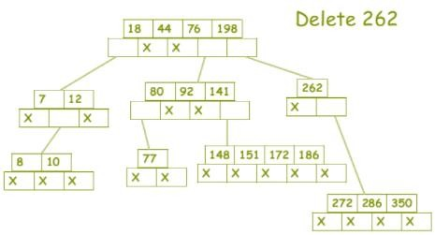
5 Way - Deletion

Slide 10
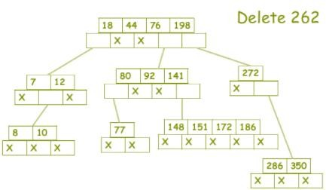
5 Way - Deletion

Slide 11
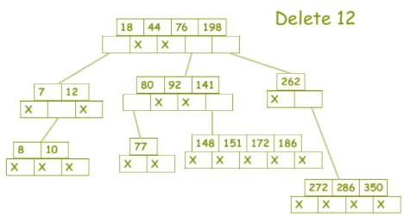
5 Way - Deletion

Slide 12
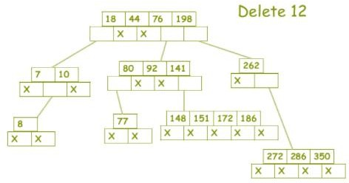
5 Way - Deletion

Slide 13
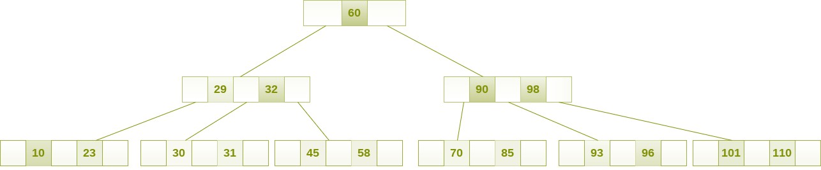
B Tree
B Tree is a specialized m-way tree that can be widely used for disk access.
B tree of order m contains all the properties of an M way tree. In addition, it contains the following properties.
Every node in a B-Tree contains at most m children.
Every node in a B-Tree except the root node and the leaf node contain at least ⌈m/2⌉ children.
The root nodes must have at least 2 nodes.
All leaf nodes must be at the same level.

Slide 14
B tree order 3
Insert 1, 7, 6, 2, 11, 4, 8
Insert 6
6
6
1
7
Insert 1, 7
1
7
1
2
7
11
Insert 2, 11

Slide 15
B Tree- Insertion
Traverse the B Tree in order to find the appropriate leaf node at which the node can be inserted.
If the leaf node contain less than m-1 keys then insert the element in the increasing order.
Else, if the leaf node contains m-1 keys, then follow the following steps.
Insert the new element in the increasing order of elements.
Split the node into the two nodes at the median.
Push the median element upto its parent node.
If the parent node also contain m-1 number of keys, then split it too by following the
same steps.

Slide 16
Insertion- B tree order 3
2
6
6
1
4
7
11
2
8
1
4
7
11
Insert 4
Insert 8

Slide 17
Insertion- B tree order 3
6
2
8
1
4
7
11
Insert 5, 15, 3, 12 ????

Slide 18
Insertion- B tree order 4
Insert 1, 7, 6, 2, 11, 4, 8, 5, 15
2
2
6
1 | 6 | 7
1
6 | 7 | 11
1
4
7
11

Slide 19
Insertion- B tree order 4
Insert 1, 7, 6, 2, 11, 4, 8, 5, 15
2
6
2
6
8
1
4
5
7 | 8 | 11
1
4
5
7
11
15

Slide 20
Insertion- B tree order 5
Insert 1, 7, 6, 2, 11, 4, 8, 5, 15
6
1 | 2 | 4 | 5
7 | 8 | 11 | 15

Slide 21
B tree- Deletion
Cases
Leaf Node
More than min no of keys - Delete
Min no of keys – Borrow from sibling, If sibling is at min no of keys, then merge with
parent.
Min Children: ⌈m/2⌉ Max Children: m Min Keys: ⌈m/2⌉ - 1 Max Keys:m-1
Internal node
Successor will replace
If not, then borrow from sibling
If not, then merge with parent

Slide 22
B tree- Deletion
Locate the node.
If there are more than ⌈m/2⌉ - 1 keys in the node then delete the desired key from the node.
If the node doesn't contain ⌈m/2⌉ - 1 keys then complete the keys by taking the element from right or left sibling.
If the left sibling contains more than ⌈m/2⌉ - 1 elements then push its largest element up to
its parent and move the intervening element down to the node where the key is deleted.
If the right sibling contains more than ⌈m/2⌉ - 1 elements then push its smallest element up to the parent and move intervening element down to the node where the key is deleted.
If neither of the sibling contain more than ⌈m/2⌉ - 1 elements then create a new node by joining two leaf nodes and the intervening element of the parent node.
If parent is left with less than ⌈m/2⌉ - 1 nodes then, apply the above process on the parent too.

Slide 23
Deletion
6
2
4
8
12
1
3
5
7
11
15
Delete 5
For order 3, min keys can be ⌈m/2⌉ - 1
=> ⌈3/2⌉ - 1
= > 1
Merge node

Slide 24
Deletion
6
2
8
12
1
3
4
7
11
15
Delete 12

Slide 25
Deletion
6
2
11
1
3
4
7
8
15

Slide 26
Complexity
 | B Tree
Access | O(Log(n))
Search | O(Log(n))
Insertion | O(Log(n))
Deletion | O(Log(n))

