Slide 1

Heap
Instructor: Engr. Laraib Siddiqui

Slide 2
Heap
A Heap is a special Tree-based data structure in which the tree is a complete binary tree.
Generally, Heaps can be of two types:
Min-Heap − root node is less than or equal to either of its children.
Max-Heap − root node is greater than or equal to either of its children.

Slide 3
Min/ Max Heap
0
8
2
3
7
6
4
5
6
4
3
2
5
4
Min Heap
Max Heap

Slide 4
Min/Max Heap Construction Algorithm
Create a new node at the end of heap.
Assign new value to the node.
Compare the value of this child node with its parent.
If value of parent is less than/greater than child(min max heap) , then swap
them.
Repeat step 3 & 4 until Heap property holds.

Slide 5

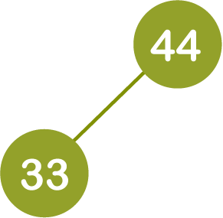
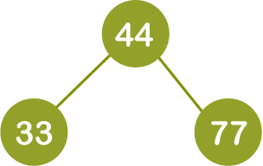
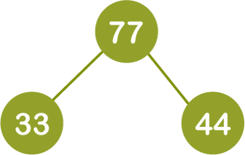
Insertion – Max Heap
44, 33, 77
Violates max heap property: swap

Slide 6
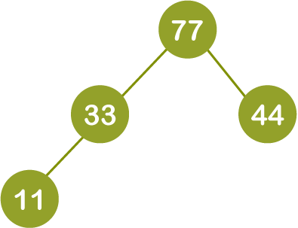
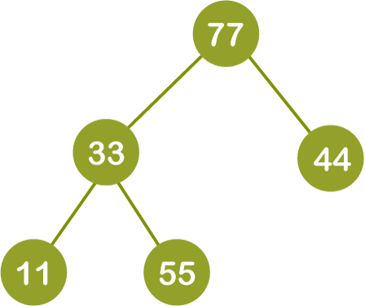
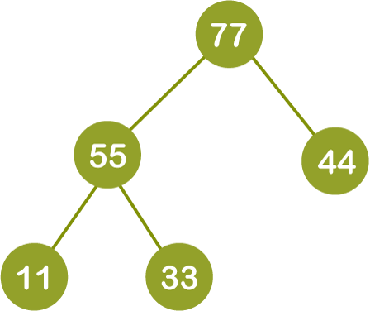
Insertion – Max Heap
11, 55

Slide 7
Insertion – Max Heap
?
Insert 88, 66

Slide 8
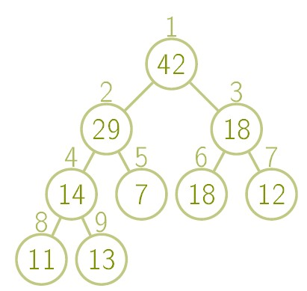

Store as Array
parent(i ) = ⌊i/2⌋ leftchild(i ) = 2i rightchild(i ) = 2i + 1
13

Slide 9
Max/Min Heap Deletion Algorithm
Remove root node.
Move the last element of last level to root.
Compare the value of this child node with its parent.
If value of parent is less than child, then swap them.
Repeat step 3 & 4 until Heap property.

Slide 10
Heap Sort
In heap sort, basically, there are two phases involved in the sorting of elements. By using the heap sort algorithm, they are as follows -
The first step includes the creation of a heap by adjusting the elements of the array.
After the creation of heap, now remove the root element of the heap repeatedly by shifting it to the end of the array, and then store the heap structure with the remaining elements.

Slide 11

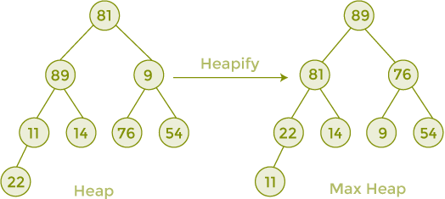

Heap Sort

Slide 12
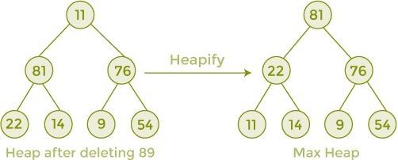

Heap Sort

Slide 13
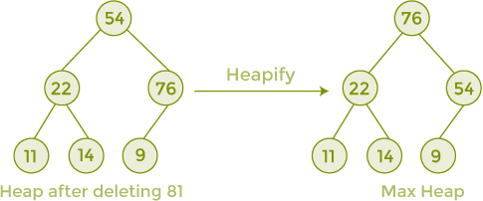

Heap Sort

Slide 14
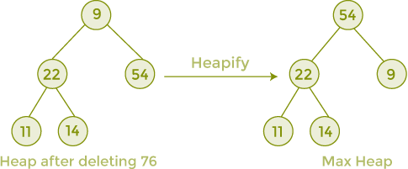

Heap Sort

Slide 15
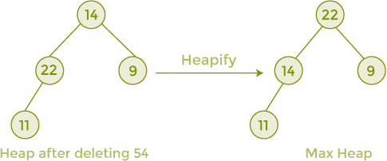

Heap Sort

Slide 16
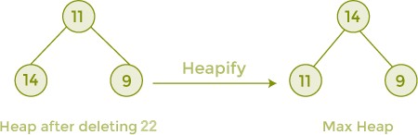

Heap Sort

Slide 17
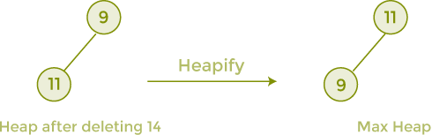

Heap Sort

Slide 18



Heap Sort

