Slide 1

DATA STRUCTURES &
ALGORITHMS
Why Study Algorithms
Instructor: Engr. Laraib Siddiqui

Slide 2
Straightforward Programming Problems
Has straightforward implementation.
Natural solution is already efficient.

Slide 3
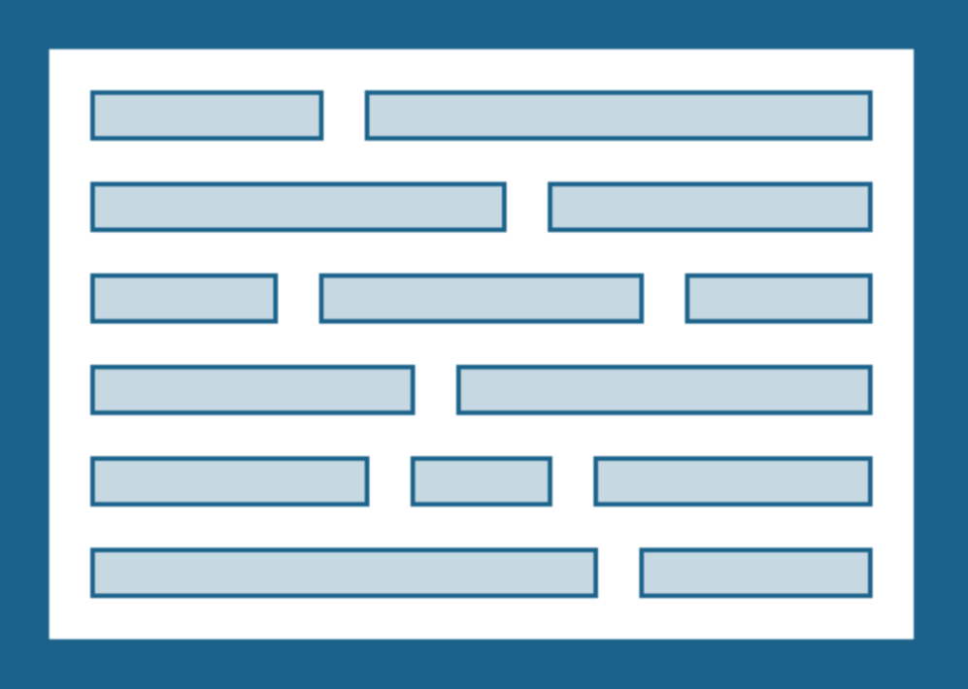
Display given text

Slide 4
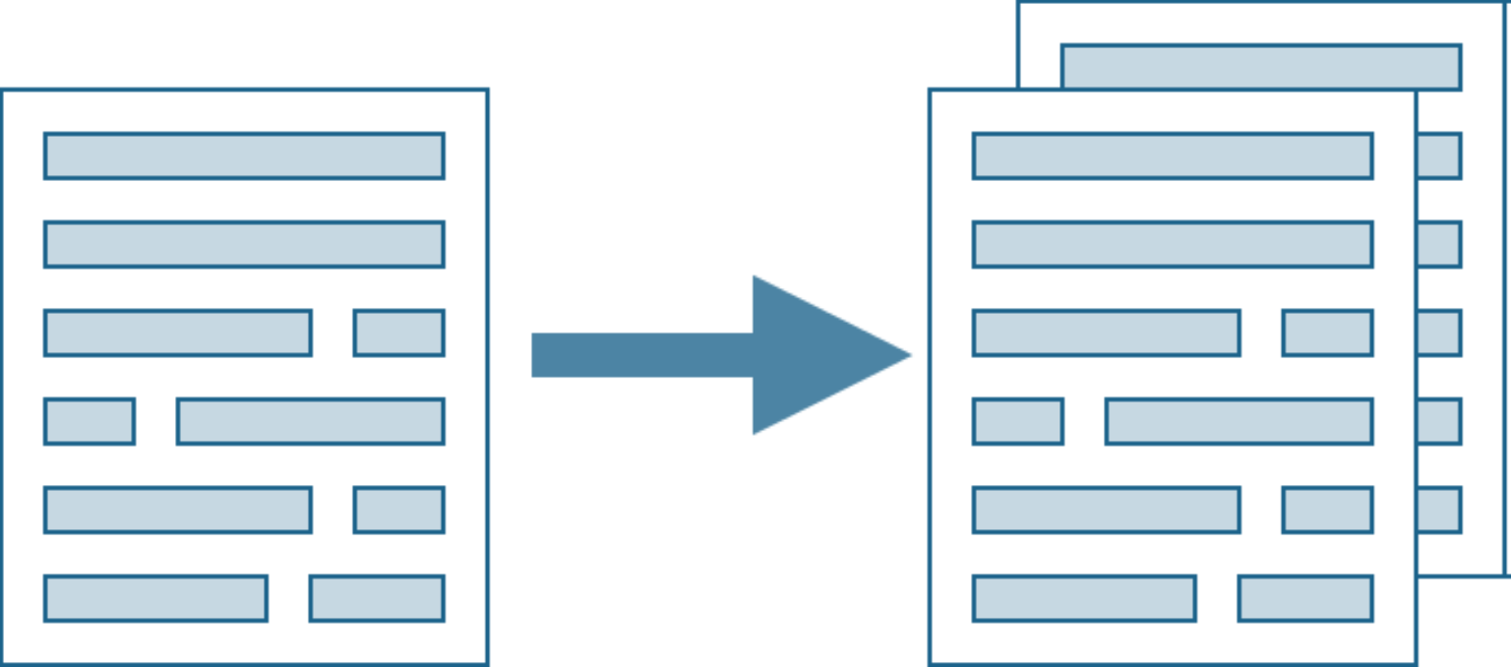
Copy a File

Slide 5
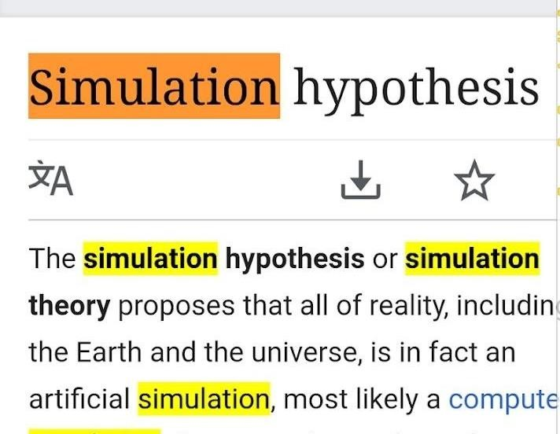
Search for a Given Word

Slide 6
Simple Programming Problems
Has linear scan.
Cannot do much better.
The obvious program works.

Slide 7

Algorithms Problems
Not so clear what to do.
Not clear how to do.
Simple ideas too slow.
Room for optimization.

Slide 8

Understand Natural Language

Slide 9

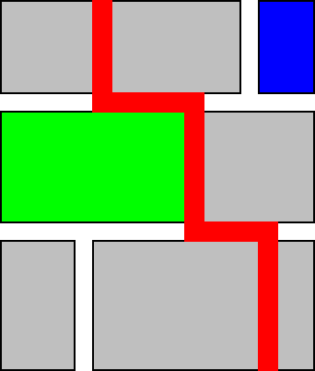
Find the Shortest Path Between Locations

Slide 10
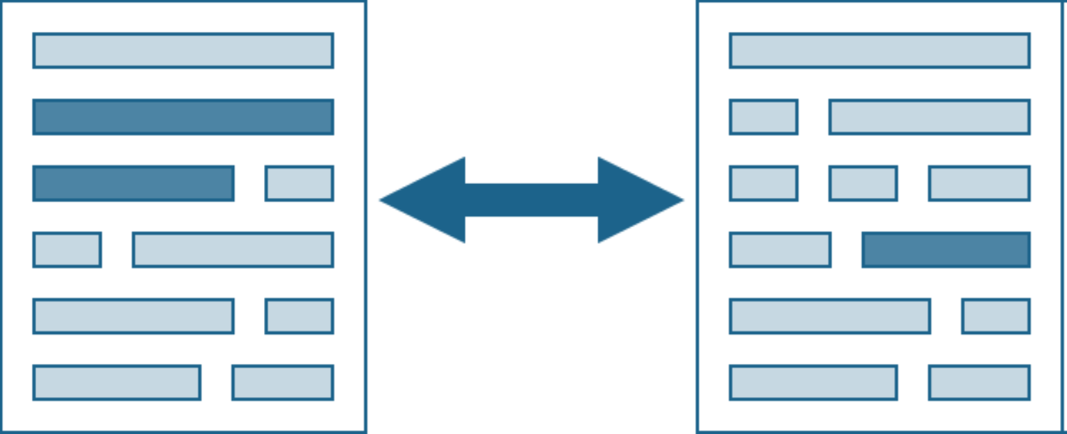
Measure Similarity of Documents

Slide 11
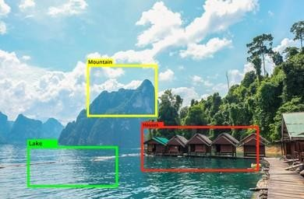
Identify Objects

Slide 12
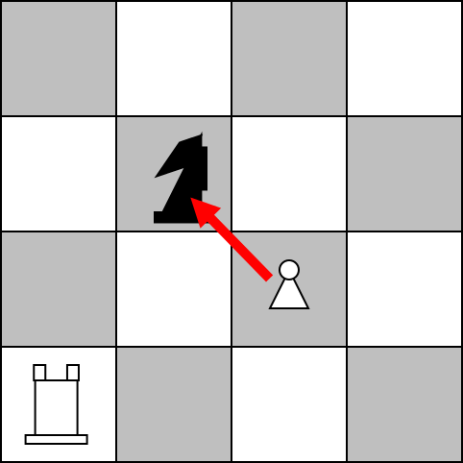
Play Games Well

Slide 13
Algorithm
Set of instructions to accomplish a particular task.
Method/process to solve a problem.
Process
Input
Output
Program is an instance of an algorithm, written in some specific programming language.
Algorithm

Slide 14
Why we need algorithms?
Internet
Web search, packet routing, distributed file sharing, ...
Computers.
Circuit layout, file system, compilers, ...
Computer graphics.
Movies, video games, virtual reality, ...
Security.
Cell phones, e-commerce, voting machines, ...
Multimedia.
MP3, JPG, DivX, HDTV, face recognition, ...
Social networks.
Recommendations, news feeds, advertisements, ...

Slide 15
Basic Algorithm
Input = a, b, c
Output = max
Process
Let max = a
If b > max then
max = b
If c > max then
max = c
Display max
Problem??? Find MAX
NOTE: Order is very important!

Slide 16
Steps for Algorithm development
Devising
Method to solve a problem
Validating
Proof the correctness of algorithm
Expressing
Implement in desired programming language

Slide 17
Efficiency of an Algorithm
Measured by the amount or resources it uses (time/space) Algorithm should:
Independent of the programming language
Should be applicable to all input sizes
Understandable to programmer

