Slide 1





Graph
Instructor: Engr. Laraib Siddiqui

Slide 2
Introduction
A graph G is consist of two things:
A set V of elements called nodes/vertices.
A set of E of edges such that each edge in E is identified with a unique pair {u, v} of nodes in V.
Graph can be indicated as G = (V, E)

Slide 3
Example
V = {a, b, c, d, e}
a
b
E = {(a,b), (a,c), (a,d), (b,e),
(c,d), (c,e), (d,e)}
c
d
e

Slide 4
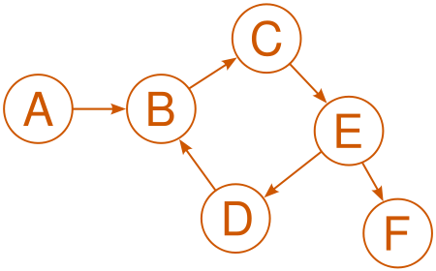
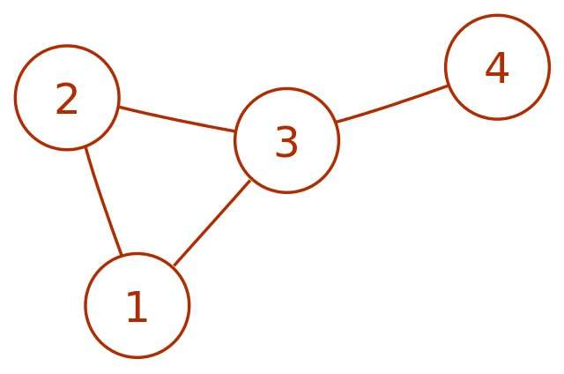
Types
Directed
When edges have direction
Undirected
When edges have no direction

Slide 5
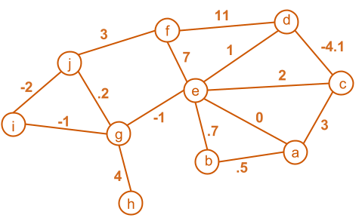
Weighted Graph
A graph in which each edge contains a value

Slide 6
Key Terms
Adjacent nodes: two nodes are adjacent if they are connected by an edge
Path: sequence of vertices that connect two nodes in a graph
Complete graph: in which every vertex is directly connected to every other vertex
Multi Graph: in which numerous edges between a pair of vertices in a graph G= (V, E) occurs. There are no self-loops.
Cycle: is a simple path with the same start and end vertex
Degree of a vertex: number of edges that touch it
In degree: no of incoming edges
Out degree: no of outgoing edges

Slide 7
Graph Representation
Adjacency matrix representation
Square grid of Boolean values
If the graph contains N vertices then the grid contains N rows N columns
For two vertices numbered I and J the element at row I and column J is true if there is an edge from I to J, otherwise false
Adjacency lists representation
A graph of n nodes is represented by a one dimensional array L of linked lists, where
L[i] is the linked list containing all the nodes adjacent from node i.
The node in the list L [i] are in no particular order

Slide 8
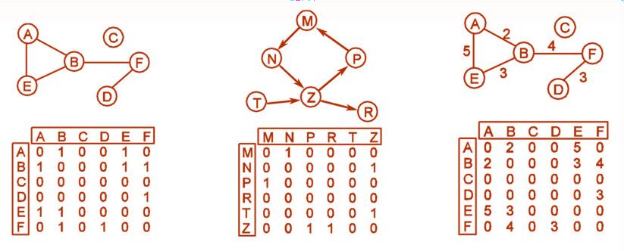
Adjacency Matrix Representation
Undirected Graph
Directed Graph
Weighted Graph

Slide 9
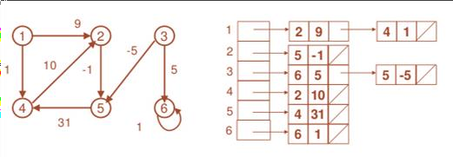
Adjacency Lists Representation

Slide 10
Breadth First Search (BFS) algorithm
Traversing a graph in a breadth ward motion and uses a queue to remember to get
the next vertex to start a search, when a dead end occurs in any iteration.
Consider a given graph G. Suppose G represents the
A
Adjacency List
A | F, C, B
B | G, C
C | F
D | C
E | D, C, J
F | D
G | C, E
J | D, K
K | E, G
daily flights between cities of some airlines and suppose we want to fly from city A to city J with minimum no. of stops. In other words, we want the minimum path p from A to J.
F
C
B
D
E
G
J
K

Slide 11
Breadth First Search (BFS) algorithm
Adjacency List
A | F, C, B
B | G, C
C | F
D | C
E | D, C, J
F | D
G | C, E
J | D, K
K | E, G
Step 1 F 1 | Queue A | Step 5 F 5 | Queue A, F, C, B, D, G
R 1 | Origin Ф | R 6 | Origin Ф, A, A, A, F, B
Step 2 F 2 | Queue A, F, C, B | Step 6 F 6 | Queue A, F, C, B, D, G
R 4 | Origin Ф, A, A, A | R 6 | Origin Ф, A, A, A, F, B
Step 3 F 3 | Queue A, F, C, B, D | Step 7 F 7 | Queue A, F, C, B, D, G, E
R 5 | Origin Ф, A, A, A, F | R 7 | Origin Ф, A, A, A, F, B, G
Step 4 F 4 | Queue A, F, C, B, D | Step 8 F 8 | Queue A, F, C, B, D, G, E, J
R 5 | Origin Ф, A, A, A, F | R 8 | Origin Ф , A, A, A, F, B, G, E
J <–– E <–– G <–– B <–– A

Slide 12
Depth First Search (DFS) algorithm
Traversing a graph in a depth ward motion and uses a stack to remember to get the next vertex to start a search, when a dead end occurs in any iteration.
Consider a given graph G. Suppose we want to find and print all nodes reachable from node J (including J itself).
A
F
C
B
D
E
G
J
K

Slide 13
Depth First Search (DFS) algorithm
Adjacency List
A | F, C, B
B | G, C
C | F
D | C
E | D, C, J
F | D
G | C, E
J | D, K
K | E, G
Step 1
Step 5
Stack J
Print C
Step 2
Stack D, E, F
Print J Stack D, K
Step 6
Print F Stack D, E
Step 3
Print K Stack D, E, G
Step 7
Print E Stack D
Step 4
Print G Stack D, E, C
Step 8
Print D Stack
J, K, G, C, F, E, D

