Slide 1

Spanning Tree
Instructor: Engr. Laraib Siddiqui

Slide 2
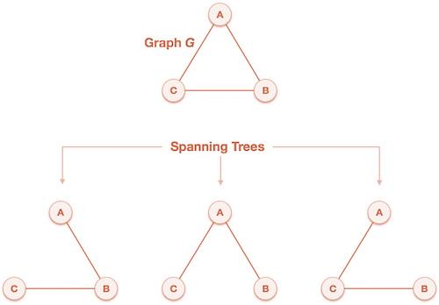
Spanning
Trees
A spanning tree is a subset of Graph G, which has all the vertices covered with
minimum possible number of edges.
2

Slide 3
Minimum Spanning Tree (MST)
In a weighted graph, a minimum spanning tree is a spanning tree that has minimum
weight than all other spanning trees of the same graph.
In real-world situations, this weight can be measured as distance, congestion, traffic
load or any arbitrary value denoted to the edges.
▪Kruskal Algorithm
▪Prim’s Algorithm
3

Slide 4
Kruskal’s Algorithm
Kruskal's algorithm to find the minimum cost spanning tree uses the greedy
approach. This algorithm treats the graph as a forest and every node it has as an
among all available options and does not violate MST properties.
Algorithm
▪Starting only with the vertices of G and proceeding sequentially add each edge which
does not result in a cycle, until (n - 1) edges are used.
▪EXIT.
4

Slide 5
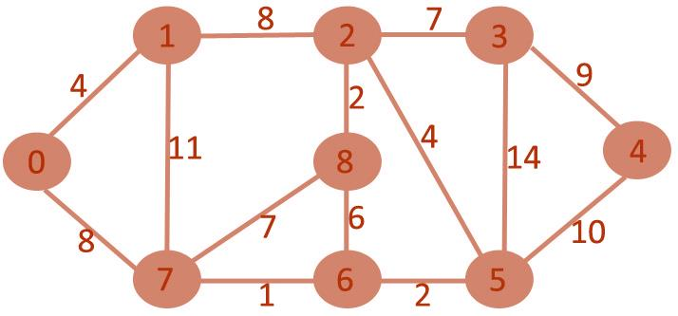
Weight
Source
Destination
1
7
6
√
2
8
2
√
2
6
5
√
4
0
1
√
4
5
2
√
6
6
8
Χ
7
2
3
√
7
7
8
Χ
8
0
7
√
8
1
2
Χ
9
3
4
√
10
5
4
Χ
11
1
7
Χ
14
5
3
Χ
5

Slide 6
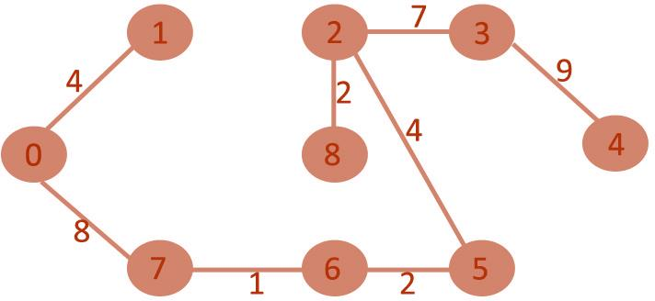
6

Slide 7
Prim’s Algorithm
It is a greedy algorithm. It starts with an empty spanning tree. The idea is to maintain two sets of vertices:
▪Contain vertices already included in MST.
▪Contain vertices not yet included.
•
At every step, it considers all the edges and picks the minimum weight edge. After picking the edge, it
moves the other endpoint of edge to set containing MST.
Algorithm
• Create MST set that keeps track of vertices already included in MST.
• Assign key values to all vertices in the input graph. Initialize all key values as INFINITE (∞).
Assign key values like 0 for the first vertex so that it is picked first.
• While MST set doesn't include all vertices.
•
Pick vertex u which is not is MST set and has minimum key value.
Include '
u'to
MST set.
•
every adjacent vertex v, if the weight of edge u.v less than the previous key value of v, update key value
as a weight of u.v
7

Slide 8
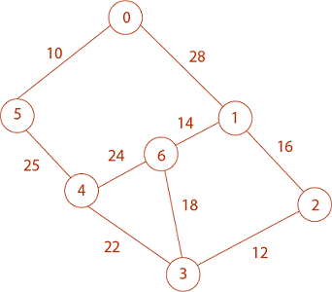
Vertex
0
1
2
3
4
5
6
Key
0
∞
∞
∞
∞
∞
∞
Parent
NIL
NIL
NIL
NIL
NIL
NIL
NIL
8

Slide 9
Vertex
0
1
2
3
4
5
6
Key
0
28
∞
∞
∞
10
∞
Parent
NIL
0
NIL
NIL
NIL
0
NIL
Vertex
0
1
2
3
4
5
6
Key
0
28
∞
∞
25
10
∞
Parent
NIL
0
NIL
NIL
5
0
NIL
Vertex
0
1
2
3
4
5
6
Key
0
28
∞
22
25
10
24
Parent
NIL
0
NIL
4
5
0
4
Vertex
0
1
2
3
4
5
6
Key
0
28
12
22
25
10
18
Parent
NIL
0
3
4
5
0
3
9

Slide 10
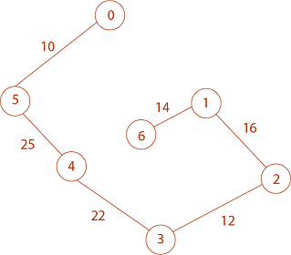
Vertex
0
1
2
3
4
5
6
Key
0
16
12
22
25
10
18
Parent
NIL
2
3
4
5
0
3
Vertex
0
1
2
3
4
5
6
Key
0
16
12
22
25
10
14
Parent
NIL
2
3
4
5
0
1
0 → 5 → 4 → 3 → 2 → 1 → 6
Total Cost = 10 + 25 + 22 + 12 + 16 + 14 = 99
10

