Slide 1
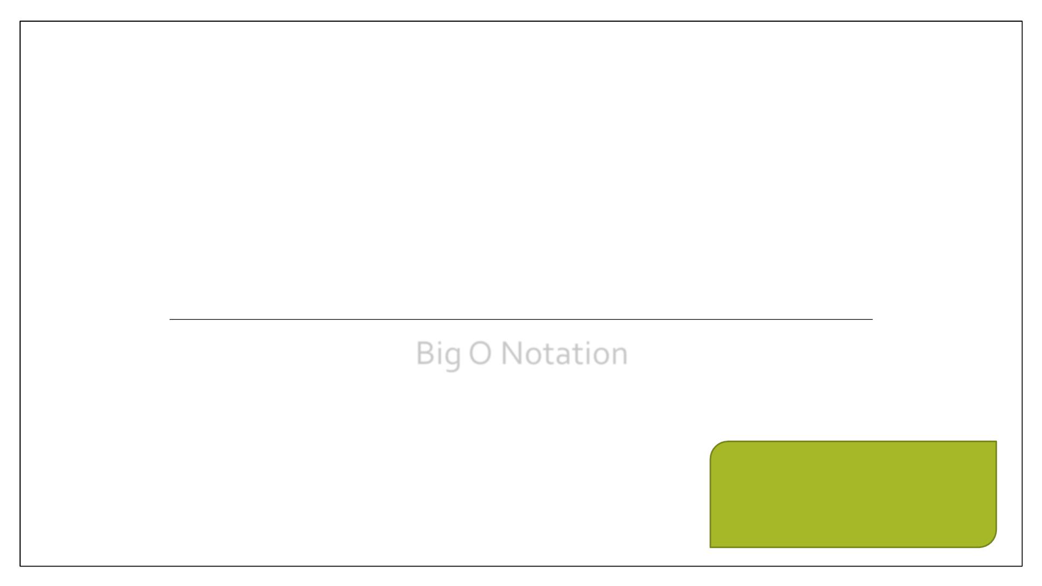
D ATA STRUCTURES &
ALGORITHMS
Big O Notation

Slide 2
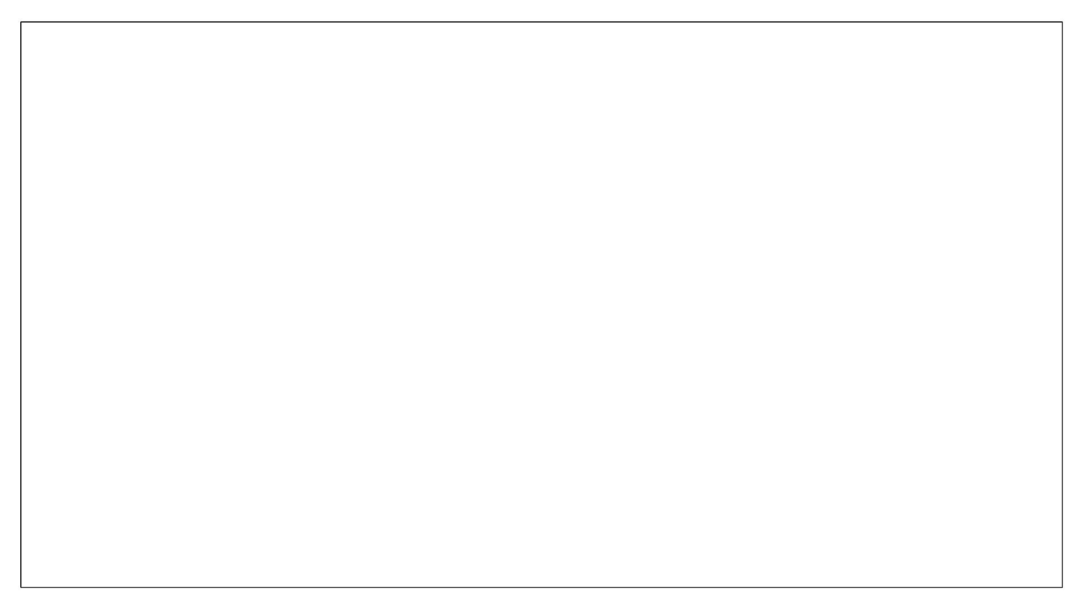
Asymptotic Analysis
▪ Asymptotic analysis deals with analyzing the properties of the running time when
the input size goes to infinity (this means a very large input size).
▪ The differences between orders of growths are more significant for larger input
size. Analyzing the running times on small inputs does not allow us to distinguish
between efficient and inefficient algorithms.
▪ The objective of asymptotic analysis is to describe the behavior of a function T(N)
as it goes to infinity.
▪ Asymptotic notations are used to describe the asymptotic analysis.
2

Slide 3
Function Bounds
Lets understand with the help of example. Suppose we have a function 10N²
Can we say it is bounded by 11N and 9N for all N ≥ 1?
2
2
• i.e 10N
² cannot go above 11N2 and doesn’t come down below 9N2 for all values of N.
10N2 is sandwiched between 9N2 and 11N2
• Now if f(n) is 10N^{2 and g(n) is N2}
• Then we say that f(n) is Θ (g(n))
3

Slide 4
Big Oh Notation
Sometimes we are only interested in proving one bound.
We use O-notation, when we have only an asymptotic upper bound.
4

Slide 5

Big Oh Notation
Simplified analysis of an algorithm’s efficiency.
• The letter O is used because the rate of growth of a function is also called its order
• Used in complexity theory, computer science and mathematics to describe the
behavior of functions.
• It determines how fast a function grows or declines.
For worst
cases
5

Slide 6
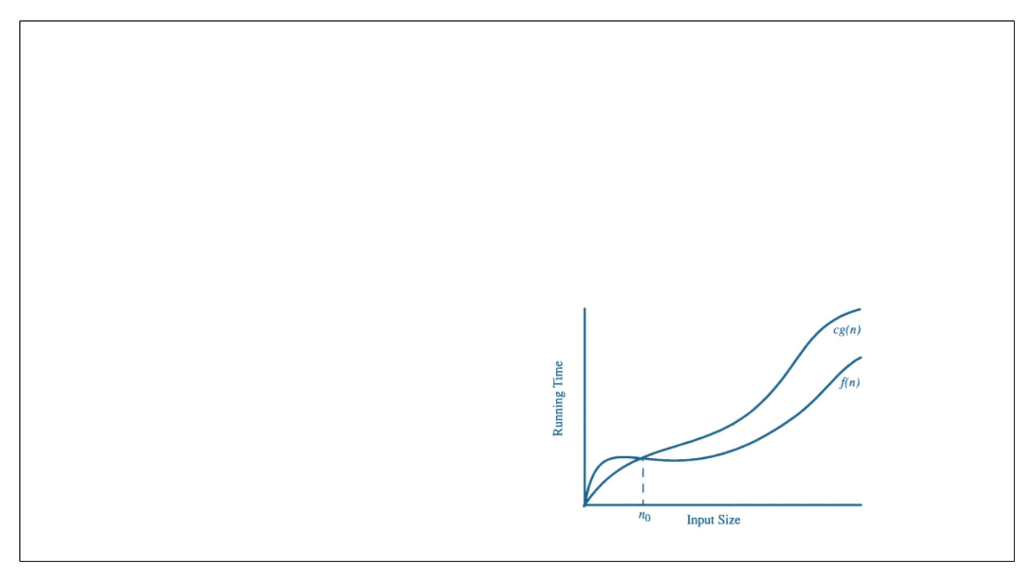
Big Oh Notation
• Let f (n) and g(n) be functions mapping non-negative numbers to non-negative
numbers.
• Big-Oh. f (n) is O(g(n)) if there is a constant c > 0 and a constant n ≥ 1 such that f
0
(n) ≤ c · g(n) for every number n ≥ n .
0
6

Slide 7
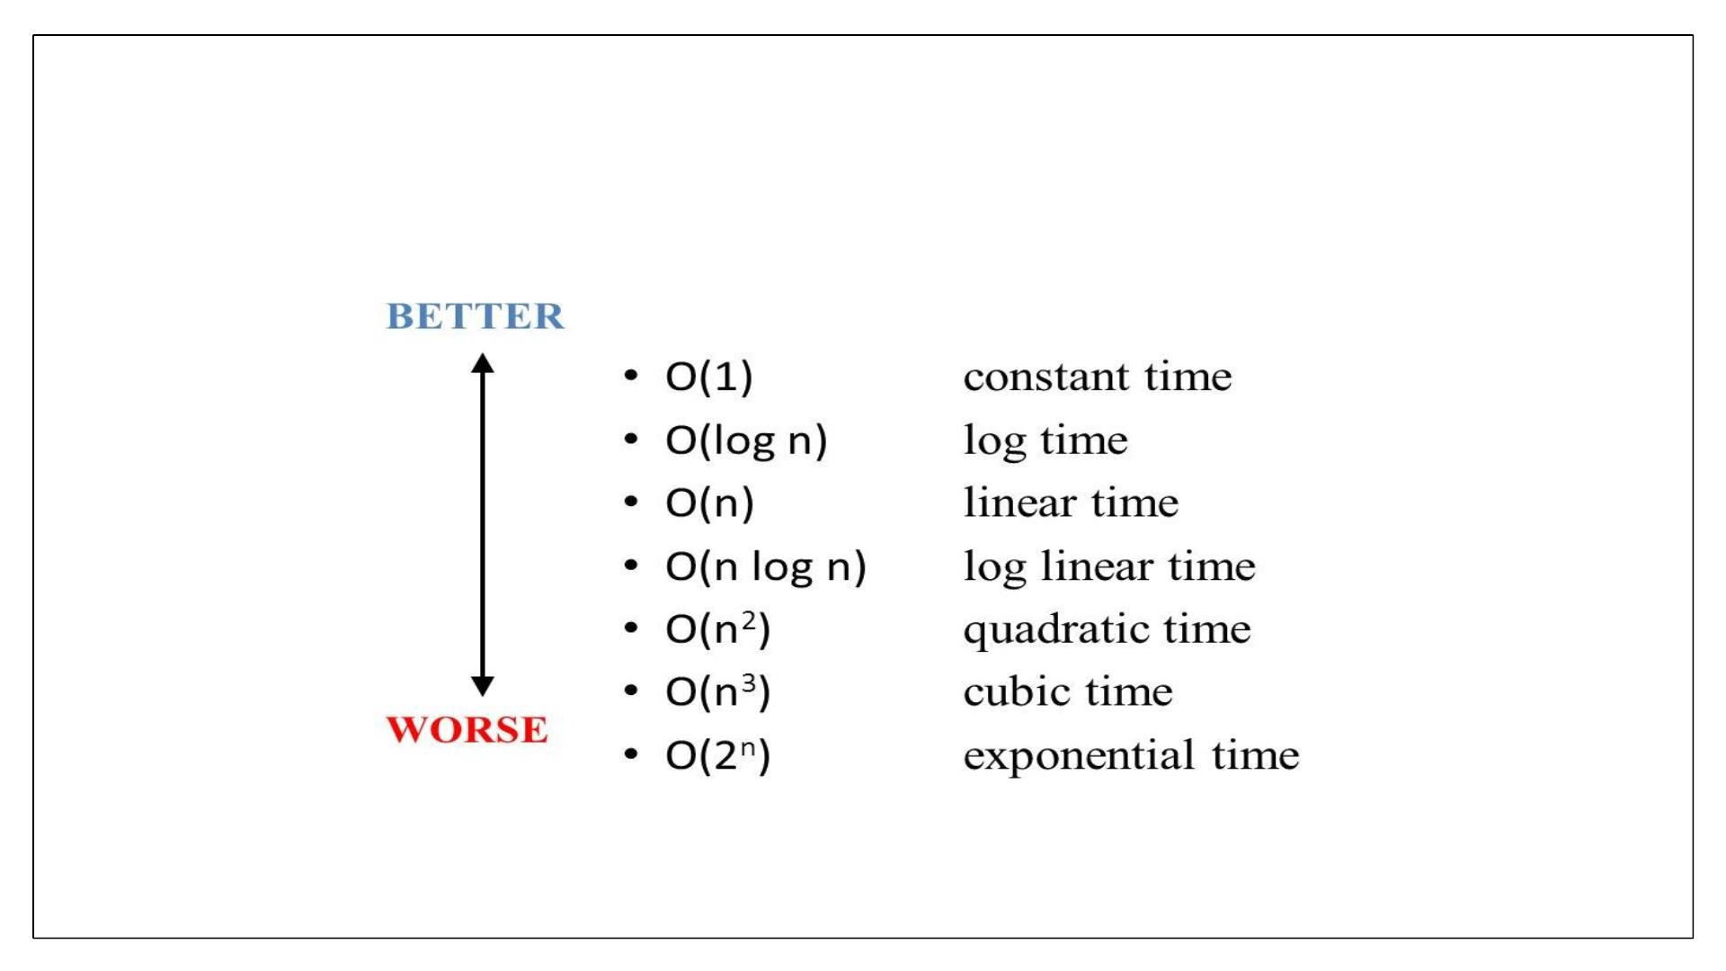
Big Oh
7

Slide 8
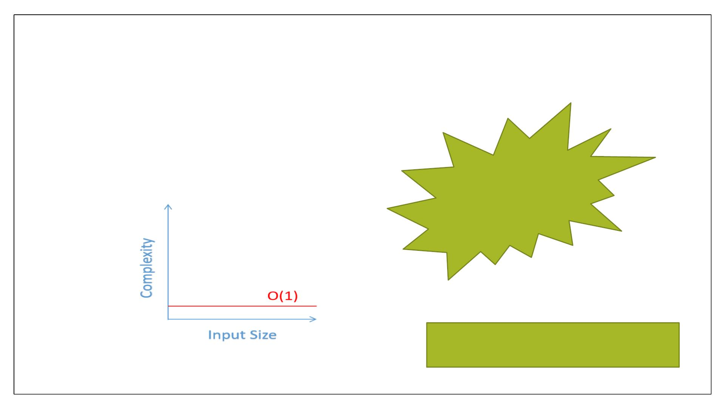
Constant Time: O(1)
Run in constant time if it requires the
same amount of time regardless of the
input size.
Daily life
Example???
• Example: accessing any element
in array
8

Slide 9
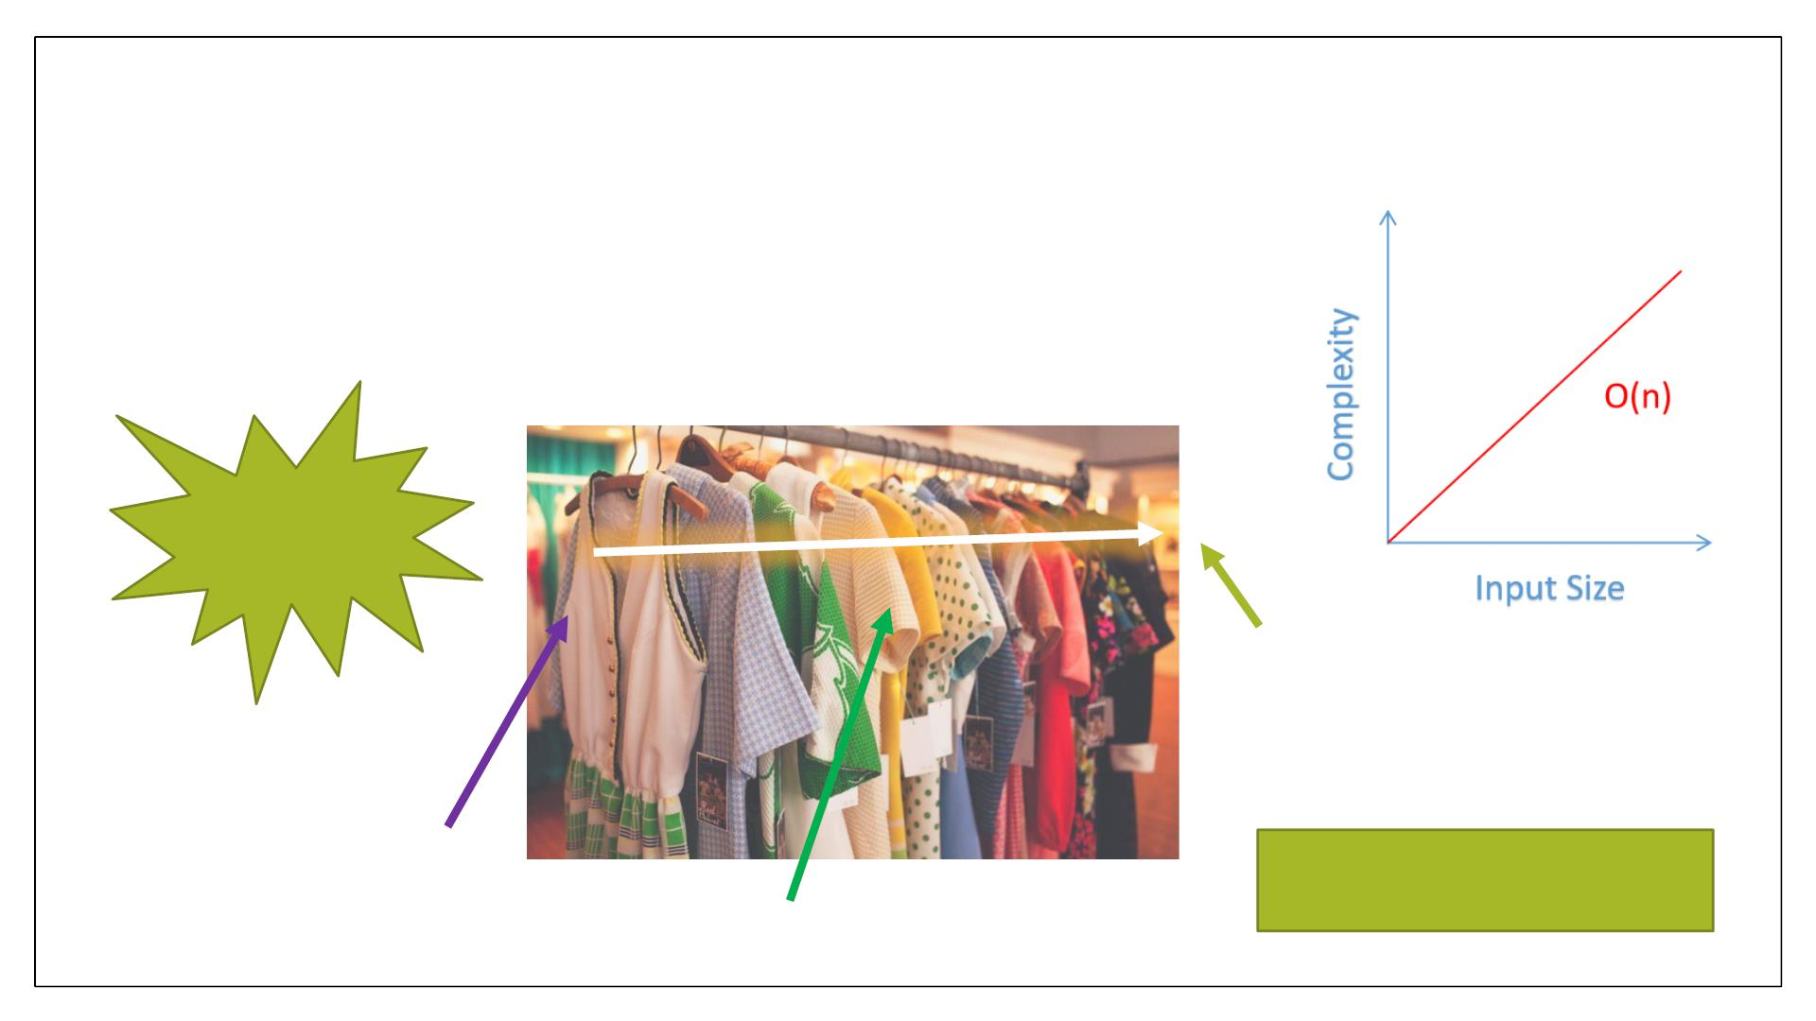
Linear Time: O(n)
n= number of items
What will be
the worst
case???
Worst case
need ‘n’ steps
for ‘n’ items
best
Example: traversing an array
average
9

Slide 10
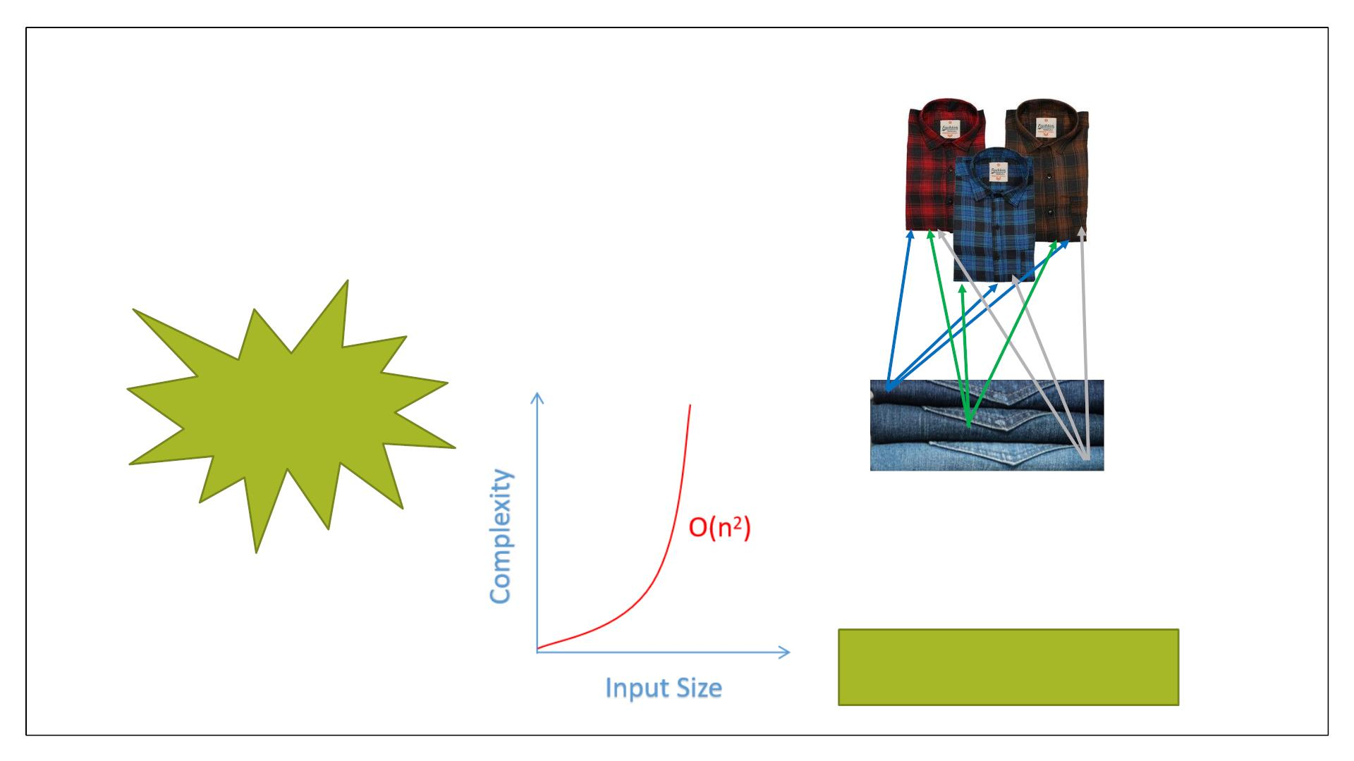
Quadratic Time: O(n²)
Worst case
• n= number of
need ‘n*n’ steps for desired
output
items
What will be
the worst
case???
Example: bubble sort,
selection sort, insertion sort
10

Slide 11
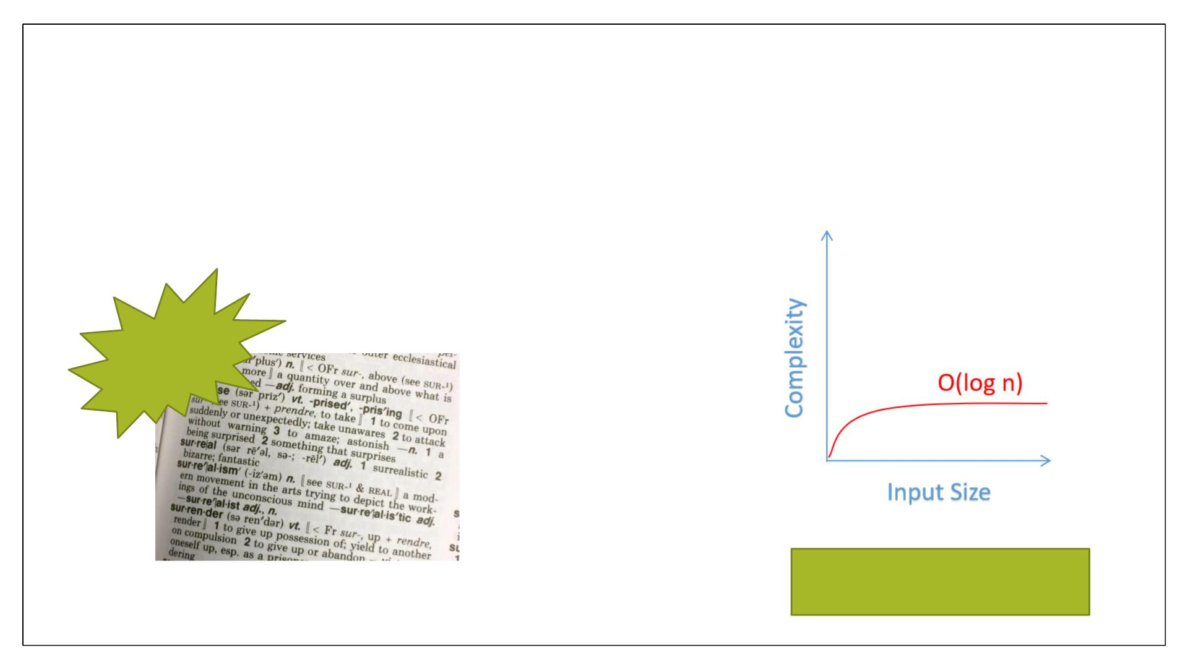
Logarithmic Time: O(log n)
log 10 = ?
L0g 20 =?
Sorted
order
Log 100 = ?
Example: binary search
11

Slide 12

O(nlog n)
• Growth rate is faster as compared to linear and log functions
Consider buying
pair for your shirts
from store but not
going through every
item
Example: merge sort
12

Slide 13
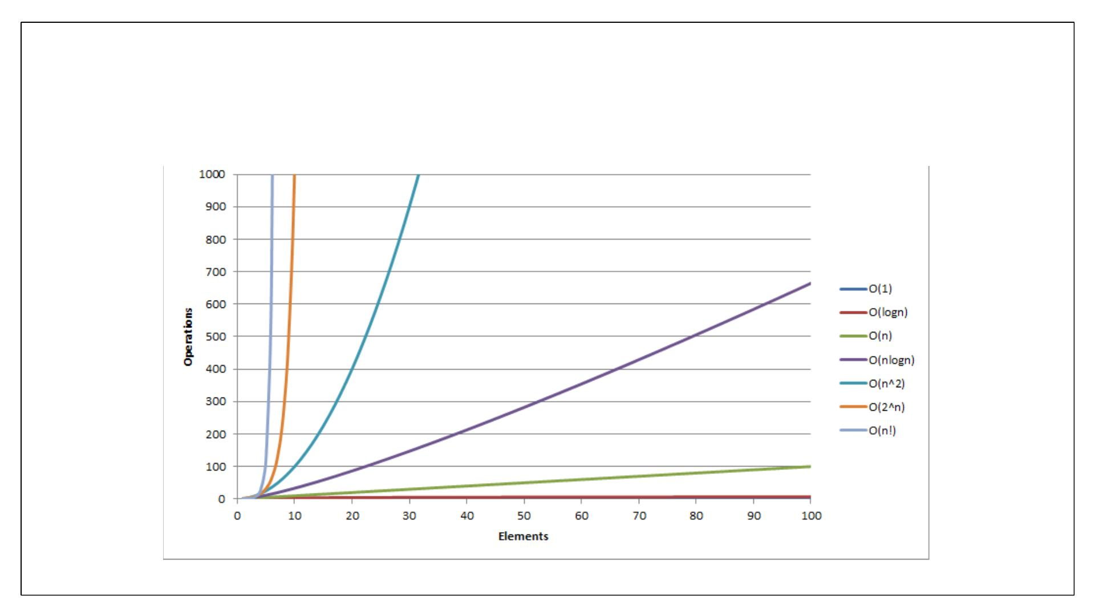
Complexity graph
13

Slide 14
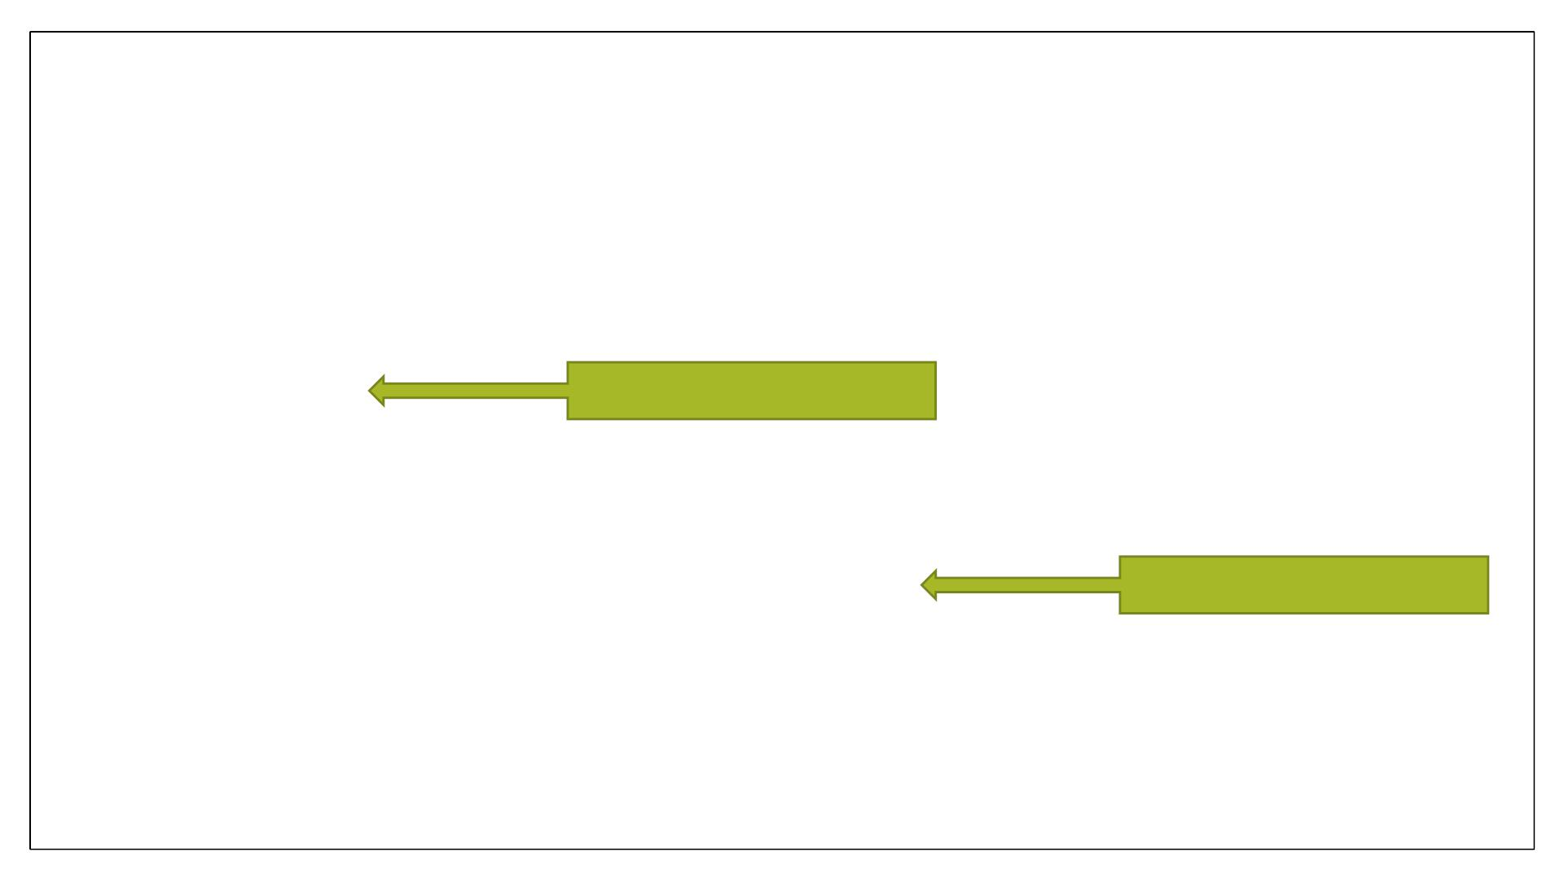
Rules for analysis
Ignore multiplicative constants
‘n’ gets larger & constant no
longer matter
6n –> O(N)
Certain terms dominate others
Ignore lower order terms
O(1) < O(logn) < O(n) < O(nlogn) < O(n²) < O(2^{n}) < O (n!)
14

Slide 15
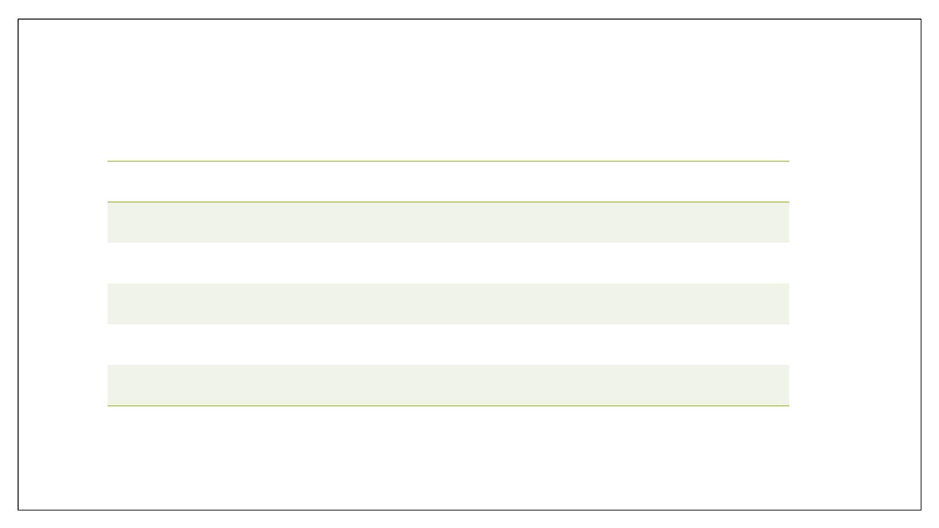
Rules for analysis
Loops
Number of iterations
Nested loops
Consecutive statements
If/else
Complexity of inner loop * outer loop
Addition
Block which take long time
Block which take long time
Switch case
15

Slide 16
Example
x= 5 + (15 * 30);
// O(1)
(independent of input size)
x= 5 + (15 * 30);
// O(1)
// O(1)
// O(1)
y= 6-4;
print x+y;
Total Time = O(1) + O(1) + O(1) = > O(1)
(drop constant)
16

Slide 17
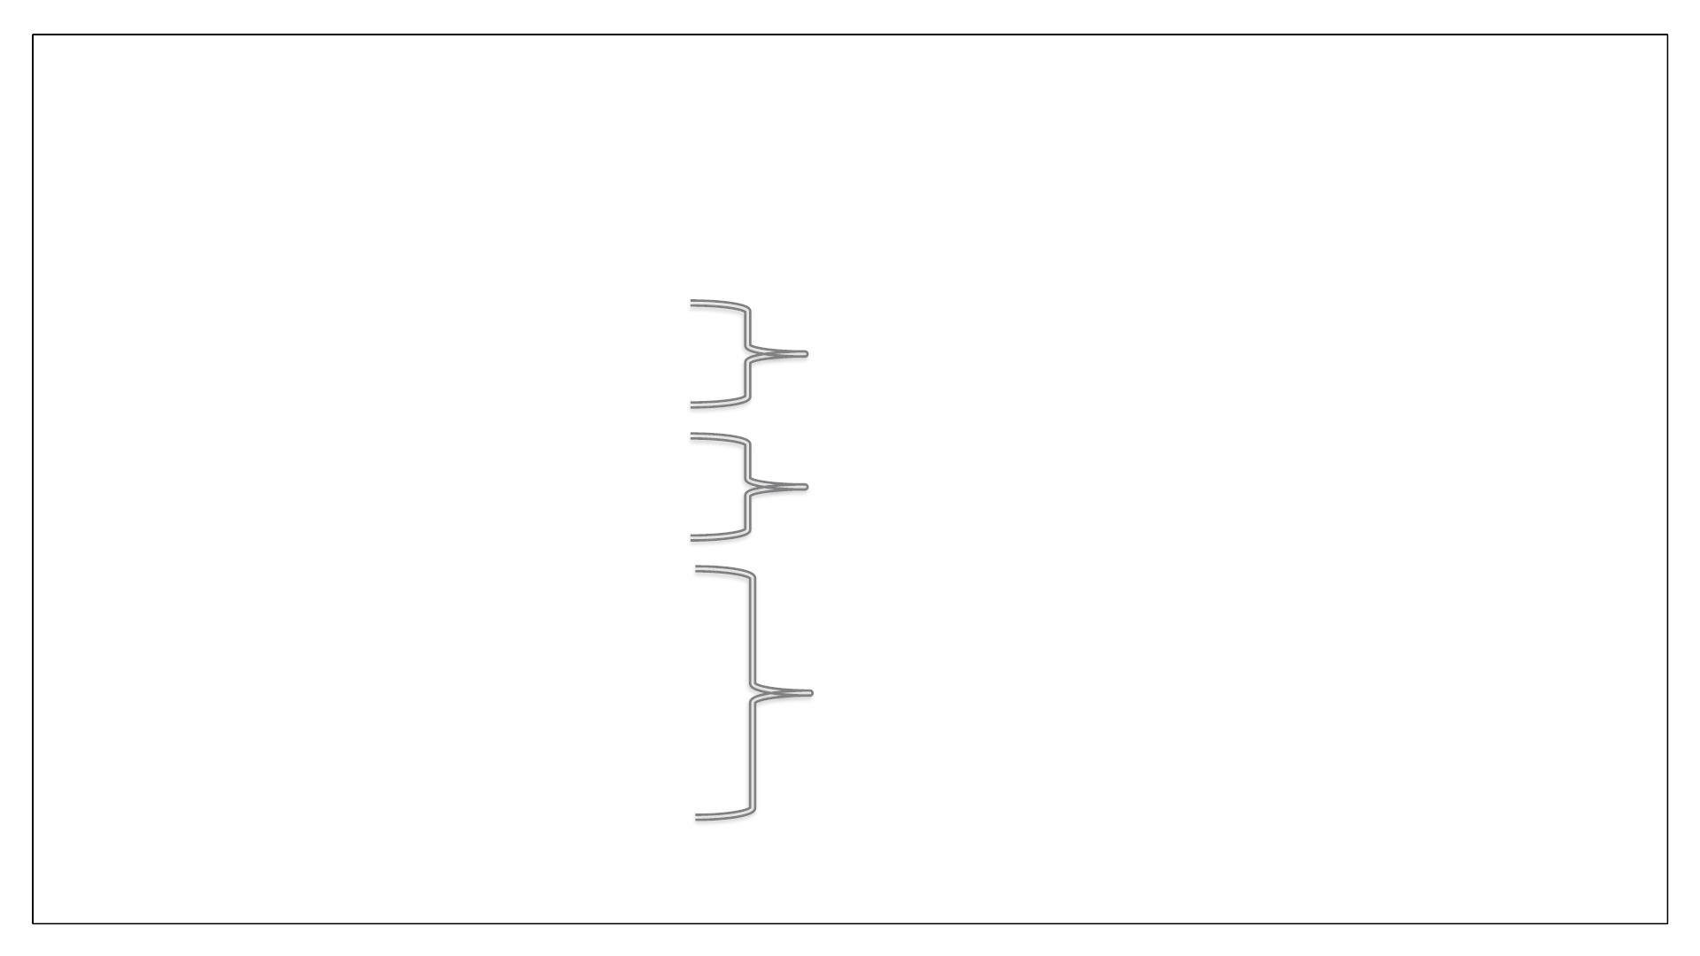
Example
for (int i = 0; i < n; i ++)
sum = sum – i;
O(n)
for (int i = 0; i < n * n ; i ++)
sum = sum + i;
O(n²)
sum = 0
for (int i = 0; i < n; i ++)
for (int j = 0; j < n; j ++)
sum + = i * j;
O(n²)
17

Slide 18

Practice
int sum( int n )
{
int partialSum;
partialSum = 0;
Complexity??
for( int i = 1; i <= n; ++i )
partialSum += i * i * i;
return partialSum;
}
18

Slide 19
Practice
Fiblist(n)
create an array F [0 . . . n]
F [0] ← 0
F [1] ← 1
for i from 2 to n:
F [i ] ← F [i − 1] + F [i − 2]
return F [n]
Complexity??
19

