Slide 1
Arrays
Instructor: Engr. Laraib Siddiqui

Slide 2
Arrays
Memory Layout
▪
Collection of cells of the same type.
Cells are numbered with consecutive integers
x[0]
▪
▪
Declaration:
int
x[6];
x[1]
▪
Access: use the array name and an index:
x[0], x[1], x[2], x[3], x[4], x[5]
x[2]
Name
Elements
x[3]
int x[6] = {35, 33, 42, 10, 11, 19}
x[4]
0 1 2 3 4 5
Type
x[5]
Size
Index
2

Slide 3
Declaring array
Syntax: data_type array_name [array_size];
If we are declaring ‘x’ is an array name,
‘x’ is not an value.
int x[6];
int n;
▪
x[0] = 5;
x[1] = 2;
▪
For example,
x = 3;
// not allowed
// not allowed
we can write
x = &n;
b = 2;
a = b;
What’s special
about arrays?
But we cannot write
2 = a; // not allowed
Constant time access
3

Slide 4


Traversing an array
LA is a linear array with lower bound LB and upper bound UB.
1. [Initialize counter] Set K := LB.
2. Repeat steps 3 and 4 while K <= UB.
3.
[Visit element] Apply PROCESS to LA[K].
4.
[Increment counter] Set K := K + 1.
[End of Step 2 loop.]
5. Exit.
4

Slide 5
Traversing an array
e.g Array {8,9,5,12}
for (i=0; i<4; i++)
{
printf (“%d\t”, a[i]);
}
8
9
5
12
5

Slide 6
Insertion in arrays
INSERT (LA, N, K, ITEM)
linear array with N elements and K is a positive integer such that K <= N.
Following algorithm inserts an element ITEM into the Kth position in LA.
1.[Initialize counter.] Set J := N.
2.Repeat Steps 3 and 4 while J >= K.
3.
[Move Jth element downward.] Set LA[J+1] := LA[J].
4.
[Decrease counter.] Set J := J – 1.
[End of Step 2 loop.]
5.[Insert element.] Set LA[K] := ITEM.
6.[Reset N.] Set N := N + 1.
7.Exit.
6

Slide 7
Insertion in arrays
25
14
56
16
38
Value to be inserted 28 in
Index positi0n 2
Values
25
14
28
56
16
38
Index
0
1
2
3
4
5
7

Slide 8
Deletion
DELETE (LA, N, K, ITEM)
array with N elements and K is a positive integer such that K <= N.
Following algorithm deletes the Kth element from LA.
1. Set ITEM := LA[K].
2. Repeat for J = K to N - 1.
[End of loop.]
3. [Reset the number N of elements in LA.] Set N := N - 1.
4. Exit.
8

Slide 9
Deletion
25
14
28
56
16
38
Value to be deleted 28 from
Index positi0n 2
Values
25
14
56
16
38
Index
0
1
2
3
4
9

Slide 10
Dynamic Arrays
Problem:
▪Process of different data sets with same array is not possible
Solution:
10

Slide 11
Applications
▪Accessing and storing sequential data.
▪Creating string objects temporary.
▪I/O routines as buffers
▪Dynamic programming
▪Lookup tables
11

Slide 12
Complexity
Static
Dynamic
Access
O(1)
O(1)
Search
O(n)
O(n)
Delete
O(n)
O(n)
Insertion
O(1)
O(n)
12

Slide 13
Sorting
Sorting can be defined as an operation of rearranging the elements such that:
A[1] < A[2] < …….. < A[N]
1
2
3
4
5
6
77
42
35
12
101
5
1
2
3
4
5
6
5
12
35
42
77
101
13

Slide 14
Bubble Sort
▪Bubble Sort is a simple yet effective sorting algorithm.
▪Data is placed adjacent to each other.
▪The sort starts from one end (the beginning), compares 2 adjacent data, and
swaps them if they are in the wrong order.
▪It moves on down the list and continues doing so.
▪When it reaches the end of the data, it starts over until all the data is in the right
order.
▪Its not efficient when dealing with a large set of data.
▪Compared to other sorting algorithm, bubble sort is really slow.
14

Slide 15
Algorithm
Step 1 : Starting with the first element(index = 0), compare the current element
with the next element of the array.
Step 2: If the current element is greater than the next element of the array, swap
them.
Step 3: If the current element is less than the next element, move to the next
element. Repeat Step 1.
15

Slide 16




Bubble Sort - Example
First Iteration/pass
Wrong order
1
2
3
4
5
6
1
2
3
4
5
6
1
77
42
35
12
101
5
42
77
35
12
101
5
Swapped
1
2
3
4
5
6
1
2
3
4
5
6
2
42
77
35
12
101
5
42
35
77
12
101
5
16

Slide 17



Bubble Sort - Example
1
2
3
4
5
6
1
2
3
4
5
6
3
42
35
77
12
101
5
42
35
12
77
101
5
1
2
3
4
5
6
4
42
35
12
77
101
5
No need to swap
17

Slide 18
Bubble Sort - Example
Largest element
1
2
3
4
5
6
1
2
3
4
5
6
5
42
35
12
77
101
5
42
35
12
77
5
101
Second Iteration/pass
1
2
3
4
5
6
1
2
3
4
5
6
6
42
35
12
77
5
101
35
42
12
77
5
101
18

Slide 19
Bubble Sort - Example
1
2
3
4
5
6
1
2
3
4
5
6
7
35
42
12
77
5
101
35
12
42
77
5
101
1
2
3
4
5
6
8
35
12
42
77
5
101
No need to swap
19

Slide 20

Bubble Sort - Example
2
nd
Largest element
1
2
3
4
5
6
1
2
3
4
5
6
9
35
12
42
77
5
101
35
12
42
5
77
101
Third Iteration/pass
1
2
3
4
5
6
1
2
3
4
5
6
35
12
42
5
77
101
12
35
42
5
77
101
10
20

Slide 21


Bubble Sort - Example
1
2
3
4
5
6
11
12
35
42
5
77
101
No need to swap
1
2
3
4
5
6
1
2
3
4
5
6
12
12
35
42
5
77
101
12
35
5
42
77
101
3
rd
Largest element
21

Slide 22
Bubble Sort - Example
Forth Iteration/pass
1
2
3
4
5
6
13
12
35
5
42
77
101
No need to swap
1
2
3
4
5
6
1
2
3
4
5
6
14
12
35
5
42
77
101
12
5
35
42
77
101
4
th
Largest element
22

Slide 23
Bubble Sort - Example
Fifth Iteration/pass
1
2
3
4
5
6
1
2
3
4
5
6
15
12
5
35
42
77
101
5
12
35
42
77
101
Sorted list
23

Slide 24
Selection Sort
▪The Selection Sort searches (linear search) all of the elements in a list until it finds
the smallest element. It “swaps” this with the first element in the list.
▪Next it finds the smallest of the remaining elements, and “swaps” it with the
second element and so on.
▪Its not very efficient when dealing with a huge list of items.
24

Slide 25
Algorithm
Step 1 − Set MIN to location 0
Step 2 − Search the minimum element in the list
Step 3 − Swap with value at location MIN
Step 4 − Increment MIN to point to next element
Step 5 − Repeat until list is sorted
25

Slide 26
Selection Sort - Example
1st iteration/Pass:
77
✓Smallest = 77
✓42 < 77, smallest = 42
42
✓35 < 42, smallest = 35
Smallest ??
35
✓12 < 35, smallest = 12
12
✓101 > 12, smallest = 12
✓5 < 12 smallest = 5
101
5
Swap 77 and 5
26

Slide 27
Selection Sort - Example
Next Smallest ??
5
5
42
12
35
35
12
42
101
101
77
77
27

Slide 28
Selection Sort - Example
Next Smallest ??
5
5
12
12
35
35
42
42
101
101
77
77
28

Slide 29
Selection Sort - Example
Next Smallest ??
5
5
12
12
35
35
42
42
101
77
77
101
29

Slide 30
Selection Sort - Example
Next Smallest ??
5
5
12
12
35
35
42
42
101
77
77
101
30

Slide 31
Insertion Sort
▪Insertion sort is a simple sorting algorithm that works similar to the way you sort playing cards in
your hands.
▪The array is virtually split into a sorted and an unsorted part.
▪Values from the unsorted part are picked and placed at the correct position in the
31

Slide 32
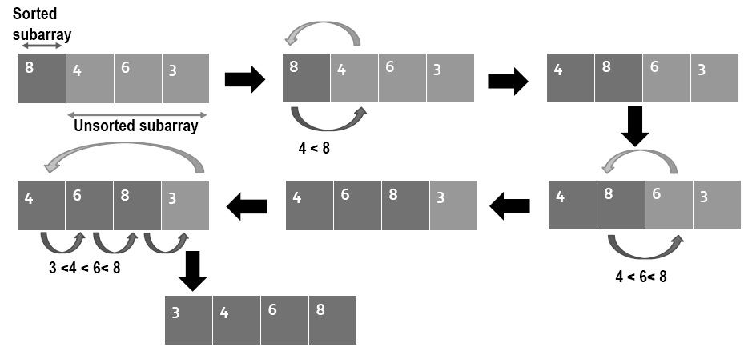
Insertion Sort - Example
32

Slide 33
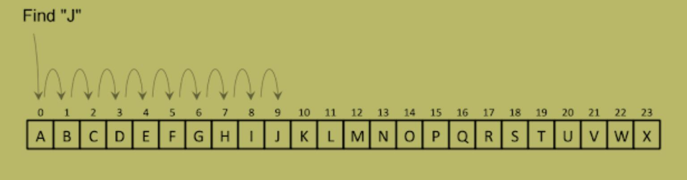
Linear Search
▪Linear search is used whether the given element is present in an array and if it present then at what
location it is present.
▪We keep on comparing each element with the element to search until the desired element is found
or list ends.
33

Slide 34
Linear Search
1.[Initialize] Set K:=1 and LOC :=0
2.Repeat Steps 3 and 4 while LOC =0 and K<=N.
3.IF ITEM = DATA[K],then :Set LOC :=K.
A linear array DATA with N elements
and a specific ITEM of information are
4.Set K:= K+1.[Increments counter.]
[End of Step 2 loop.]
5.[Successful?]
LOC of ITEM in the array DATA or sets
LOC=0.
If LOC =0,then:
Write: ITEM is not in the array DATA.
Else:
Write: LOC is the location of ITEM.
34

Slide 35
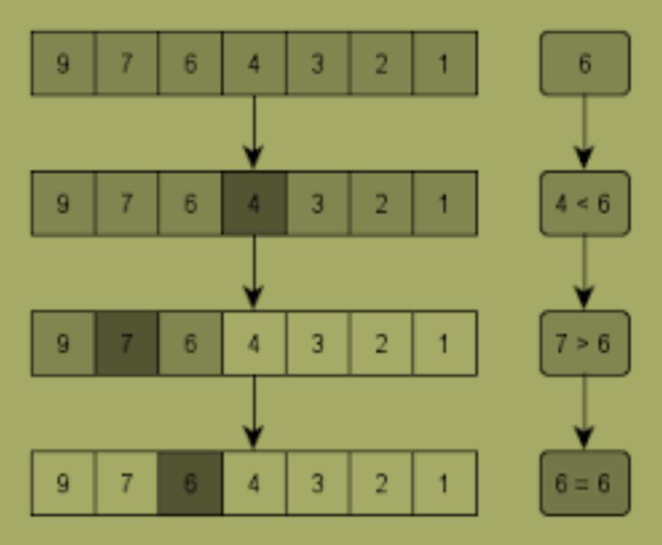
Binary search
• Binary search is an efficient way for finding an item from an ordered list of items.
• It works by repeatedly dividing in half the portion of the list that could contain the item, until you've
narrowed down the possible locations to just one.
35

Slide 36
Algorithm
BINARY(DATA,LB,UB,ITEM,LOC)
1.[Initialize segment variable.] Set BEG:=LB, END:=UB, MID:=INT((BEG+END)/2).
2.Repeat step 3 and 4 while BEG <= END and DATA [MID]!=ITEM.
3.If ITEM < DATA[MID]. then:
Here DATA is a sorted array with lower bound LB
and upper bound UB and ITEM is the given item of
Set END:=MID-1.
Else
Set BEG:=MID+1.
denote the beginning, the end and the middle of
[End of if structure.]
segment
of
the
element
of
DATA.
This
4.Set MID:= INT ((BEG+END)/2).
[End of step 2 loop.]
LOC:=NULL if the search is unsuccessful.
5.If DATA[MID]=ITEM. then:
Set LOC:=MID.
Else
Set LOC:=NULL.
[End of if structure.]
6.Exit.
36

Slide 37
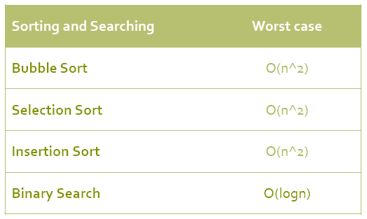
Complexity
37

