Slide 1

Linked Lists
Instructor: Engr. Laraib Siddiqui

Slide 2
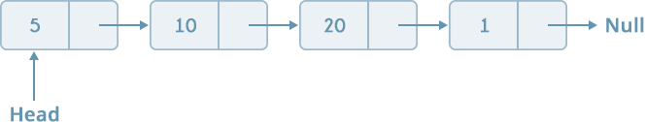
Linked list
It’s a linear data structure, consist of nodes.
Nodes includes:
Data - elements
Address/Link - address of another node.
Node
Data
Address
Representation

Slide 3
Linked list vs Arrays
Array | Linked List
Size is fixed; resizing is expensive | Size is dynamic
Data can be access randomly | No random access
Insertion and Deletion operation takes more time. | Insertion and Deletion operations are fast in linked list.
Data is stored in consecutive location. | Data is randomly stored.

Slide 4
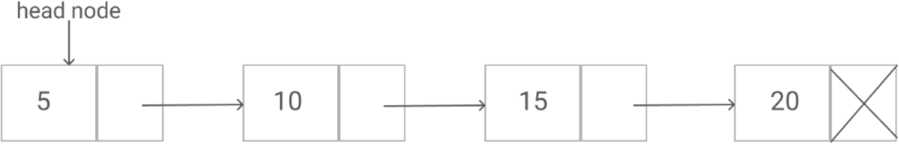
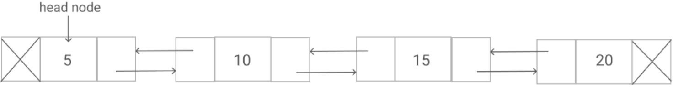
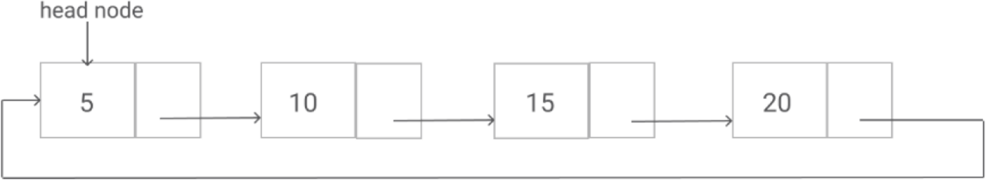
Types
Singly linked list − Item navigation is forward only.
Doubly linked list − Items can be navigated forward and backward.
Circular Linked List − Last item contains link of the first element as next and the first element has a link to the last element as previous.

Slide 5
Comparison
 | Singly | Doubly
Strength | Consume less memory Easy to implement | Traversing can be done in both directions
Weakness | Access previous elements not easy | Consume more memory

Slide 6
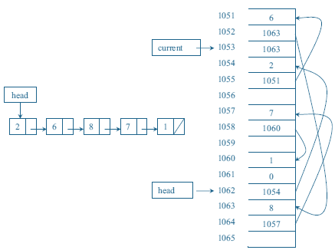
Memory Layout

Slide 7
Creation of a node
Using Structure
struct Node {
int data;
struct Node* next;
};
Using Class class Node { public:
int data;
Node* next;
};

Slide 8
Traversing
Let LIST be a linked list in memory. Following algorithm traverses LIST, applying an operation PROCESS to each element of LIST. The variable PTR points to the node currently being processed.
Set PTR: = START. [Initializes pointer PTR]
Repeat Steps 3 and 4 while PTR ≠ NULL.
Apply PROCESS to INFO [PTR]
Set PTR:= LINK[PTR]. [PTR now points to the next node.] [End of Step 2 loop.]
5. Exit
3.
4.

Slide 9




Insertion
2
8
12
5
2
5
8
12

Slide 10
Insertion at the beginning
Create a new node and assign the address to any node say ptr.
OVERFLOW,IF(PTR = NULL) write : OVERFLOW and EXIT.
ASSIGN INFO[PTR] = ITEM
IF(START = NULL)
ASSIGN NEXT[PTR] = NULL
ELSE
ASSIGN NEXT[PTR] = START
ASSIGN START = PTR
EXIT

Slide 11


Deletion
2
5
8
12
2
5
8
12
2
5
12

Slide 12
Deletion
Check whether list is Empty (head == NULL)
If it is Empty then, display 'List is Empty!!! Deletion is not possible' and terminate the function.
If it is Not Empty then, define a Node pointer 'temp' and initialize with head.
Check whether list is having only one node (temp → next == NULL)
If it is TRUE then set head = NULL and delete temp (Setting Empty list conditions)
If it is FALSE then set head = temp → next, and delete temp.

Slide 13
Complexity
 | Singly | Doubly
Access | O(n) | O(n)
Search | O(n) | O(n)
Delete | O(1) | O(1)
Insert | O(1) | O(1)

Slide 14
Applications
Queue & stack implementation.
Model real world objects.
Model repeating event cycles.
Separate chaining.
Adjacency list for graphs.

