Slide 1
Recursion
Instructor: Engr. Laraib Siddiqui

Slide 2
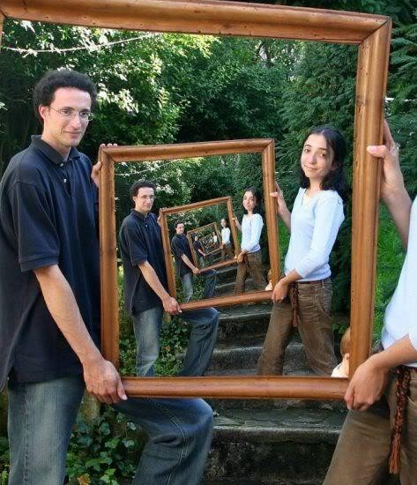
Recurrence

Slide 3
Basic objective
When we have a bigger problem whose solution is complex.
We decompose the problem into smaller units until we reach to the smallest sub-
problem (base case) for which a solution is known.
Then go back in reverse order and build upon the solutions of the sub-problems.

Slide 4
Recursion
A well defined mathematical function in which the function being defined is applied within its own definition.

Slide 5
Recursive Functions
Function may call itself
Function may call other Function and
the other function in turn again may call the calling Function

Slide 6
Direct & indirect Recursion
Recursion is said to be direct when functions calls itself directly and is said to be
indirect when it calls other function that in turn calls it

Slide 7
Other Types
Linear recursion : makes at most one recursive call each time it is invoked.
Binary recursion : makes two recursive calls.
Multiple recursion : method may make (potentially more than two) recursive calls.

Slide 8
Finding a recursive solution
Each successive recursive call should bring you closer to a situation in which the answer is known
A case for which the answer is known (and can be expressed without recursion) is
called a base case
Each recursive algorithm must have at least one base case, as well as the general
recursive case

Slide 9

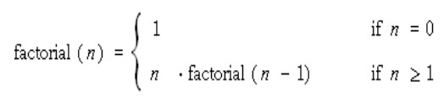
Recursion vs. Iteration
The factorial of a positive integer For example, 4! = 4·3·2·1 = 24.
Iterative Solution
Recursive Solution

Slide 10
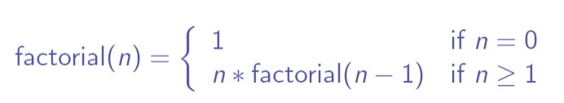
Example
Factorial of n

Slide 11
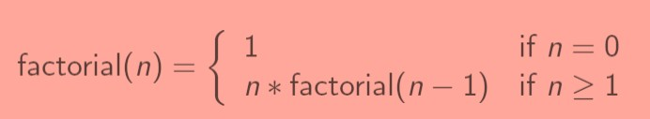
Example - Factorial
main()
fact(3)
3 > 1 , fact call itself
3
fact(n) 3x2
6
fact(2)
2 > 1 , fact call itself
fact() multiplies 3 with 2, received
from lower fact() and returns the
2
fact(n) 2x1
product to upper fact()
fact(1)
n=1, returns 1
2
1
fact(n)
1
fact() multiplies 2 with 1, received from lower fact() and returns the product to upper fact()
1

Slide 12
Example Fibonacci Series
fib(n)
if(n<2)
return n
else
return ( fib(n-1) + fib(n-2) )
5
fib(5)
3 2
fib(4) + fib(3)
n is 1 and 1 it will return n , after adding 1+1 it will return 2 to the upper function call and
2 1
1 1
fib(2) + fib(1)
0
so on..
fib(3) + fib(2)
1 1 1 0
fib(2) + fib(1) fib(1) + fib(0)
1
fib(1) + fib(0)
1 0
n is 1 and 0 it will return n ,
fib(1) + fib(0) after adding 1+0 it will return 1
to the upper function call

Slide 13


Run time stack tracing
x=3;
y= 2* f(2)
push copy of f
Consider the function
x=2;
y= 2* f(1)
push copy of f
int f(int x) { int y; if(x==0)
return 1;
else {
y = 2 * f(x-1); return y + 1;
}
}
x=1;
y= 2* f(0)
push copy of f
push copy of f
x=0;
y=? Return 1;
pop copy of f
y= 2 *1 =2
return y+1= 3 pop copy of f
y= 2 *3 =6
return y+1= 7
pop copy of f
y= 2 *7 =14
return y+1= 15
pop copy of f

