Slide 1
Lab 11 BST AND AVL TREE
CSC-221
Data Structure and Algorithms

Slide 2
Binary Search Tree (BST)
Binary Search Tree is a node-based binary tree data structure which has the following properties:
The left subtree of a node contains only nodes with keys lesser than the node’s key.
The right subtree of a node contains only nodes with keys greater than the node’s key.
The left and right subtree each must also be a binary search tree.

Slide 3
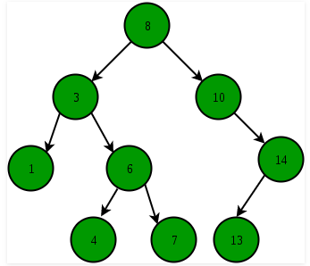
BST

Slide 4
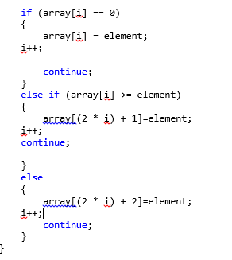
Implementation of BST using Static trees

Slide 5
AVL tree
AVL tree is a binary search tree in which the difference of heights of left and right subtrees of any node is less than or equal to one. The technique of balancing the height of binary trees was developed by Adelson, Velskii, and Landi and hence given the short form as AVL tree or Balanced Binary Tree.

Slide 6
AVL Tree
An AVL tree can be defined as follows:
Let T be a non-empty binary tree with T_{L} and T_{R} as its left and right subtrees. The tree is height balanced if:
T_{L} and T_{R} are height balanced
h_{L} - h_{R} <= 1, where h_{L} - h_{R} are the heights of T_{L} and T_{R}
The Balance factor of a node in a binary tree can have value 1, -1, 0, depending on whether the height of its left subtree is greater, less than or equal to the height of the right subtree.

Slide 7
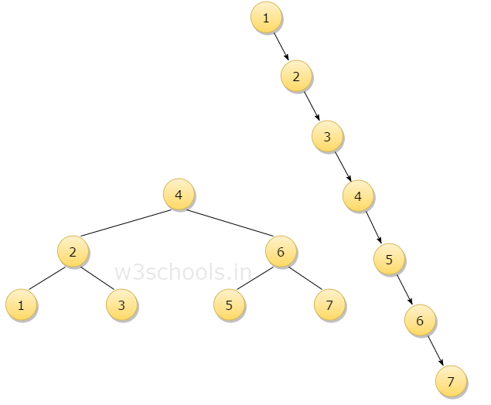
Advantages of AVL Tree
Advantages
Since AVL trees are height balance trees, operations like insertion and deletion have low time complexity. Let us consider an example:
If you have the following tree having keys 1, 2, 3, 4, 5, 6, 7 and then the binary tree will be like the second figure:
To insert a node with a key Q in the binary tree, the algorithm requires seven comparisons, but if you insert the same key in AVL tree, from the above 1st figure, you can see that the algorithm will require three comparisons.

Slide 8
ALGORITHM FOR INSERTION IN AVL
Step 1: First, insert a new element into the tree using BST's (Binary Search Tree) insertion logic.
Step 2: After inserting the elements you have to check the Balance Factor of each node.
Step 3: When the Balance Factor of every node will be found like 0 or 1 or -1 then the algorithm will proceed for the next operation.
Step 4: When the balance factor of any node comes other than the above three values then the tree is said to be imbalanced. Then perform the suitable Rotation to make it balanced and then the algorithm will proceed for the next operation.

Slide 9
Algorithm For Deletion
Step 1: Firstly, find that node where k is stored
Step 2: Secondly delete those contents of the node (Suppose the node is x)
Step 3: Claim: Deleting a node in an AVL tree can be reduced by deleting a leaf. There are three possible cases:
When x has no children then, delete x
When x has one child, let x' becomes the child of x.
Notice: x' cannot have a child, since subtrees of T can differ in height by at most one :
then replace the contents of x with the contents of x'
then delete x' (a leaf)
Step 4: When x has two children,
then find x's successor z (which has no left child)
then replace x's contents with z's contents, and
delete z
In all of the three cases, you will end up removing a leaf.

Slide 10
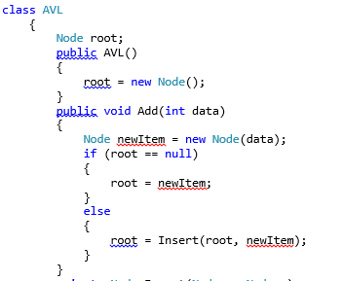
ADD ROOT
Add (3)
Root=insert(root,newitem)

Slide 11
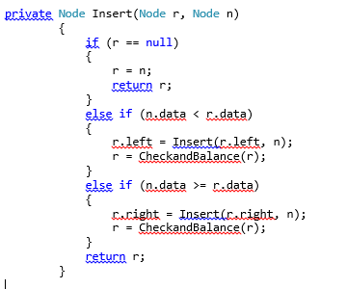
Insert method
Insertnode()
Checkbalance()

Slide 12
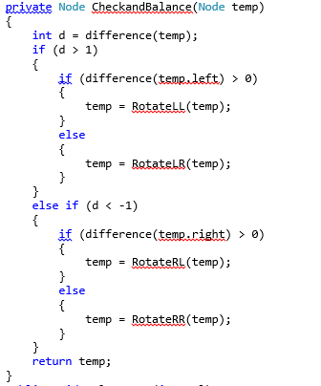
Check and Balance

Slide 13
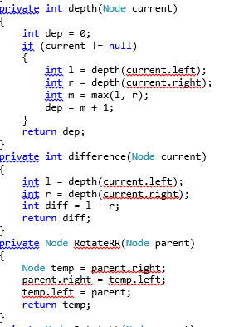
Depth, difference and Rotate RR methods

Slide 14
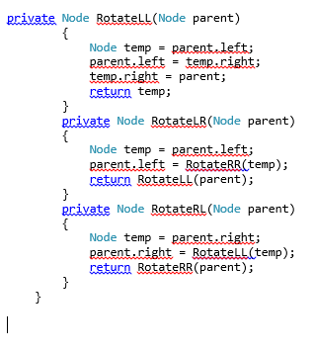
Rotate LL,LR,RL Methods

Slide 15
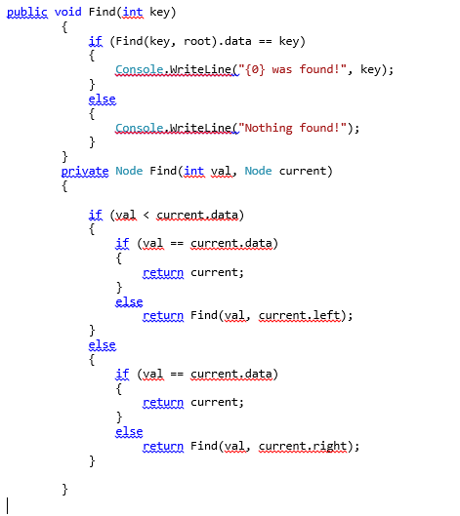
Find method

Slide 16
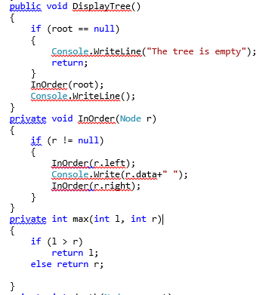
Display , Inorder ,max methods

Slide 17
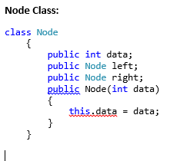
Node class

Slide 18
Lab 12 (Lab Tasks)
Write a program to implement concept of Binary Search Tree using dynamic trees
Implement the AVL Tree by performing searching.

Slide 19
Thank You

