Slide 1
Graphs

Slide 2
Graph
A Graph is a non-linear data structure consisting of nodes and edges. The nodes are sometimes also referred to as vertices and the edges are lines or arcs that connect any two nodes in the graph.
Graphs are used to solve many real-life problems. Graphs are used to represent networks. The networks may include paths in a city or telephone network or circuit network. Graphs are also used in social networks like linkedIn, Facebook. For example, in Facebook, each person is represented with a vertex(or node). Each node is a structure and contains information like person id, name, gender, locale etc.

Slide 3
Representations of Graph
Following two are the most commonly used representations of a graph.
1. Adjacency Matrix
2. Adjacency List

Slide 4
Adjacency Matrix
Adjacency Matrix:
Adjacency Matrix is a 2D array of size V x V where V is the number of vertices in a graph. Let the 2D array be adj[][], a slot adj[i][j] = 1 indicates that there is an edge from vertex i to vertex j. Adjacency matrix for undirected graph is always symmetric. Adjacency Matrix is also used to represent weighted graphs. If adj[i][j] = w, then there is an edge from vertex i to vertex j with weight w.

Slide 5
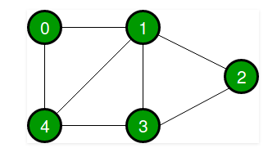
Example
Following is an example of an undirected graph with 5 vertices.

Slide 6
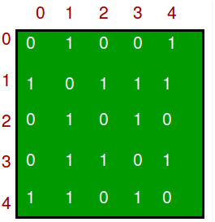
Example
The adjacency matrix for the above example graph is:

Slide 7
Adjacency List
Adjacency List:
An array of lists is used. Size of the array is equal to the number of vertices. Let the array be array[]. An entry array[i] represents the list of vertices adjacent to the ith vertex. This representation can also be used to represent a weighted graph. The weights of edges can be represented as lists of pairs. Following is adjacency list representation of the above graph.

Slide 8
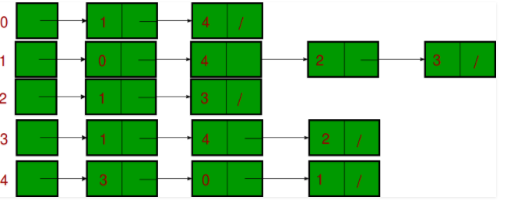
Example

Slide 9
BFS
Breadth First Traversal (or Search) for a graph is similar to Breadth First Traversal of a tree .The only catch here is, unlike trees, graphs may contain cycles, so we may come to the same node again. To avoid processing a node more than once, we use a boolean visited array. For simplicity, it is assumed that all vertices are reachable from the starting vertex.

Slide 10
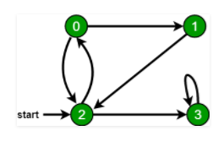
Example of BFS
For example, in the following graph, we start traversal from vertex 2. When we come to vertex 0, we look for all adjacent vertices of it. 2 is also an adjacent vertex of 0. If we don’t mark visited vertices, then 2 will be processed again and it will become a non-terminating process. A Breadth First Traversal of the following graph is 2, 0, 3, 1.

Slide 11
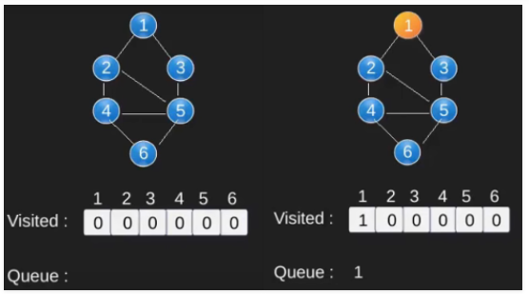
Example of BFS

Slide 12
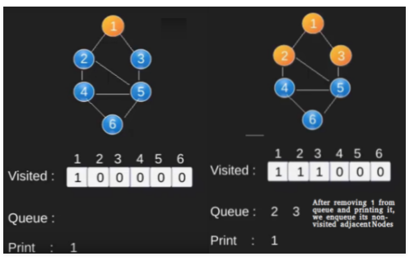
Example of BFS

Slide 13
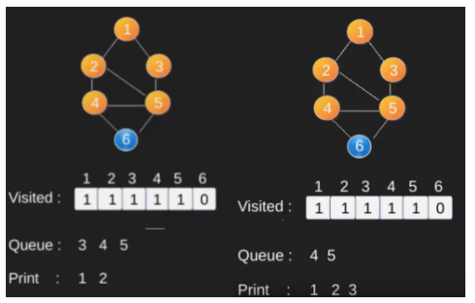
Example of BFS

Slide 14
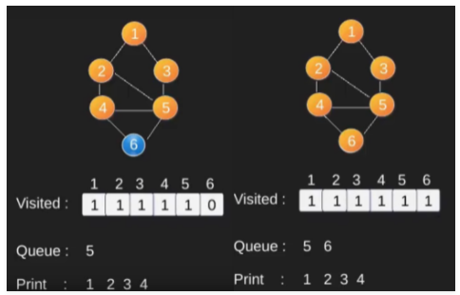
Example of BFS

Slide 15
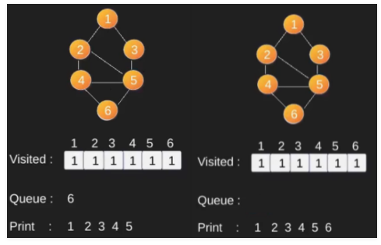
Example of BFS

Slide 16
DFS
The DFS algorithm is a recursive algorithm that uses the idea of backtracking. It involves exhaustive searches of all the nodes by going ahead, if possible, else by backtracking.
Here, the word backtrack means that when you are moving forward and there are no more nodes along the current path, you move backwards on the same path to find nodes to traverse. All the nodes will be visited on the current path till all the unvisited nodes have been traversed after which the next path will be selected.

Slide 17
DFS
This recursive nature of DFS can be implemented using stacks. The basic idea is as follows:
Pick a starting node and push all its adjacent nodes into a stack.
Pop a node from stack to select the next node to visit and push all its adjacent nodes into a stack.
Repeat this process until the stack is empty. However, ensure that the nodes that are visited are marked. This will prevent you from visiting the same node more than once. If you do not mark the nodes that are visited and you visit the same node more than once, you may end up in an infinite l

Slide 18
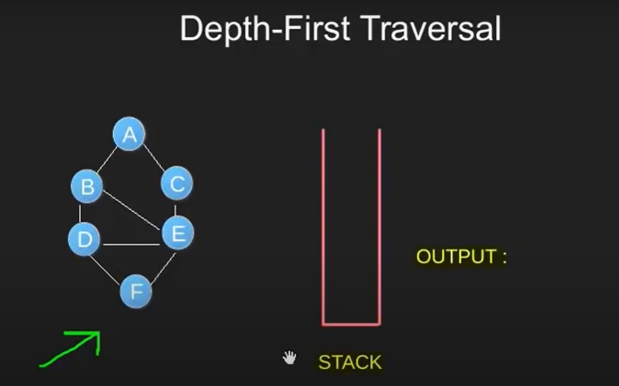
EXAMPLE DFS

Slide 19
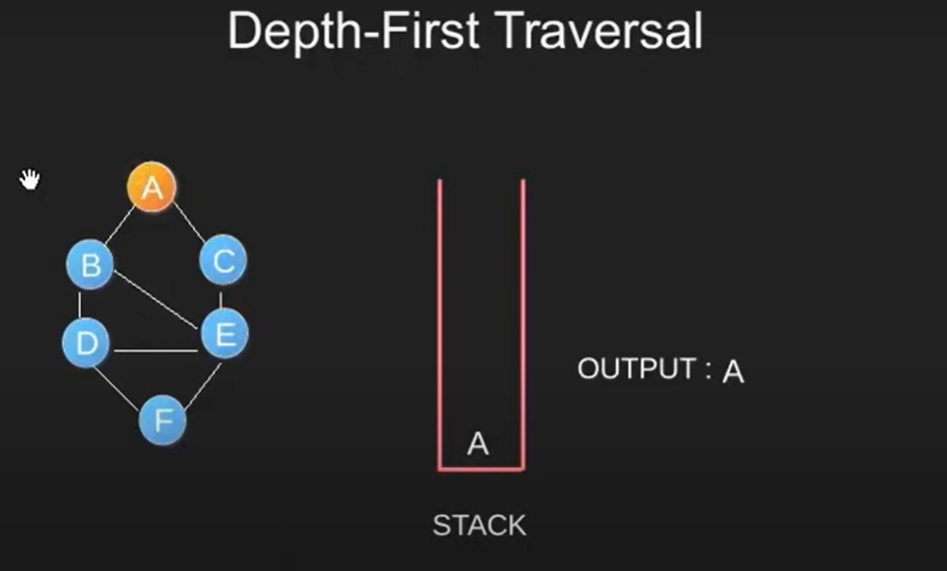
EXAMPLE DFS

Slide 20
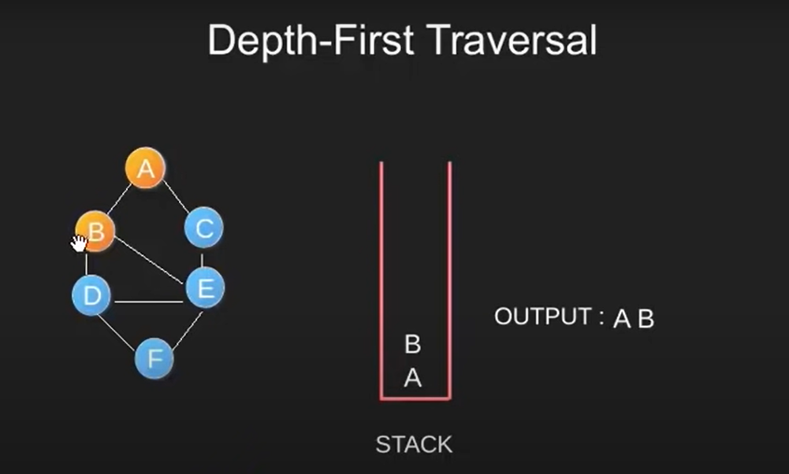
EXAMPLE DFS

Slide 21
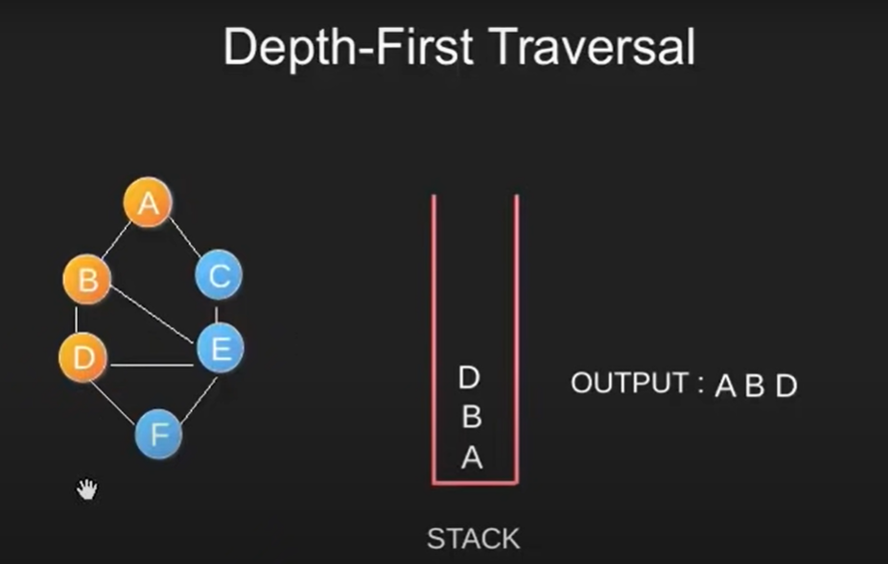
EXAMPLE DFS

Slide 22
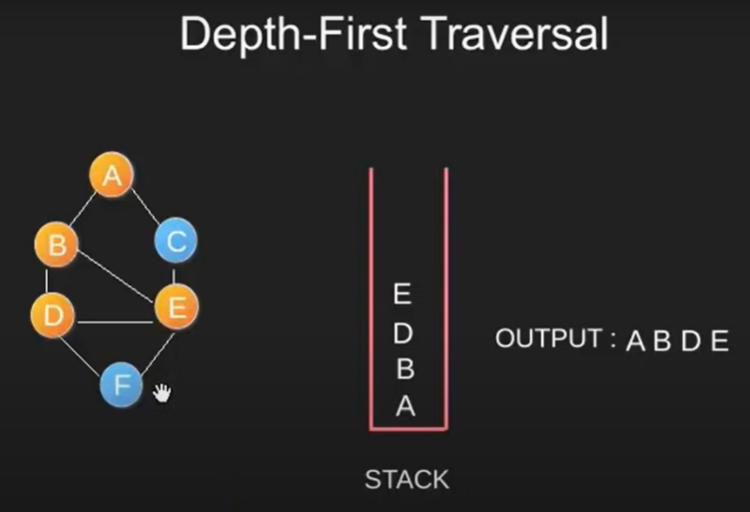
EXAMPLE DFS

Slide 23
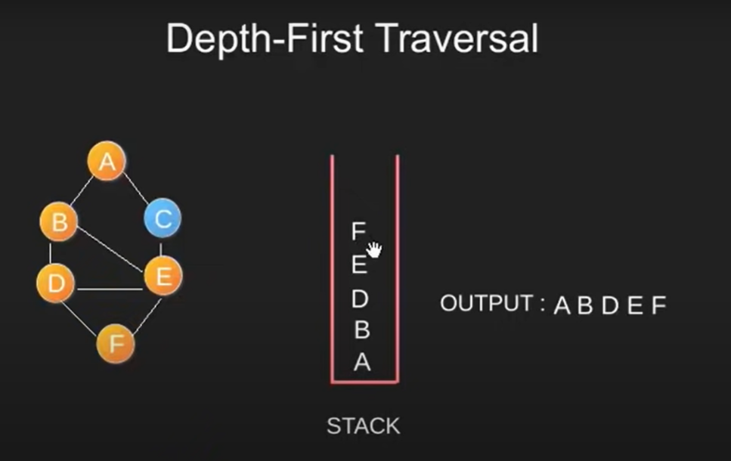
EXAMPLE DFS
Here we pop “F” as it has no unvisited adjacent node

Slide 24
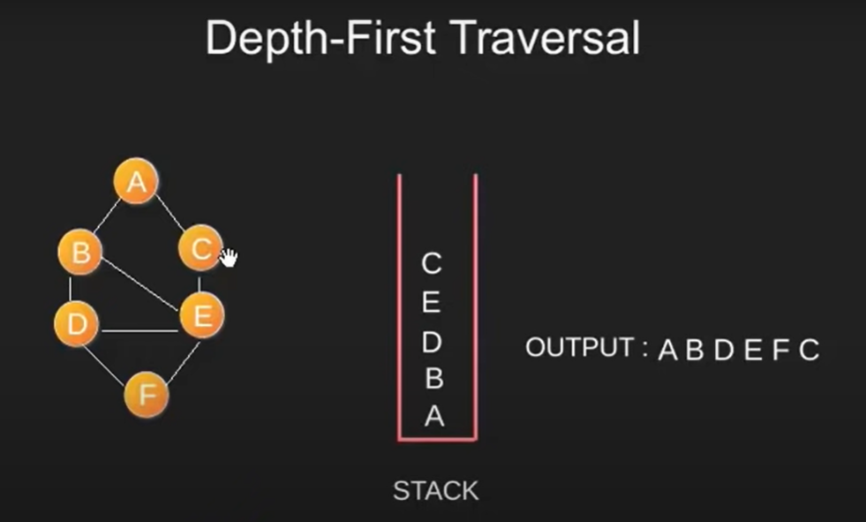
EXAMPLE DFS
No keep popping the nodes until the stack is empty

Slide 25
Lab (Lab Tasks)
Create a program to implement Graphs With Adjacency matrix
Create a program to implement Graphs With Adjacency list
Create a program to implement BFS.
Create a program to implement DFS.

