Slide 1
Heap Sort

Slide 2
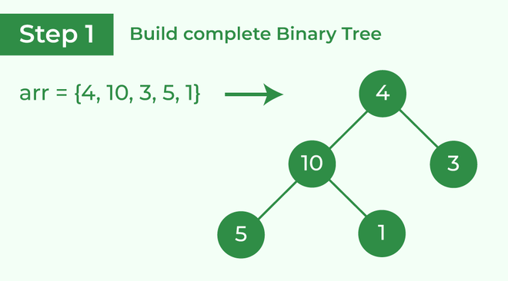
Heap Sort

Slide 3
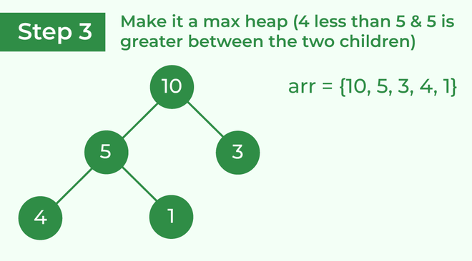
Heap Sort
Transform it into a max heap image widget
Now, as seen, 4 as a parent is smaller than the child 5, thus swap both of these again and the resulted heap and array should be like this:

Slide 4
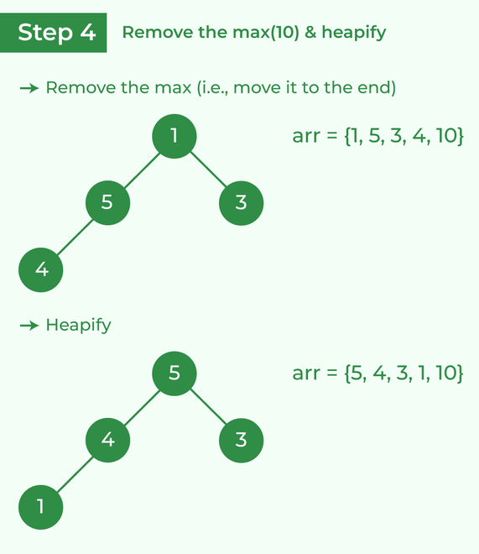

Slide 5
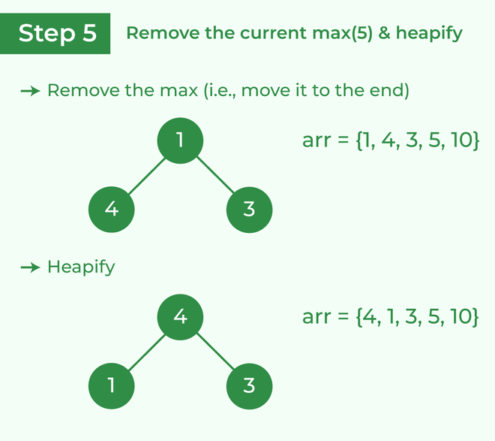

Slide 6
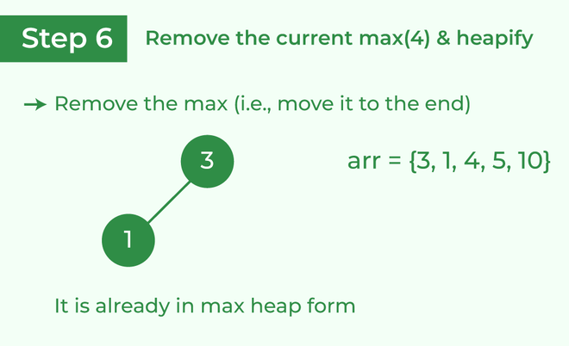

Slide 7
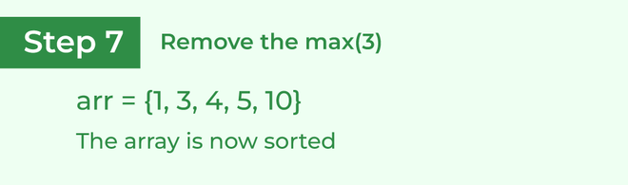

Slide 8
