Slide 1
CSC-110
COMPUTING FUNDAMENTALS COMPUTER PROGRAMMING FUNDAMENTALS

Slide 2
INTRODUCTION
Computer is an electronic device that accepts data, processes it, and generates the relevant output. It can perform both simple and complex tasks with very high speed and accuracy.
Computers need to be instructed about “how” the task is to be performed. The set of instructions that instruct the computer about the way the task is to be performed is called a program.
A program is required for processing all kind of tasks— simple tasks like addition of two numbers, and complex tasks like gaming etc.

Slide 3
PROGRAM DEVELOPMENT LIFE CYCLE
A program is needed to instruct the computer about the way a task is to be performed. The instructions in a program have three essential parts:
Instructions to accept the input data that needs to be processed,
Instructions that will act upon the input data and process it, and
Instructions to provide the output to user.

Slide 4
PROGRAM DEVELOPMENT LIFE CYCLE
Steps of a program development cycle:
Program Analysis
Understand the problem
Have multiple solutions
Select a solution
Program Design
Write Algorithm
Write Flowchart
•Write Pseudo code

Slide 5
PROGRAM DEVELOPMENT LIFE CYCLE
Program Development
Choose a programming language
Write the program by converting the pseudo code, and then using the programming language.
Compile the program and remove syntax errors, if any
Execute the program.
Test the program. Check the output results with different inputs. If the
output is incorrect, modify the program to get correct results.
Install the tested program on the user’s computer.

Slide 6
PROGRAM DEVELOPMENT LIFE CYCLE
Program Documentation and maintenance
Document the program, for later use.
Maintain the program for updating, removing errors, changing requirements etc.

Slide 7
ALGORITHM
Algorithm is an ordered sequence of finite, well defined, unambiguous instructions for completing a task. Algorithm is an English-like representation of the logic which is used to solve the problem.
It is a step- by-step procedure for solving a task or a problem. The steps must be ordered, unambiguous and finite in number.

Slide 8
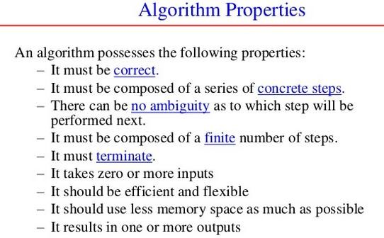
ALGORITHM

Slide 9
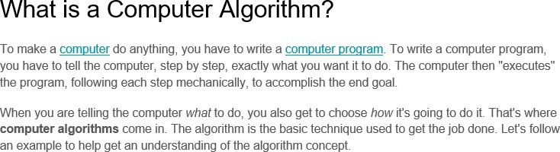
ALGORITHM

Slide 10
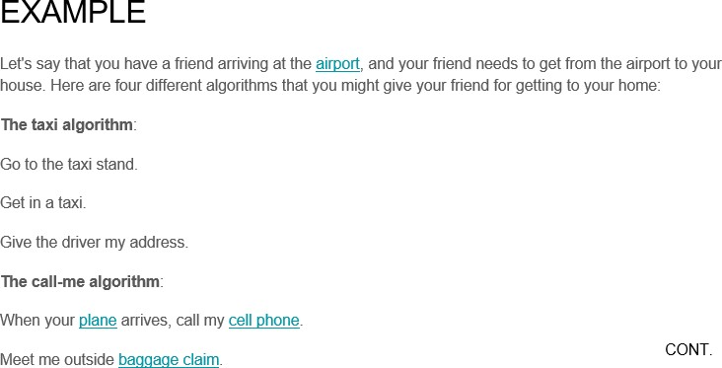
ALGORITHM

Slide 11
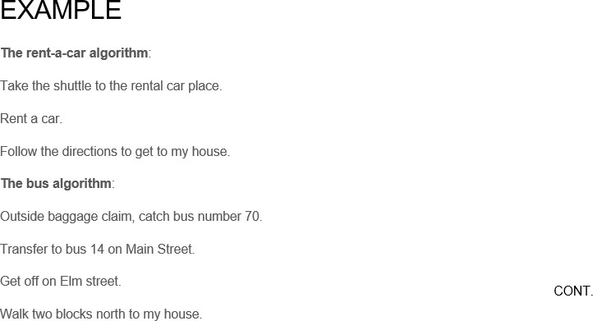
ALGORITHM

Slide 12
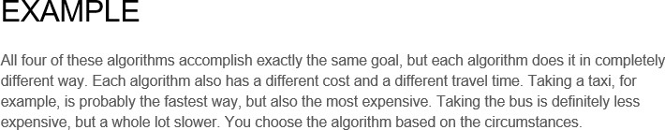
ALGORITHM

Slide 13
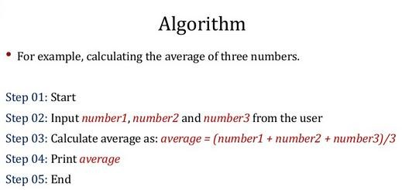
ALGORITHM

Slide 14
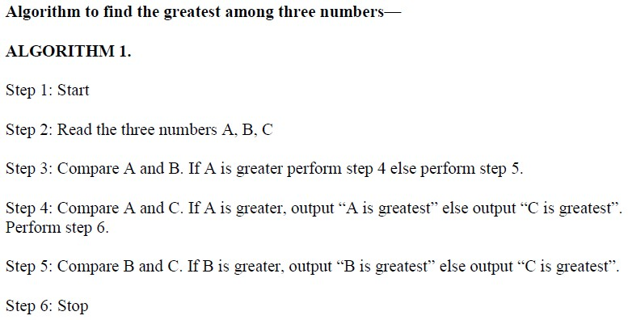
ALGORITHM

Slide 15
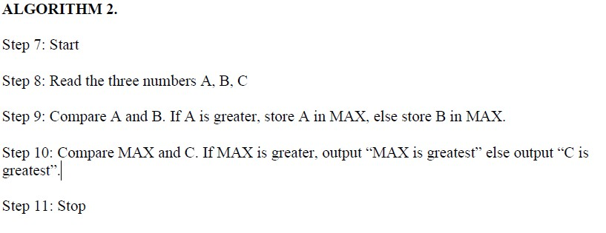
ALGORITHM

Slide 16
ALGORITHM
Both the algorithms accomplish the same goal, but in different ways. The programmer selects the algorithm based on the advantages and disadvantages of each algorithm. For example, the first algorithm has more number of comparisons, whereas in the second algorithm an additional variable MAX is required.

Slide 17
CONTROL STRUCTURES
The logic of a program may not always be a linear sequence of statements to be executed in that order. The logic of the program may require execution of a statement based on a decision. It may repetitively execute a set of statements unless some condition is met. Control structures specify the statements to be executed and the order of execution of statements.
Flowchart and Pseudo code use control structures for representation. There are three kinds of control structures:
Sequential—instructions are executed in linear order
Selection (branch or conditional)—it asks a true/false question and then selects the next instruction based on the answer
Iterative (loop)—it repeats the execution of a block of instructions.

Slide 18
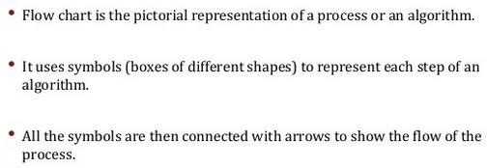
FLOWCHART

Slide 19
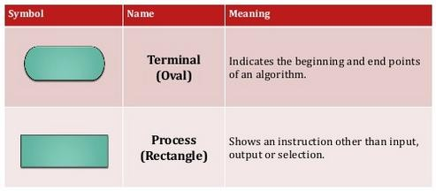
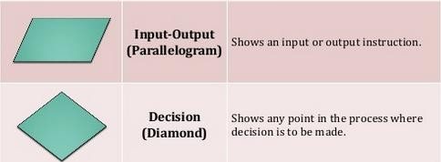
FLOWCHART

Slide 20
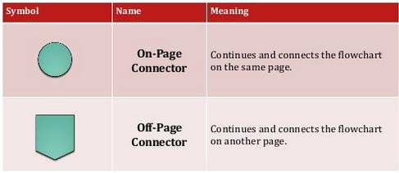
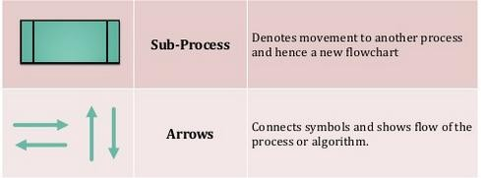
FLOWCHART

Slide 21
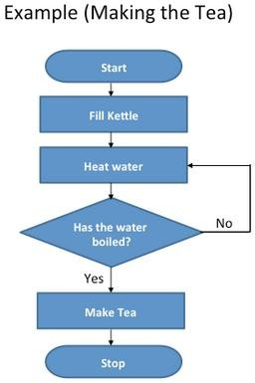
FLOWCHART

Slide 22
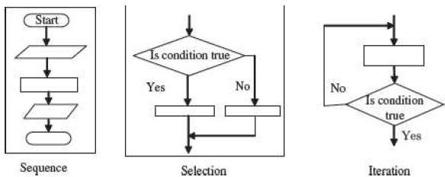
FLOWCHART
Control structures in flowchart.

Slide 23
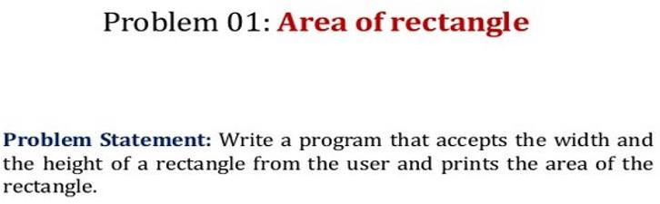
FLOWCHART

Slide 24
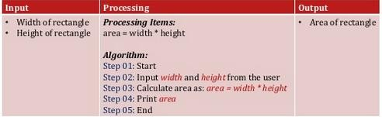
FLOWCHART

Slide 25
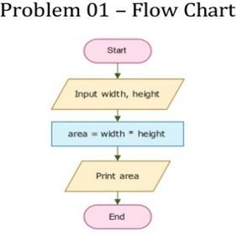
FLOWCHART

Slide 26
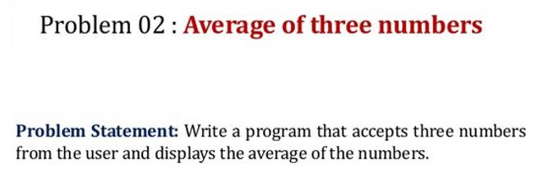
FLOWCHART

Slide 27
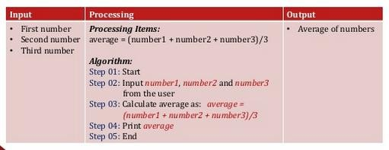
FLOWCHART

Slide 28
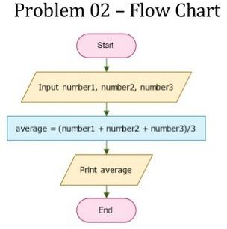
FLOWCHART

Slide 29
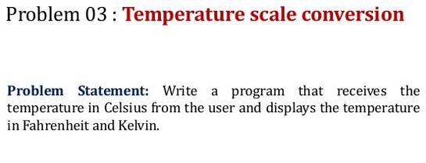
FLOWCHART

Slide 30
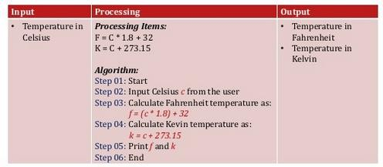
FLOWCHART

Slide 31
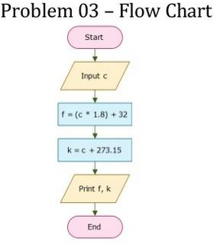
FLOWCHART

Slide 32
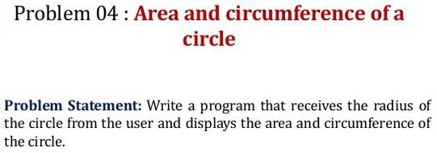
FLOWCHART

Slide 33
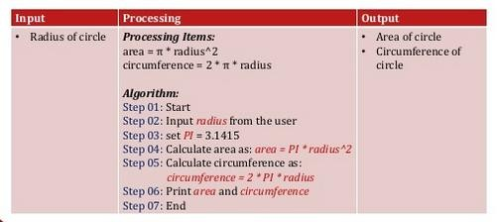
FLOWCHART

Slide 34
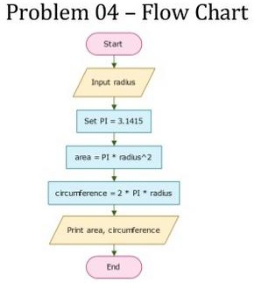
FLOWCHART

Slide 35
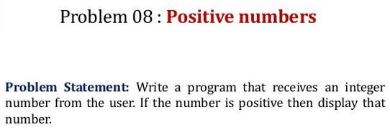
FLOWCHART

Slide 36
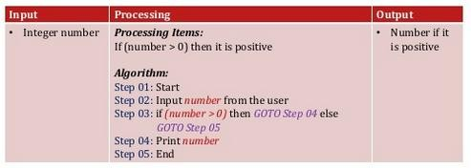
FLOWCHART

Slide 37
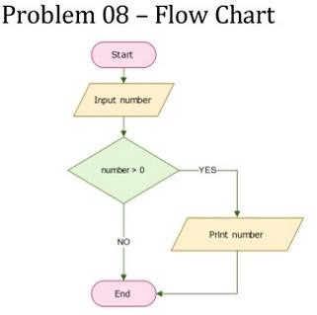
FLOWCHART

Slide 38
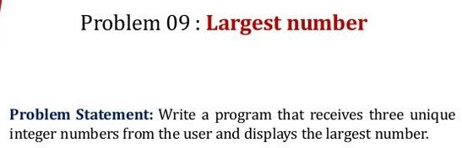
FLOWCHART

Slide 39
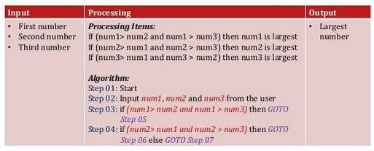

FLOWCHART

Slide 40
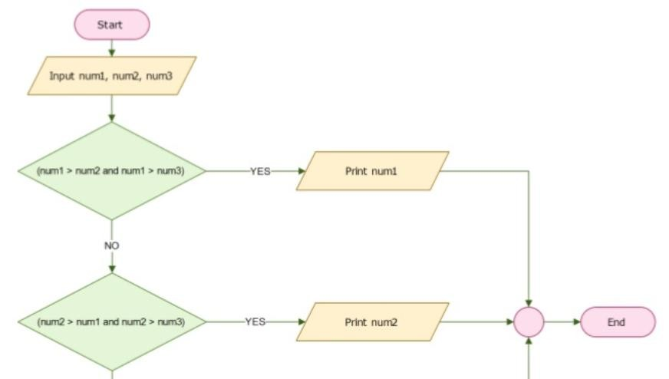


Slide 41
PSEUDO CODE
Pseudo code consists of short, readable and formally-styled English language used for explaining an algorithm. Pseudo code does not include details like variable declarations, subroutines etc.
Pseudo code is a short-hand way of describing a computer program.
It is used to give a sketch of the structure of the program, before the actual coding. It uses the structured constructs of the programming language but is not machine-readable. Pseudo code cannot be compiled or executed. Thus, no standard for the syntax of pseudo code exists. For writing the pseudo code, the programmer is not required to know the programming language in which the pseudo code will be implemented later.

Slide 42
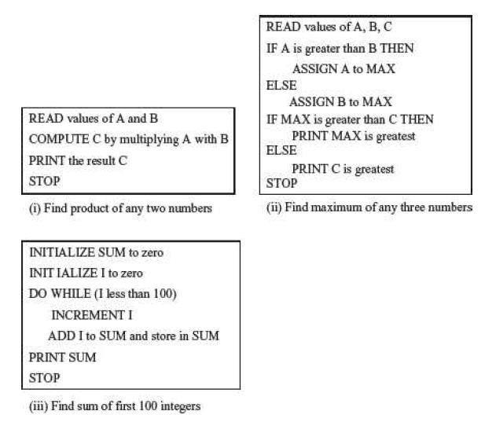

Slide 43
PSEUDO CODE
A pseudo code is easily translated into a programming language. But, as there are no defined standards for writing a pseudo code, programmers may use their own style for writing the pseudo code, which can be easily understood. Generally, programmers prefer to write pseudo code instead of flowcharts.

Slide 44
DIFFERENCE BETWEEN ALGORITHM, FLOWCHART, AND PSEUDO CODE
An algorithm is a sequence of instructions used to solve a particular problem. Flowchart and Pseudo code are tools to document and represent the algorithm. In other words, an algorithm can be represented using a flowchart or a pseudo code. Flowchart is a graphical representation of the algorithm. Pseudo code is a readable, formally styled English like language representation of the algorithm.

Slide 45
PROGRAMMING PARADIGMS
There are three types of Programming Paradigms or styles/patterns of programming:
1- Procedural Programming
2- Functional Programming
3- Object Oriented Programming

Slide 46
PROGRAMMING PARADIGMS
Procedural programming uses a list of instructions to tell the computer what to do step by step.
Procedural programming is also referred to as imperative or structured programming.
Examples of procedural languages that use the style of procedural programming include Fortran, COBOL and C, which have been around since the 1960s and 70s.

Slide 47
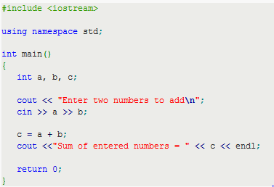
PROGRAMMING PARADIGMS
EXAMPLE OF PROCEDURAL PROGRAMMING

Slide 48
PROGRAMMING PARADIGMS
Functional programming is an approach to problem solving that treats every computation as a mathematical function.
It is when functions are used as the fundamental building blocks of a program..
Examples of functional programming languages include Erlang, Haskell, Lisp and Scala. .

Slide 49
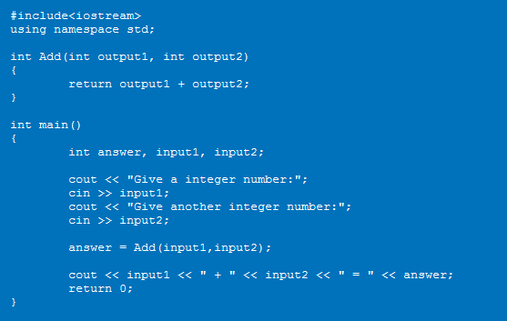
PROGRAMMING PARADIGMS- EXAMPLE

Slide 50
PROGRAMMING PARADIGMS
Object Oriented Programming: The fundamental idea behind object-oriented languages is to combine into a single unit both data and the functions that operate on that data.
A computer language is object-oriented if they support the four specific object properties called abstraction, polymorphism, inheritance, and encapsulation.

Slide 51
PROGRAMMING PARADIGMS
Abstraction allows dealing with the complexity of the object. Abstraction allows picking out the relevant details of the object, and ignoring the non-essential details.
Encapsulation means information hiding.
Polymorphism means, many forms. It refers to an entity changing its form depending on the circumstances.
The Inheritance feature of object-oriented software allows a new class, called the derived class, to be derived from an already existing class known as the base class.

Slide 52
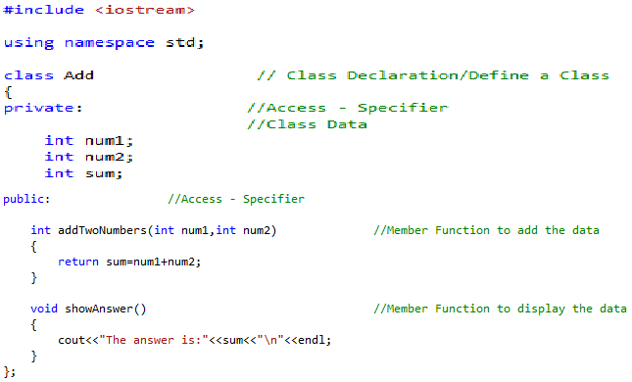

Slide 53
