Slide 1


Slide 2

When we type some letters or words, the computer translates them in numbers as computers can
understand only numbers.
A computer can understand the positional number system where there are only a few symbols called digits and these symbols represent different values depending on the position they occupy in the number.
The value of each digit in a number can be determined using −
The digit
The position of the digit in the number
The base of the number system (where the base is defined as the total number of digits available in the number system)

Slide 3
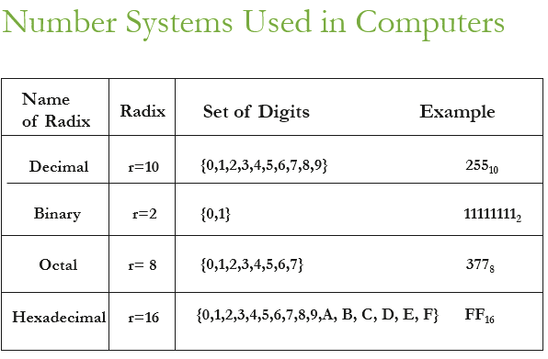

Slide 4
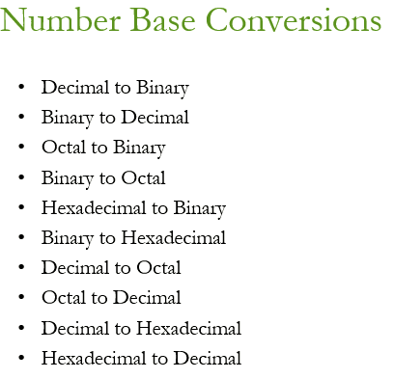

Slide 5
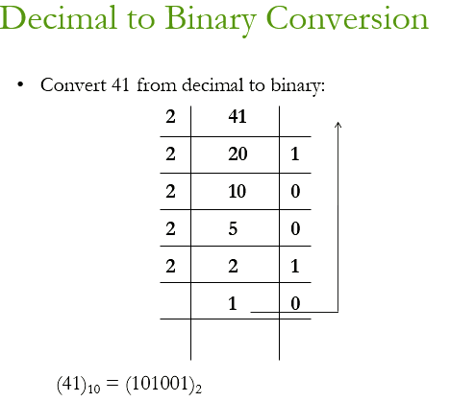

Slide 6
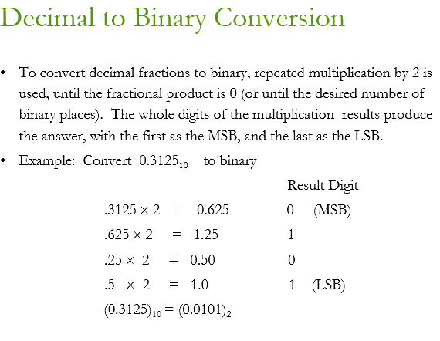

Slide 7
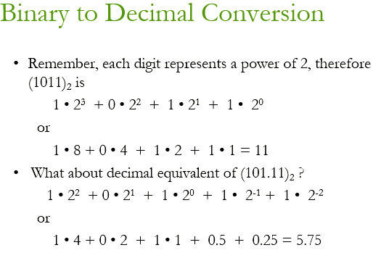

Slide 8
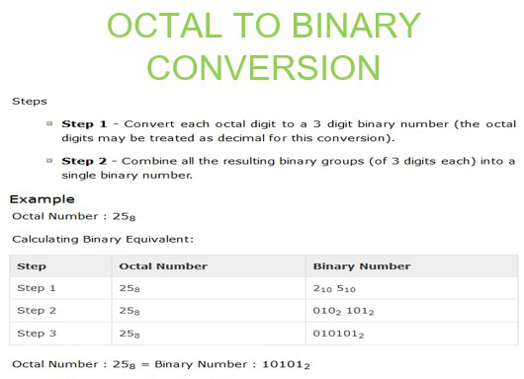

Slide 9
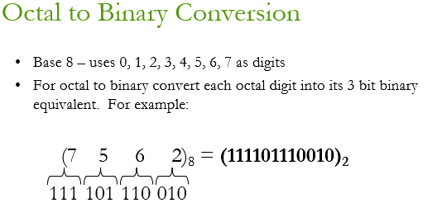

Slide 10
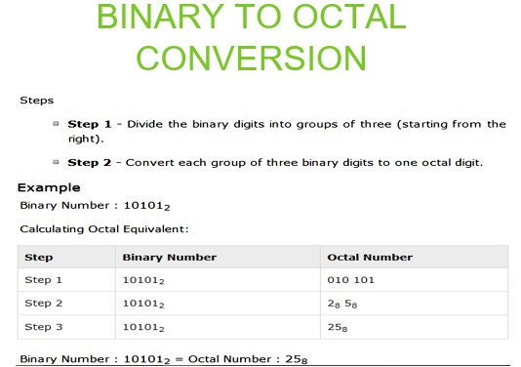

Slide 11
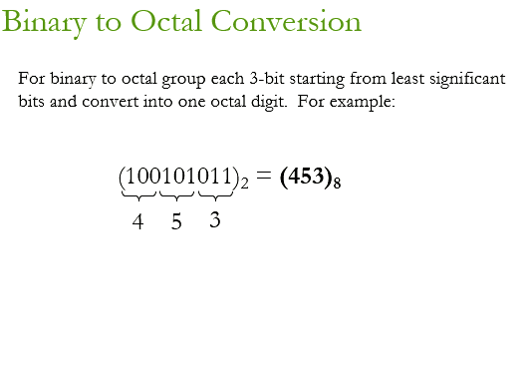

Slide 12
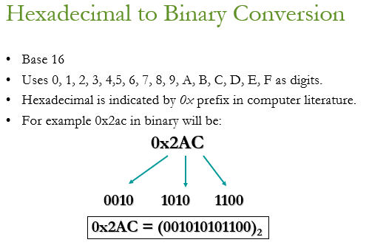

Slide 13
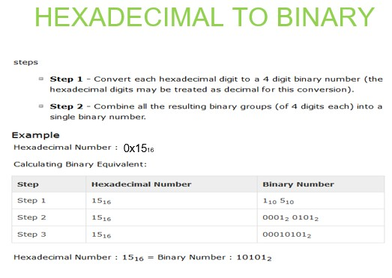

Slide 14
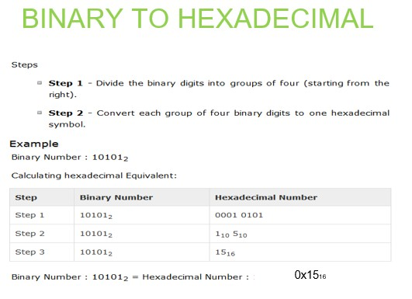

Slide 15
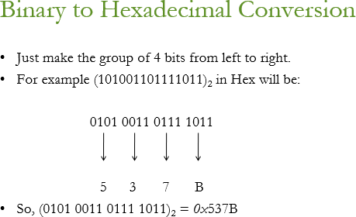

Slide 16
