Slide 1

Preparing for Emergency Response
Lecture 11

Slide 2

CHEMICAL SPILLS/ Hazards

Slide 3
Industrial development and increasing demand for diverse goods and services chemicals being utilized in many products and processes.
This has increased the chemical exposure of people, both at home and in the workplace.
Exposure to chemicals and their harmful effects has spread across the globe at alarming rates causing a rise in health problems and negatively affecting worker safety.
According to the Hazard Communication Standard (HCS) of the Occupational Safety and Health Administration (OSHA), it is important that employees are aware of the risks and hazards associated with their daily work. Hazard recognition also reduces the chance of exposure to hazardous chemicals and the injuries they can bring.

Slide 4
Types of Chemical Hazards

Slide 5
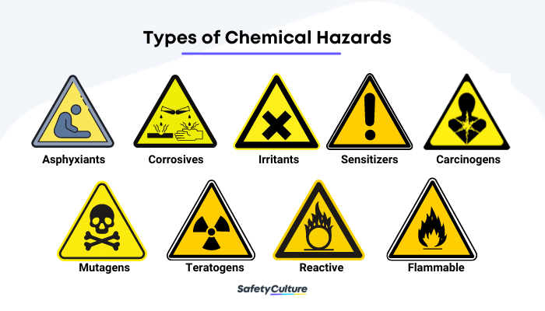

Slide 6
Asphyxiants – these are chemicals or gasses that can cause difficulty in breathing, unconsciousness, or death by suffocation.
Corrosives – these are chemicals that can cause severe skin burns and damages in tissue once contacted with.
Irritants – these chemicals usually cause redness, rashes, or inflammation of the affected area. Although the presence of symptoms are normally short-term, there are still instances where they create long-lasting effects on others.
Sensitizers – people or animals that are exposed to this type of chemical develop allergic reactions after a significant amount of time or repeated exposure to the specific chemical.

Slide 7
Reactive – these are substances that, under certain conditions or exposure to other chemicals or elements, can cause severe physical hazards such as fires or explosions.
Flammable – these are chemical substances or materials that can ignite once exposed to air and other elements.
Carcinogens – carcinogens are substances that are known to be cancer-causing chemicals. They are categorized as either natural or manmade, but it is crucial to note that even a small amount of this type of chemical can severely damage human health.
Teratogens – these are chemicals that can cause physiological development abnormalities or birth defects.

Slide 8
Managing Workplace Chemical Hazards
The Occupational Safety and Health Administration (OSHA) guides employers to protect employees in the workplace from chemical hazards. Using the strategy of the Hierarchy of Controls, developed by the National Institute for Occupational Safety and Health (NIOSH), the recommendations from the most effective to the least effective ways to control chemical hazards are as follows:
Elimination/Substitution – where the need for hazardous chemical usage is completely removed or an alternate less or non-hazardous chemical is used.
Engineering Controls – where employers must implement changes that are physical to the workplace that helps to reduce exposure to the chemical hazard on the workers using or handling hazardous chemical substances.
Administrative and Work Practice Controls – changing how a work task is performed or establishing efficient workplace policies, protocols, processes, and control and monitoring mechanisms.
Personal Protective Equipment (PPE) – using PPE such as respirators, gloves, protective full-body suits, etc., can help in reducing the workers’ direct contact with the hazardous chemical.

Slide 9
CHEMICAL SPILLS

Slide 10
Many chemicals are inherently hazardous or even deadly when they’re not used in a properly controlled manner, or when accidents occur.
chemicals are used to some degree at nearly every workplace.
Some are highly corrosive or toxic and others are flammable, may oxidize quickly, or may react with other substances to create a deadly situation.
When chemicals are stored or handled properly, the inherent risk is minimized.

Slide 11
Prevention: the best solution
The key is to follow proper procedures for storing, transferring, handling, using, and disposing of chemicals. All workers on a jobsite should be trained to recognize the hazards and proper procedures associated with every chemical they may encounter, including the actions they need to take when a spill occurs.
Chemicals should be stored and transported properly, as noted in the MSDS. For example, some chemicals should not be exposed to excessive heat. Others must be stored in fireproof containers. Still others cannot be jostled while they are being moved.
Workers using the chemicals must wear the proper personal protective equipment (PPE) to minimize the chance of injury, because even a small splash in the eyes can create a traumatic injury.

Slide 12
BHOPAL Tragedy
In the predawn hours of December 3, 1984, a toxic cloud of methyl isocyanate gas escaped from the Union Carbide pesticide plant in Bhopal, India, and quickly spread throughout the city. Vomiting and gasping for air, those who didn’t die in their sleep poured into unprepared area hospitals or desperately attempted to outrun the fumes. Dog, bird, cow and water buffalo corpses reportedly lined the streets. Investigations later uncovered a slew of safety violations at the plant, including broken and outdated equipment. Though estimates vary, roughly 15,000 Bhopal residents are believed to have died in what’s often referred to as history’s worst industrial accident. Hundreds of thousands of additional inhabitants suffered afflictions ranging from memory loss and nerve damage to blindness and organ failure. To this day, the site of the plant, now owned by Dow Chemical Company, remains highly contaminated.

Slide 13
CHERNOBYL
On April 26, 1986, a turbine test on one of the reactors at the Chernobyl nuclear power station went horribly awry, leading to a series of explosions that spewed massive amounts of radioactive material into the atmosphere. The accident, which the Soviet authorities attempted to cover up, initially claimed only 31 lives: two plant workers who died in the blasts, a third who reportedly keeled over of a heart attack and 28 first responders who contracted acute radiation syndrome during the frantic early stages of the cleanup. However, Chernobyl also unleashed a thyroid cancer epidemic and likely caused additional cancer cases as well. In 2005, a United Nations-backed panel calculated the eventual death toll at up to 4,000, whereas other organizations put this number significantly higher. For perhaps centuries to come, an exclusion zone, set up around the plant following the forced evacuation of tens of thousands of area residents, will be off limits to human habitation.

