Slide 1

Preparing for Emergency Response
Lecture 12

Slide 2
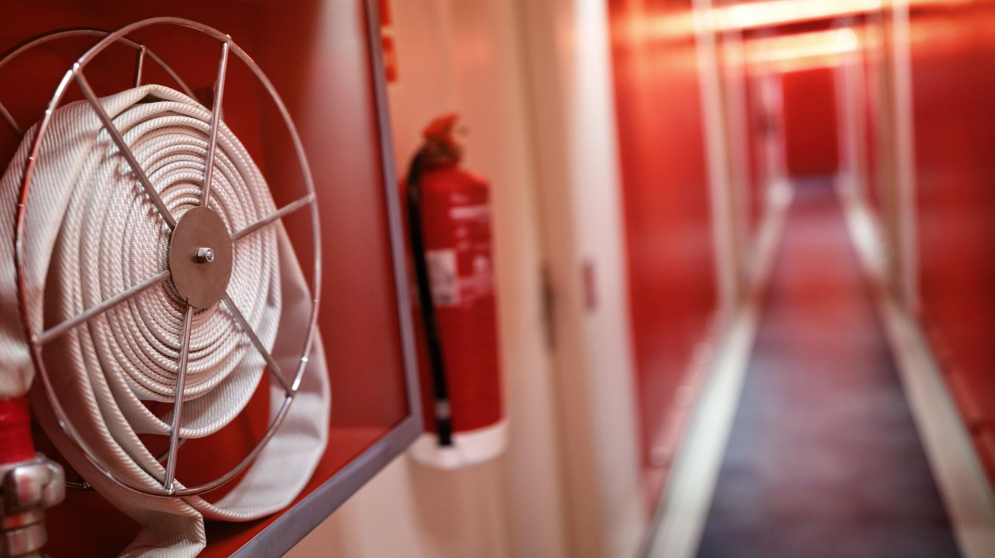
First Aid and Safety drills/Training (Firefighting, Evacuation in case of Emergency)

Slide 3
Emergency
As per WHO
Emergency is a state in which normal procedures are suspended and extra-ordinary measures are taken in order to avert a disaster

Slide 4
Emergency drills and practice exercises are important for preparing for emergency situations.
An organization should follow these six steps to successfully conduct emergency drills and exercises: 1. Develop emergency plans 2. Train employees 3. Conduct tabletop exercises 4. Conduct drills 5. Conduct functional exercises 6. Conduct full-scale exercises

Slide 5
Develop
Develop Emergency Plans
The emergency plans should be based on the actions you want your employees and visitors to perform regardless of the emergency.
Train
Train All Employees
All employees should be trained at least annually on the emergency response plans and guides and on their roles within the plans..

Slide 6
Step 3: Conduct Tabletop Exercises
Tabletop exercises allow organizations to test their emergency plans and individuals’ knowledge of their roles and responsibilities using hypothetical situations, without causing disruption to the business day.
Example participants may include: • Management • Employees • Maintenance staff • Transportation staff • Safety/Security personnel • Fire department/EMS • Law enforcement • Emergency management • Crisis team members • Nurse

Slide 7
Conduct Drills
Many organizations already conduct drills during the year.
Emergency drills for responses such as lockdown, shelter-in-place or employee injury provide the training and route memorization of the skill sets necessary for emergency situations.
Drills should be unannounced and performed under varying and nonideal conditions (e.g., different times of day, different weather conditions, different times during the year or during absence of key personnel).
All employees should be trained prior to any drill to make sure they know what is expected. Invite local emergency responders to observe the drill.

Slide 8
Step 5: Conduct Functional Exercise
After you have performed a number of drills for specific procedures, the next step is functional exercises.
These exercises help you understand how your emergency plans integrate with local emergency responders’ plans, how your incident command structure operates and how you communicate with emergency responders during an emergency.

Slide 9
Step 6: Conduct Full-Scale Exercises
A full-scale exercise is a complex, multiagency, multijurisdictional, multiorganizational exercise designed to validate many facets of emergency plans and preparedness.
They not only test the organization’s emergency plans, but also the plans of the responding agencies.
Very few organizations ever perform this type of exercise due to time requirements (six to eight months of planning), coordination and expense involved.
Full-scale exercises are conducted in real time, creating a stressful, time-constrained environment that closely mirrors real events in a safe manner.
This may include simulated building damage, human casualties, active search and rescue, mass transportation and other activities, depending on the scenario

Slide 10

FIRST AID

Slide 11
First Aid
It is a requirement of OSHA that employees be given a safe and healthy workplace that is reasonably free of occupational hazards.
It is unrealistic to expect accidents not to happen.
Employers are required to provide medical and first aid personnel and supplies commensurate with the hazards of the workplace.
The details of a workplace medical and first aid program are dependent on the circumstances of each workplace and employer.

Slide 12
The role of the first aider
Assessing the situation
What happened Number of casualties History, signs, symptoms
Protecting from dangers
Assess for further danger Protect yourself first
Getting help
Ask bystanders Which emergency services? Recognise your limitations
Prioritising treatment
Most urgent thing first Most urgent person first Offer support and comfort
Minimising infection risks
Wash hands before and after giving help
Wear disposable gloves Wear protective clothing if needed Cover your own cuts with a plaster
Dispose of contaminated waste carefully Use sterile, undamaged, in-date dressings

Slide 13
The aims of first aid
Preserve
Preserve Life
Prevent
Prevent Worsening
Promote
Promote Recovery

Slide 14
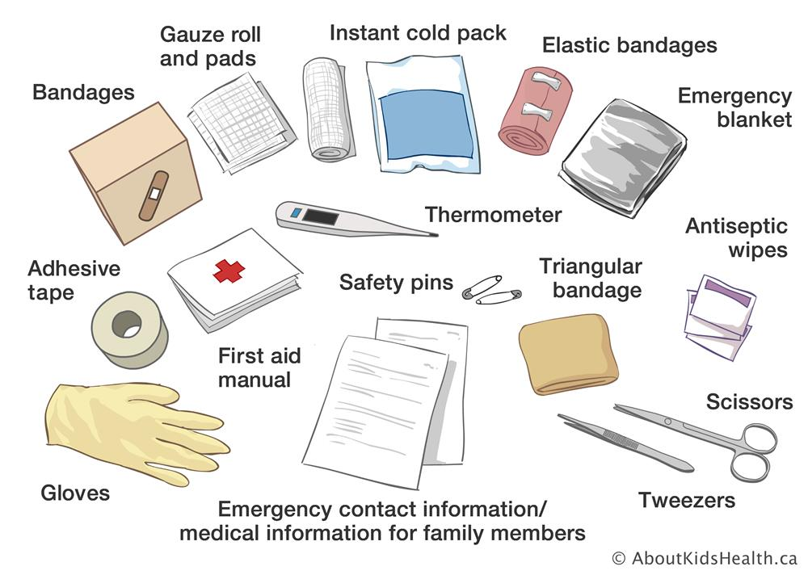
First aid kits

Slide 15

Chain of survival

