Slide 1

Stress and Safety at Work Environment
Lecture 14

Slide 2
Shift Work
Irregular hours of work and work patterns that include night and early morning shifts can lead to disruption of the internal body clock, sleeping difficulties and fatigue.
If workers are fatigued, they will be less alert, their reaction time will be slower, they will find it harder to concentrate and they may make poor decisions.
This can lead to accidents and injuries.

Slide 3
Stress & Safety
Researches indicate that there is a direct correlation between an increase in worker stress and an increase in workplace accidents.
"It's very clear that a big proportion of safety problems are due to human error, and some of that is related to stress," Spiegel said.
Stress can also contribute to distraction.
A stressed worker is more likely to be thinking about his or her stress source and be less focused on the task at hand.

Slide 4
Improving Safety by Reducing stress Tips

Slide 5

Improving Safety by Reducing stress Tips
Encourage Open Communication
Offer Mental and Physical Health Benefits
Bring in Meditation Classes
Offer Paid Time Off
Encourage Employees to Take Breaks
Take the Team Out on Company Offsites
Bring Some Diversions into the Office
Consider Flexible Work
Know Your Paid and Unpaid Leave Policies
Set an Example

Slide 6
ERGONOMICS
Ergonomics is designing a job to fit the worker so the work is safer and more efficient. Implementing ergonomic solutions can make employees more comfortable and increase productivity.

Slide 7
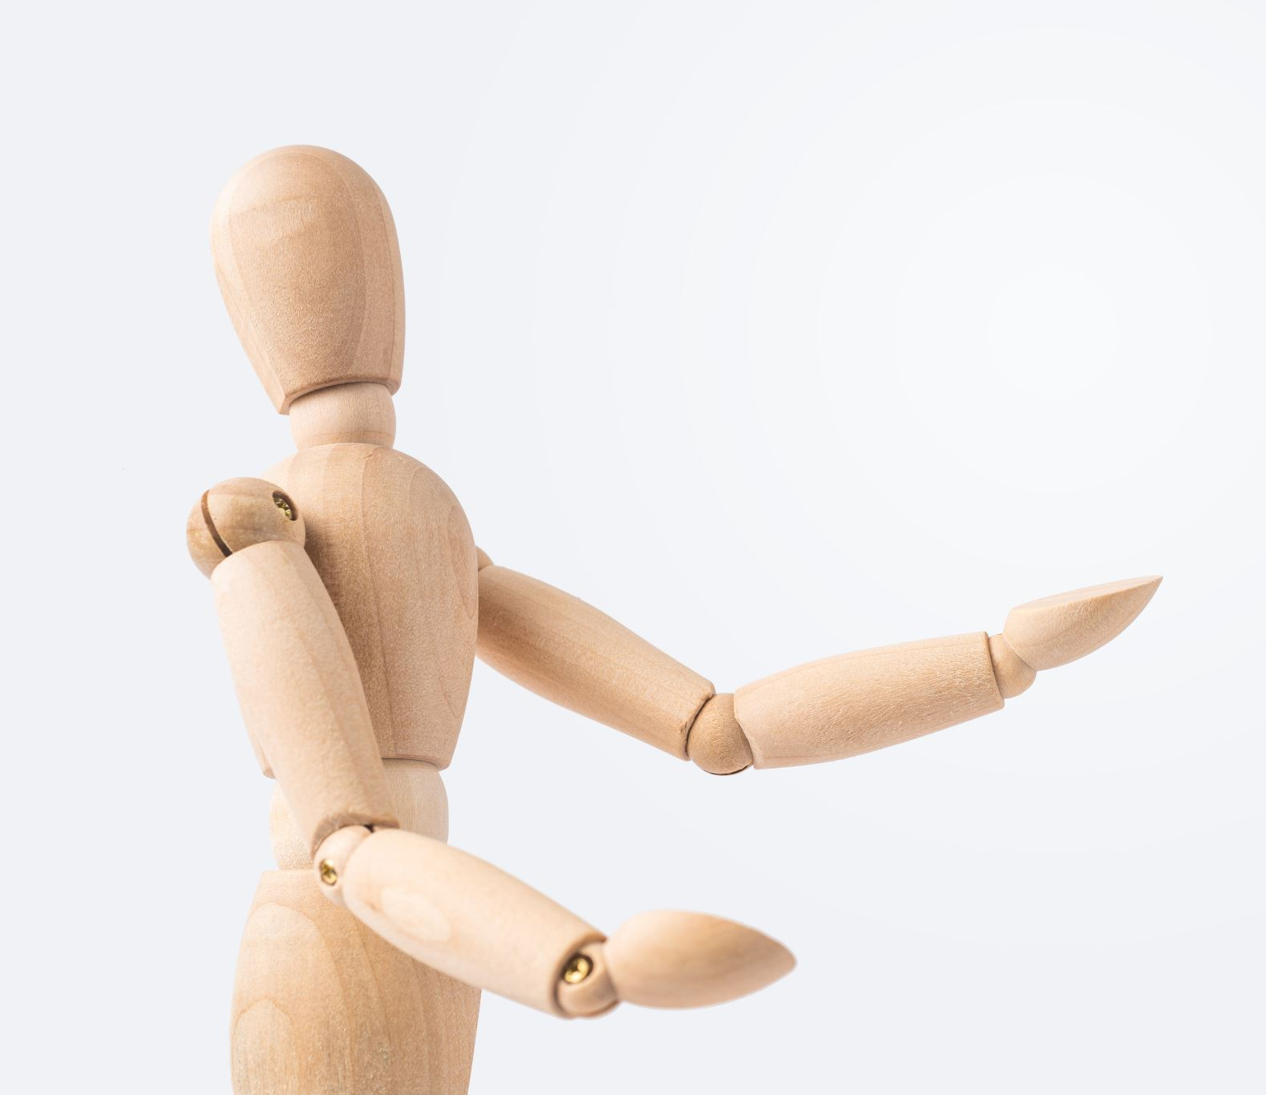
Importance of Ergonomics
Ergonomics is important because when you’re doing a job and your body is stressed by an awkward posture, extreme temperature, or repeated movement your musculoskeletal system is affected.
Your body may begin to have symptoms such as fatigue, discomfort, and pain, which can be the first signs of a musculoskeletal disorder.

Slide 8
Focal areas for ergonomists in any organization are:
Size and shape: Anthropometry is the branch of ergonomics that deals with human variability in size, shape and strength. Tables of anthropometric data are used by the ergonomists to ensure that places and items they are designing fit the user.
Vision: Vision being the prime channel for information, designers should ensure that the users see the workplace clearly. Many workers using computers cannot see their screens because of the glare or reflection. Similarly, those doing precise assembly tasks under insufficient lighting suffer eyestrain.

Slide 9
Sound: Sound can be a useful way to provide information, especially for warning signals. However, care should be taken not to overload this sensory channel.
Job design: One goal of ergonomics is to design jobs to fit people. This means taking account of differences such as size, strength and ability to handle information for a wide range of users. Then the tasks, the workplace and tools are designed around these differences. This leads to improved efficiency, quality and job satisfaction.

Slide 10
Human error: Human errors in nuclear and chemical industries, rail and sea transport, aviation, etc. could be catastrophic. However, when disasters occur, the blame is often laid with the operators, pilots or drivers concerned, and labelled as „human error‟. Often though, these errors are caused by poor equipment and system design. Here ergonomists pay particular attention to the mental demands on the operators, designing tasks and equipment to minimise the chances of misreading information or operating the wrong controls, for example.

Slide 11
Musculoskeletal disorder
Musculoskeletal disorders (MSDs) are conditions that affect your body’s muscles, joints, tendons, ligaments, and nerves.
MSDs can develop over time or can occur immediately due to overload.

Slide 12
Advantages of ergonomics
1. Increased savings • Fewer injuries • More productive and sustainable employees • Fewer workers’ compensation claims 2. Fewer employees experiencing pain • Implementing ergonomic improvements can reduce the risk factors that lead to discomfort.
3. Increased productivity • Ergonomic improvements can reduce the primary risk factors for MSDs, so workers are more efficient, productive, and have greater job satisfaction.
4. Increased morale • Attention to ergonomics can make employees feel valued because they know their employer is making their workplace safer.
5. Reduced absenteeism • Ergonomics leads to healthy and pain-free workers who are more likely to be engaged and productive.

