Slide 1
Accidents & Their Effect on Industry
Lecture 06

Slide 2
Contents
Costs of accidents
Time lost
Work injuries
Parts of the body injured on the job
Chemical Burn injuries
Construction injuries
Fire injuries

Slide 3
All accidents, cases of occupational disease and scheduled dangerous occurrences represent some degree of loss to a company.
There are both direct and indirect costs.

Slide 4
Direct costs
These are sometimes referred to as ‘insured costs’ and involve the company’s liabilities both as an occupier of premises and employer of
staff.
Companies pay premiums to an insurance company to give them cover against claims made by injured persons.
Premiums are determined largely by the past claims history and the risks involved in the business operation.
Other direct costs are, perhaps, product liability claims for defective or unsafe products or specific injury claims, which may be settled in or out of a court.
Fines imposed by courts for breaches of the law, together with defence costs in such cases, can also be substantial direct costs.

Slide 5
Indirect costs
Very little attention is paid to the indirect costs.
Many of these costs may be hidden in other costs and thus not fully recognised, eg production
costs, administration costs.
Typical indirect costs, many of which can be simply calculated, include the following: treatment costs of the injured employee, eg first aid, transport to hospital, hospital charges, attendance by a local doctor or specialist treatment following the accident; lost time costs,
of the injured person, management, first aid staff and others involved; production costs, eg lost production; extra overtime costs to make up production losses; damage costs; and training and supervision costs.
It can also be extremely costly to investigate an accident thoroughly in terms of time involvement of management, supervisory staff and witnesses.
Other miscellaneous costs include, perhaps, replacement of damaged personal property and incidental costs incurred by witnesses attending court.

Slide 6
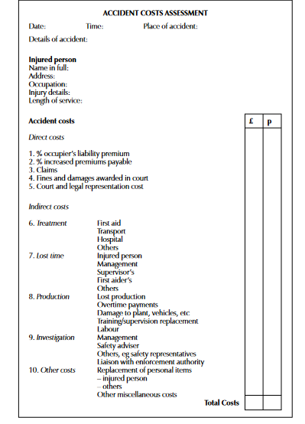

Slide 7
Lost Time Injury
Lost time injury rate (LTI), lost time incident rate, or lost time accident rate are all same
They define the organization’s safety performance.
The higher the incident rate, the lower your organization’s safety performance.
A lost time accident is an incident that has resulted in an employee needing to miss work due to sustaining an injury while working.
It allows for the opportunity to prevent similar incidents from happening again in the future.

Slide 8
Lost Time Accident Rates Matter
High rates means low safety performance
More expensive insurance premiums
Lack of employee loyalty
Difficulty in hiring top candidates
Difficulty in gaining new clients and contracts
Bad press and poor reputation

Slide 9
