Slide 1

Assessing and Minimizing the Risks from Hazards
Lecture 09

Slide 2
Hierarchy of Controls
The hierarchy of controls is a widely accepted system for minimizing or eliminating employee exposure to particular hazards.
Specifically, the hierarchy of controls examines hazard control methodologies from a tiered perspective, ranking them from most effective to least effective as follows:

Slide 3
Engineering controls
Engineering controls refer to denying access to a specific hazard.
This can include redesigning equipment or work processes to reduce the frequency of dangerous tasks, or isolating a hazard altogether by installing screens or barriers.
Using our chemical hazard example, engineering controls could involve installing a ventilation system.
It includes
Elimination
Substitution
Ventilation
Isolation
Process or Design change

Slide 4
Elimination
Elimination refers to physically removing a specific hazard from your workplace altogether.
This is one of the most effective ways to manage on-the-job risks and involves altering policies, procedures, materials, parts, products, equipment or tools you use to help workers perform their duties safely.
For example, imagine that your business requires the use of a hazardous chemical as part of its daily operations.
One elimination strategy could involve halting the use of the chemical altogether.
Because the chemical is no longer used in your workplace, it poses no threat to your employees moving forward.

Slide 5
Substitution
Substitution refers to replacing materials, processes or equipment with a less hazardous equivalent.
This is typically used when elimination is not possible.
Using the same chemical hazard example outlined above, substitution could involve swapping the chemical used in the workplace for a less toxic one that’s just as effective.

Slide 6
Presence Sensing Devices
Presence Sensing Devices are one of the most common safeguards for automatic feed part revolution clutch presses.
They are designed to automatically stop the machine stroke if the sensing field is interrupted.
Proper use of presence sensing devices provides protection not only for operators but also for other employees in the area.
They also minimize operator resistance to these types of safety devices due to their nonrestrictive design.
Presence sensing devices are commonly referred to as light curtains.
There are many requirements that must be met before light curtains can be installed as point-of-operation safeguards.

Slide 7
Awareness Devices
Backup alarms
Warning signals both audible and visible
Warning signs

Slide 8
Work Practices
SOPs
Trainings

Slide 9
Administrative controls
Administrative controls refer to changing the way your employees work to limit specific hazards.
These are implemented when engineering controls can’t be used and relate to establishing new processes and procedures for safe work.
Administrative controls could include altering policies, posting signage and training employees.
Under our chemical hazard example, administrative controls might involve limiting an employee’s exposure to the chemical in question.

Slide 10
Management controls
Policies
Directives
Responsibilities (line and staff)
Budget
Accountability
Vigour and example

Slide 11
Personal protective equipment (PPE)
In general, providing employees with PPE (e.g., respirators) is considered to be the least effective hazard control method.
Still, PPE plays an important role in worker safety and can protect workers from common workplace hazards, like noise, cuts and head injuries.
PPE is inexpensive and used frequently where hazards can’t be addressed using other controls.
For our chemical hazard example, PPE could include the use of a respirator.

Slide 12
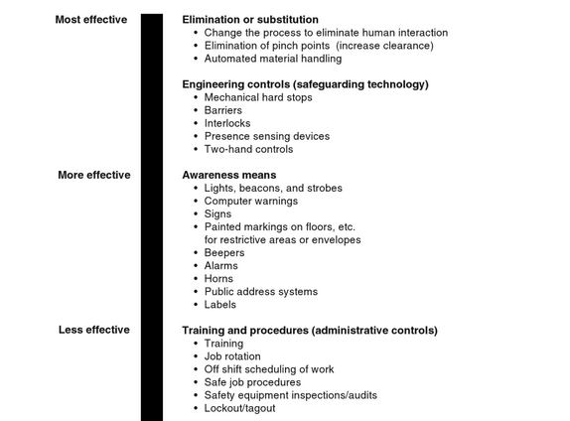

Slide 13
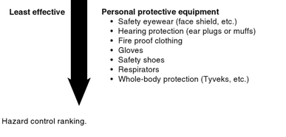

Slide 14
Hazard Audit
A hazard audit is a systematic and critical examination of a facility, its operations and safety systems.
Its object is to identify any shortcomings in the measures which are in place to minimise the likelihood and consequences of hazardous incidents.

Slide 15


