Slide 1
Lecture 1 Introduction to Software Engineering

Slide 2
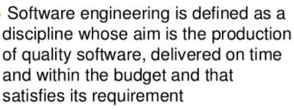
What is Software Engineering?

Slide 3
Software Engineering
The IEEE definition:
Software Engineering:
– The application of a systematic, disciplined, quantifiable approach to the development, operation, and maintenance of software; that is, the application of engineering to software.
16

Slide 4
Software Engineering
Software is:
(1) instructions (computer programs) that when executed provide desired features, function, and performance;
data structures that enable the programs to adequately manipulate information and
documentation that describes the operation and use of the programs.

Slide 5
An Introduction to SE
Software Activities
Software specification: customers and engineers define the software that is to be produced and the constraints on its operation.
Software development : the software is designed and programmed.
Software validation : the software is checked to ensure that it is what the customer requires.
Software evolution : the software is modified to reflect changing customer and market requirements.
15

Slide 6
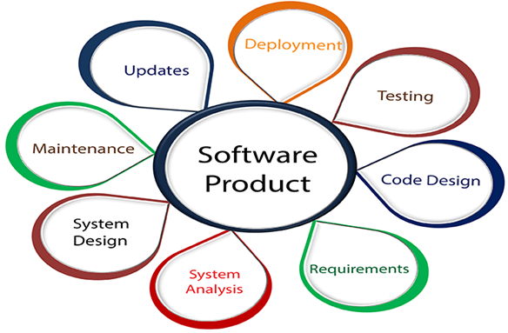
Software Engineering

Slide 7
What is Good Software
General characteristics
Functionality
Usability
Maintainability
Dependability
Efficiency
Good software products require good programming
Notes:
The dependability of a system reflects the user’s degree of trust in that system.
availability, reliability, safety and security.

Slide 8
Essential attributes of good software
Product characteristic | Description
Maintainability | Software should be written in such a way so that it can evolve to meet the changing needs of customers. This is a critical attribute because software change is an inevitable requirement of a changing business environment.
Dependabili ty and security | Software dependability includes a range of characteristics including reliability, security and safety. Dependable software should not cause physical or economic damage in the event of system failure. Malicious users should not be able to access or damage the system.
Efficiency | Software should not make wasteful use of system resources such as memory and processor cycles. Efficiency therefore includes responsiveness, processing time, memory utilisation, etc.
Acceptability | Software must be acceptable to the type of users for which it is designed. This means that it must be understandable, usable and compatible with other systems that they use.

Slide 9
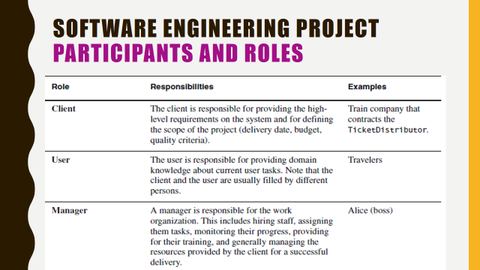
Participants & Roles

Slide 10
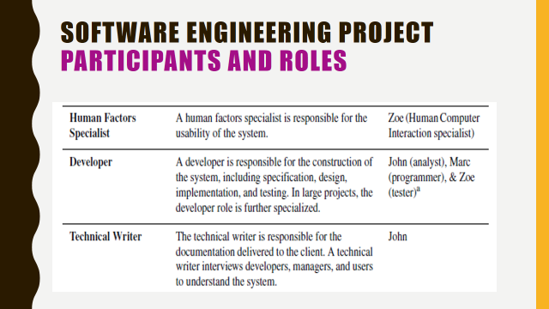
Participants & Roles

Slide 11
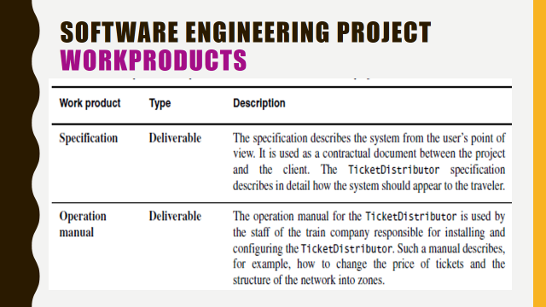
Manual Types

Slide 12
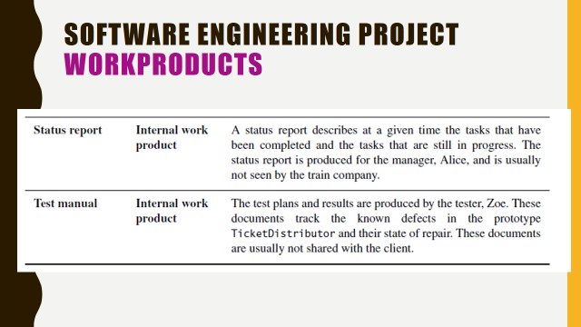

Slide 13
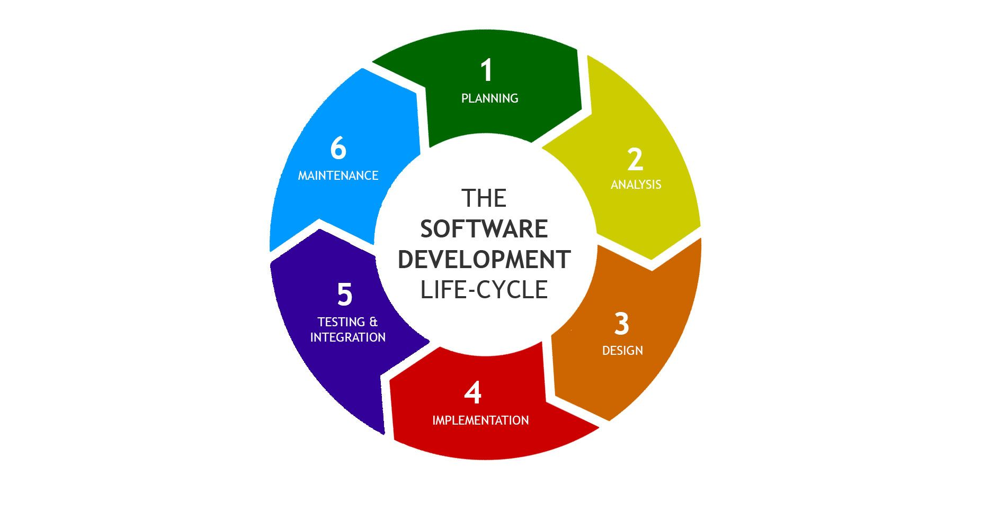
SDLC (Software Development Life Cycle)

Slide 14
SDLC Phases
Given below are the various phases:
Requirement gathering or planning
Analysis
Design
Implementation
Testing & Integration
Maintenance

Slide 15
1) Requirement gathering (Planning)
During this phase, all the relevant information is collected from the customer to develop a product as per their expectation.
Any ambiguities must be resolved in this phase only.

Slide 16
2) Analysis
An analysis is done to check the feasibility of the development of a product.
In case of any ambiguity, a call is set up for further discussion.

Slide 17
3) Design
In this phase, the requirement gathered in the SRS document is used as an input and software architecture that is used for implementing system development is derived.

Slide 18
4) Implementation
Implementation/Coding starts once the developer gets the Design document.
The Software design is translated into source code. All the components of the software are implemented in this phase.

Slide 19
5) Testing
Testing starts once the coding is complete and the modules are released for testing. In this phase, the developed software is tested thoroughly and any defects found are assigned to developers to get them fixed.
Retesting, regression testing is done until the point at which the software is as per the customer’s expectation. Testers refer SRS document to make sure that the software is as per the customer’s standard.

Slide 20
6) Maintenance
After the deployment of a product on the production environment, maintenance of the product i.e. if any issue comes up and needs to be fixed or any enhancement is to be done is taken care by the developers.

Slide 21
The Three-way Trade-off
▷Competing goals Every software project has a trade-off between functionality, cost, and time.
▷ Extra functionality adds extra costs for testing development, maintenance, etc.

Slide 22
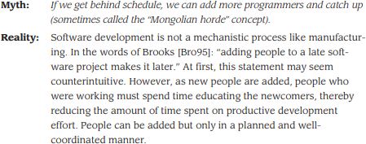
Software Myth
22

Slide 23

Software Myth
23

Slide 24
Software—New Categories
Open world computing—pervasive, distributed computing,
Creating software to allow machines of all sizes to communicate with each
other across vast networks
Ubiquitous computing—wireless networks,
to appear anytime and everywhere.
computing is made
Net-sourcing—the Web as a computing engine, Architecting simple and sophisticated applications that benefit targeted end-user markets worldwide
Open source—”free” source code open to the computing community, Distributing source code for computing applications so customers can make local modifications easily and reliably

Slide 25








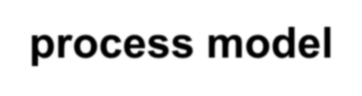

A Layered Technology
Software engineering encompasses a process, the management of activities, technical methods, and use of tools to develop software products.
tools
Foundation
Bedrock
methods
process model
a “quality” focus
Software Engineering

Slide 26
Software Process
The software process forms the basis for:
management control of software projects
establishes the context in which technical methods are applied
work products (models, documents, data, reports, etc.) are produced
milestones are established
quality is ensured
change is properly managed.

Slide 27
Software Method
S/W eng methods provide the technical “how to’s” for building S/W.
Methods encompass a broad array of tasks that include
communication,
req. analysis,
design,
coding,
testing and support.

Slide 28
Software Tools
S/W eng tools provide automated or semi- automated support for the process and the methods.
When tools are integrated so that info. Created by one tool can be used by another,
a system for the support of S/W development called computer-aided software engineering is established.

Slide 29
CASE TOOLS
CASE tools are set of software
application automate
programs, which are used to
SDLC(Systems activities.
Analysis and Design
Life Cycle )
Ex: Analysis | tools, | Design | tools, Project
management | tools, | Database | Management

Slide 30
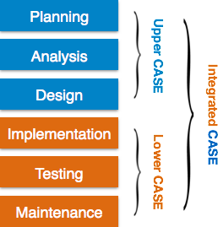
Components of CASE Tools
Upper Case Tools - Upper CASE tools are used in planning, analysis and design stages of SDLC.
Lower Case Tools - Lower CASE tools are used in implementation, testing and maintenance.
Integrated Case Tools - Integrated CASE tools are helpful in all the stages of SDLC, from Requirement gathering to Testing and documentation.

Slide 31
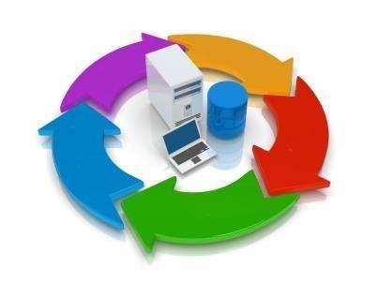
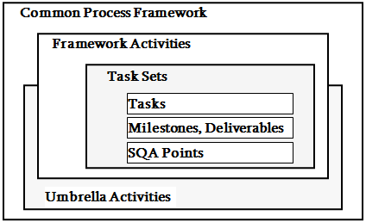





A Process Framework
Process framework
Framework activities
work tasks work products
milestones & deliverables QA checkpoints
Umbrella Activities

Slide 32
Umbrella Activities
Software project management
Formal technical reviews
Software quality assurance
Software configuration management
Work product preparation and production
Reusability management
Measurement
Risk management

Slide 33
Summary
Software engineering is the combination of paperwork and Systematic solution of the addressed problem
Software is first designed then engineered .
Evolution and the maintenance is the essential and the last step of SE

Slide 34
Q/A

