Slide 1
Introduction to Software Engineering
Software Quality

Slide 2
Software Quality
Objectives
  Quality
  Software Quality Assurance
  Standard (IEEE & ISO)
  CMM (Capability Maturity Model)
  Summary

Slide 3
What Is Quality Software?
Is it software that works?
Is it software that is error-free?
Is it software that is very well-documented and has help facility for all its functions?
Is it software that does not ‘hang’ the machine?
Software Engineering

Slide 4
Software Quality Definition
Software Quality can be defined as:
“An affective software process applied in manner that creates a useful product that provides measureable values for those who produce it and who use it”
(Software Engineering: A Practitioner’s Approach, 7/e by Roger S. Pressman)
Software Engineering
Notes:
The management aspects of process create the checks and balances that help avoid project chaos—a key contributor to poor quality.
A useful product delivers the content, functions, and features that the end-user desires
The software organization gains added value because high quality software requires less maintenance effort, fewer bug fixes, and reduced customer support. _x0001_ The user community gains added value because the application provides a useful capability in a way that expedites some business process.

Slide 5
Software Qualities
Correctness
Reliability
Robustness
Performance
User friendliness
Verifiability
Maintainability
Reparability
Safety
Evolvability
Reusability
Portability
Understandability
Productivity
Size
Timeliness
Visibility
Select the critical attributes and plan how to achieve them
Software Engineering

Slide 6
Benefits Of Software Quality
Reduced maintenance cost
Stable and useful product
Satisfy customer needs
Better chances for continuing releases
Build corporate culture and identity
Better chances for software and design reuse
Software Engineering

Slide 7
Software Quality Assurance
Quality assurance – a set of establish framework (procedures & standard) used by an organization to achieve high quality software
Assure each of the software qualities is met
  Goal set in requirements specification
  Goal realized in the implementation
SQA is applied at every stage of the software process
Quality standard is selected to apply to the software process
Software Engineering

Slide 8
SQA Activities
Formulating a Quality Management Plan: identifies the quality aspects of the software product
Formal Technical Reviews: FTRs help in detecting errors at an early phase of development
Multi-tiered Testing Strategy: Software testing is a critical task of SQA activity, which aims at error detection.
Control of Change: Change control mechanism is implemented during the development and maintenance stages
Record keeping and Reporting: The results of reviews, audits, change control, testing, and other SQA activities are reported and compiled for future reference.
Software Engineering
Notes:
https://www.zeepedia.com/read.php?software_quality_assurance_activities_software_project_management&b=18&c=19

Slide 9
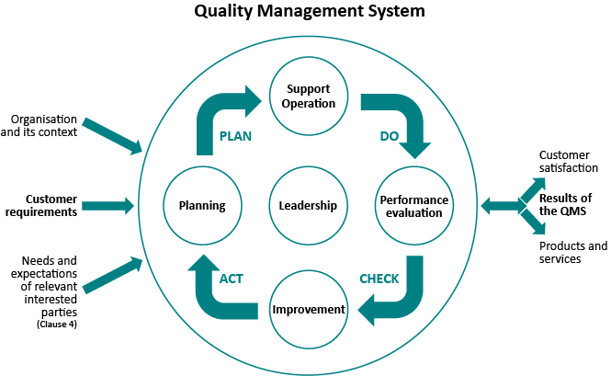
Quality Management System
Software Engineering

Slide 10
ISO & SQA
ISO (the International Organization for Standardization) is a worldwide federation of national standards bodies.
Ideally quality management should be separate from project management
This is to ensure quality considerations are not compromised by concerns of budget and schedule
Software Engineering
Notes:
International Organization for Standardization

Slide 11
Capability Maturity Model
Developed by Software Engineering Institute
SEI was established to improve the capabilities of US software industry
Focus on improving the process of software engineering
Similar to ISO, organizations are assessed and certified to be on Level 1 to Level 5
Software Engineering

Slide 12
Process Maturity Model
Level 5
Optimizing
Level 4
Managed
Level 3
Defined
Level 2
Repeatable
Level 1
Initial
Software Engineering

Slide 13
Level 1 Initial
No effective management procedures or project plans
Unstable environment for software development.
No basis for predicting product quality, time for completion, etc.
Software Engineering

Slide 14
Level 2 Repeatable
Focuses on establishing basic project management policies.
Experience with earlier projects is used for managing new similar natured projects.
Project Planning
Configuration Management
Requirements Management etc
Software Engineering

Slide 15
Level 3 Defined
At this level, documentation of the standard guidelines and procedures takes place.
It is a well defined integrated set of project specific software engineering and management processes.
Software Engineering

Slide 16
Level 4 Managed
At this stage, quantitative quality goals are set for the organization for software products as well as software processes.
The measurements made help the organization to predict the product and process quality within some limits defined quantitatively.

Slide 17
Level 5 Optimising
This is the highest level of process maturity in CMM and focuses on continuous process improvement in the organization using quantitative feedback.
Use of new tools, techniques and evaluation of software processes is done to prevent recurrence of known defects.

Slide 18
Key Process Area
Optimizing
Process change management
Technology change management
Defect prevention
Managed
Software quality management
Quantitative process management
Defined
Peer reviews
Intergroup coordination
Software product engineering
Integrated software management
Training program
Organization process definition
Organization process focus
Repeatable
Software Configuration Management
Software Quality Assurance
Software Subcontract management
Software project tracking and oversight
Software project planning
Requirements management
Initial

Slide 19
Summary
This lecture emphasise on SQA.
ISO stands for International Organization for Standards.
SEI stands for Software Engineering Institute

