Slide 1
Risk Management
Credit : (3 + 0) / Week

Slide 2
Learning Outcome
Risk, Project Risk,
Reactive Vs. Proactive Approach
Principles
Risk identification
Risk Management
Software Risks
Risk Management Process
Risk Analysis
Risk Planning
Risk Monitoring
Risk Indicator
RMMM (Risk Mitigation, Monitoring & Management)

Slide 3
RISK
Risk – potential problem that might happen!
Risk concerns future happenings
Can we change today to make things better in the future?
Change minds, opinions, actions, etc.
Risk involves uncertainty and loss
Risk analysis is to quantify the level of uncertainty and the degree of loss associated.
Risk management is to understand and manage uncertainty

Slide 4
Project Risks
What can go wrong?
What is the likelihood?
What will the damage be?
What can we do about it?
Project Risk Analysis is a series of activities to quantify the impact of uncertainty on a project. These activities are risk identification, probability assessment, and impact estimation. Risk analysis creates the foundation for running the risk management process throughout the project lifecycle.

Slide 5
REACTIVE VS. PROACTIVE
Reactive risk strategies seem to be the norm – fire-fighting mode
“I’ll deal with it when it happens, if it happens”
“Don’t worry, I’ll think of something”
Often lead to crisis
Proactive risk strategies accept uncertainty (smart strategy with the primary objective to avoid risk)
Potential risks are identified
Assess probability and impact
Try to avoid it or develop a contingency plan to respond in a controlled and effective manner.

Slide 6
Reactive Risk Management
project team reacts to risks when they occur
Mitigation(reduce seriousness)—plan for additional resources in anticipation of fire fighting
fix on failure—resource are found and applied when the risk strikes
crisis management—failure does not respond to applied resources and project is in jeopardy(danger of loss)

Slide 7
Proactive Risk Management
formal risk analysis performed
organization corrects the root causes of risk
TQM(total quality management concepts and statistical SQA(Statistical qualification archive)
examining risk sources that lie beyond the bounds of the software
developing the skill to manage change

Slide 8
ATTACK RISKS
“If you don’t actively attack the risks, they will actively attack you”
Tom Gilb

Slide 9
Seven Principles
Maintain a global perspective—view software risks within the context of system and the business problem
Take a forward-looking view—think about the risks that may arise in the future; establish contingency (future)plans
Encourage open communication—if someone states a potential risk, don’t discount it.
Integrate—a consideration of risk must be integrated into the software process
Emphasize a continuous process—the team must be vigilant(careful) throughout the software process, modifying identified risks as more information is known and adding new ones as better insight is achieved.
Develop a shared product vision—if all stakeholders share the same vision of the software, it likely that better risk identification and assessment will occur.
Encourage teamwork—the talents, skills and knowledge of all stakeholder should be pooled

Slide 10
Risk Management Paradigm
control
track
RISK
identify
plan
analyze

Slide 11
Risk Components
performance risk—the degree of uncertainty that the product will meet its requirements and be fit for its intended use.
cost risk—the degree of uncertainty that the project budget will be maintained.
support risk—the degree of uncertainty that the resultant software will be easy to correct, adapt, and enhance.
schedule risk—the degree of uncertainty that the project schedule will be maintained and that the product will be delivered on time.

Slide 12
RISK MANAGEMENT
Risk management is concerned with identifying risks and drawing up plans to minimise their effect on a project.
A risk is a probability that some adverse circumstance will occur
Project risks affect schedule or resources;
Product risks affect the quality or performance of the software being developed;
Business risks affect the organisation developing or procuring the software.

Slide 13
SOFTWARE RISKS (I)
Risk | Risk type | Description
Staff turnover | Project | Experienced staff will leave the project before it is finished
Management change | Project | There will be a change of organisational management with different priorities
Hardware unavailability | Project | Hardware which is essential for the project will not be delivered on schedule
Requirements change | Project and product | There will be a larger number of changes to the requirements than anticipated
Specification delays | Project and product | Specification of essential interfaces are not available on schedule
Technology change | Business | The underlying technology on which the system is built is superseded by new technology

Slide 14
THE RISK MANAGEMENT PROCESS
Risk identification
Identify project, product and business risks;
Risk analysis
Assess the likelihood and consequences of these risks;
Risk planning
Draw up plans to avoid or minimise the effects of the risk;
Risk monitoring
Monitor the risks throughout the project;

Slide 15
THE RISK MANAGEMENT PROCESS

Slide 16
RISK IDENTIFICATION
Technology risks.
People risks.
Organisational risks.
Tools risks.
Requirements risks.
Estimation risks.

Slide 17
RISK ANALYSIS
Assess probability and seriousness of each risk.
Probability may be very low, low, moderate, high or very high.
Risk effects might be catastrophic, serious, tolerable or insignificant.

Slide 18
RISK ANALYSIS
Estimate risk probability:
Very low (< 10%)
Low (10-25%)
Moderate (25-50%)
High (50-75%)
Very high (> 75%)
Establish risk seriousness:
Insignificant
Tolerable
Serious
Catastrophic

Slide 19
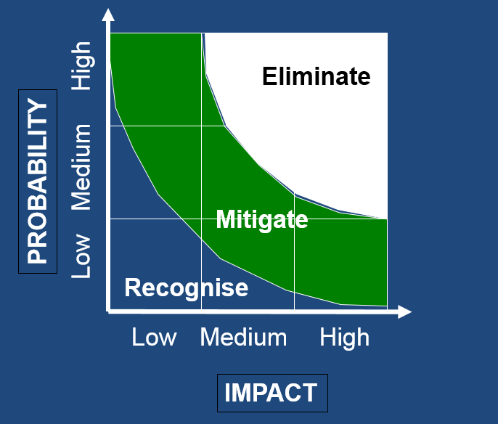
RISK MAP

Slide 20
RISK PLANNING
Consider each risk and develop a strategy to manage that risk.
Avoidance strategies
The probability that the risk will arise is reduced;
Minimisation strategies
The impact of the risk on the project or product will be reduced;
Contingency plans
If the risk arises, contingency plans are plans to deal with that risk;

Slide 21
RISK MONITORING
Assess each identified risks regularly to decide whether or not it is becoming less or more probable.
Also assess whether the effects of the risk have changed.
Each key risk should be discussed at management progress meetings.

Slide 22
Risk Mitigation, Monitoring, and Management
mitigation—how can we avoid the risk?
monitoring—what factors can we track that will enable us to determine if the risk is becoming more or less likely?
management—what contingency plans do we have if the risk becomes a reality?

Slide 23
RMMM EXAMPLE
Consider that staff turnover is a high risk
Impact is serious on cost and schedule
Risk Mitigation, Monitoring, and Management:
- An effective risk strategy must consider three issues:
Risk Avoidance
Risk Monitoring
Risk Management and contingency planning

Slide 24
Risk Exposure (Impact)
The overall risk exposure, RE, is determined using the following relationship [Hal98]:
RE = P x C
where
P is the probability of occurrence for a risk, and
C is the cost to the project if the risk occur (i.e loss).

Slide 25

END OF LECTURE
Any Questions !!!

