Slide 1
Software Engineering
Lecture 12
Software Testing

Slide 2
Chapter-15: Testing
Objectives
To understand the role of testing in ensuring software quality
To discuss issues relevant to software testing
To describe the different techniques used for testing software
Summary

Slide 3
The Process of Coding, Testing and Installation
Coding
Physical design specifications are turned into working computer code.
Testing
Tests are performed using various strategies.
Testing can be performed in parallel with coding.
Installation
The current system is replaced by the new system.

Slide 4
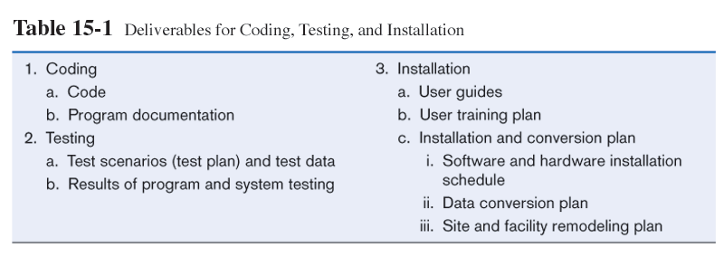
Deliverables

Slide 5
Validation & Verification
Validation
“Are we building the product right?”
Ensure software meets customer’s needs
Verification
“Are we building the right product?”
Ensure software meet specification (error-free)

Slide 6
Testing Terminology
Failure
Incorrect or unexpected output
Symptom of at fault
Fault
Invalid execution state
Symptom of an error
May or may not produce failure
Error
Defect or anomaly in source code
Commonly referred as bug
May or may not produce fault

Slide 7
Why We Need Software Testing?
Reveal faults/failures/errors
Locate faults/failures/errors
Show system correctness
Improved confidence that system performs as specified (verification)
Improved confidence that system performs as desired (validation)
Indicator of system reliability and system quality

Slide 8
Importance of Testing
Critical Element of Software Quality Assurance
Well-planned and thorough testing are important in reducing the high cost of software failure
Can take up to 40% of development effort
In systems that require high reliability, testing can be 3 to 5 times of all the other steps combined

Slide 9
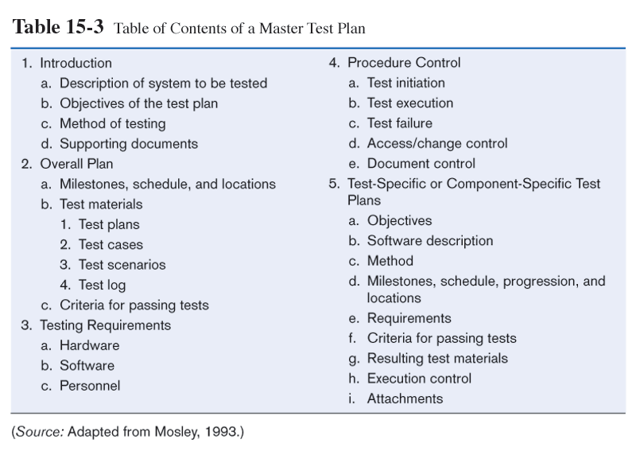

Slide 10
Testing Principles
All test should be traceable to customer requirements.
Tests should be planned before testing begins.
Testing should begin with individual components and move towards to integrated cluster of components.
The most effective testing should be conducted by an independent third party.

Slide 11
Who Should Test The Software?
Developer (individual units)
Independent test group (ITG)
removes conflict of interest
reports to SQA team

Slide 12
Test Cases
Test case: a scenario of transactions, queries or navigation paths
Can represent either:
Typical system use (qualities of a particular type of system)
Critical system use ( facts on judgements)
Abnormal system use
Test cases and results should be thoroughly documented so they can be repeated for each revision of an application.

Slide 13
Test Cases (cont.)
Test cases are usually developed by analysts.
Test cases should not be created by the programmers.
Separate people should program and test in order to ensure objectivity.

Slide 14
Test Cases (cont)
Test case : unit of testing activity
Test cases have 3 parts :-
Goal
Aspect of the system being tested
Input and system state
Data provided to the system under stated condition
Expected behavior
The output or action the system should take according to its requirements

Slide 15
Levels of Specification
Three Levels
Specifications of large systems usually contain at least three levels of software specification documents
(1) Functional specifications (or requirements) give a precise description of the required behavior (functionality) of the system
- describe what the software should do, not how it should do it
- may also describe constraints on how this can be achieved

Slide 16
Levels of Specification
(2) Design specifications describe the architecture of the design of a design to implement the functional specification
- describe the components of the software and how they are to relate to one another
(3) Detailed design specifications describe how each component of the architecture, down to the individual code units, is to be implemented

Slide 17
Levels of Testing
Corresponding Test Levels
Given the hierarchy of specifications, it is usual to structure testing into three (or more) corresponding levels
(3) Unit testing addresses the verification that individual components of the architecture meet their detailed design specification
(2) Integration testing verifies that the groups of units corresponding to architectural elements of the design specification can be integrated to work as a whole

Slide 18
Levels of Testing
(1) System testing verifies that the integrated total product has the functionality specified in the functional specification
To these levels it is usual to add the additional test level:
(0) Acceptance testing, in which the actual customers validate that the software meets their real intentions

Slide 19
User Acceptance Testing
Actual users test a completed information system.
End result is the users’ final acceptance of the system.
Alpha testing: use simulated data
Beta testing: use real data in real user environment

Slide 20
Type Of Test Cases
Test cases are derived for
Valid and expected input
Invalid and unexpected input
Test if the system does less than specified requirement
Test if the system does more than specified requirement

Slide 21
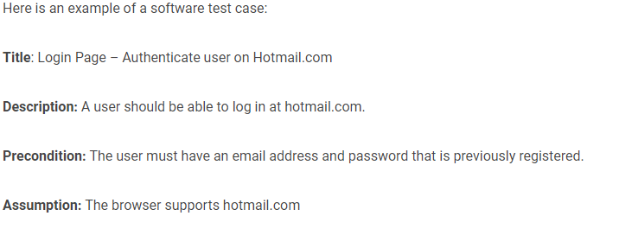
Example of Test case (User Authentication)

Slide 22
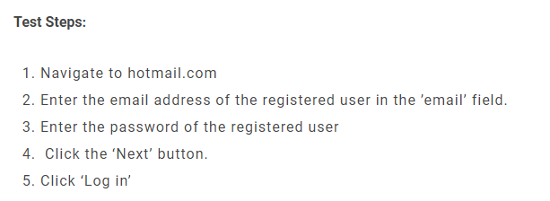
Example of Test case

Slide 23
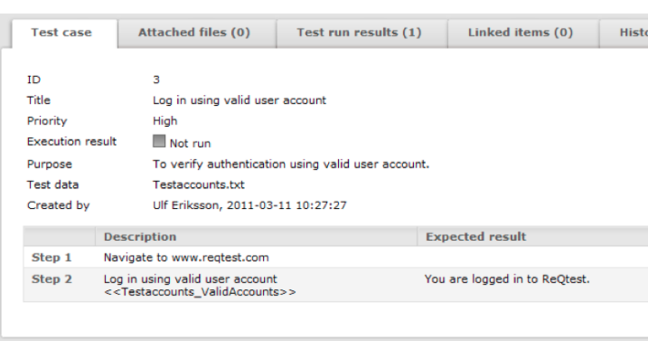
Example of Test case

Slide 24
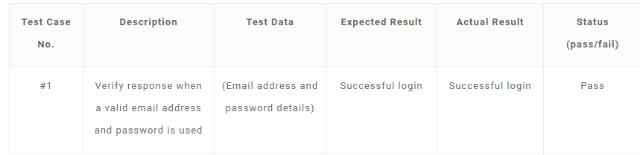
Example of Test case

Slide 25
Unit testing
Unit testing is the process of testing individual components in isolation.
It is a defect testing process.
Units may be:
Individual functions or methods within an object
Object classes with several attributes and methods
Composite components with defined interfaces used to access their functionality.

Slide 26
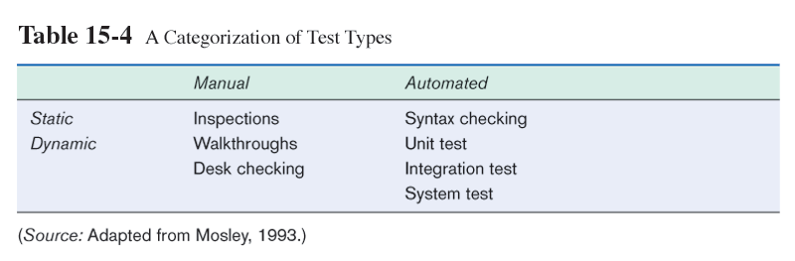
Test Classification
Manual vs. Automated
Static (syntax only) vs. Dynamic (execution)

Slide 27
White Box Testing Techniques
Basis path testing
Flow graph notation
Cyclomatic complexity
Derived test cases
Graph metrics
Control structure testing
Condition testing
Data Flow testing
Loop testing
Notes:
White Box Testing is software testing technique in which internal structure, design and coding of software are tested to verify flow of input-output and to improve design, usability and security. In white box testing, code is visible to testers so it is also called Clear box testing, Open box testing, Transparent box testing, Code-based testing and Glass box testing.
Derived test cases are named after their parent test case with a numeric suffix.

Slide 28
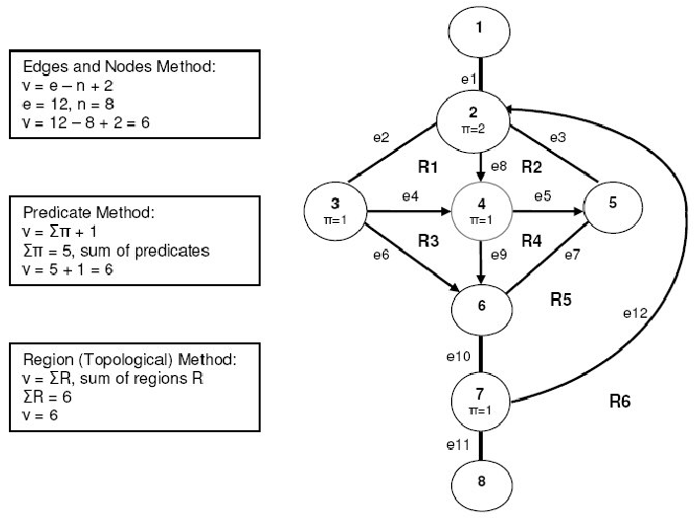
Cyclomatic Complexity

Slide 29
Boundary Value Analysis
Boundary testing is the process of testing between extreme ends or boundaries between partitions of the input
Look at output boundaries for test cases
Example 1: Equivalence and Boundary Value
Let's consider the behavior of Order Pizza Text Box Below
Pizza values 1 to 10 is considered valid. A success message is shown.
While value 11 to 99 are considered invalid for order and an error message will appear, "Only 10 Pizza can be ordered"

Slide 30
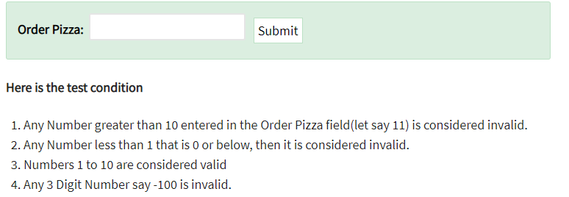
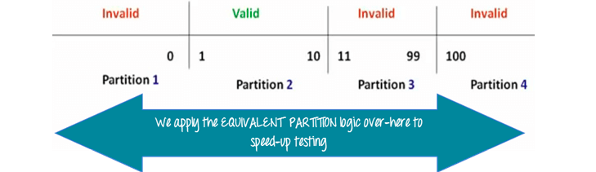
Example

Slide 31
Black Box vs. White Box
Two Kinds of Methods
Systematic testing methods can be divided into two kinds:
black box and white box (a.k.a. glass box)
Black box methods cannot see what the software code to test is (it may not exist yet), so they can only base their tests on the requirements or specifications
White box methods can see what the software’s code is, so they can base their tests on the software’s actual architecture or code itself

Slide 32
Summary
We have learned
To understand the role of testing in ensuring
software quality
To discuss issues relevant to software testing
To describe the different techniques used for
testing software

Slide 33
References

