Slide 1
Introduction to Statistics and Data Analysis

Slide 2
Basic Definitions
Unit
A single entity, usually an object or person, whose characteristics are of interest.
Population of units
The complete collection of units about which information is sought.
A statistical population
It is the set of all measurements corresponding to each unit in the entire population of units about which information is sought.
Sample
A portion of the entire population that are actually collected in the course of an investigation.

Slide 3
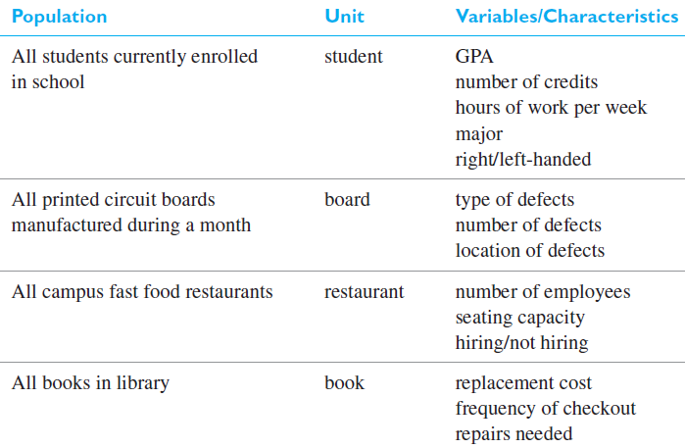
Examples of populations, units, and variables

Slide 4
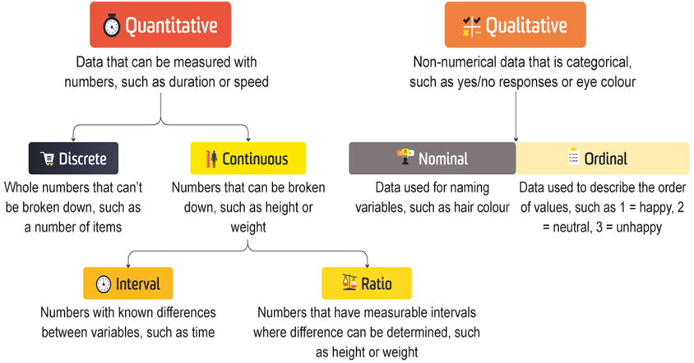
Types of Data

Slide 5
Qualitative vs. Quantitative Data
Qualitative data:
Refers to information about qualities, or information that cannot be measured.
It’s usually descriptive and textual.
Examples include someone’s eye color or the type of car they drive.
Quantitative data:
It is numerical. It’s used to define information that can be counted.
Some examples of quantitative data include distance, speed, height, length and weight.

Slide 6
Types of Measurement Scales
Nominal Scale
Unordered set of categories identified only by name.
Nominal measurements only permit you to determine whether two individuals are the same or different.
For example:
Which brand of smartphones do you prefer?
Apple
Samsung
Others

Slide 7
Types of Measurement Scales
Ordinal Scale
Ordered set of categories.
Ordinal measurements tell you the direction of difference between two individuals.
For example:
How satisfied are you with our services?
Very Unsatisfied
Unsatisfied
Neutral
Satisfied
Very Satisfied

Slide 8
Types of Measurement Scales
Interval Scale
Ordered series of equal-sized categories.
Interval measurements identify the direction and magnitude of a difference.
The zero point may be located arbitrary on an interval scale.
For example:
What is your family income?
50000 – 100000
100000 – 200000
More than 200000

Slide 9
Types of Measurement Scales
Ratio Scale
On a ratio scale, the data obtained can not only be categorized and ranked but also have equal intervals.
A ratio scale has a true zero, that is, the zero possesses a meaningful value.
The true zero value in a ratio scale makes it possible to describe the amount of magnitude
For Example:
How much distance the runner-up lost from the winner in a racing track?

Slide 10
Types of Measurement Scales
Interval vs. Ratio Scale
Interval scales hold no true zero and can represent values below zero.
For example:
you can measure temperature below 0 degrees Celsius, such as -10 degrees.
Ratio scale never fall below zero.
For example:
Height and weight measure from 0 and above, but never fall below it.

Slide 11
Statistics
Statistics is a tool for analyzing data and discovering and proving it’s true meaning.
Statistics is the study of the collection, organization, analysis, interpretation and presentation of data.

Slide 12
Descriptive Statistics
Descriptive statistics:
Methods for organizing and summarizing data.
tables or graphs are used to organize data, and descriptive values such as the average score are used to summarize data.
Inferential statistics:
Methods for using sample data to make general conclusions about populations.

Slide 13
Types of Statistical Studies
Observational studies
Surveys based studies
Experimental studies
Meta-analysis
Retrospective

Slide 14
1-Observational Studies
Observes individuals and measures variables of interest.
It describe a group of individuals or to investigate an association between two variables.
We can answer questions about a population with an observational study.

Slide 15
1-Observational Studies
We can also investigate a relationship between two variables.
But in an observational study, researchers do not attempt to manipulate one variable to cause an effect in another variable. For this reason, an observational study does not provide convincing evidence of a cause-and-effect relationship.

Slide 16
2-Survey based studies
As a field of statistics concentrating on human research surveys.
Survey methodology studies the sampling of individual units from a population and associated techniques of survey data collection.
Survey data collection includes questionnaire construction and methods for improving the number and accuracy of responses to surveys.
Basic type of surveys includes:
Online, paper based, telephonic and one-to-one interviews

Slide 17
3-Experimental Studies
Demonstrates a cause-and-effect relationship between two variables. (All other variables are controlled to prevent them from influencing the results).
It proves that changing the value of one variable causes changes to occur in a second variable.
The manipulated variable is called the independent variable.
Observed variable is the dependent variable.
Notes:
X=5y+90

Slide 18
4-Meta-analysis
A meta-analysis is a statistical analysis that combines the results of multiple scientific studies.
Meta-analyses can be performed when there are multiple scientific studies addressing the same question, with each individual study reporting measurements that are expected to have some degree of error.

