Slide 1
Joint Probability Distribution

Slide 2
Joint Probability Distribution
Previously we have seen one-dimensional sample space in which there was only one random variable.
We can assume an experiment having simultaneous outcomes of more than one random variable.
If we observe an experiment having two random variables, we will find 2 dimensional sample space (or a plane).
For example
we might measure the amount of precipitate P and volume V of gas released from a controlled chemical experiment.
we might be interested in the hardness H and tensile strength T of cold-drawn copper

Slide 3
Joint Probability Distribution
If X and Y are two discrete random variables, the probability distribution for their simultaneous occurrence can be represented by a function f(x, y)
It contains pair of values (x, y) within the range of the random variables X and Y
This function will be called joint probability distribution of X and Y .

Slide 4
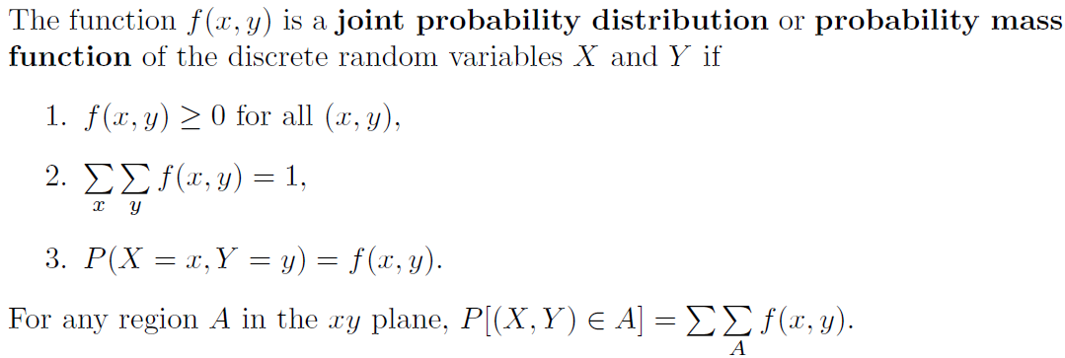
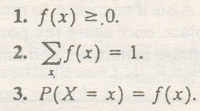
Joint Probability Distribution
Definition 3.8:
Compare with
single RV PMF

Slide 5
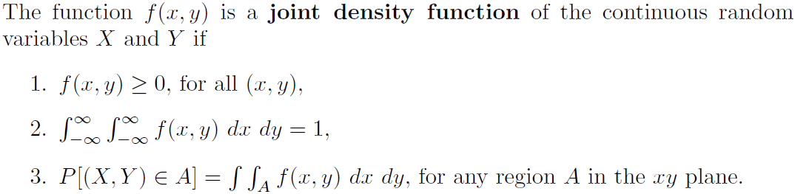
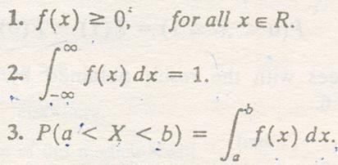
Joint Probability Distribution
Definition 3.9:
Compare with
single RV pdf

Slide 6
Joint Probability Distribution
Example 3.14
Two ballpoint pens are selected at random from a box that contains 3 blue pens, 2 red pens, and 3 green pens. If X is the number of blue pens selected and Y is the number of red pens selected, find:
Joint probability function f(x, y)
P[(X,Y) ∈ A], where A is the region {(x, y)|x + y ≤ 1}.

Slide 7
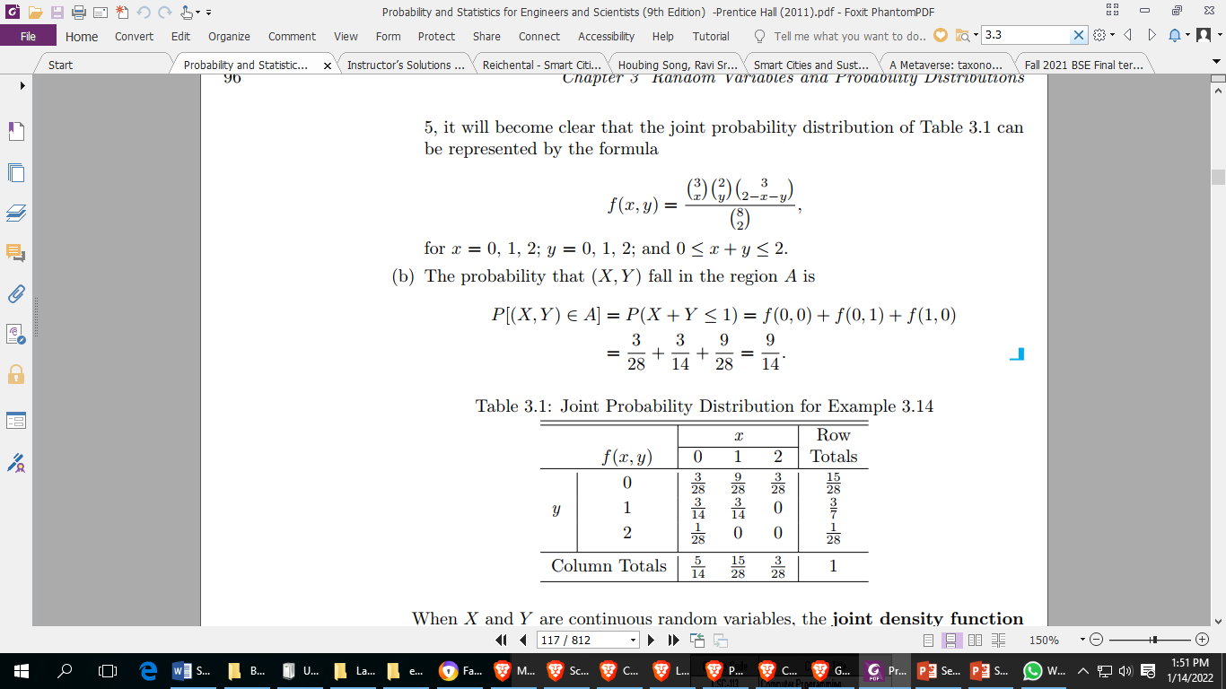
Joint Probability Distribution
Example 3.14-Solution

Slide 8
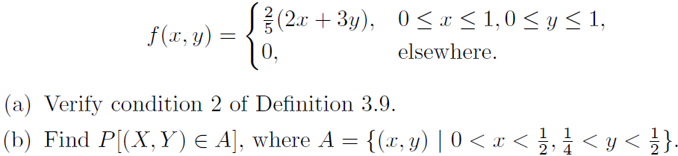
Joint Probability Distribution
Example 3.15:
A privately owned business operates both a drive-in facility and a walk-in facility. On a randomly selected day, let X and Y , respectively, be the proportions of the time that the drive-in and the walk-in facilities are in use, and suppose that the joint density function of these random variables is:

Slide 9
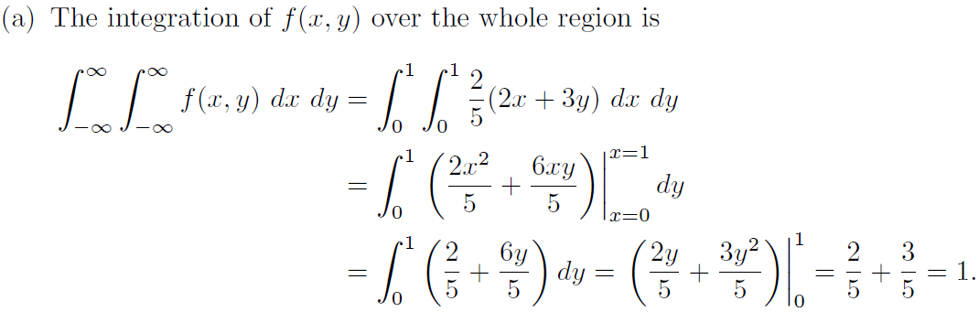
Joint Probability Distribution
Example 3.15 - Solution:

Slide 10
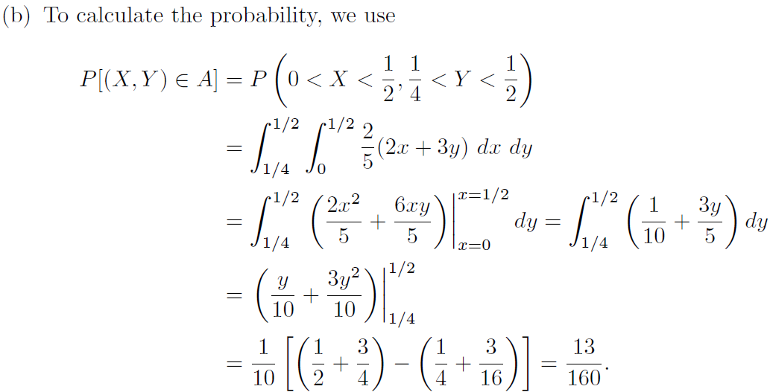
Joint Probability Distribution
Example 3.15 - Solution:

Slide 11
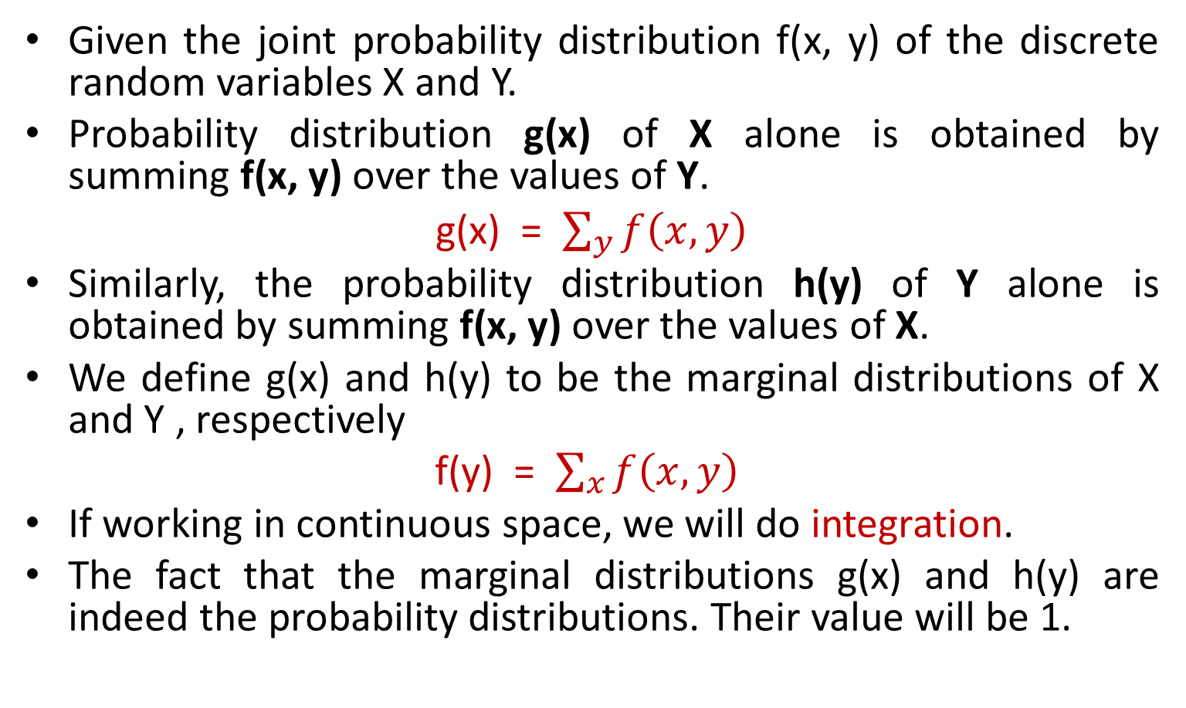
Marginal Distributions
Given the joint probability distribution f(x, y) of the discrete random variables X and Y.
Probability distribution g(x) of X alone is obtained by summing f(x, y) over the values of Y.
g(x) = $\sum_{y}{f\left(x,y\right)}$
Similarly, the probability distribution h(y) of Y alone is obtained by summing f(x, y) over the values of X.
We define g(x) and h(y) to be the marginal distributions of X and Y , respectively
f(y) = $\sum_{x}{f\left(x,y\right)}$
If working in continuous space, we will do integration.
The fact that the marginal distributions g(x) and h(y) are indeed the probability distributions. Their value will be 1.

Slide 12
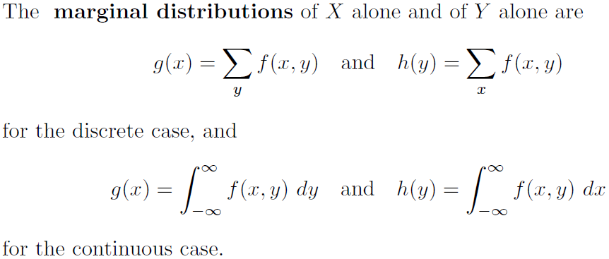
Marginal Distributions
Definition 3.10:

Slide 13
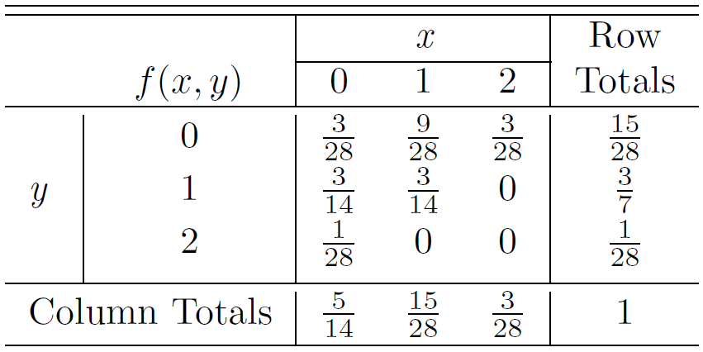
Marginal Distributions
Example 3.16:
Show that the column and row totals of given table give the marginal distribution of X alone and of Y alone.

Slide 14
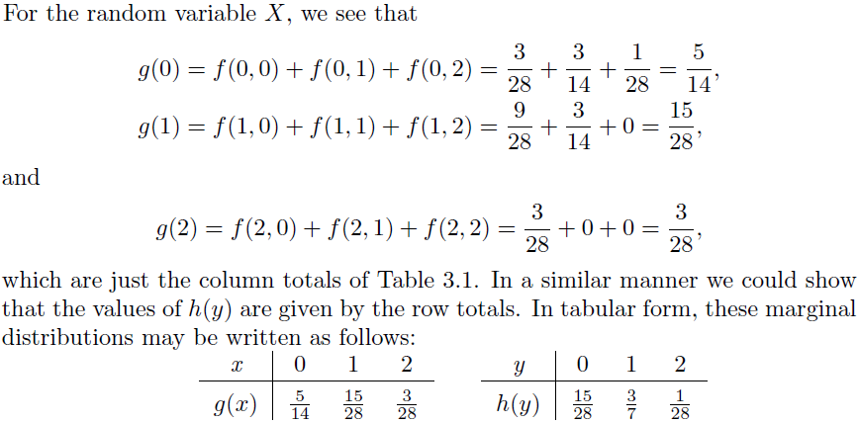
Marginal Distributions
Example 3.16 - Solution:

Slide 15

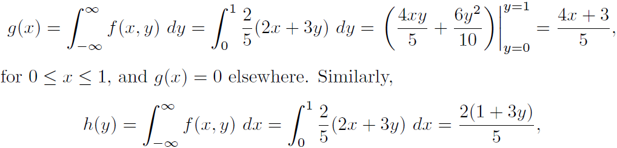
Marginal Distributions
Example 3.17:
Find g(x) and h(y) for the joint density function of
Solution:

Slide 16
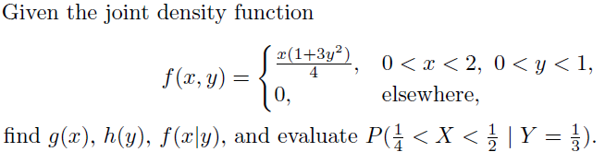
Conditional Distribution
Example 3.20:

Slide 17
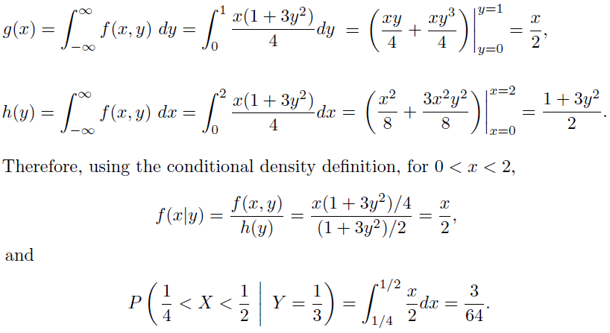
Conditional Distribution
Example 3.20-Solution:

