Slide 1
Chapter 5
Some Discrete Probability Distributions
Chapter 5
Some Discrete Probability Distributions
PBST 6/1

Slide 2

Introduction
Chapter 5.1
Introduction
Often, the observations generated by different statistical
experiments have the same general type of behavior.
The discrete random variables associated with these experiments can be described by essentially the same probability distribution in a single formula.
In fact, one needs only a handful of important probability distributions to describe many of the discrete random variables encountered in practice.
In this chapter, we are going to present these commonly used
distributions with various examples.

Slide 3

Discrete Uniform Distribution
Chapter 5.2 Discrete Uniform Distribution
If the random variable X assumes the values x₁, x₂, ..., x_{k}, with
equal probabilities, then the discrete uniform distribution is given
by
1
f ( x; k ) = , x = x₁ , x₂ , , x_{k}
k
When a light bulb is selected at random from a box that contains a 40-watt bulb, a 60-watt bulb, a 75-watt bulb, and a 100-watt bulb, each element of the sample space S = {40, 60, 75, 100} occurs with probability 1/4.
Therefore, we have a uniform distribution, with
f ( x; 4) = , x = 40, 60, 75,100
4
1

Slide 4
Discrete Uniform Distribution
Chapter 5.2
Discrete Uniform Distribution
When a dice is tossed, each element of the sample space S = {1, 2, 3,
4, 5, 6} occurs with probability 1/6.
Therefore, we have an uniform distribution with
1
f ( x; 6) = , x = 1, 2, 3, 4, 5, 6
6

Slide 5
Bernoulli Process
Chapter 5.3
Binomial and Multinomial Distributions
An experiment often consists of repeated trials, each with two possible outcomes that may be labeled success or failure. We may choose to define either outcome as a success.
The process is referred to as a Bernoulli process.
Each trial is called a Bernoulli trial.
Strictly speaking, the Bernoulli process must possess the following
properties:
The experiment consists of n repeated trials.
Each trial results in an outcome that may be classified as a success or a failure.
The probability of success, denoted by p, remains constant from
trial to trial.
The repeated trials are independent.

Slide 6
Bernoulli Process
Chapter 5.3
Binomial and Multinomial Distributions
Consider the set of Bernoulli trials where three items are selected at random from a manufacturing process, inspected, and classified defective or non-defective. A defective item is designated a success. The number of successes is a random variable X assuming integer values from 0 to 3.
The items are selected independently from a process and we shall
assume that it produces 25% defectives.
The probability of the outcome NDN can be calculated as
9
P ( NDN ) = P ( N ) P ( D ) P ( N ) = ^{⎛ 3 ⎞ ⎛ 1 ⎞ ⎛ 3 ⎞} =
⎜ ₄ ⎟ ⎜ ₄ ⎟ ⎜ ₄ ⎟
⎝ ⎠ ⎝ ⎠ ⎝ ⎠
64

Slide 7

Bernoulli Process
Chapter 5.3
Binomial and Multinomial Distributions
The probabilities for the other possible outcomes can also be calculated to result the probability distribution of X
The number X of successes in n Bernoulli trials is called a
binomial random variable.
The probability distribution of this discrete random variable is called the binomial distribution, and denoted by b(x; n, p).
9
P ( X = 2) = f ( 2) = b ( 2 : 3, ¹ ) =
4
64

Slide 8
Binomial Distribution
Chapter 5.3 Binomial and Multinomial Distributions
|Binomial Distribution| A Bernoulli trial can result in a success with probability p and a failure with probability q = 1 – p. Then the probability distribution of the binomial random variable X, the number of successes in n independent trials, is
b ( x : n, p ) =
x n − x
_{n} C _{x} p q , x = 0,1, 2, ..., n
The mean and variance of the binomial distribution b(x; n, p) are
μ = np
_{ο} 2
= npq
The probability that a certain kind of component will survive a given shock test is 3/4. Find the probability that exactly 2 of the next 4 components tested will survive.
3
4
p =
⎛
3 ⎞
2
2
54
256
b ⎜ 2 : 4, ⎟ =
⎛ 3 ⎞ ⎛ 1 ⎞
4 ^{C} 2 ⎜ ⎟ ⎜ ⎟
=
⎝
4 ⎠
⎝ 4 ⎠ ⎝ 4 ⎠

Slide 9
Binomial Distributions
Chapter 5.3 Binomial and Multinomial Distributions
The probability that a patient recovers from a rare blood disease is
0.4. If 15 people are known to have contracted this disease, what is the probability that (a) at least 10 survive, (b) from 3 to 8 survive, and (c) exactly 5 survive?
Let X be the number of people that survive. Table A.1 gives help.
9
P ( X ≥ 10) = 1 − P ( X < 10) = 1 − ∑ b ( x;15, 0.4) = 1 − 0 .9662 =
0 .0338
(a)
x = 0
?manually?
15
∑
x =10
Can you calculate
b ( x;15, 0.4) =
8 8 2
(b) P (3 ≤ X ≤ 8) = ∑ b ( x;15, 0.4) = ∑ b ( x;15, 0 .4 ) − ∑ b ( x;15, 0 .4 )
x = 3 x = 0 x = 0
= 0 .9050 − 0 .0271 = 0 .8779
(c)
P ( X = 5) = b (5;15, 0.4)
5 10
= ₁₅ C ₅ (0.4) (0.6) = 0 .1859

Slide 10
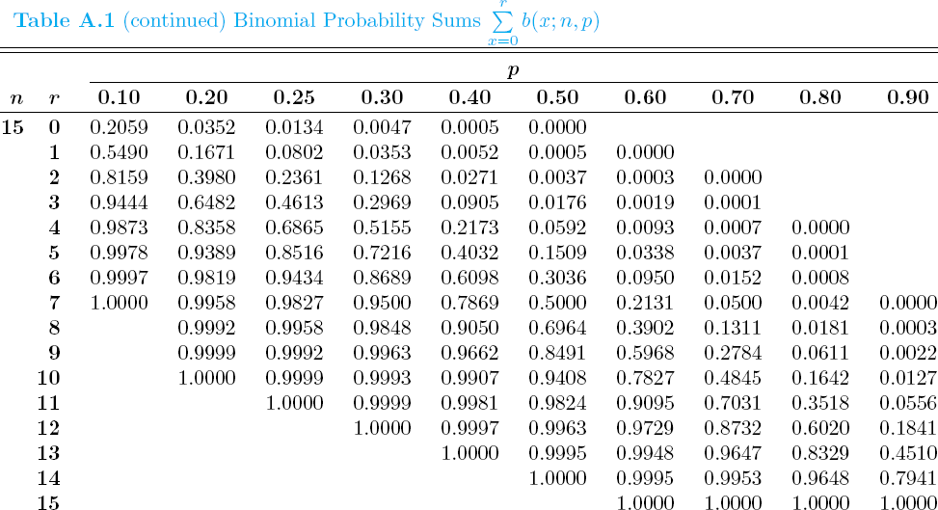
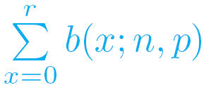
Table A.1 Binomial Probability Sums
Chapter 5.3 Binomial and Multinomial Distributions

Slide 11
Binomial Distributions
Chapter 5.3 Binomial and Multinomial Distributions
A large chain retailer purchase a certain kind of electronic device from a manufacturer. The manufacturer indicates that the defective rate of the device is 3%.
The inspector of the retailer randomly picks 20 items from a shipment. What is the probability that there will be at least one defective item among these 20?
Suppose that the retailer receives 10 shipments in a month and the inspector randomly tests 20 devices per shipment. What is the probability that there will be 3 shipments containing at least one defective device?
Let X be the number of defective devices among the 20 items. (a) P ( X ≥ 1) = 1 − P ( X < 1) = 1 − P ( X = 0) = 1 − C (0.03) ⁰ (1 − 0.03) ²⁰ = 0 .4562
20 0
(b)
3 10 − 3
p = 0.4562 ⇒ P (Y = 3) = b (3;10, 0.4562) = ₁₀ C ₃ (0.4562) (1 − 0.4562) =
0 .1602

Slide 12
Binomial Distributions
Chapter 5.3 Binomial and Multinomial Distributions
It is conjectured that an impurity exists in 30% of all drinking wells in a certain rural community. In order to gain some insight on this problem, it is determined that some tests should be made. It is too expensive to test all of the many wells in the area so 10 were randomly selected for testing.
Using the binomial distribution, what is the probability that exactly three wells have the impurity assuming that the conjecture is correct?
What is the probability that more than three wells are impure?
(a)
3 10 − 3
P ( X = 3) = ₁₀ C ₃ (0.3) (1 − 0.3) = 0 .2668
(b)
P ( X > 3) = 1 − P ( X ≤ 3)
3
= 1 − ∑ b ( x;10, 0.3)
?A.1 to find this value
Try also to use Table
x = 0
= 1 − {0 .0282 + 0 .1211 + 0 .2335 + 0 .2668}
= 0 .3504

