Slide 1
Introduction to Statistics and Data Analysis

Slide 2
Statistics
Statistics is a tool for analyzing data and discovering and proving it’s true meaning.
Statistics is the study of the collection, organization, analysis, interpretation and presentation of data.

Slide 3
Descriptive Statistics
Descriptive statistics:
Methods for organizing and summarizing data.
tables or graphs are used to organize data, and descriptive values such as the average score are used to summarize data.
Inferential statistics:
Methods for using sample data to make general conclusions about populations.

Slide 4
Types of Statistical Studies
Observational studies
Surveys based studies
Experimental studies
Meta-analysis
Retrospective

Slide 5
1-Observational Studies
Observes individuals and measures variables of interest.
It describe a group of individuals or to investigate an association between two variables.
We can answer questions about a population with an observational study.

Slide 6
1-Observational Studies
We can also investigate a relationship between two variables.
But in an observational study, researchers do not attempt to manipulate one variable to cause an effect in another variable. For this reason, an observational study does not provide convincing evidence of a cause-and-effect relationship.

Slide 7
2-Survey based studies
As a field of statistics concentrating on human research surveys.
Survey methodology studies the sampling of individual units from a population and associated techniques of survey data collection.
Survey data collection includes questionnaire construction and methods for improving the number and accuracy of responses to surveys.
Basic type of surveys includes:
Online, paper based, telephonic and one-to-one interviews

Slide 8
3-Experimental Studies
Demonstrates a cause-and-effect relationship between two variables. (All other variables are controlled to prevent them from influencing the results).
It proves that changing the value of one variable causes changes to occur in a second variable.
The manipulated variable is called the independent variable.
Observed variable is the dependent variable.
Notes:
X=5y+90

Slide 9
4-Meta-analysis
A meta-analysis is a statistical analysis that combines the results of multiple scientific studies.
Meta-analyses can be performed when there are multiple scientific studies addressing the same question, with each individual study reporting measurements that are expected to have some degree of error.

Slide 10
5-Retrospective
This type of study uses strictly historical data, data taken over a specific period of time. One obvious advantage of retrospective data is that there is reduced cost in collecting the data.

Slide 11
Types of Sampling Procedures
Key informant
Snowball
Convenience
Random table/random selection
Stratified
Whole population

Slide 12
Types of Sampling Procedures
Key informant
A specific person that you believe will give you the most information-sometimes used to develop interview questions.
Snowball
You ask the participants to provide you with names of those that will be able to provide you with important information
Convenience
Simply asking anyone to whom you have easy access. Avoid this if possible
Random table/random selection
When each person of the population has an equal chance of been selected. Selection is based on random procedure such as using random table of numbers.

Slide 13
Types of Sampling Procedures
5. Stratified sampling
choosing from various sub-groups. The population is divided into subpopulations and random samples are taken of each subpopulation. For example, stratified by gender.
If the population has 25% females and 75% males, the sample should be chosen randomly by subpopulations and consist of 25% females and 75% males.
6. Whole population
The entire population is used.
This is especially true if the population is small.

Slide 14
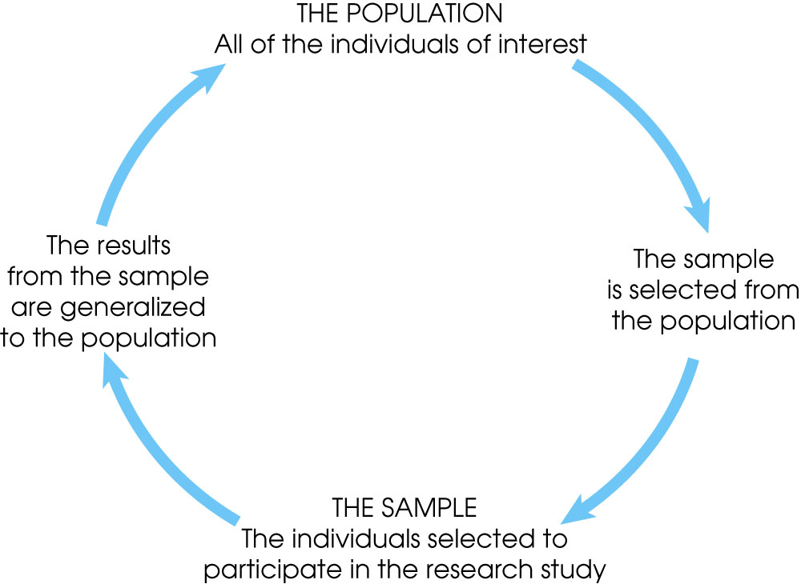
Sample and Generalization

Slide 15
Measures of Location/Central Tendency
Measures of location are designed to provide the analyst with some quantitative values of where the center, or some other location, of data is located.
It includes:
Mean of the sample
Median of the sample
Mode of the sample

Slide 16
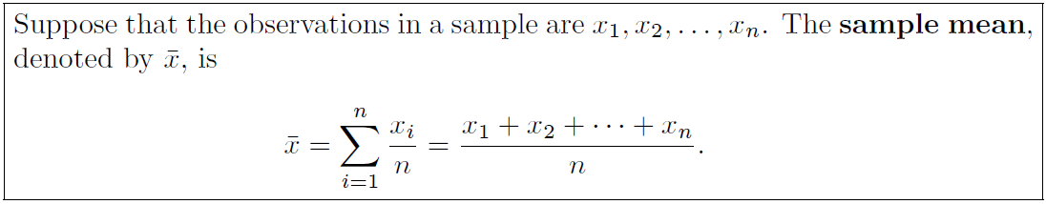
Mean of the Sample
Also called numerical average.
Sample mean is the centroid of the given data.
The trimmed mean is calculated by eliminating the highest and lowest values in the sample and taking the mean of the remaining values.
For a 10% trimmed mean, the largest 10% and the smallest 10% are eliminated.

Slide 17
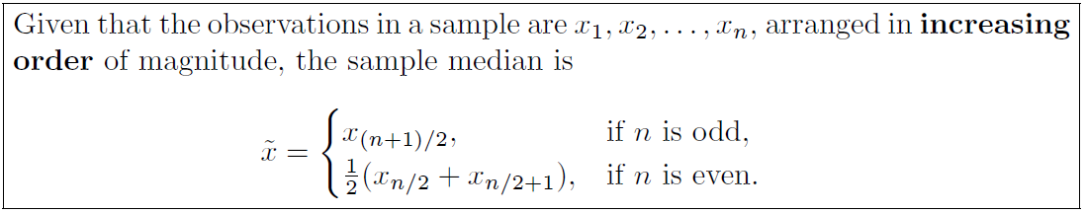
Median of the Sample
The purpose of the median is to reflect the central tendency of the sample in such a way that it is uninfluenced by extreme values or outliers.

Slide 18
Exercises
Page 13, Exercises 1.1 to 1.6

Slide 19
Mode of the sample
The value that has a higher frequency in a given set of values.
It is the value that appears the most number of times.
Example:
Consider : 2, 4, 5, 5, 6, 7
The mode of the data set is 5 since it has appeared in the set twice.

Slide 20
Mode of the sample
Bimodal:
When there are two modes in a data set, then the set is called bimodal.
For example
The mode of Set A = {2,2,2,3,4,4,5,5,5} is 2 and 5, because both 2 and 5 is repeated three times in the given set.

Slide 21
Mode of the sample
Trimodal
When there are three modes in a data set, then the set is called trimodal.
For example
The mode of set A = {2,2,2,3,4,4,5,5,5,7,8,8,8} is 2, 5 and 8
Multimodal
When there are four or more modes in a data set, then the set is called multimodal.

Slide 22

Mode Examples
The following table represents the number of wickets taken by a bowler in 10 matches. Find the mode of the given set of data.
Notes:
It can be seen that 2 wickets were taken by the bowler frequently in different matches. Hence, the mode of the given data is 2.

Slide 23
Mode Examples
Find the mode of the given data set: 3, 3, 6, 9, 15, 15, 15, 27, 27, 37, 48.
Find the mode of 4, 4, 4, 9, 15, 15, 15, 27, 37, 48 data set.
Find the mode of 3, 6, 9, 16, 27, 37, 48.
Notes:
Solution-1
In the following list of numbers, 3, 3, 6, 9, 15, 15, 15, 27, 27, 37, 48
15 is the mode since it is appearing more number of times in the set compared to other numbers.
Solution-2
Given: 4, 4, 4, 9, 15, 15, 15, 27, 37, 48 is the data set.
As we know, a data set or set of values can have more than one mode if more than one value occurs with equal frequency and number of time compared to the other values in the set.
Hence, here both the number 4 and 15 are modes of the set.
Solution-3
Solution: If no value or number in a data set appears more than once, then the set has no mode.
Hence, for set 3, 6, 9, 16, 27, 37, 48, there is no mode available.

Slide 24
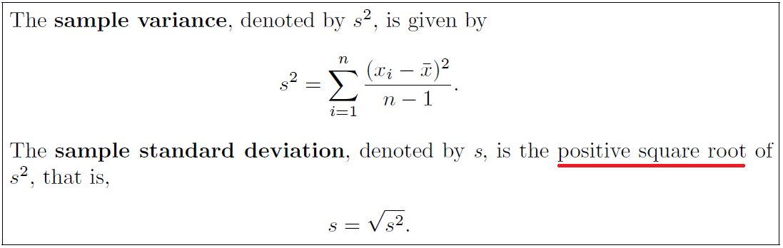
Measures of Variability
It includes:
Variance (s ² / σ²)
Standard Deviation (s / SD / σ)
Notes:
Bessel correction (use of n − 1 instead of n)
This method corrects the bias in the estimation of the population variance

Slide 25
Measures of Variability
Variance (σ²)
It measures how spread out the values in a data set are around the mean.
A large variance indicates that numbers in the set are far from the mean and from each other.
Variance can be negative.
A variance value of zero indicates that all values within a set of numbers are identical.

Slide 26
Measures of Variability
Standard Deviation (σ)
It is the measure of spread.
It is a measure of the average distance between the values of the data in the set and the mean.
The standard deviation is always a positive number and is always measured in the same units as the original data

Slide 27
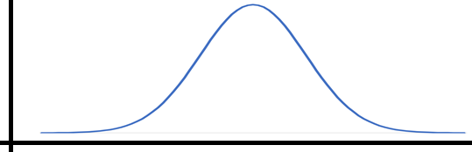
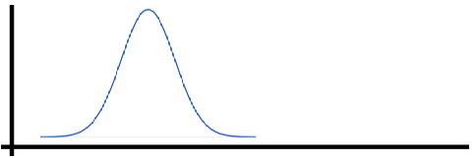
Measures of Variability
Standard Deviation (σ)
High spread data
Low spread data

