Slide 1
Introduction to Statistics and Data Analysis

Slide 2
Exercises
Page 17, Exercises 1.7 to 1.12

Slide 3
Relationship between Mean, Median and Mode
There exists an empirical relationship between mode, median and mean and this can be expressed using the formula:
Mode = 3 Median – 2 Mean

Slide 4
Statistical Modeling
Scatter Plot
Stem-and-Leaf Plot
Histograms and frequency polygons
Box-and-Whisker Plot or Box Plot

Slide 5
Scatter Plot
A scatter plot (aka scatter chart, scatter graph) uses dots to represent values for two different numeric variables.
The position of each dot on the horizontal and vertical axis indicates values for an individual data point.
Scatter plots are used to observe relationships between variables.

Slide 6
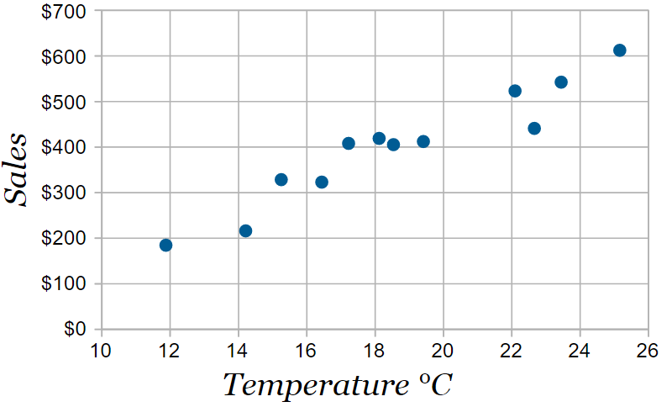
Scatter Plot
For Example:
Temperature °C | Ice Cream Sales
14.2° | $215
16.4° | $325
11.9° | $185
15.2° | $332
18.5° | $406
22.1° | $522
19.4° | $412
25.1° | $614
23.4° | $544
18.1° | $421
22.6° | $445
17.2° | $408

Slide 7
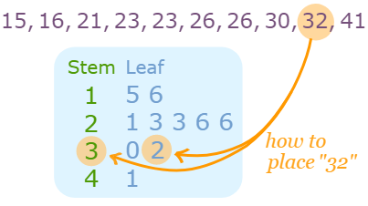
Stem-and-Leaf Plot
A Stem and Leaf Plot is a special table where each data value is split into a "stem" (the first digit or digits) and a "leaf" (usually the last digit).
For example:
Stem "1" Leaf "5" means 15
Stem "1" Leaf "6" means 16
Stem "2" Leaf "1" means 21

Slide 8
Histograms and frequency polygons
A histogram or frequency histogram, consists of a set of rectangles having bases on a horizontal axis, with centers at the class marks and lengths equal to the class interval sizes, and areas proportional to the class frequencies.
Frequency polygon is a line graph of the class frequencies plotted against class marks. It can be obtained by connecting the midpoints of the tops of the rectangles in the histogram.
Background →Frequency Distribution

Slide 9
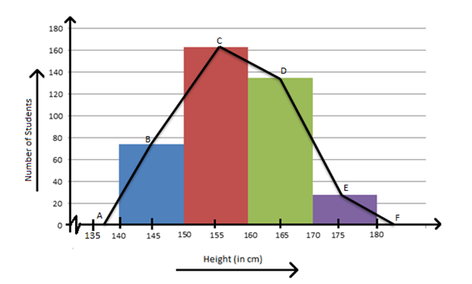
Histograms and frequency polygons
For example:

Slide 10
Frequency Distribution
Raw Data
Raw data are collected data that have not been organized numerically.
An example is the set of heights of 100 male students obtained from an alphabetical listing of university records.
Array
An array is an arrangement of raw numerical data in ascending or descending order of magnitude.
Range
The difference between the largest and smallest numbers is called the range of the data.
For example: if the largest height of 100 male students is 74 inches (in) and the smallest height is 60 in, the range
Range = 74 – 60 = 14 in.

Slide 11
Frequency Distribution
Class Frequency
When summarizing large masses of raw data, it is often useful to distribute the data into classes, or categories, and to determine the number of individuals belonging to each class, called the class frequency.
Frequency Distribution
A tabular arrangement of data by classes together with the corresponding class frequencies is called a frequency distribution, or frequency table.
No. of height of students
Height | Count
60-62 | 5
63-65 | 18
66–68 | 42
69–71 | 27
72–74 | 8

Slide 12
Frequency Distribution
Class Intervals
A symbol defining a class, such as 60–62 in table is called a class interval.
The terms class and class interval are often used interchangeably, although the class interval is actually a symbol for the class.
Class Limits
The end numbers, 60 and 62, are called class limits; the smaller number (60) is the lower class limit and the larger number (62) is the upper class limit.
Open class interval
A class interval that has either no upper class limit or no lower class limit indicated is called an open class interval.
For example, referring to age groups of individuals, the class interval ‘‘65 years and over’’ is an open class interval.

Slide 13
Frequency Distribution
Class Boundary
Class boundaries are the numbers used to separate classes. The size of the gap between classes is the difference between the upper class limit of one class and the lower class limit of the next class.
Class size, width or length
The size, or width, of a class interval is the difference between the lower and upper class boundaries and is also referred to as the class width, class size, or class length.
If all class intervals of a frequency distribution have equal widths, this common width is denoted by c.
Class mark / mid point
The class mark is the midpoint of the class interval and is obtained by adding the lower and upper class limits and dividing by 2. Thus the class mark of the interval 60–62 is (60 + 62)/2 = 61.
Notes:
https://youtu.be/TeTxqUvdB6g

Slide 14
Frequency Distribution
General rules for frequency distributions
Determine the largest and smallest numbers in the raw data and thus find the range (the difference between the largest and smallest numbers).
Divide the range into a convenient number of class intervals having the same size. If this is not feasible, use class intervals of different sizes or open class intervals.
Class intervals are also chosen so that the class marks (or midpoints) coincide with the actually observed data.
This tends to lessen the so-called grouping error involved in further mathematical analysis.
However, the class boundaries should not coincide with the actually observed data.
Determine the number of observations falling into each class interval; that is, find the class frequencies.
Notes:
https://youtu.be/TeTxqUvdB6g

Slide 15
Frequency Distribution
Relative-frequency distributions
The relative frequency of a class is the frequency of the class divided by the total frequency of all classes and is generally expressed as a percentage.
For example:
No. of height of students
Height | Count | Relative Frequency
60-62 | 5 | 5/100 = 5%
63-65 | 18 | 18/100 = 18%
66–68 | 42 | 42/100 = 42%
69–71 | 27 | 27/100 = 27%
72–74 | 8 | 8/100 = 8%
Total | 100 | 100%

Slide 16
Frequency Distribution
Relative-frequency distributions example:
Frequency Distribution of Prices for 20 Gas Stations:
Relative class distribution will be:
Gas Prices ($/Gallon) | Number of Gas Stations
$3.50–$3.74 | 6
$3.75–$3.99 | 4
$4.00–$4.24 | 5
$4.25–$4.49 | 5

Slide 17
Frequency Distribution
Cumulative Frequency Distribution
The cumulative frequency is calculated by adding each frequency from a frequency distribution table to the sum of its predecessors.
The last value will always be equal to the total for all observations, since all frequencies will already have been added to the previous total.

Slide 18
Frequency Distribution
Example: Cumulative Frequency Table (Ungrouped data)
The following table gives the frequency distribution of marks obtained by 28 students in a particular test.
Construct a cumulative frequency table for the given data.
Marks | 30 | 31 | 32 | 33
Frequency | 5 | 7 | 10 | 6
Solution:
Less Than or Equal to | Cumulative Frequency
30 | 5
31 | 5 + 7 =12
32 | 12 + 10 =22
33 | 22 + 6 =28

Slide 19
Frequency Distribution
Example: What will be the classes and total number of observations of the following data?
Height | Number of Students
Less than 59.5 | 0
Less than 62.5 | 5
Less than 65.5 | 23
Less than 68.5 | 65
Less than 71.5 | 92
Less than 74.5 | 100

Slide 20
Histograms and frequency polygons
In order to create a frequency polygon, one must follow these steps:
Creation of a histogram.
Finding the midpoints for each bar that exists on the histogram.
Placing a point on the origin of the histogram and its end.
Connection of the points.

Slide 21
Histograms and frequency polygons
Example: Construct a frequency polygon using the data given below:
Test Scores | Frequency
49.5-59.5 | 5
59.5-69.5 | 10
69.5-79.5 | 30
79.5-89.5 | 40
89.5-99.5 | 15

Slide 22
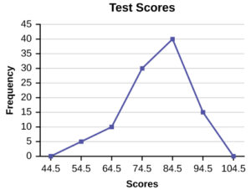
Histograms and frequency polygons
We now start by plotting the class marks such as 54.5, 64.5, 74.5 and so on till 94.5.
Note that we will also plot the previous and next class marks to start and end the polygon, i.e. we plot 44.5 and 104.5 as well.
Then, the frequencies corresponding to the class marks are plotted against each class mark.
This makes sense as the frequency for class marks 44.5 and 104.5 are zero and touching the x-axis. These plot points are used only to give a closed shape to the polygon.

Slide 23
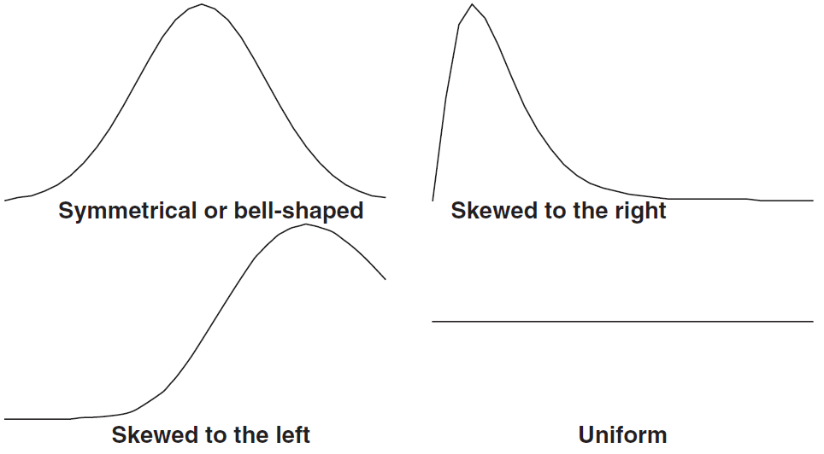
Types of frequency curves
Four common frequency distribution curves are as follows:

