Slide 1
Introduction to Statistics and Data Analysis

Slide 2
Types of frequency curves
1-Symmetrical or bell-shaped
Characterized by the fact that observations equidistant from the central maximum have the same frequency.
Example: Adult male and adult female heights have bell shaped distributions.
2-Skewed to the left
Curves that have tails to the left are said to be skewed to the left.
Example: The lifetimes of males and females are skewed to the left. A few die early in life but most live between 60 and 80 years. Generally, females live about ten years, on the average, longer than males.

Slide 3
Types of frequency curves
3-Skewed to the right
Curves that have tails to the right are said to be skewed to the right.
Example: The ages at the time of marriage of brides and grooms are skewed to the right. Most marry in their twenties and thirties but a few marry in their forties, fifties, sixties and seventies.
4-Uniform curve
Curves that have approximately equal frequencies across their values are said to be uniformly distributed.
Example: Certain machines that dispense liquid colas do so uniformly between 15.9 and 16.1 ounces.

Slide 4
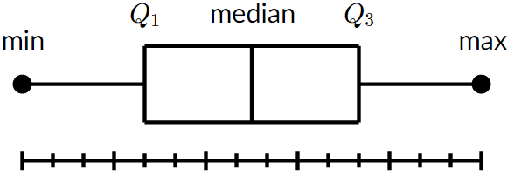
Box-and-Whisker Plot or Box Plot
A box and whisker plot—also called a box plot—displays the five-number summary of a set of data. The five-number summary is the minimum, first quartile, median, third quartile, and maximum.
In a box plot, we draw a box from the first quartile to the third quartile. A vertical line goes through the box at the median. The whiskers go from each quartile to the minimum or maximum.
Notes:
https://www.khanacademy.org/math/statistics-probability/summarizing-quantitative-data/box-whisker-plots/a/box-plot-review

Slide 5
Box-and-Whisker Plot or Box Plot
Interquartile Range (IQR)
It is the width of the box in the box-and-whisker plot.
That is, IQR = Q3 – Q1 .
The IQR can be used as a measure of how spread-out the values are.
Outliers
Statistics assumes that values are clustered around some central value.
The IQR tells how spread out the "middle" values are; it can also be used to tell when some of the other values are "too far" from the central value.
These "too far away" points are called "outliers", because they "lie outside" the range in which we expect them.
Detecting outlier
An outlier is any value that lies more than one and a half times the length of the box.
i.e. Values outside the boundary
before [Q1 - 1.5(IQR)] or after [Q3 +1.5(IQR)] will be consider as OUTLIERs.
Notes:
https://www.khanacademy.org/math/statistics-probability/summarizing-quantitative-data/box-whisker-plots/a/box-plot-review

Slide 6
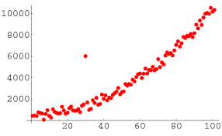
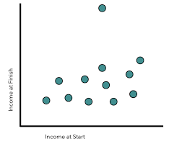
Box-and-Whisker Plot or Box Plot
Outliers

Slide 7
Box-and-Whisker Plot or Box Plot
Example: Find the outliers, if any, for the following data set:
10.2 14.1 14.4 14.4 14.4 14.5 14.5 14.6 14.7 14.7 14.7 14.9 15.1 15.9 16.4

Slide 8
Handling on grouped data
Central Tendency
Mean
Median
Mode
Variability
Variance
Standard Deviation

Slide 9

Mean of grouped data
Formula
$$\overline{x}=\frac{Σf⋅m}{\sum{f}}$$
Where,
f = Frequency of class
m = Class mark of the class (mid-point)

Slide 10
Mean of grouped data
Following table shows the grades and their frequencies obtained by the students. Obtain the mean of grade
Grades | Frequency
40-49 | 3
50-59 | 5
60-69 | 6
70-79 | 9
80-89 | 8
90-100 | 7
Mid-points
44.5
54.5
64.5
74.5
84.5
95
f.m
133.5
272.5
387
670.5
676
665

Slide 11

Mean of grouped data
Example (to do): We asked a group of people about how many hours per week they exercise, the results were as follows:
What will be the average hours per week a person exercise?
Hours/Week | Frequency
0-5 | 15
5-10 | 63
10-15 | 44
15-20 | 8
$$\overline{x}=\frac{Σf⋅m}{\sum{f}}$$

Slide 12
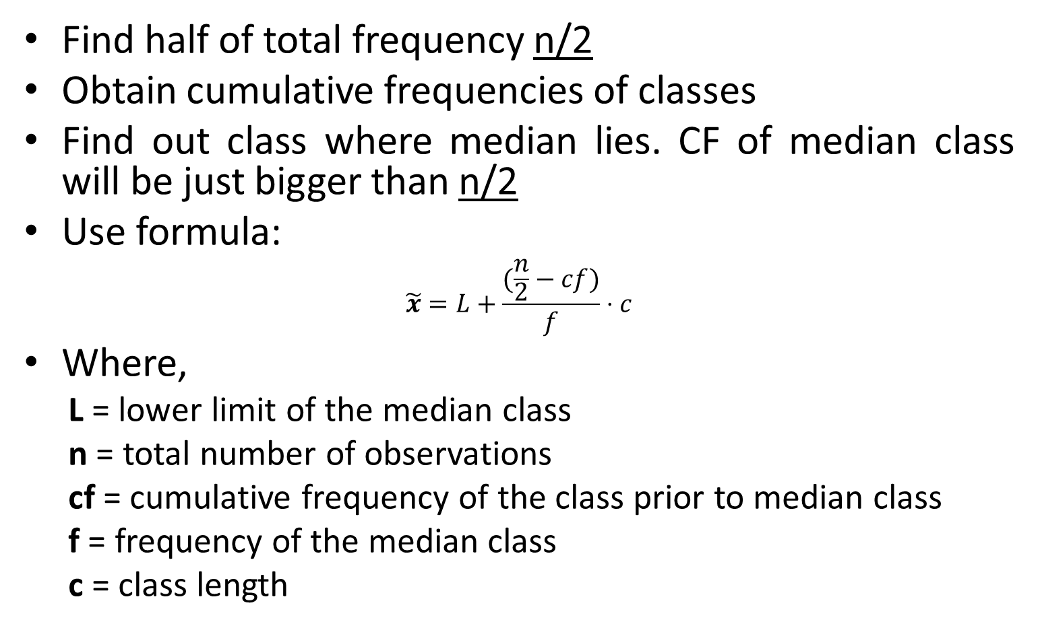
Median of grouped data
Find half of total frequency n/2
Obtain cumulative frequencies of classes
Find out class where median lies. CF of median class will be just bigger than n/2
Use formula:
$$\tilde{x}=L+\frac{(\frac{n}{2}−cf)}{f}⋅c$$
Where,
L = lower limit of the median class
n = total number of observations
cf = cumulative frequency of the class prior to median class
f = frequency of the median class
c = class length

Slide 13
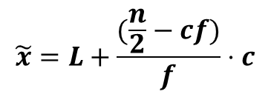
Median of grouped data
Example:
$$\tilde{x}=L+\frac{(\frac{n}{2}−cf)}{f}⋅c$$
Grades | Frequency
40-49 | 3
50-59 | 5
60-69 | 6
70-79 | 9
80-89 | 8
90-100 | 7
Σ | 38
cf
3
8
14
23
31
38
L = 70
n = 38
cf = 14
f = 9
c = 9
Median = 75
Median class: 70-79
(23 just bugger than 19)
n=38
n/2=19

Slide 14

Median of grouped data
Example (to do): A survey on random peoples yield the following data. Find out the median age.
Age | Frequency
11-20 | 3
21-30 | 4
31-40 | 7
41-50 | 8
51-60 | 5
61-70 | 2
71-80 | 1
cf
3
7
14
22
27
29
30
n = Σf = 30
n/2=15
Median class = 41-50
$$\tilde{x}=L+\frac{(\frac{n}{2}−cf)}{f}⋅c$$
L = 41
n = 30
cf = 14
f = 8
c = 9
Median = 42.125

Slide 15
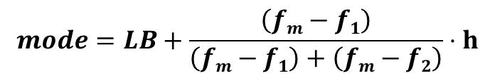
Mode of grouped data
Steps:
Obtain class boundaries.
Find out the class that has largest frequency. Call it mode class.
Use the formula:
Where,
LB = Lower class boundary of modal class
h = Class interval
f_{m}=frequency of modal class
f₁=frequency of class prior to modal class
f₂= frequency of class after modal class
$$mode=LB+\frac{\left(fm−f1\right)}{\left(fm−f1\right)+\left(fm−f2\right)}⋅h$$

Slide 16

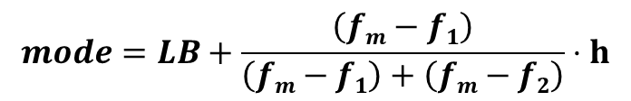
Mode of grouped data
Example
$$mode=LB+\frac{\left(fm−f1\right)}{\left(fm−f1\right)+\left(fm−f2\right)}⋅h$$
Height (inches) | Frequency
48-50 | 5
50-52 | 7
52-54 | 10
54-56 | 9
56-58 | 6
58-60 | 3
f₁=7
Modal class f_{m}=10
f₂=9
LB=52
h=2
$mode=52+\frac{(10−7)}{\left(10−7\right)+(10−9)}⋅$2
mode=53.5

Slide 17
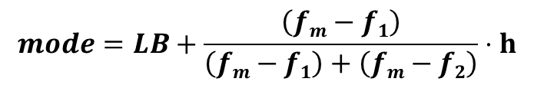
Mode of grouped data
Example: Following table shows the grades and their frequencies obtained by the students. Obtain the mode of grade
$$mode=LB+\frac{\left(fm−f1\right)}{\left(fm−f1\right)+\left(fm−f2\right)}⋅h$$
Grades | Frequency
40-49 | 3
50-59 | 5
60-69 | 6
70-79 | 9
80-89 | 8
90-100 | 7
Mode=77

